Slide 1







RECIPEVAULT
A NOSQL-POWERED RECIPE MANAGEMENT SYSTEM

Slide 2

TEAM MEMBERS
Arwa mohey hamdy aboalia 23101371
Sondous Adel Metwalli 23101396
Yomna mohamed 23101506

Slide 3


THE NATURE OF RECIPE DATA
What is a Recipe?
It is a self-contained entity. A recipe includes basic info, a list of ingredients, and step-by-step instructions.
The Problem:
Traditional Relational Databases (SQL) force us to split this unified data into multiple separate tables.
Our Solution:
Build "RecipeVault" using a NoSQL Document Store (MongoDB) to keep recipe data together, exactly as it appears to the user.

Slide 4

SQL VS. NOSQL FOR RECIPE MANAGEMENT
The SQL Approach (Relational):
Scattered Data: Requires 4 tables (Recipes, Ingredients, Steps, Categories).
Slow Retrieval: Fetching ONE recipe requires 3 complex JOIN operations.
Rigid Schema: Adding a new optional field (e.g., "Video Link") requires database migrations (ALTER TABLE).
The NoSQL Approach (Document-Oriented):
Unified Data: The entire recipe lives inside one single JSON-like document.
Lightning-Fast Reads: A single findOne() query fetches everything in O(1) time.
Schema Flexibility: Easily add new fields to new recipes without breaking existing records.

Slide 5

FOUR-TIER APPLICATION ARCHITECTURE
Frontend Layer: Nginx (Serves static UI & acts as a Reverse Proxy).
Security Layer: Rate Limiting (100 req/15 min) & Strict CORS Policy.
Backend API: Node.js / Express (Router ➔ Controller ➔ Mongoose ODM).
Database Layer: MongoDB (Containerized Collections & Native Indexes).

Slide 6

THE DOCUMENT SCHEMA IN ACTION
Single-Collection Approach: One Recipe = One Document.
Zero Transformation Overhead: Data is stored exactly as the UI needs it.
Structure Example:
{
"_id": "6a00a0115725c15e609e",
"name": "Classic Shakshuka",
"category": "Breakfast",
"prepTime": 10,
"difficulty": "Medium",
"ingredients": "4 eggs\n1 can tomatoes\n1 onion",
"instructions": "Sauté onion\nAdd tomatoes\nPoach eggs",
"createdAt": "2026-05-4T15:11:13Z"
}

Slide 7

OPTIMIZING SEARCH NATIVELY IN MONGODB
Why this matters:
We built a powerful search engine without needing external tools like Elasticsearch.
1. Weighted Text Index:
Recipe Name (Weight: 10) ➔ Highest priority in search results.
Ingredients (Weight: 5)
Description (Weight: 1)
2. Category Index:
Enables fast O(log n) execution for dropdown filtering.
3. Timestamp Index:
Optimizes sorting for "Newest First" display.

Slide 8

RESTFUL CRUD & DATA INTEGRITY
Endpoints Built:
GET (List/Search), GET (Single), POST, PUT, DELETE.
The Defense Pipeline (Protecting the NoSQL DB):
Input Sanitization: Whitelisting allowed fields (Ignoring unexpected data).
NoSQL Injection Prevention: Applying escapeRegex() on user search queries to prevent malicious operators (like $gt).
Schema Enforcement: Mongoose Validators ensure data types match before database insertion.

Slide 9
CONTAINERIZED STACK VIA DOCKER COMPOSE
Isolated Environments:
recipevault-frontend (Nginx - Port 80)
recipevault-api (Node.js - Port 5001)
recipevault-mongo (MongoDB 6 - Port 27017)
Seamless Execution: The entire system runs with one command: docker compose up --build.
Data Persistence: Recipes are safely stored via the mongo_data Docker volume, surviving any container restarts.

Slide 10
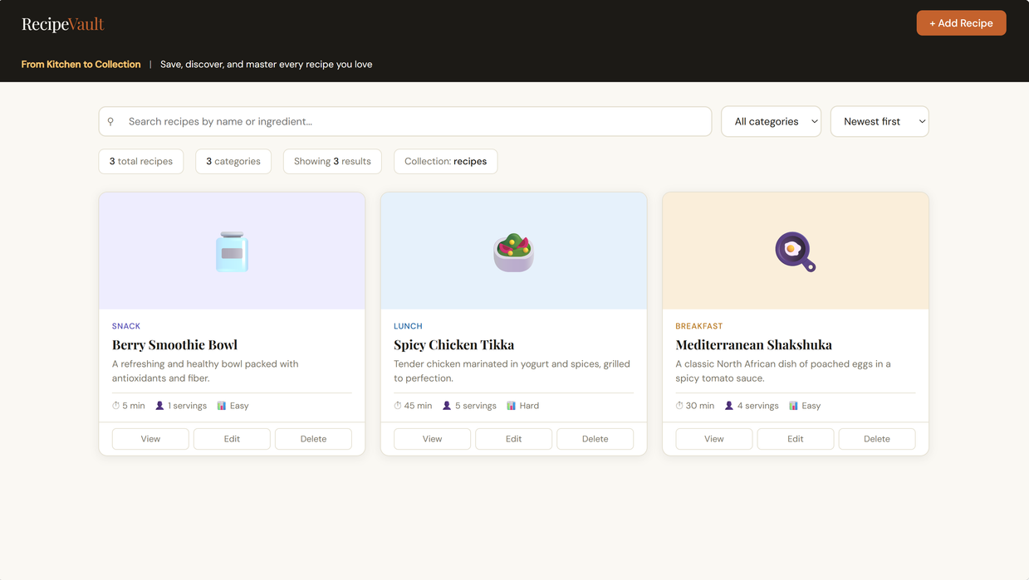
RECIPEVAULT UI IN ACTION
Dynamic Dashboard: Real-time search functionality powered by MongoDB Weighted Text Indexes (Name: 10, Ingredients: 5).
Advanced Filtering: Instant O(log n) execution for category filtering and sorting by date or difficulty.
Interactive Modals: Responsive "Add/Edit" forms with immediate schema-level validation via Mongoose.
Responsive Experience: A seamless 3-tier integration between the Node.js API and a clean, user-centric frontend.

Slide 11

OBSTACLES & HOW WE SOLVED THEM
Challenge 1: Preventing NoSQL injection attacks via the search bar.
Solution: Built custom RegEx escaping utilities and enforced strict category whitelists.
Challenge 2: Networking between isolated Docker containers.
Solution:Configured Docker named bridge networks so containers communicate securely via service names.
Challenge 3: Mapping complex recipe arrays from UI forms to the database.
Solution:Simplified inputs into newline-separated strings, matching the NoSQL document naturally.

Slide 12
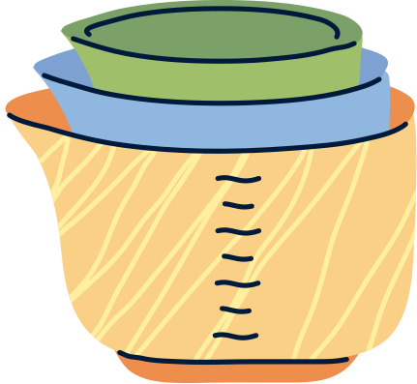
KEY TAKEAWAYS FROM RECIPEVAULT
Database Fit is Crucial: Document databases (MongoDB) are the perfect architectural match for inherently self-contained data (like recipes).
NoSQL Requires Application-Level Security: Lacking rigid schemas means validation MUST happen heavily at the API level (Router & ODM).
Native Features are Powerful: MongoDB's built-in text indexing is robust enough to handle complex search features, proving you don't always need complex external plugins.

Slide 13

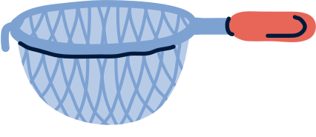
THANK YOU!

