Slide 1







IBM CAPSTONE PROJECT
Yomol Raju
11 August 2024

Slide 2



OUTLINE
Executive Summary
Introduction
Methodology
Results
Visualization – Charts
Dashboard
Discussion
Findings & Implications
Conclusion
Appendix

Slide 3

EXECUTIVE SUMMARY
Data contextualization and analysis goal.
Methodology description.
Data gathering.
Data analysis.
Data visualizations.
Results presentation supported with graphs and trends.
Discussion of overall findings and implications regarding the results previously exposed.
Final conclusions of the carried-out research.

Slide 4

INTRODUCTION
.
Stack Overflow’s annual Developer Survey is the most extensive and detailed survey of programmers worldwide.
The results may not fully represent the entire developer community
The survey includes responses from nearly 90,000 developers.
It identifies trends to forecast the future direction of the developer community.
It provides a comprehensive overview of developers globally.

Slide 5

METHODOLOGY
Collect survey data & explore its content
Web Scraping
APIs.
Request library.
Data Wrangling
Exploratory data analysis
Analysing data distribution.
Handling outliers.
Correlations.
Data Visualization
Highlight distribution of data, relationships, the composition and comparison of data.
Dashboards

Slide 6

RESULTS

Slide 7
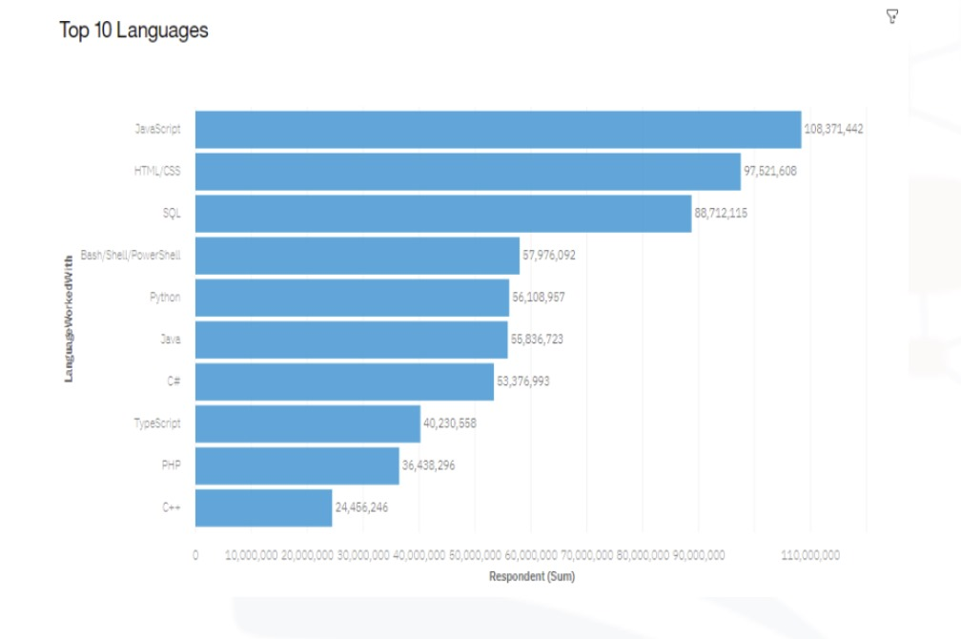
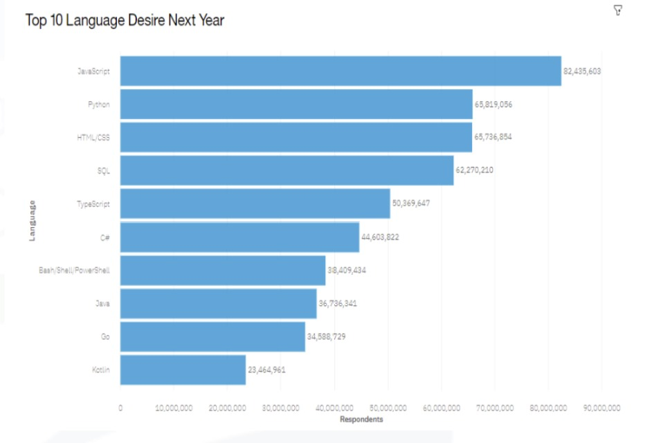
PROGRAMMING LANGUAGE TRENDS
Current Year
Next Year

Slide 8
PROGRAMMING LANGUAGE TRENDS - FINDINGS & IMPLICATIONS
Findings
JavaScript seems to keep as leading language.
Python fastest-growing.
Great interest in TypeScript
Implications
Possible developers' migration from JavaScript to TypeScript.

Slide 9
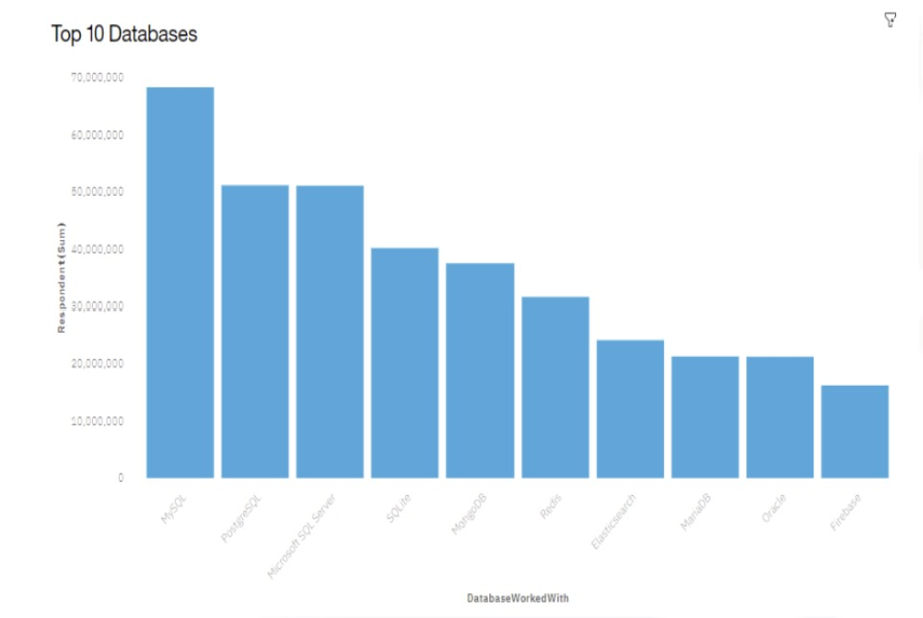
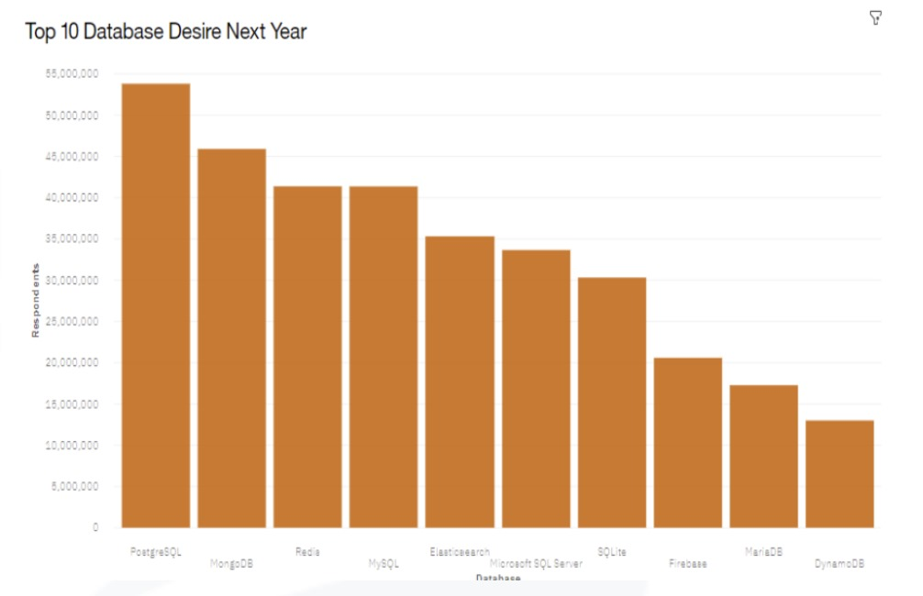
DATABASE TRENDS
Current Year
Next Year

Slide 10
DATABASE TRENDS - FINDINGS & IMPLICATIONS
Findings
MySQL as most used database.
Lack of interest in Microsoft SQL Server and SQLite.
Increasing interest in PostgreSQL and MongoDB.
Implications
Microsoft SQL Server and SQLite losing ground in the market.
PostgreSQL and MongoDB establishment in the market.

Slide 11
DASHBOARD
https://github.com/yomolraju/-ibm-data-analyst-capstone-project/tree/main

Slide 12
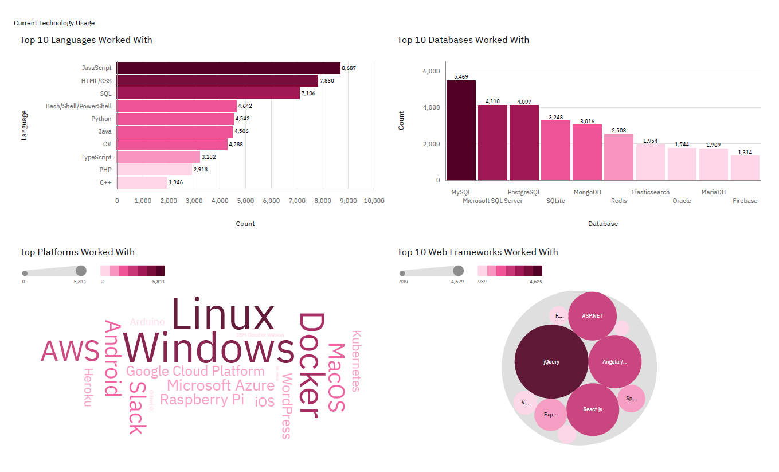
DASHBOARD TAB 1

Slide 13
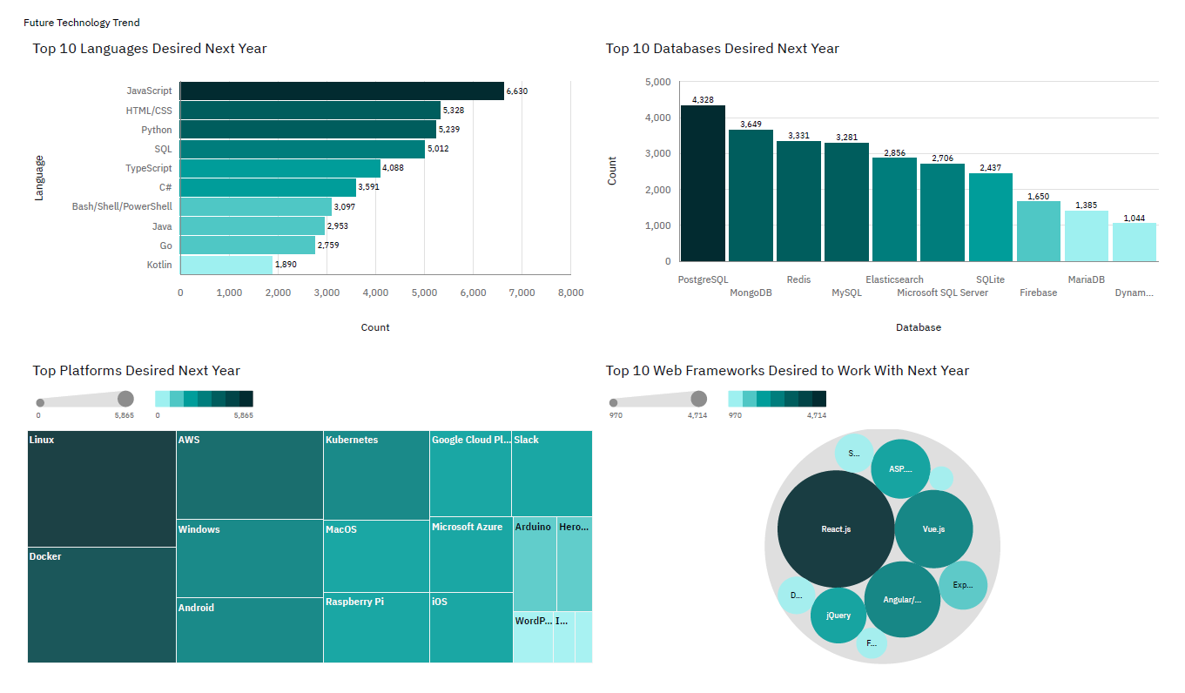
DASHBOARD TAB 2

Slide 14
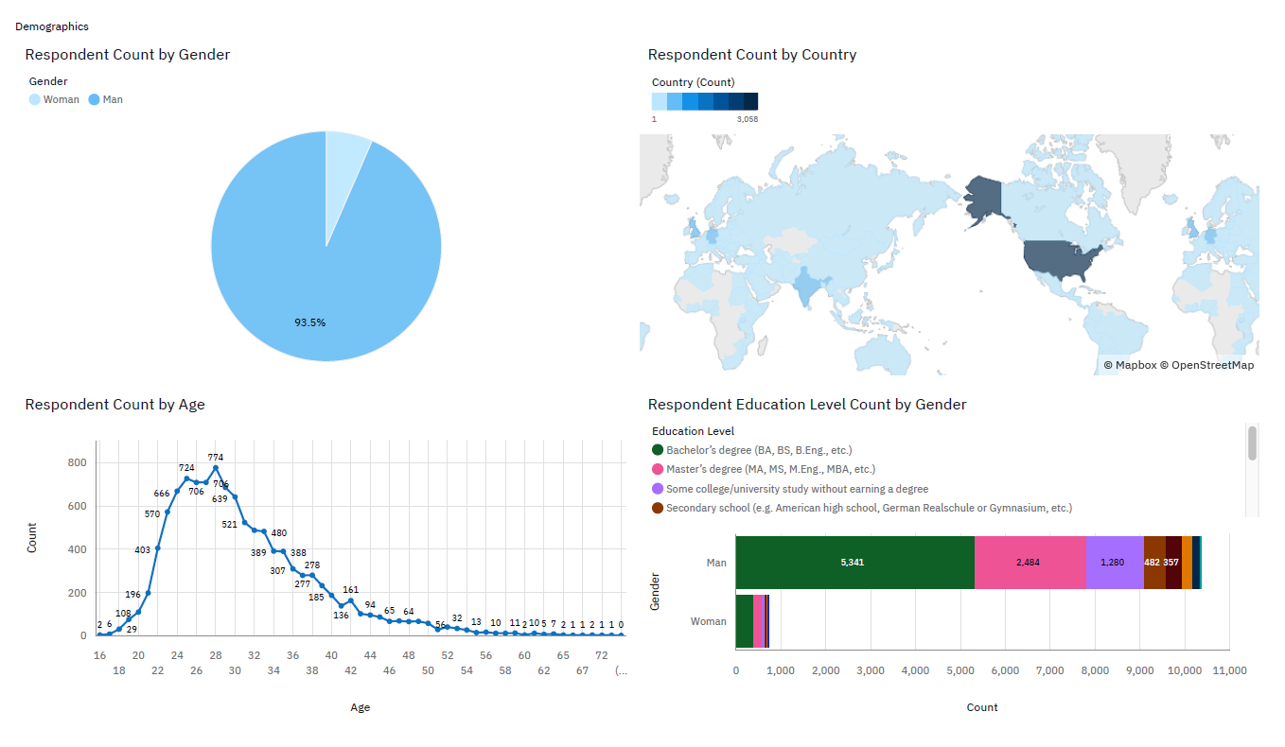
DASHBOARD TAB 3

Slide 15
DISCUSSION

Slide 16
OVERALL FINDINGS & IMPLICATIONS
Findings
JavaScript widely used and TypeScript getting popular.
Over 90% young male developers.
Developers mostly located in developed countries.
Implications
JavaScript and TypeScript web frames gaining followers.
Global polarization of developer's location and gender.
Young developers without postgrad studies on its majority.

Slide 17

CONCLUSION
Developers are people with very marked characteristics.
A good idea of popularity trends of different tools, platforms and languages can be obtained.
There is a job to be done to spread accessibility of this labor market to countries in development.

Slide 18

APPENDIX

Slide 19
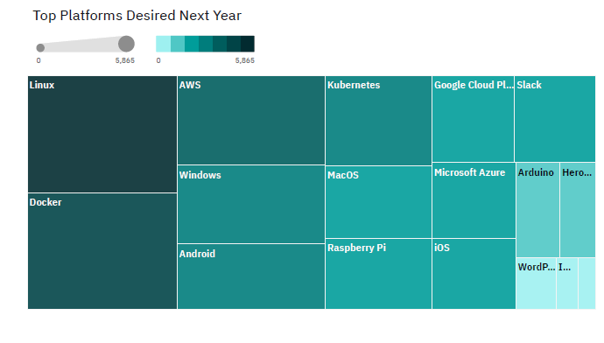
PLATFORM DESIRED NEXT YEAR

Slide 20
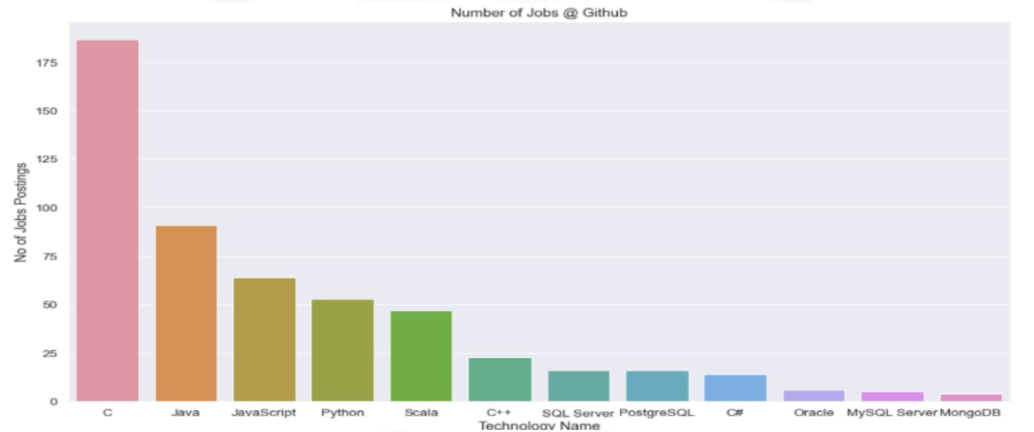
JOB POSTINGS

Slide 21
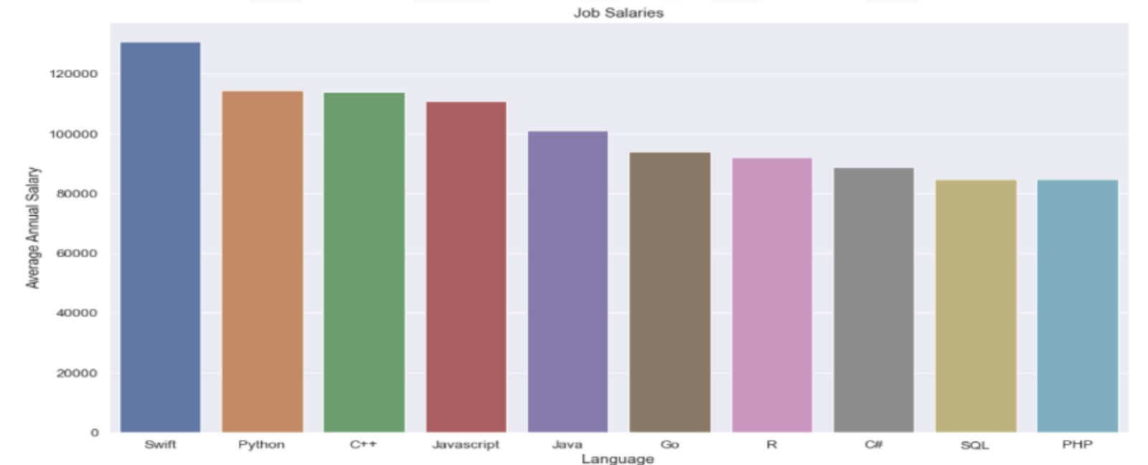
POPULAR LANGUAGES

