Slide 1
Heart disease detection
Yonah Kunin

Slide 2
AGENDA
The Problem
EDA
Modeling & Optimization
Evaluation

Slide 3
The problem
Detect whether a patient has heart disease
Notes:
According to his medical history, determine whether a patient has heart disease

Slide 4
Evaluation metrics
Focus on recall
False-Negatives are worse than false-positives
Better to call false-positives back for a blood-test than send home false-negatives
Optimize F1 score because recall creates greedy predictions

Slide 5
EDA

Slide 6
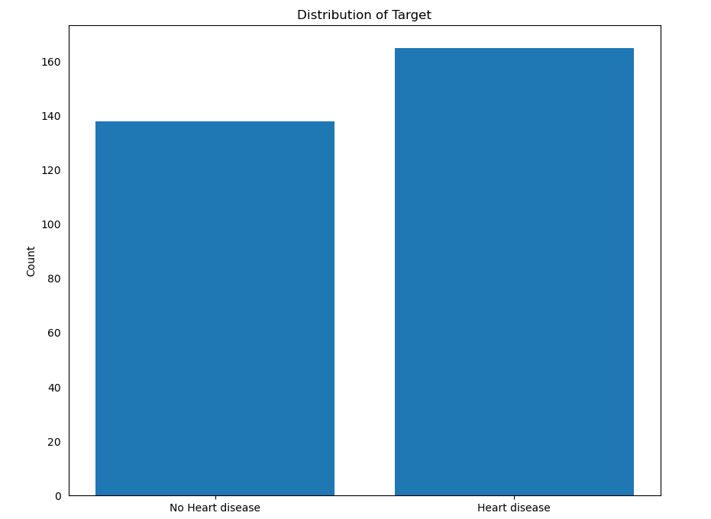
Data description
303 instances
165 positives
138 negatives
14 initial features
No missing values
Notes:
Because of the small number of instances, we took a very cautious approach in altering features and handling outliers.

Slide 7
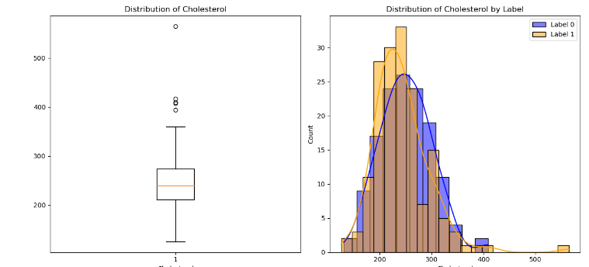
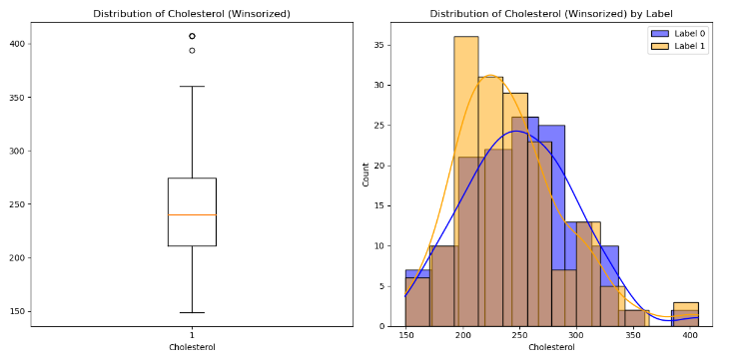
Outlier handling: winsorsizing

Slide 8
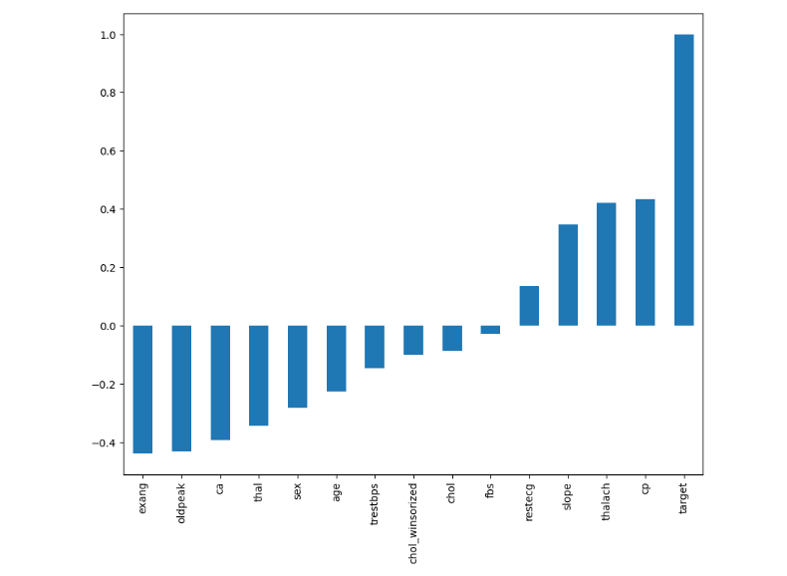
Pearson-Correlations to target variable
Notes:
Linear correlations suggest logistic regression will work well

Slide 9
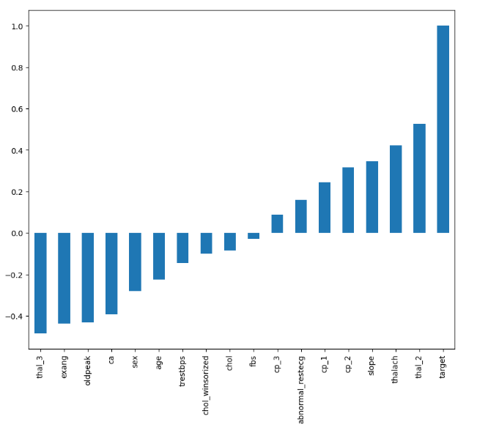
Correlations after One-hot encoding
Two datasets created
With dummies for Logistic Regression
Without dummies for other models

Slide 10
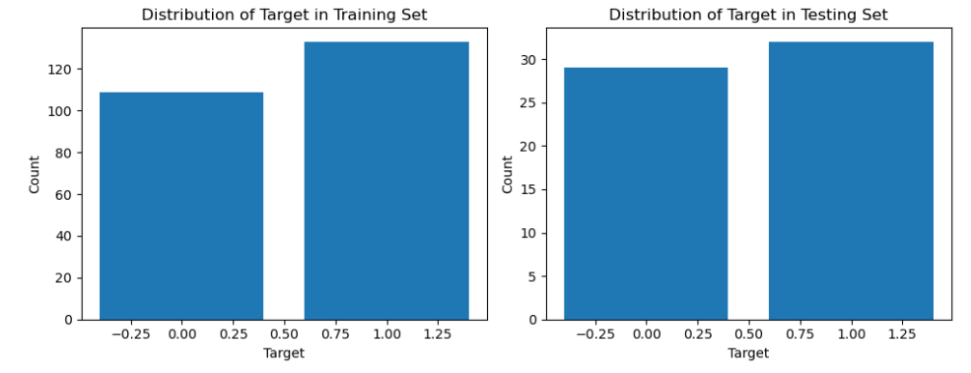
Train-test split
Training data: 80% (242 instances)
K-folds was used for validation
Testing data: 20% (61 instances)

Slide 11
Modeling & Optimization

Slide 12
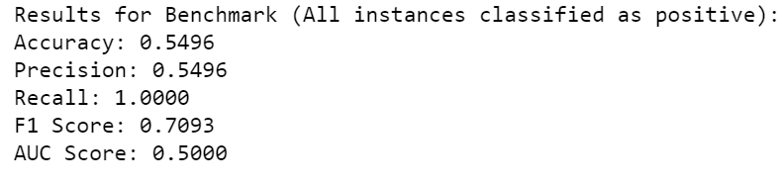
Benchmark model

Slide 13
Logistic regression
Normalization
MinMax
Hyperparameter Optimization
GridSearch
Feature Selection
Forward Selection
Notes:
Alpha, stopping criteria (eps), max iterations, penalty type (L2)

Slide 14
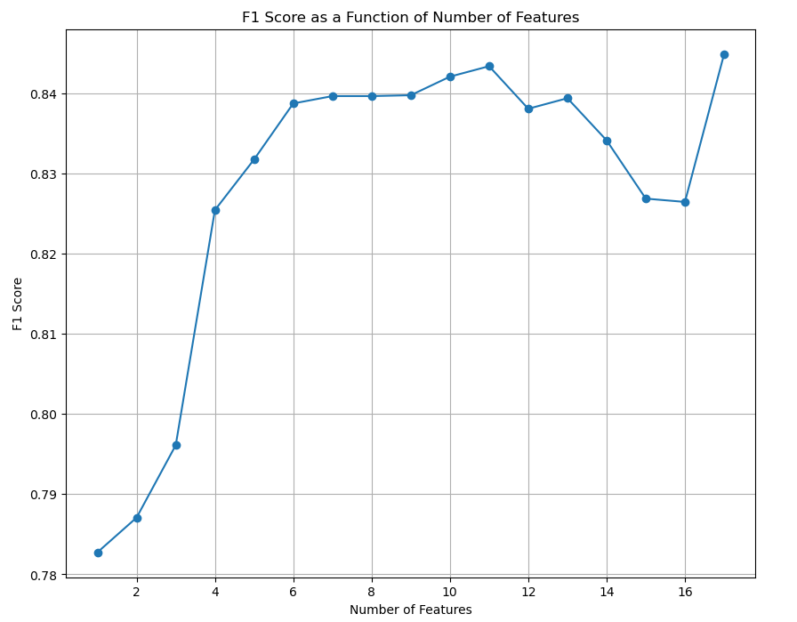
Feature selection
Notes:
No stopping criteria for forward selection

Slide 15
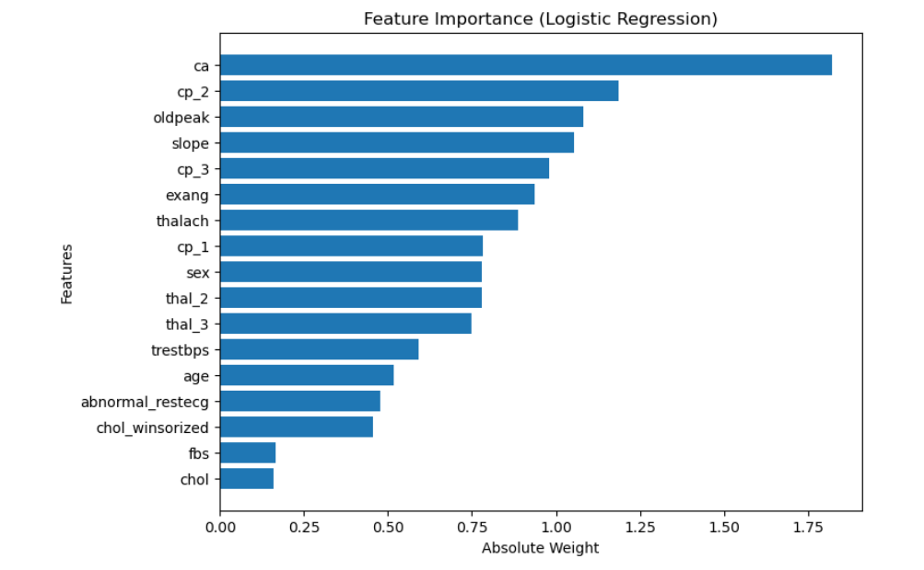
Feature Importance
Most important feature: Number of major vessels (ca)
Notes:
Weights are absolute value

Slide 16
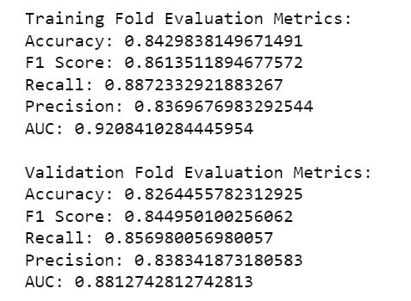
LR results
Notes:
Unfortunately, none of the metrics saw much improvement except for the AUC score, which improved by 6%. The rest stayed the same.

Slide 17
Ensembling
Logistic Regression
K-NN
Adaboost (decision tree)
Naïve Bayes
Random Forest

Slide 18
Individual CV results after optimization
 | LR | KNN | ADABOOST | NB | RF | ENSEMBLE | BEST COMBO
F1 | 0.845 | 0.868 | 0.852 | 0.821 | 0.840 | 0.861 | 0.860
Recall | 0.857 | 0.932 | 0.895 | 0.819 | 0.857 | 0.893 | 0.901
Precision | 0.838 | 0.812 | 0.816 | 0.826 | 0.828 | 0.833 | 0.823
Accuracy | 0.826 | 0.842 | 0.831 | 0.805 | 0.822 | 0.843 | 0.839
AUC | 0.881 | 0.918 | 0.905 | 0.878 | 0.905 | 0.835 | 0.830
Best combo: LR + adaboost + Naïve-bayes
Notes:
Our hunch was that on the testing data, our ensembles would be able to outperform the knn model…

Slide 19
Evaluation

Slide 20
Final evaluation on the testing data
 | LR | KNN | ADABOOST | NB | RF | ENSEMBLE | BEST COMBO
F1 | 0.885 | 0.892 | 0.861 | 0.870 | 0.861 | 0.892 | 0.906
Recall | 0.843 | 0.906 | 0.875 | 0.844 | 0.875 | 0.906 | 0.906
Precision | 0.931 | 0.878 | 0.848 | 0.900 | 0.848 | 0.878 | 0.906
Accuracy | 0.885 | 0.885 | 0.852 | 0.867 | 0.852 | 0.885 | 0.901
AUC | 0.887 | 0.884 | 0.851 | 0.870 | 0.851 | 0.884 | 0.901
Notes:
We recommend collecting more data as it can improve model generalization, reduce overfitting, increase model stability, and provide a more robust evaluation of performance, considering the critical nature of the problem.

Slide 21
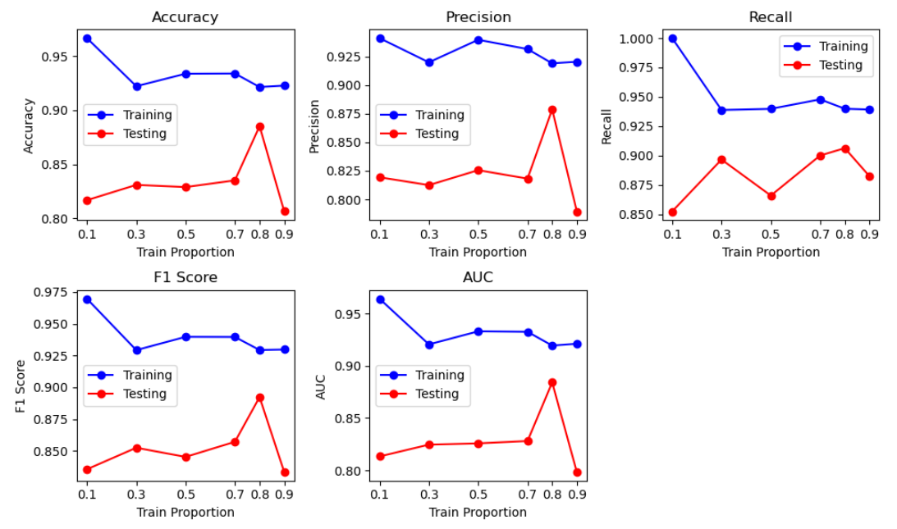
Changing Train-Test Ratio (ENSEMBLE)
Notes:
Original split of 80-20 produces best results, however, we used that split for optimization so it is hard to tell…

