Slide 2

Exploratory Data Analysis (EDA) AMEO Dataset
BY: Yonas Ashagrie
February 2024

Slide 3
About me
I am Yonas, pursuing a BCA from Maharishi Markandeshwar University. This journey, to step into the world of technology, was commenced with a diploma in Electrical Engineering. Besides, I also pursued a Google and Coursera Cybersecurity course to secure the digital environment with updated skills.
What does excite me is the potential of data in revolutionizing a couple of fields. With an educational background in electrical engineering and expertise in cybersecurity, I am targeting bringing the best solutions to problems in real-world experiences through innovation using Data Science and Machine Learning.
I am currently an intern at Innomatics Research Lab, where I have an exposure opportunity of getting practical knowledge in leading techniques in data analysis and machine learning. The internship is going to provide an opportunity to work under real-world applications of data science. Meanwhile, I am pursuing a rigorous Data Science Bootcamp from Hyperion Dev to further strengthen my skills in data analytics and machine learning algorithms.
Github repository for this program:https://github.com/yonasashagrie/EDA-AMEO-Dataset.git
My Linkdin profile :https://www.linkedin.com/in/yonas-ashagrie-b36269257

Slide 4
OBJECTIVE
The aim of this project: is to report, in an informative, clear, and summarized way, about the findings and insights achieved during the Exploratory Data Analysis (EDA) exercise carried out over the dataset provided for analysis.
- Summarize data with its key features.
- Highlight found patterns, trends, outliers, and other interesting features.
- Discuss research questions needed to answer in the analysis, providing evidence-based conclusions.
- Provide some recommendations or further areas of investigation for the identified issues.

Slide 5
SUMMARY
The dataset was released by Aspiring Minds from the Aspiring Mind Employment Outcome 2015 (AMEO). Primarily, this study is limited to only students with an engineering discipline. The dataset has the employment outcome of engineering graduates, which is the dependent variable (Salary, Job Titles, and Job Locations) along with the standardized scores from three different areas—Cognitive skills, Technical skills, and Personality skills. The dataset also contains demographic features. The dataset has approximately 40 independent variables and 4000 data points. Independent variables are both continuous and categorical in nature. The dataset contains a unique identifier for each candidate.

Slide 6
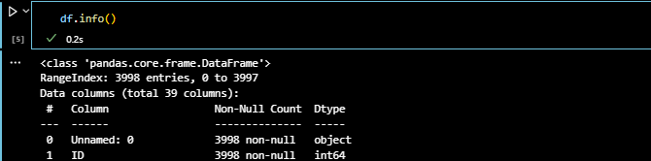
DATA CLEANING AND PREPROCESSING
UNDERSTANDING OUR DATA SET Pandas is the python package that provides strong tools for searching through datasets in the world of data analysis. Importing Pandas with an alias 'pd', we make our code more readable. We will start our research from the "data.csv" file. Using the Pandas library, we read and converted the csv file to a DataFrame, the kind of tabular spreadsheet-like structure. It is a canvas to extract some insights out of this dataset. The first orientation in the dataset is done by the method head(), while it is immediately visible by the method info() about a little more details on row count, column names, data types, and probable null values. At this point, armed with this knowledge, we will descend into the labyrinth of data, set to uncover the secrets.

Slide 7
I begin by identifying the types of variables present in our dataset. Two primary types of variables emerged: categorical and continuous.
I executed the activity by segregating the dataset into two distinct categories: category and continuous.
Finding Outliers in Numeric Columns: Outliers are basically extreme values deviating from the mean of most values. They might affect our analysis to a great extent, from being able to influence statistical measures to changing trends.
Analyzing probability and frequency distribution: help discover the underlying pattern and characteristics of numerical data. Analyzing the distribution for every numeric column tells a lot about both the tendency and the inherent variability of the structure of the dataset, using visualizations like histograms.

Slide 8
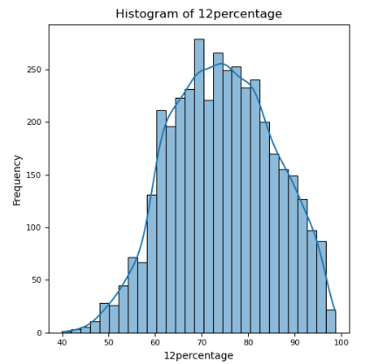
This is a histogram is a type of graph that shows the distribution of a numerical variable. It can help you understand the shape, center, spread, and outliers of the data. The 12percentage variable could represent the percentage of marks obtained by students in grade 12, for example.
The histogram has normal distribution, which means most of the values are clustered around the mean, and the frequencies decrease as you move away from the center. The mean of this distribution is around 70, which means the average 12percentage score is 70%. The standard deviation, which measures how much the values vary from the mean, is around 10, which means most of the scores are within 10 percentage points of the mean
Sample graph 01

Slide 9
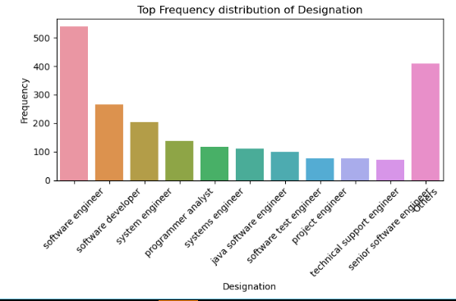
Regarding this chart, it displays the number of people carrying different titles of jobs . It is a horizontal bar chart with two axes. The vertical one shows frequency from 0 to 500. The horizontal axis shows the different designations of jobs: software engineer, software developer, system engineer, etc. It contains ten bars of color matching the number of jobs. The length of the bar is the frequency of that job title. The graph also contains the legend, which shows what each color represents. From the graph, it is vivid that the most common job titles under software development were Senior Software Engineer and Software Engineer, with frequencies that were in close proximity to 500.
Sample graph 02

Slide 10
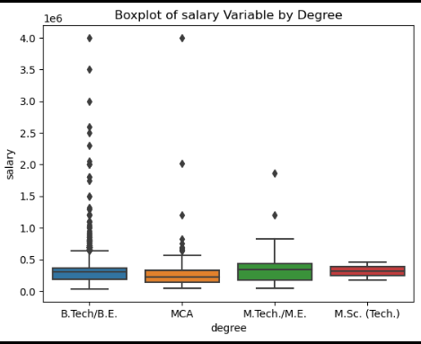
This graph is a boxplot that shows the distribution of salaries for individuals with different degrees: B.Tech/B.E., MCA, M.Tech/M.E., and M.Sc. (Tech.).
The graph has four categories on the x-axis, representing the degree of the individual. The y-axis shows the salary in rupees. Each category has a colored box that indicates the interquartile range (IQR) of the salaries, which is the difference between the 25th and 75th percentiles. The black line inside the box is the median salary, which is the middle value of the data. The whiskers extend from the box to the minimum and maximum values, excluding the outliers.
Sample graph 03

Slide 11
The analysis highlights several key points:
Majority of fresh graduates in Computer Science Engineering earn around 300,000 INR annually.
Candidates generally perform well academically, with strong scores in 10th and 12th grades.
Proficiency in English, Logical, Quantitative, and Computer Programming skills is notable among candidates.
Diversity in personality traits is observed.
Electronics and Communication Engineering is a popular specialization.
Trends include active skills development, disparity in career advancement, Bangalore as a significant job center, gender gap, and preference for B.Tech/B.E degrees.
Salary differences exist based on education level, with M.Tech/M.E graduates earning higher median salaries.
Females tend to have higher GPAs but are outnumbered by males in all degree fields, especially in Mechanical Engineering.
Positive correlation exists between Logical and Computer Programming scores, indicating potential salary increase with GPA.
Average salaries align with expectations mentioned in media reports.
Specialization preferences show a gender gap, with Electronics & Communication Engineering being the most preferred among both genders.

Slide 12
Research Questions
Times of India article dated Jan 18, 2019 states that “After doing your Computer Science Engineering if you take up jobs as a Programming Analyst, Software Engineer, Hardware Engineer and Associate Engineer you can earn up to 2.5-3 lakhs as a fresh graduate.” Test this claim with the data given to you.
Conclusion:
As per the inspection of my data, the expectations of salary through the Times of India provided are justified,
since average salaries for fresh graduates to hold the specified job roles are very near to the lower bound of salaries.
It is pretty clear though that there's a variation of a lot in the pay that some graduates are getting;
some do receive way above the range the article had quoted and some way lower.
Is there a relationship between gender and specialization? (i.e. Does the preference of Specialisation depend on the Gender?)
Conclusion
All specializations mentioned above are more in demand with males than with females.
Electronics & Communication Engineering is the specialization preferred the most among males as well as females,
followed by Computer Science & Engineering and Information Technology.
Mechanical engineering has the largest gender gap, with males outnumbering females by more than 10 times.

