Slide 1
Charity data set

Slide 2
background
A non-profit organization has setup a data-set of donors.
Feature include information on prior campaigns.
About 100,000 training examples (80,000 train 20,000 valid) and about 100,000 test.

Slide 3
Objective
At first, the objective is donation>0 classifier.
Later on, the main objective is to maximize the profit.
Each request has a package cost.
The amount gained is the actual donation minus 0.7 if package was sent and 0 otherwise.

Slide 4
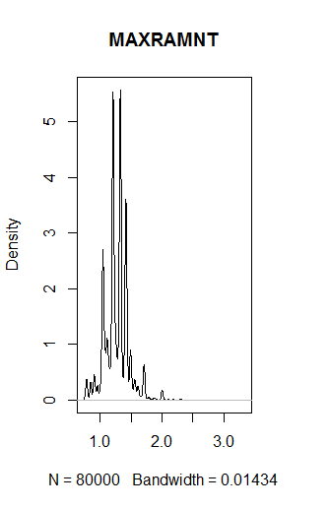
MAXRAMNT
Dollar amount of largest gift to date

Slide 5
TCODE
TCODE Donor title code
Freq | Value | Code
0.4268 | _ | 000
0.2712 | MR | 001
0.1777 | MRS | 002
0.0199 | MR. & MRS | 1002
… | … | …

Slide 6
LASTDATE
Date associated with the most recent gift.
9511 (year 95, month 11).

Slide 7
RFA (RECENCY/FREQUENCY/AMOUNT)
RFA_24 – 94 campaign
RFA_3 – 96 campaign
Example A1F
First letter, F=FIRST TIME DONOR, N=NEW DONOR, A=ACTIVE DONOR,…
Second letter, 1=One gift in the period of recency 2=Two gift in the period of recency …
Third Letter, A=$0.01 - $1.99, B=$2.00 - $2.99, C=$3.00 - $4.99, D=$5.00 - $9.99

Slide 8
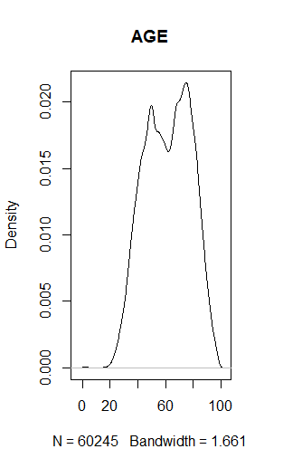
AGE
Has missing values

Slide 9
PEPSTRFL
Indicates Star Status
blank = Not considered to be a Star
'X' = Has Star Status

Slide 10
RDATE_
Date the gift was received for campaign_
Many missing

Slide 11
ADATE_
Date the _ promotion was mailed.

