Slide 1
Unix Processes
תהליכים ביוניקס
ESPL
Fall 2012/2013
Slides are based upon IBM technical library, Speaking Unix, Part 8: Unix processes

Slide 2

Motivation
On UNIX, each computing task is represented by a process.
UNIX runs many tasks seemingly at the same time
One can run multiple commands and carry out multiple tasks at a time
Each process receives a little slice of CPU time by the scheduler

Slide 3
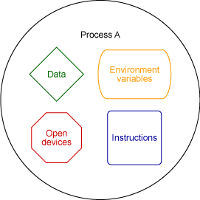
What is a process ?
A process is something of a container, bundling:
a running application
its environment variables
the state of the application's input and output
the state of the process (priority, etc’)

Slide 4
Which came first: the chicken or the egg?
Most processes come and go rapidly, as tasks start and complete
So, where does the first process come from?
On UNIX, some processes run from system boot to shutdown
The UNIX kernel spawns the first process during the boot sequence
The first process is called, appropriately enough, init and its PID is 1.

Slide 5
How many processes do we have?
UNIX system has a finite, albeit large pool of processes
In practice, a system almost never runs out of processes
Each new task -- say, launching vi -- immediately allocates a process from the pool with a unique PID
$ sleep 10 & ps -o pid,command,state,stime
PID COMMAND S STIME
16351 -bash S 11:23
16845 sleep 10 S 11:42
16846 ps -o pid,u R 11:44

Slide 6
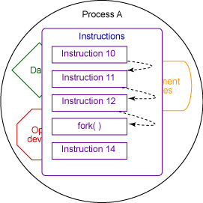
Forking a new process
Each new UNIX process is the spawn of an existing process
In UNIX, the fork() system call is used to spawn a new process
A “child” process is a clone of the “parent” process (PID is different), until the “child” continues execution independently
Had you ever “fork” a process ?

Slide 7
You are always forking new processes
The ls command in the shell prompt is actually a “child” process
if a user types the ls command at a shell prompt a new process will be forked
The Linux kernel will duplicate the shell's pages of memory and then execute the ls command

Slide 8
fork()
#include <sys/wait.h>
#include <stdlib.h>
#include <unistd.h>
#include <stdio.h>
int main(int argc, char *argv[]) {
pid_t cpid;
int status;
cpid = fork();
if (cpid == -1) { perror("fork"); exit(EXIT_FAILURE); }
if (cpid == 0) { /* Code executed by child */
printf("PID is %ld\n", (long) getpid()); exit(argc==2?atoi(argv[1]):0); }
else { /* Code executed by parent */
printf("Child PID is %ld\n", (long)cpid);
wait(&status); /* waits on the exit status from the child*/
printf("%ld exited with status %ld\n",(long)cpid,(long)status);
exit(0);
}
}
The fork() system call returns twice; in both the parent and the child processes
In the “parent” process it returns the PID of the “child” process
While in the “child” process it return 0

Slide 9
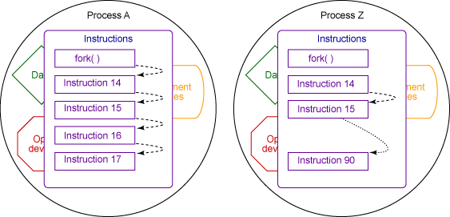
fork() – (cont.)
Process Z has the same environment variables as A, the same memory contents, the same program state, and the same files open

Slide 10
Concurrency
“Parent” and “child” processes run simultaneously
They use the same resources until one of them decides to change the data
Then, a unique copy of the considered data is duplicated for its use (copy-on-write)

Slide 11
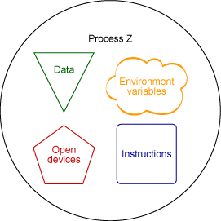
exec()
After the fork, Process A might continue running the same application
However, process Z might immediately choose to run another application
The later operation is called execution and it is invoked by the exec() system call
It loads a new program, and overrides the parent’s one

Slide 12
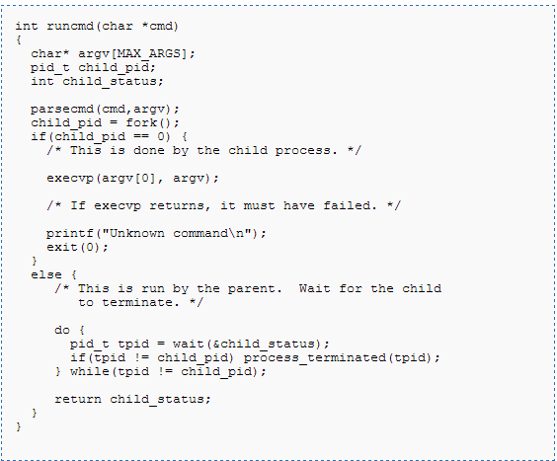
exec() – (cont.)
Uses the PATH environment variable

Slide 13
Inter Process Communication
Mechanism for processes to communicate and to synchronize their actions
IPC facility provides two operations:
– send (message) – message size fixed or variable
– receive (message)
If P and Q wish to communicate, they need to:
establish a communication link between them
exchange messages via send/receive
Implementation of communication link
physical (e.g., shared memory, hardware bus)
logical (e.g., logical properties: FIFO, error free)

Slide 14
Signals – Direct Communication
The source process can "raise" a signal and have it delivered to destination process.
The destination process' signal handler is invoked
and the process can handle it
A direct communication in which unidirectional
channels are established automatically
Processes must name each other explicitly using the
process ID in order to send messages of fixed size
Asynchronous
What types of signals you are familiar with?

Slide 15
PIPES – Indirect communication
There is no form of IPC that is simpler than pipes
A direct communication in which unidirectional channels are established between “related” processes
Basically, a call to the int pipe(int fd[2])
function attaches a pair of file descriptors to the pipe
One of these descriptors is connected to the write end of the pipe, and the other is connected to the read end
On many systems, pipes will fill up after you write
about 10KB to them without reading anything out
fd[1]
fd[0]
write()
PIPE
read()

Slide 16
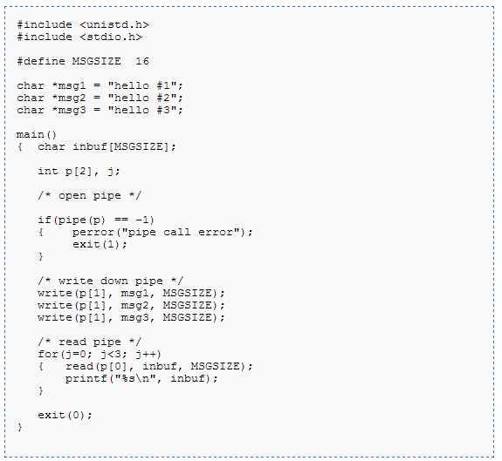
Simple example

Slide 17
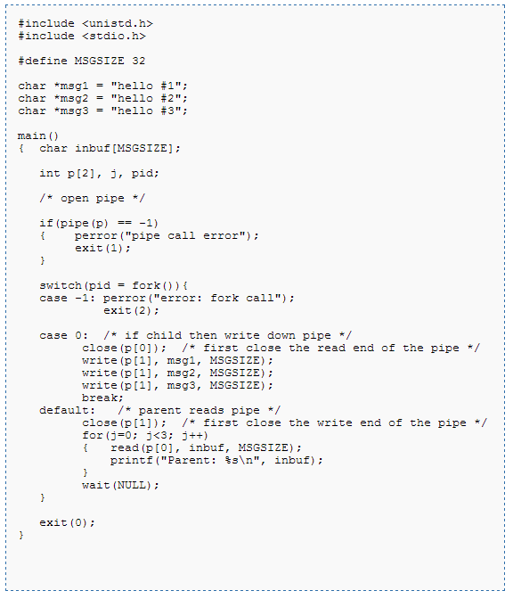
Example – “Parent” and “Child”

