Slide 1

Stop Re-inventing. Start Re-integrating.

Slide 2
What is SynchroB?
A marketplace where, with one prompt, a company that wishes to develop a feature will get the best existing technologies on the market for their need, and a solution on how to integrate it into their product.

Slide 3



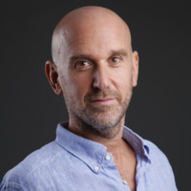

The Team
Jonathan Arbel
Nadav Levy
Ohad Rosenfeld
Founder | CEO & Innovation
Co-Founder | GTM & Product
Co-Founder | Revenue
B.Sc. CS (Data Science)
eToro Software Engineer
Deep Learning & High-scale Systems
Customer Success Lead at Bites
B2B Strategy & Account
Management Specialist
Ex-IAF
Field Sales Expert
Community-driven Growth
ADVISORY BOARD
Benny Arbel
Oren Carmel
Serial Entrepreneur
VP R&D
20 Years of Experience
Leading Tech Companies

Slide 4
The Problem
PROVIDER SIDE
INTEGRATION
GAP
SEEKER SIDE
Tech Companies & Their IP
Enterprise Needs
World-class tech gets buried
Trillions in lost IP value
Building what already exists
$300B+ wasted on redundant R&D
6+ months per feature rebuild

Slide 5
The Problem in Numbers
$300B+
6 Months
Annual Global Waste
Average Time Saved
In redundant R&D and
'reinventing the wheel'
Per feature integration
using SynchroB

Slide 6
LIVE DEMO
synchrob.onrender.com

Slide 7
Road to MVP
5-Month Roadmap
Month 1
Month 2
Month 3
Month 4
Month 5
1
2
3
4
5
Discovery
Scanning
Generalization
Matching
MVP Release
Ingestion Engine
Repo cloning & web scraping
Agent-based AI Audits
Capability extraction
Logic DNA Mapping
Functional fingerprinting
Prompt-to-Solution
Semantic ranking engine
Pilot Launch
First paying customers

Slide 8
Market Opportunity
TAM: $4.6 Trillion
Total Global IT Spending
SAM: $675 Billion
B2B SaaS & Enterprise Software
SOM
$180M
Israeli & European
FinTech/Cyber Hubs

Slide 9
Business Model
Success-Based Commission on Every Licensing Deal
15%
10%
7%
Commission
Commission
Commission
Up to $50K
$50K - $200K
$200K+
Performance-driven. Aligned with customer success.

Slide 10

Market Interest & Validation
Early-Stage Interest from Leading Organizations
Young Presidents' Organization

Slide 11
Competitive Landscape
AUTONOMOUS (AI)
Sourcegraph
SynchroB
StackShare
Discovery
Only
Integration
Roadmap
MuleSoft
G2
Zapier
Capterra
Libraries.io
MANUAL (Marketplace)

Slide 12
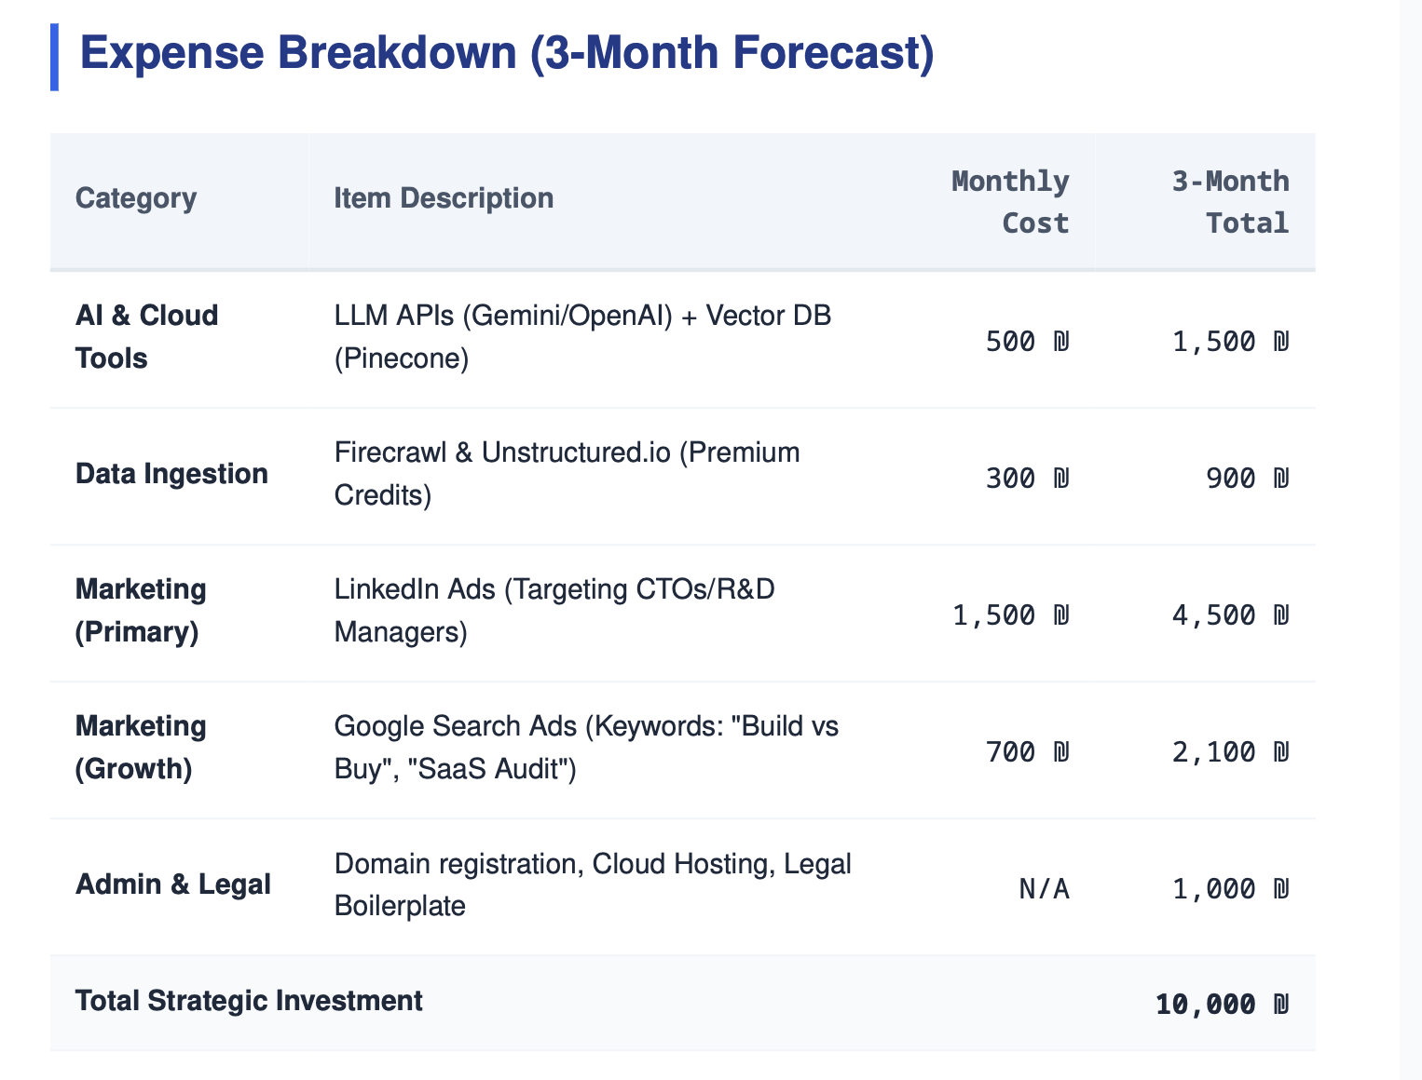
Financial Needs

Slide 13
Stop Re-inventing. Start Re-integrating.

