Slide 1
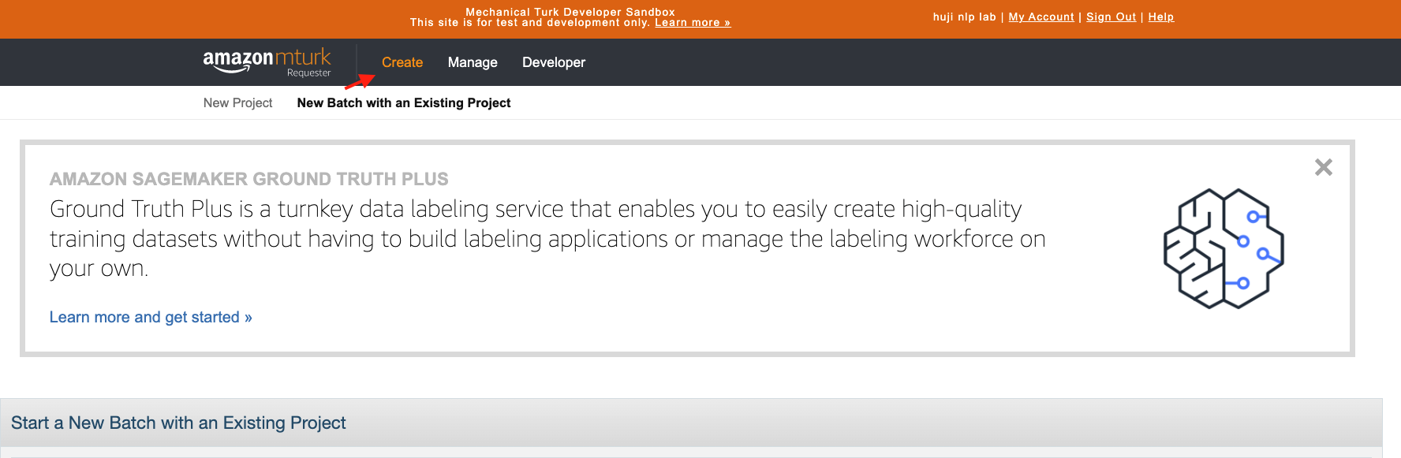
1. Enter requester sandbox, Creating new annotation task

Slide 2
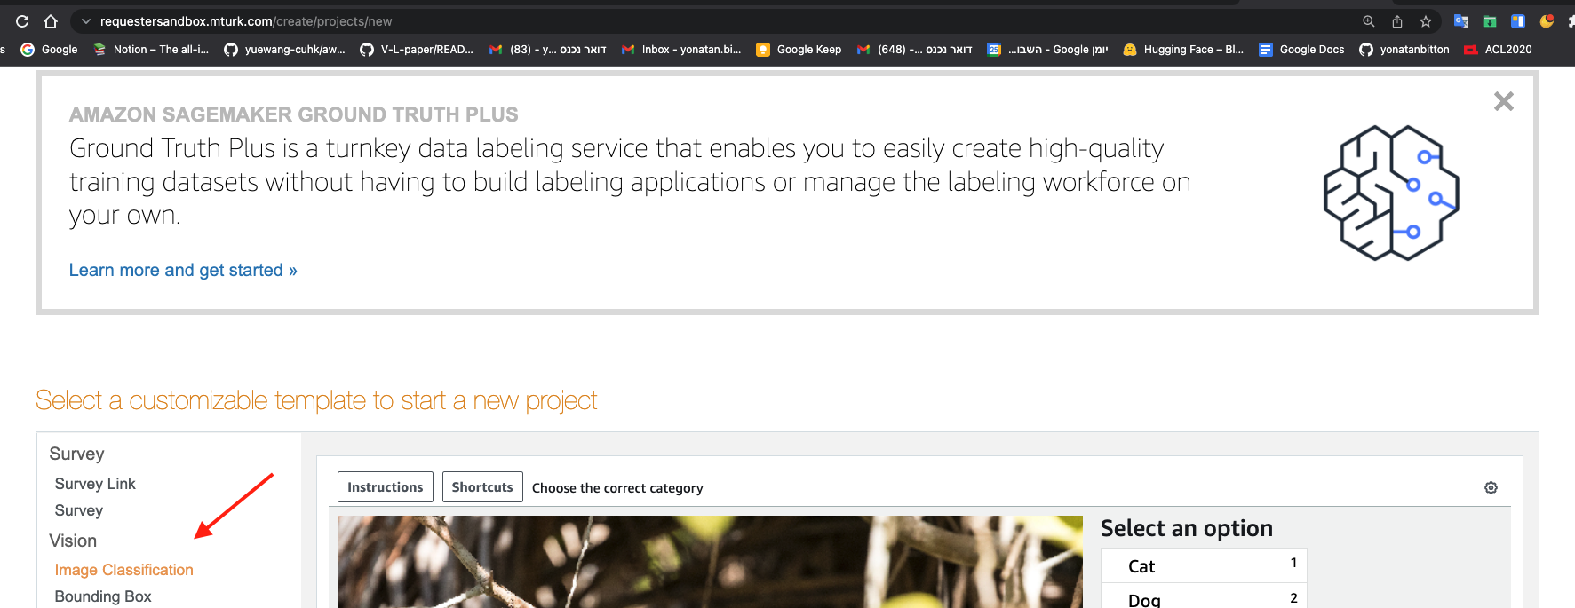
2. Choosing Image Classification

Slide 3
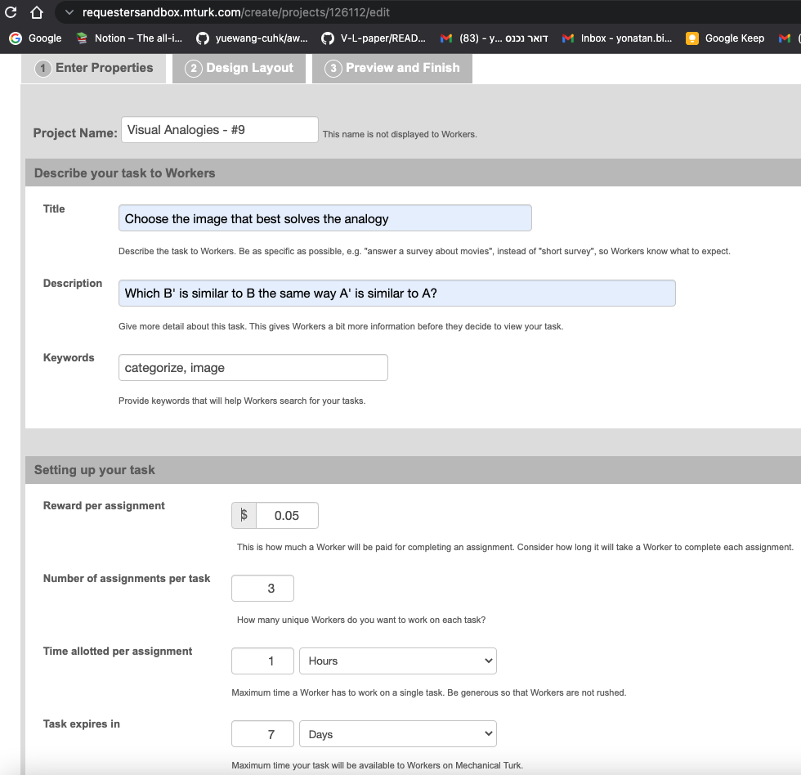
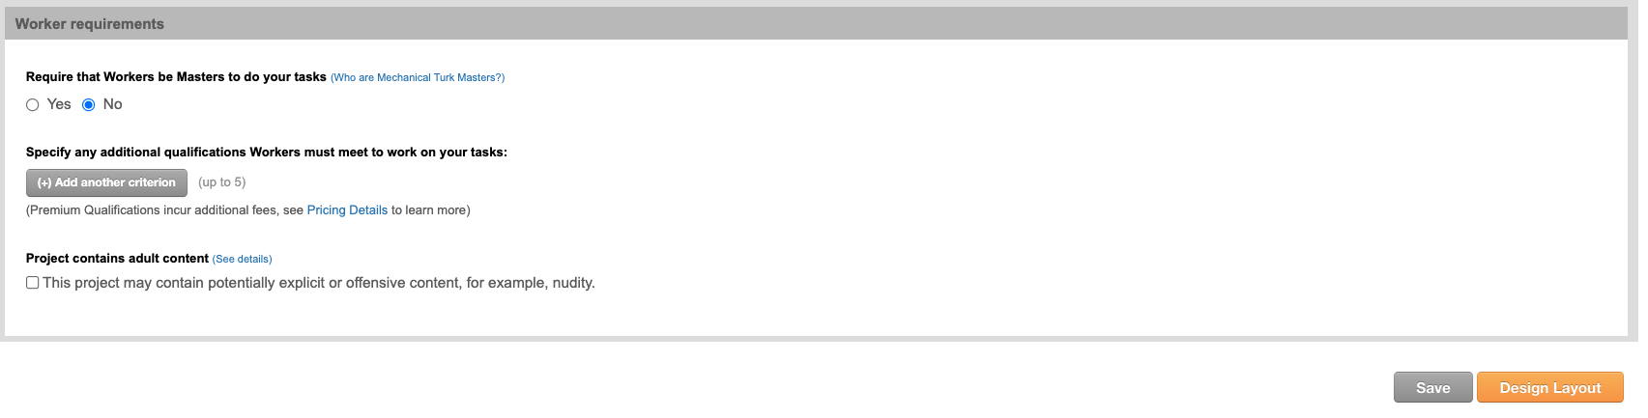
3. Editing template & Quals (no quals)

Slide 4
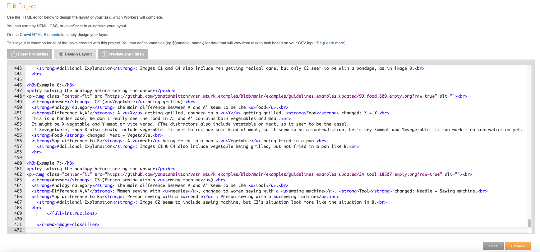
4. Editing the layout. My exact layout is here.

Slide 5
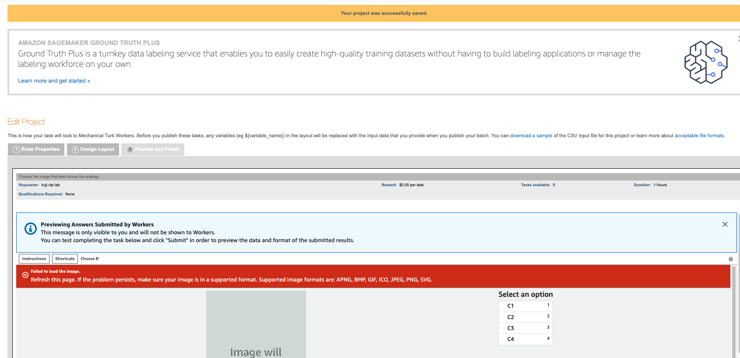
5. Preview + Save

Slide 6
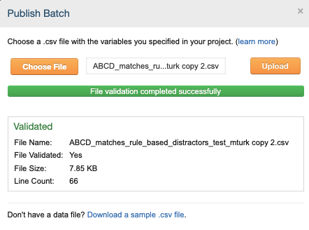
6. Publish Batch

Slide 7
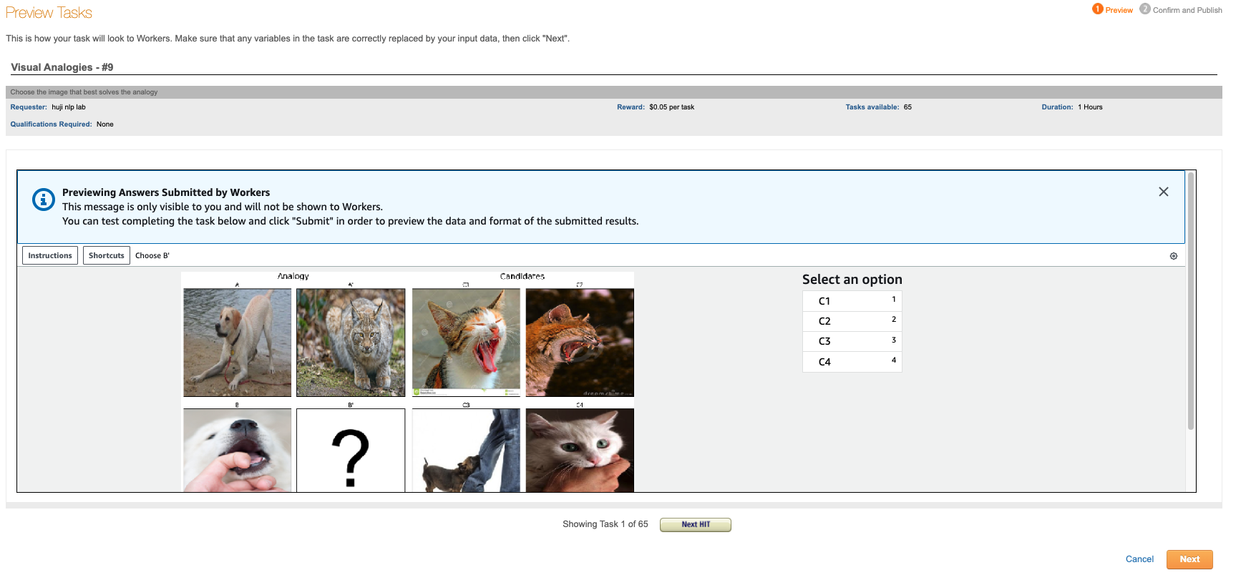
7. Uploading

Slide 8
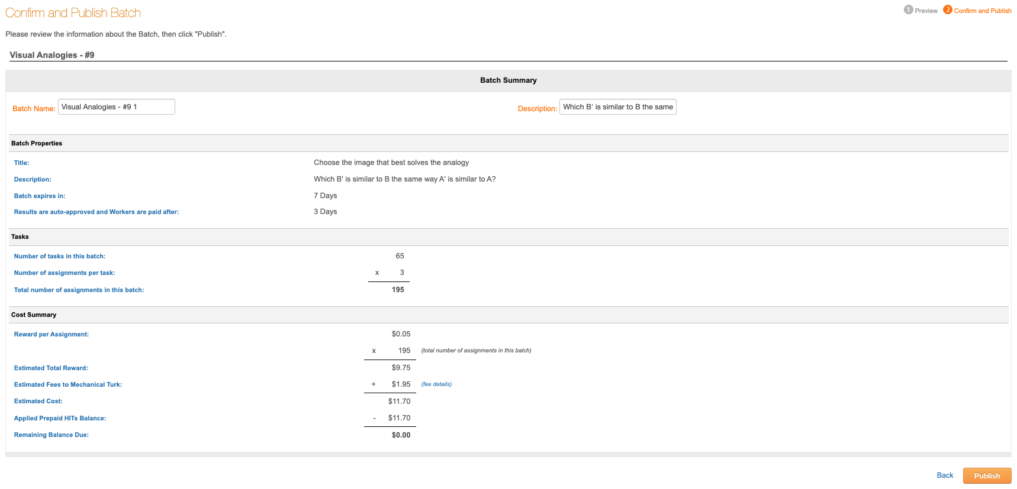
8. Confirm & Publish

Slide 9
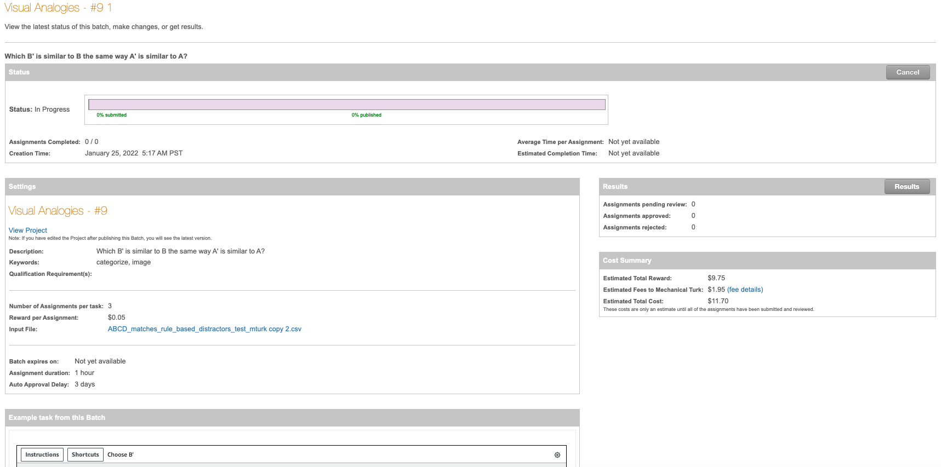
9. View Published Batch - 0% published

Slide 10
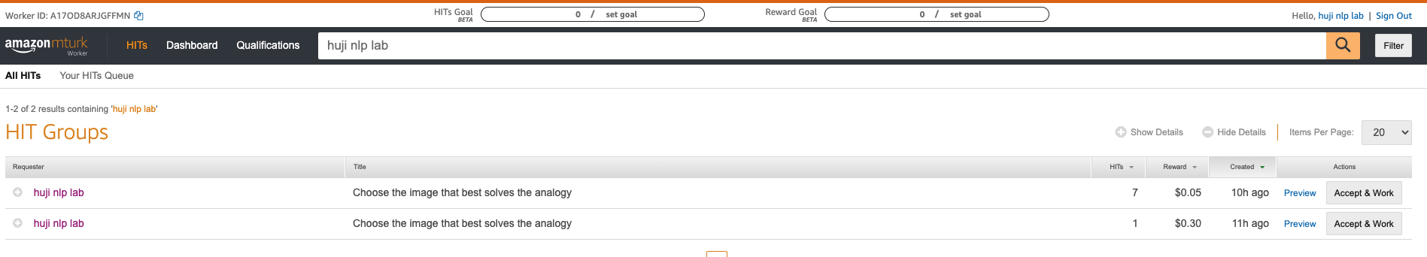
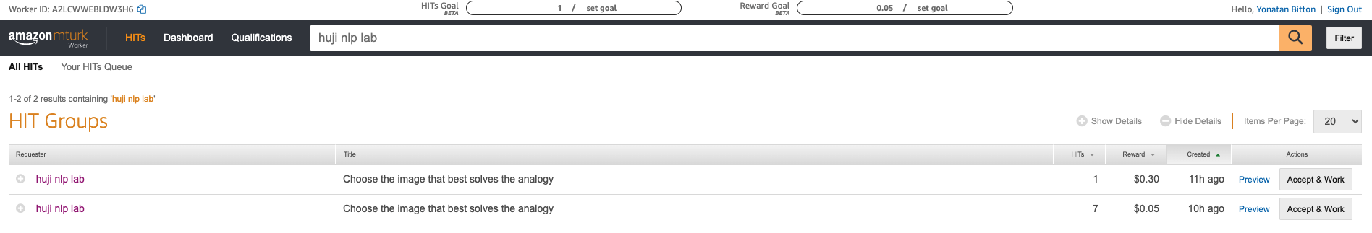
10. Enter the Worker sandbox, and search New task is not published!
Entering from the University Worker (huji nlp lab) account
Entering from my private Worker (Yonatan Bitton) account

