Slide 1
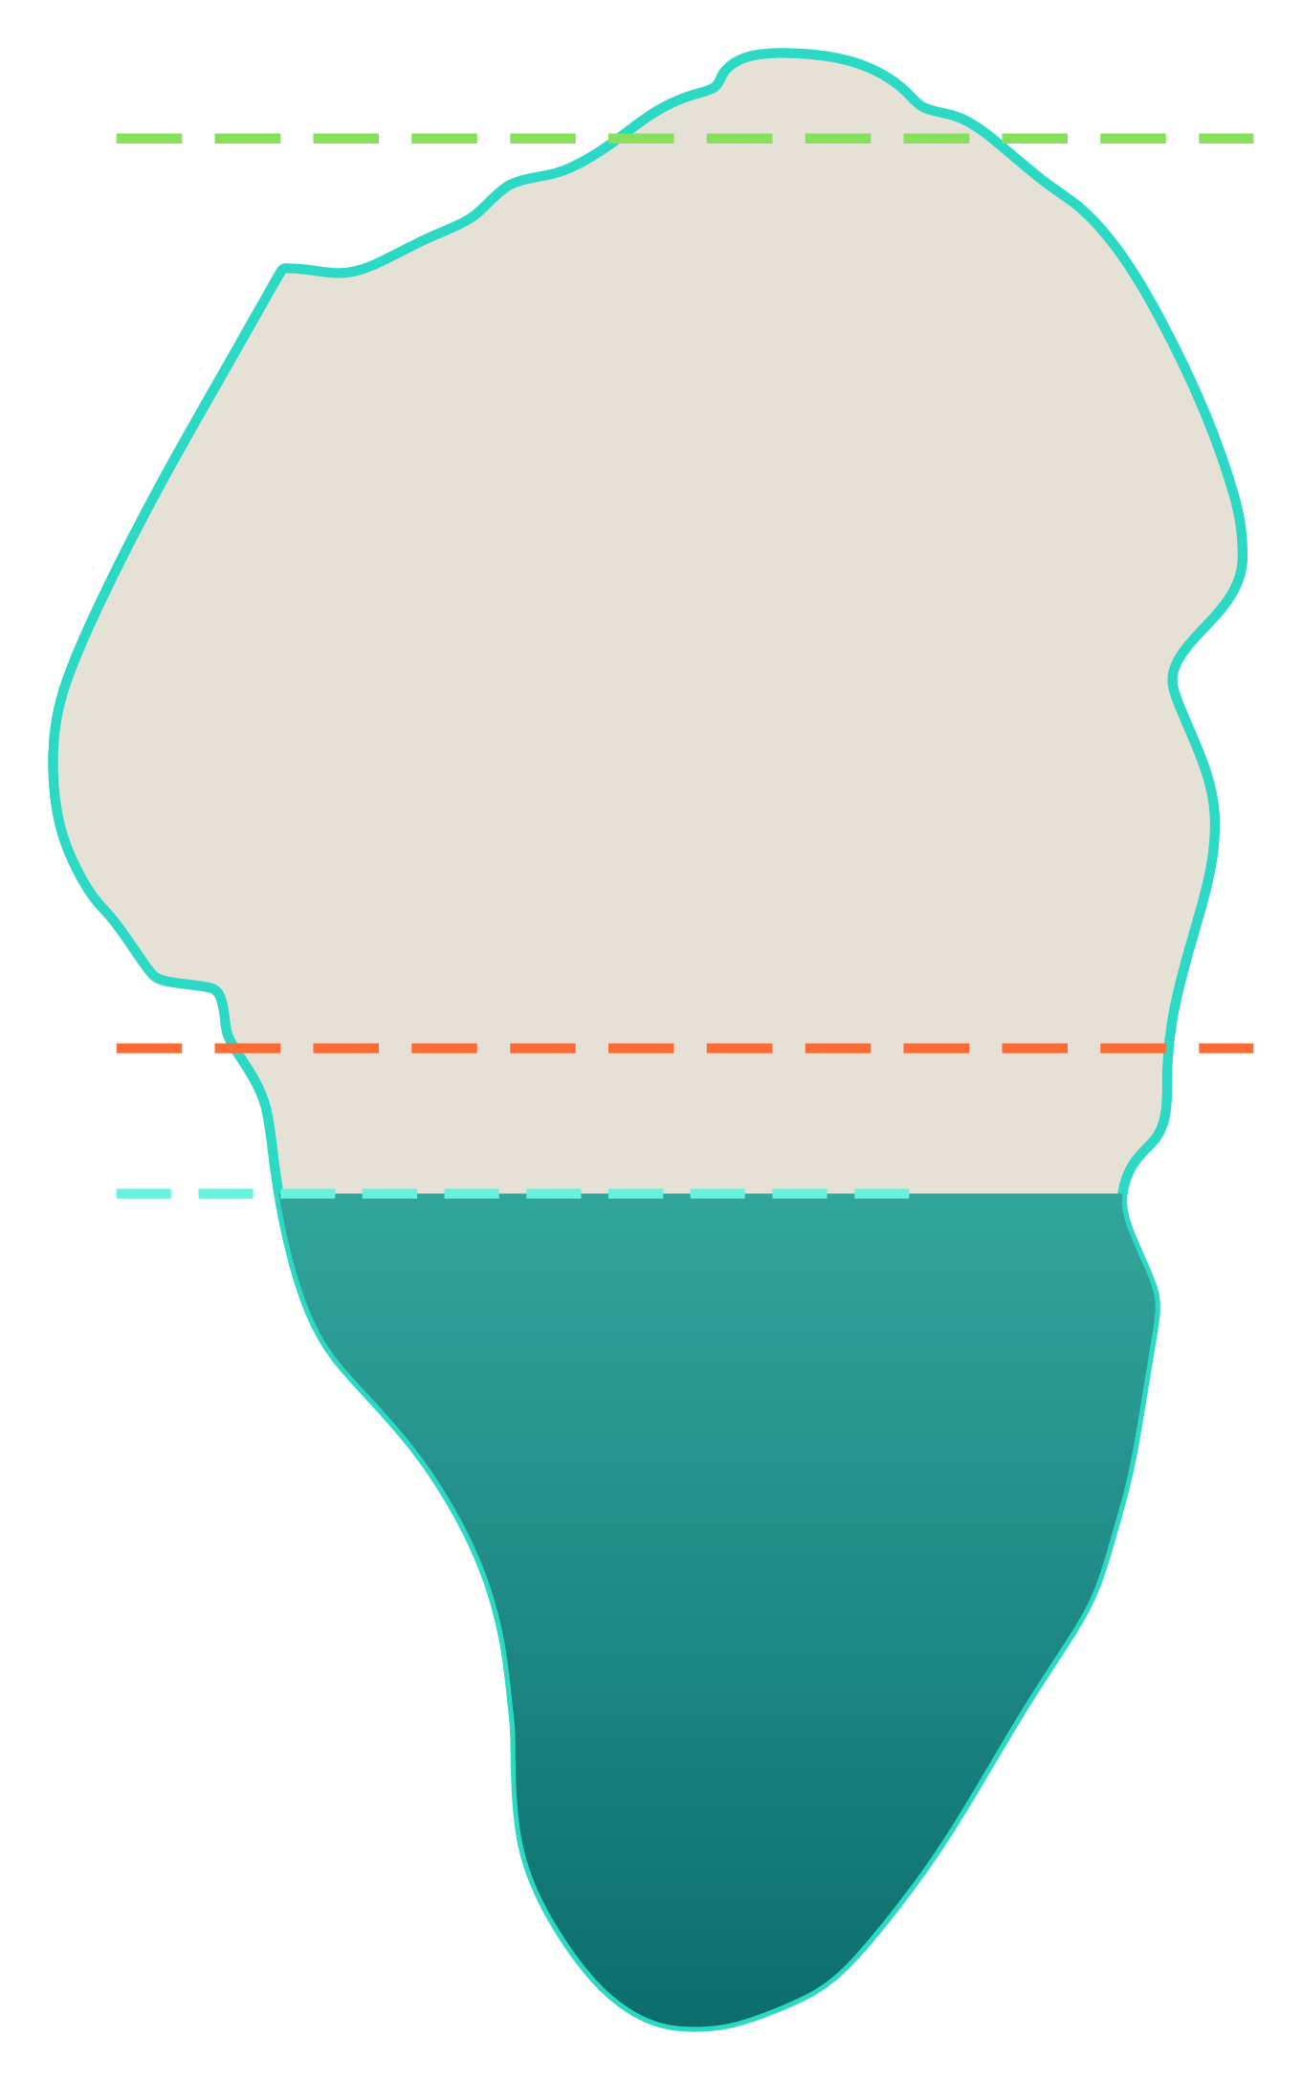
Better data, not bigger models
Yonatan Most · Adnan Agbaria
Notes:
This is the Kinneret, as our app draws it. The water is filled to the lake's level, and the orange dashed line is the lower red line.
This morning the lake stood at [today's level, from the app]. Under the red line.

Slide 2
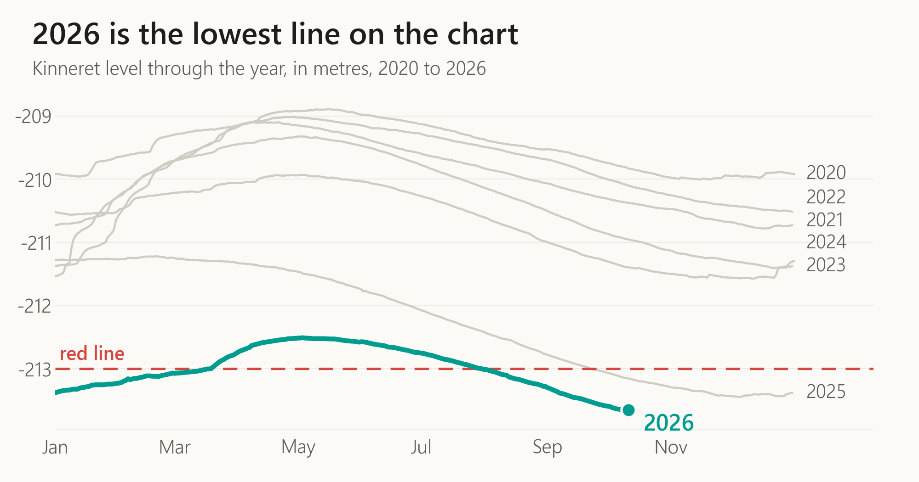
Notes:
Here is every year since twenty twenty, laid on top of each other. The teal one is this year. It's the lowest line on the chart, and it's still going down.
What happens next depends on one thing: the winter.
If this winter is like 2024–2025, the worst of the last twenty, the lake keeps falling. It ends the spring -0.77 m (winter 2024–2025) lower, at -214.43 m (winter 2024–2025), deeper under the red line. That means leaning even harder on desalination, a lake under stress, with worse water quality and more risk of algae, and pressure that spreads out in wider circles, to farming and to everyone who depends on this water.
If it's like 2018–2019, the best, the lake climbs +3.29 m (winter 2018–2019), to -210.36 m (winter 2018–2019), back above the red line. Then the whole conversation changes.
Both of those are real winters, not forecasts. So which one is coming? And wouldn't it help every decision in this room to know a little earlier?

Slide 3
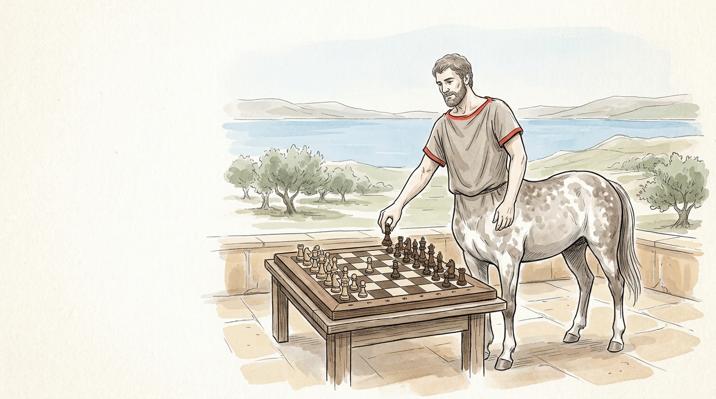
Notes:
Before I answer, a picture. This is a centaur, half human and half horse. This picture, like the others in this talk, is AI-made.
After Garry Kasparov lost to a chess computer, he started asking a different question: what happens when a human and a computer play as one team? Chess players call those teams centaurs.
In 2005 there was an open freestyle chess tournament on the internet. Anyone could enter, with any computer help they liked. The winners were not grandmasters, and not the strongest machine. They were two amateur players from the United States, running three ordinary computers, with a very good way of working together with them. The process beat the raw strength.
And today Terence Tao, one of the great mathematicians alive, works on real research problems with AI tools at his side. AI tools suggest and explore, proof-checking software verifies, and he decides what matters.
Keep the centaur in mind. We'll come back to it.

Slide 4
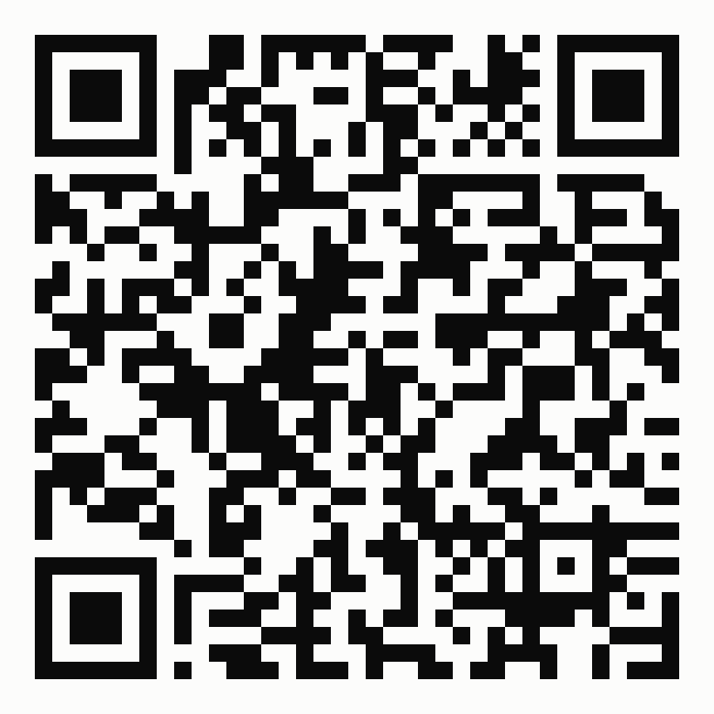
Yonatan Most
Adnan Agbaria
Notes:
So who am I? Let me start with what I'm not. I'm not a meteorologist. I'm not a data analyst. I'm not a software engineer. I can't write Python, or R.
I'm a process engineer in water treatment, and a student in a data science master's. My first data pipeline was for treatment-plant data at work: thousands of copy-pastes between Gemini and a notebook, until Claude rebuilt the whole thing, better, in about an hour.
This work is joint with my co-author, Adnan Agbaria, from Kinneret Academic College.
This code opens the app we built, so you can see today's level and this week's forecast for yourself.

Slide 5
picture to make by hand:
week.png
(prompt in images/week.prompt.txt)
Notes:
The lake is our national backup, and it's thinning. Knowing where it's heading could help decisions about the backbone of our life on this land. But can it be done?
I limited the challenge to one week: seven steps of one day, each built on the one before. Why a week? Because the model has to be told the weather, and a weather forecast is good for about a week.
One honest note before any score. When I test the models, I give them the weather that actually happened, as if the forecast were perfect. So every score you'll see today is a best case. A real forecast would do worse.

Slide 6
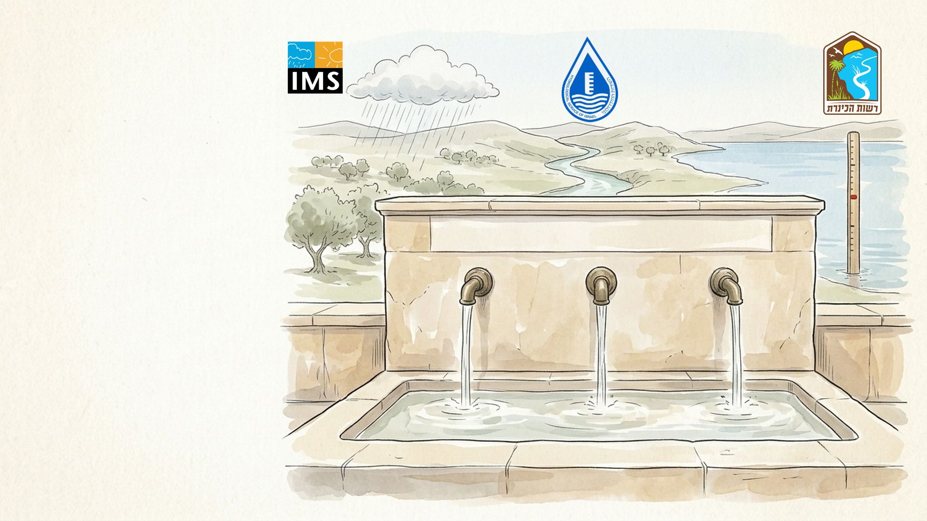
Data Sources
Notes:
Then the hunt for data. Three national authorities: the Water Authority for the lake's level, the Hydrological Service for the rivers, above all the Jordan, and the Meteorological Service for the rain, the heat, the wind and the sun.
Finding them took a while; the river data was the hardest to find. Three agencies, three formats, and none of it made to be used together.

Slide 7
picture to make by hand:
pipeline.png
(prompt in images/pipeline.prompt.txt)
Notes:
You all know this picture better than I do. Raw water comes in, you treat it in stages, and clean water comes out.
Data works the same way. I already knew the stages from my first pipeline: collect the raw data, line it up in one table, clean it, then compute what matters. So building this one took hours, not weeks.
The days went into choosing what the model sees: which past days to show it, and where. I asked more than one AI about that.

Slide 8
picture to make by hand:
model.png
(prompt in images/model.prompt.txt)
Notes:
Then the model. I searched the web for the best one, and the answer was XGBoost. So I asked Claude to build it. After a while I noticed it was building something else: gradient boosting. Many small decision trees, each one fixing the mistakes of the one before. Rather than argue, I said: let's race them.
In plain words, the model works in two steps, the way the water does. First rain and river: how much water the Jordan will carry in. Then the lake: how much it gains or loses each day, for each of the next seven days.

Slide 9
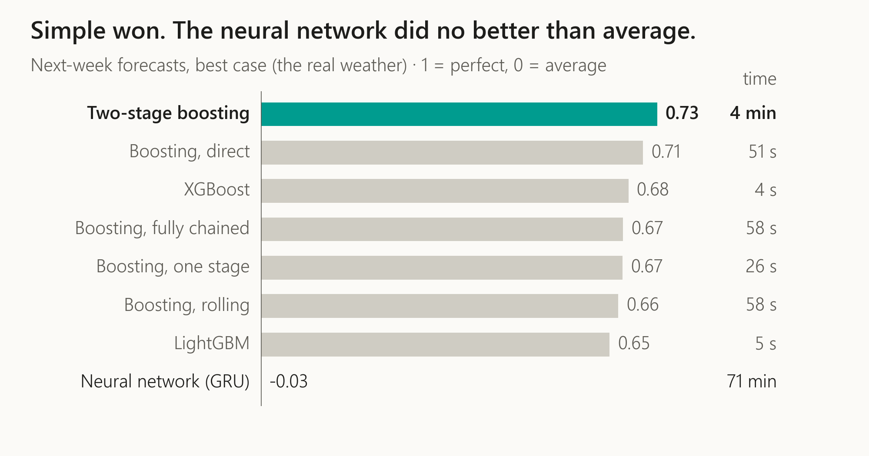
Notes:
From here on, every number was measured on one data freeze, 11 October 2026. Only today's level comes from the app.
Eight models, each forecasting how many cubic metres the lake gains or loses each day, over the next week. The score is R squared: one is perfect, zero is no better than guessing the average.
Gradient boosting won. Every run, however I tweaked the data, it came back on top. Here it scores 0.73, trained and tested in 4 min.
So I tried to out-smart the AI at its own game, with a neural network. It scored -0.03. About zero, after 71 min of training and testing. A big defeat. So I decided to trust the AI's lead.

Slide 10
The newest oldest trick in the book
picture to make by hand:
persona.png
(prompt in images/persona.prompt.txt)
Notes:
That's when I reached for the newest oldest trick in the book. You tell the AI: "You are a hydrology and meteorology specialist." It's role-play. The AI is not a hydrologist. But it reads your results differently. I called this persona Doctor Wade Storm.
Wade Storm noticed what I hadn't: every model that learned anything scored worst in 2023. Maybe not a model problem. Maybe a data problem. Even a great chef can't fix spoiled vegetables.

Slide 11
picture to make by hand:
rain.png
(prompt in images/rain.prompt.txt)
Notes:
Wade Storm was right. In 2023 the rain gauge at the lake went offline, and four small bugs in my pipeline quietly turned the missing readings into zero.
A whole year of rain became a dry year. No crash, no error. That's the scariest kind of bad data: the kind that looks fine.

Slide 12
Ride the flow, or take the wheel
picture to make by hand:
lesson.png
(prompt in images/lesson.prompt.txt)
Notes:
Here's the lesson I'd pass on. I didn't dive deep into every one of Wade Storm's pointers. I'm not a meteorologist; I rode the flow.
But you have to learn when to ride the agentic flow, letting the AI run the work step after step on its own, and when to take it into your own hands, or it drifts. What decided which changes stayed was measurement, not trust.
That's the centaur again: the machine explores, the person decides.

Slide 13
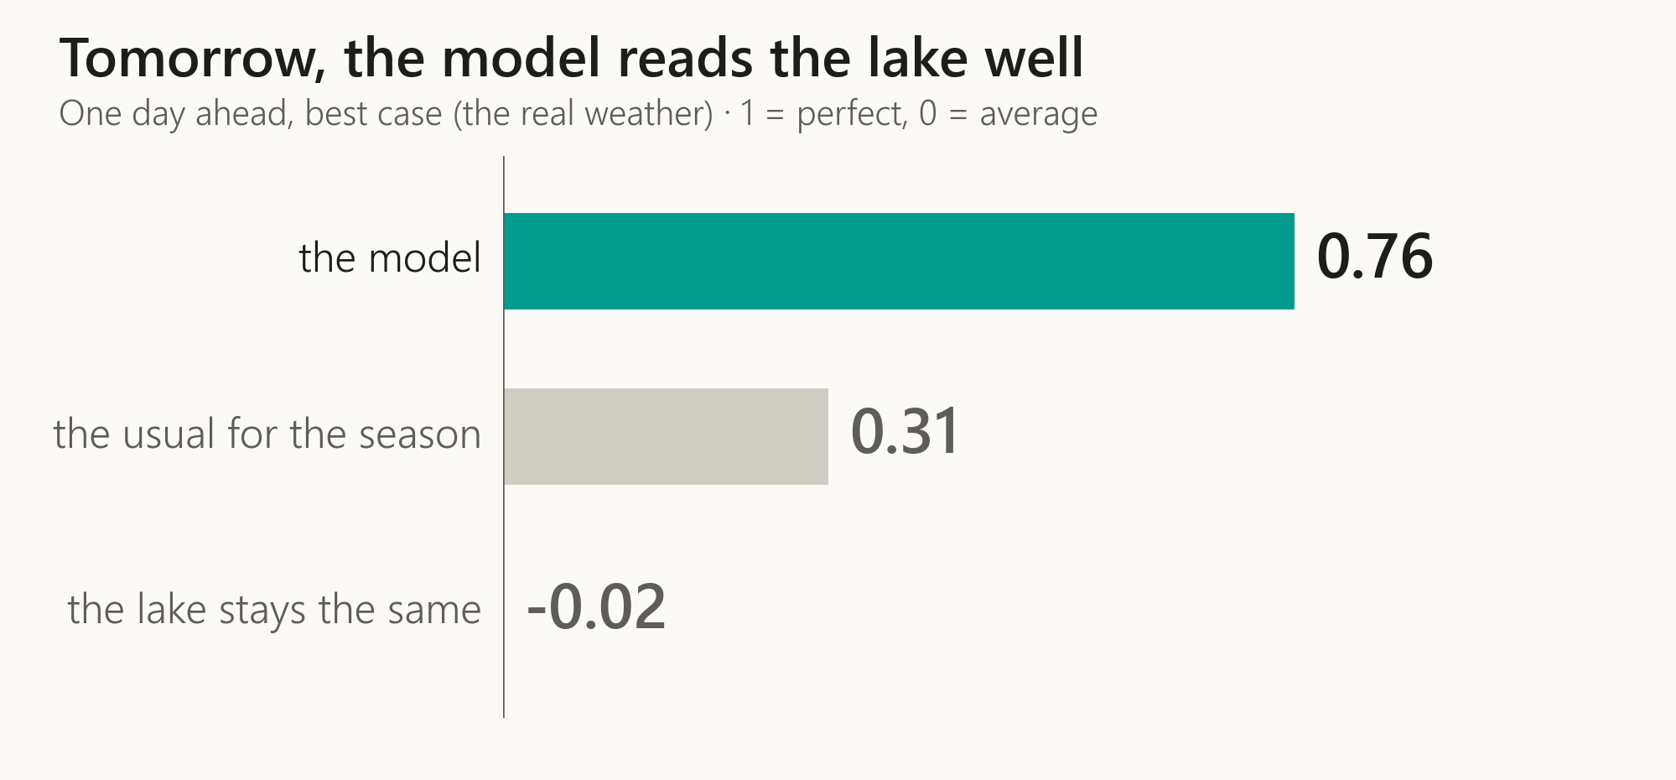
Notes:
So what came out of it? Start with a simpler question: tomorrow. Given today's real lake and the real weather, how well can we tell tomorrow's change?
The model scores 0.76. The usual change for the season scores 0.31, and "the lake stays the same" scores -0.02. Same days, same ruler, and again a best case.

Slide 14
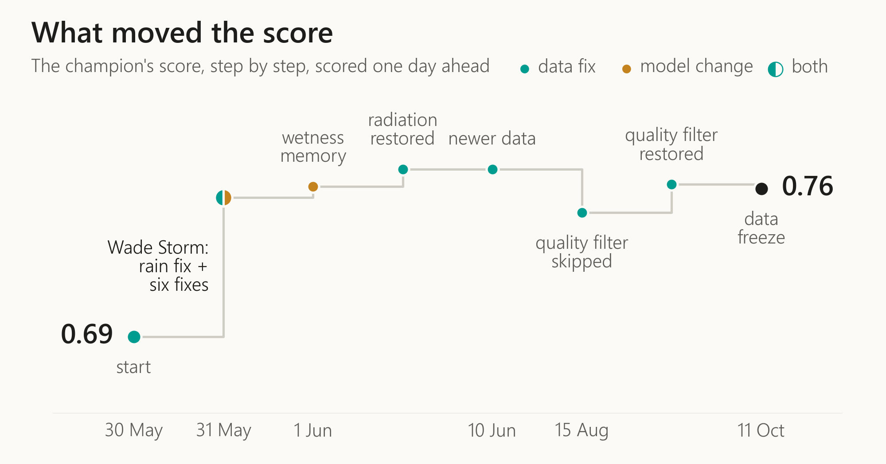
Notes:
This is the history of that one-day score, and every step is labelled with what caused it.
It started at 0.694 (May 2026). The rain fix, and then six simple fixes Wade Storm suggested, took it to 0.758 (May 2026). One example: tell the model not just how much it rained, but how hard. A downpour runs off into the river; a drizzle soaks into the ground. I credit both, and every fix earned its place by measurement.
That was the biggest step by far, and it was both: a data fix and six model changes, together. After it the moves were small, and mostly data. On our freeze it scores 0.76.

Slide 15
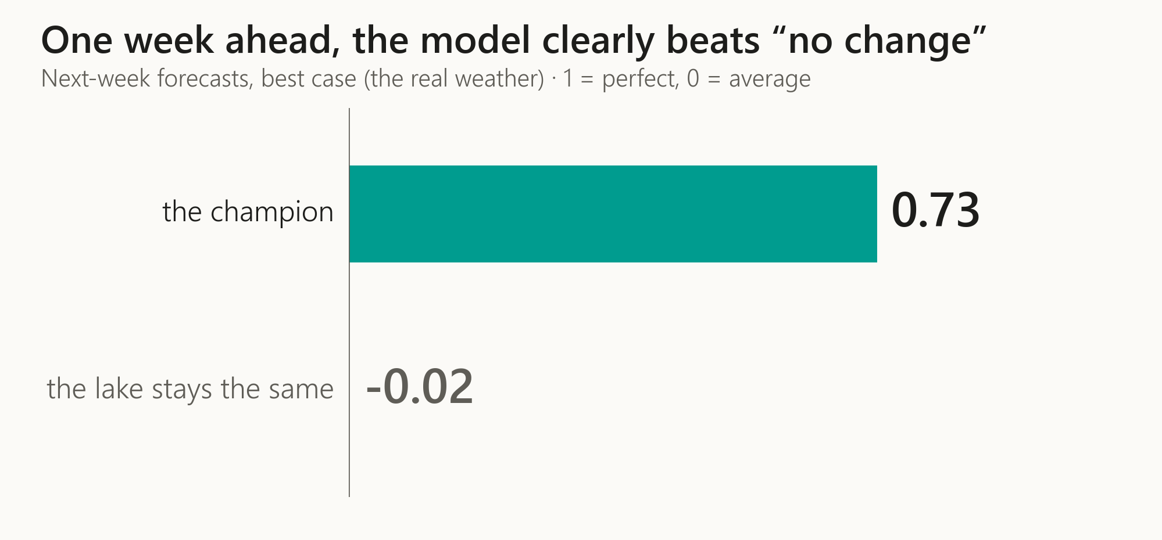
Notes:
Now the week. Seven days ahead, starting from one real day and never peeking inside the week, the champion scores 0.73, as a best case. "The lake stays the same" scores -0.02. The margin is 0.75. Skill fades with distance, but a week holds.
One caveat for the technical people: this is daily volume change, not the level. The level moves slowly, so a score on level would look flattering.
And this week's forecast is in the app, for you to check against the lake.

Slide 16
picture to make by hand:
push.png
(prompt in images/push.prompt.txt)
Notes:
Then Adnan pushed me further: what about the long term? I warned him I didn't expect good results, and I tried anyway.
These were shots in the dark, and I'll say so. The weather service's extended forecast, as an input, which turned out not to be available. A forecast driven by temperature alone. A set of regional climate models under two global-warming scenarios, which you can see on the app's climate page. And to rebuild the past back to 1960: the sun's radiation above the atmosphere, computed from astronomy, with the gap between day and night temperatures as a clue to cloud and rain.
Most missed. One partly hit: a simple soil-moisture bucket, the ground's memory of rain, gave some skill in winter, two to four weeks ahead.

Slide 17
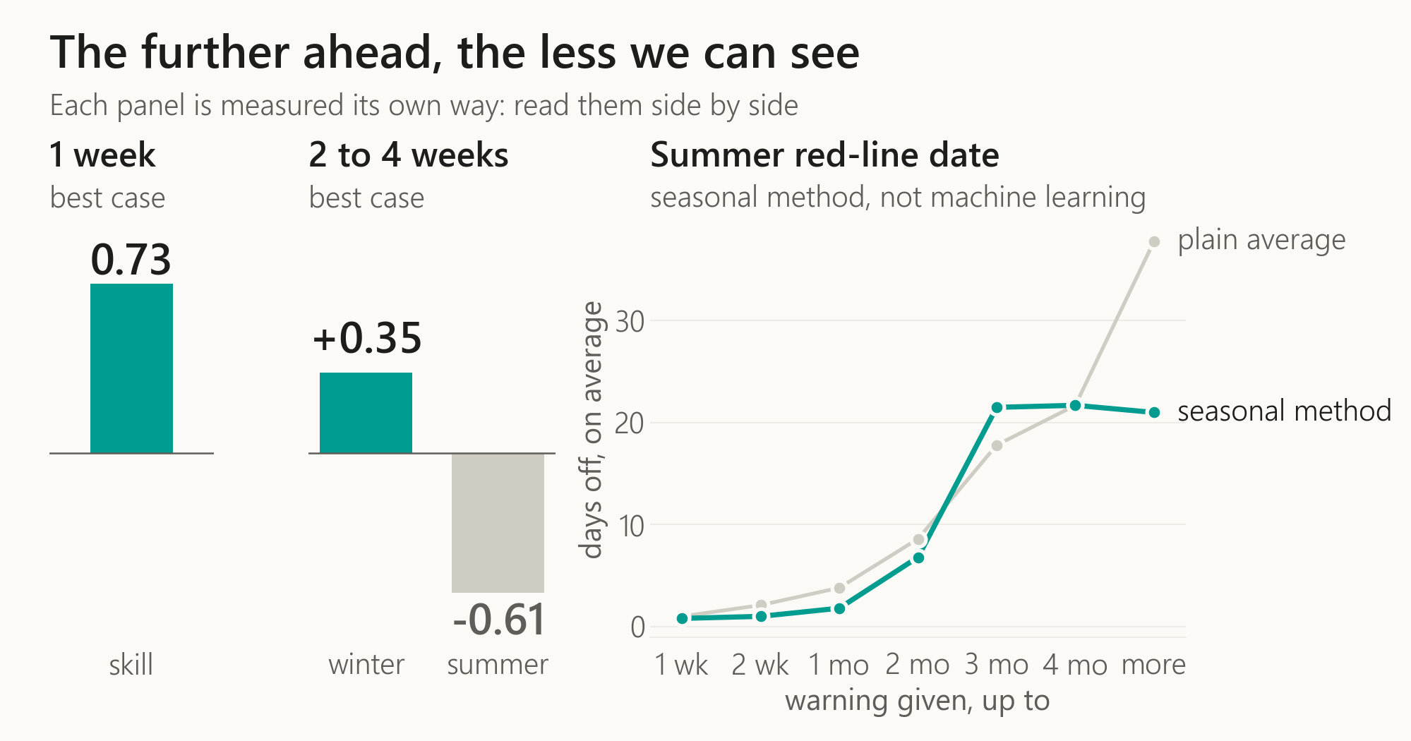
Notes:
Here is the frontier on one slide. Each panel is measured its own way.
One week: skilful. Two to four weeks: some skill in winter, thanks to that soil memory, and none in summer. Both are best cases.
On the right, the summer red line, with a seasonal method, not machine learning. Replayed for every crossing since 2008: with two weeks' to a month's warning, it misses the date by about 2 days. With two to three months, by about 22, and there the plain seasonal average does better, at 18. And 91 of its 753 forecasts never reached the line at all, every one issued two months or more ahead.
The frontier is where the data runs out.

Slide 18
picture to make by hand:
silent.png
(prompt in images/silent.prompt.txt)
Notes:
So what's missing? Three challenges, and each one applies to you.
First: bad data hides silently. A single dash in a weather file became a zero, and a whole year of rain disappeared.
This applies to you: when a number looks wrong, fix it at the source, where it entered. Don't patch it downstream.

Slide 19
picture to make by hand:
sensors.png
(prompt in images/sensors.prompt.txt)
Notes:
Second: records start, stop and change names. The Sede Nehemya station on the Jordan stopped in 2022, and the Yarmuk record ends in 2000. The station I first took as the lake's outflow, the Baptism Site, turned out to be on the lower Jordan, near the Dead Sea, not at the lake's outlet. The champion doesn't use it, but some of the other Olympics models do.
My model's table starts in September 2012, where the files I could download line up. Some of the weather stations go back further, so an earlier start may well be possible.
This applies to you: every data feed needs a backup source, and an alarm that rings when it goes quiet.

Slide 20
picture to make by hand:
share.png
(prompt in images/share.prompt.txt)
Notes:
Third, and most critical: human consumption. Pumping and abstraction from the lake. That data wasn't available to me at all. The human hand on the water balance is invisible to my model.
This applies to you: if you hold data like this, share it.
And that's my first takeaway: more people handling data, in more advanced ways, and sharing it, is a much better starting point than any model.

Slide 21
picture to make by hand:
brain.png
(prompt in images/brain.prompt.txt)
Notes:
The second takeaway: build expertise. Dive deep into fields that aren't yours, and keep improving your own model: the human brain.

Slide 22
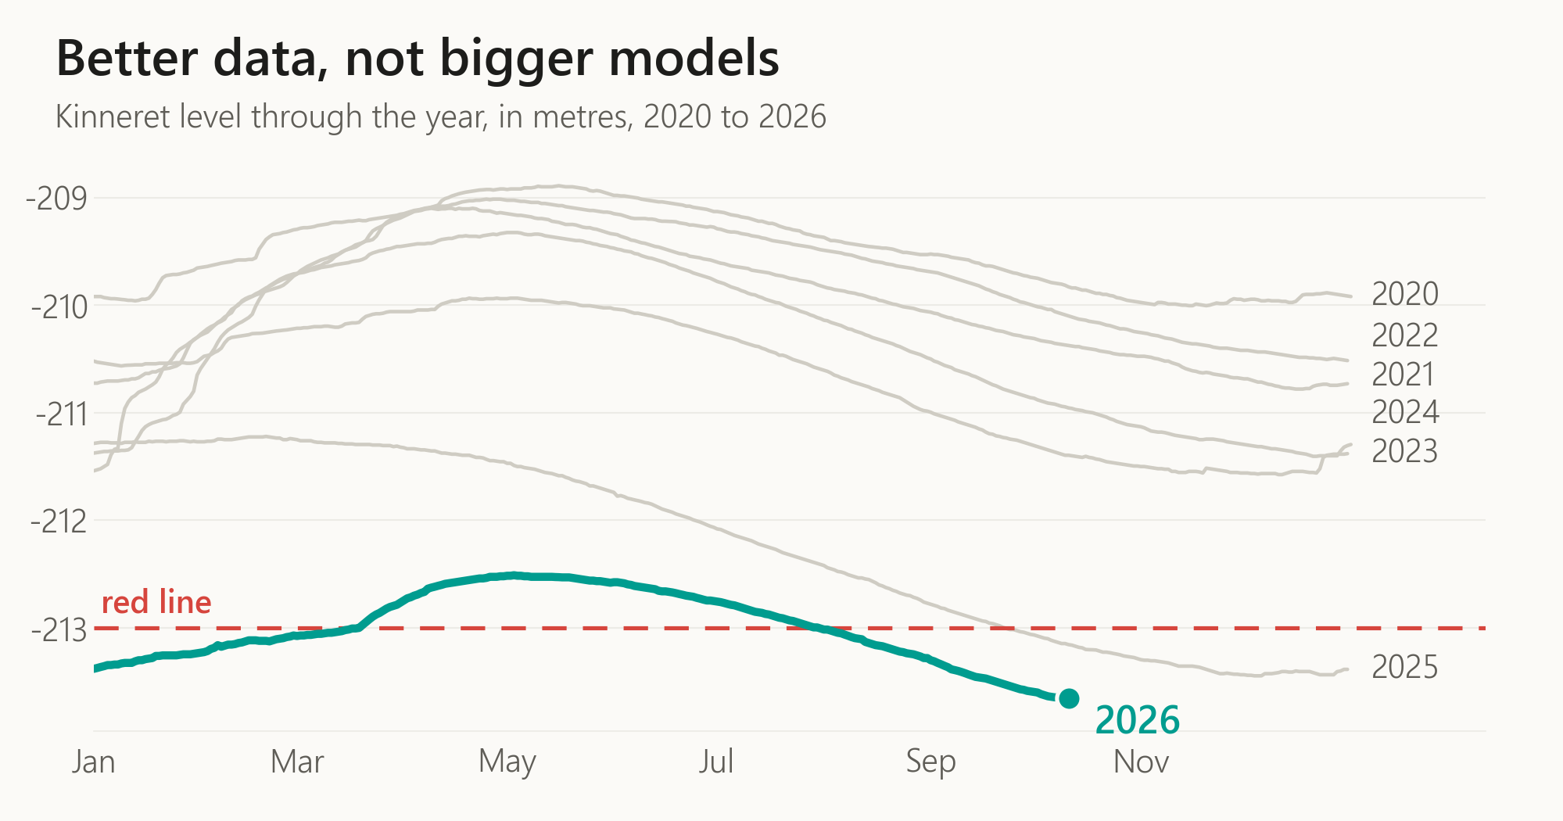
Notes:
Back to where we started. The lake, under the red line, waiting to see which winter comes.
My results are modest. They're nothing compared to what time, progress, and real cooperation between industry and institutions can reach, at scale: better decisions, and better care for the environment we all live in.
That's the centaur. Not the strongest player, not the strongest machine, but a good process, with people deciding what matters.
The code in the corner opens the app, with today's level. Thank you.

