Slide 1
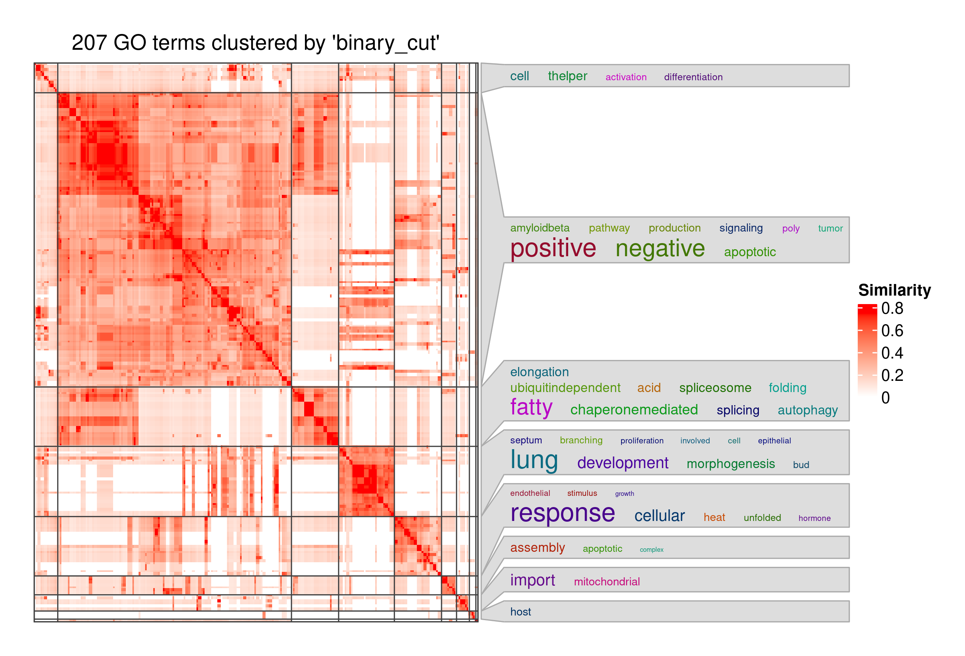
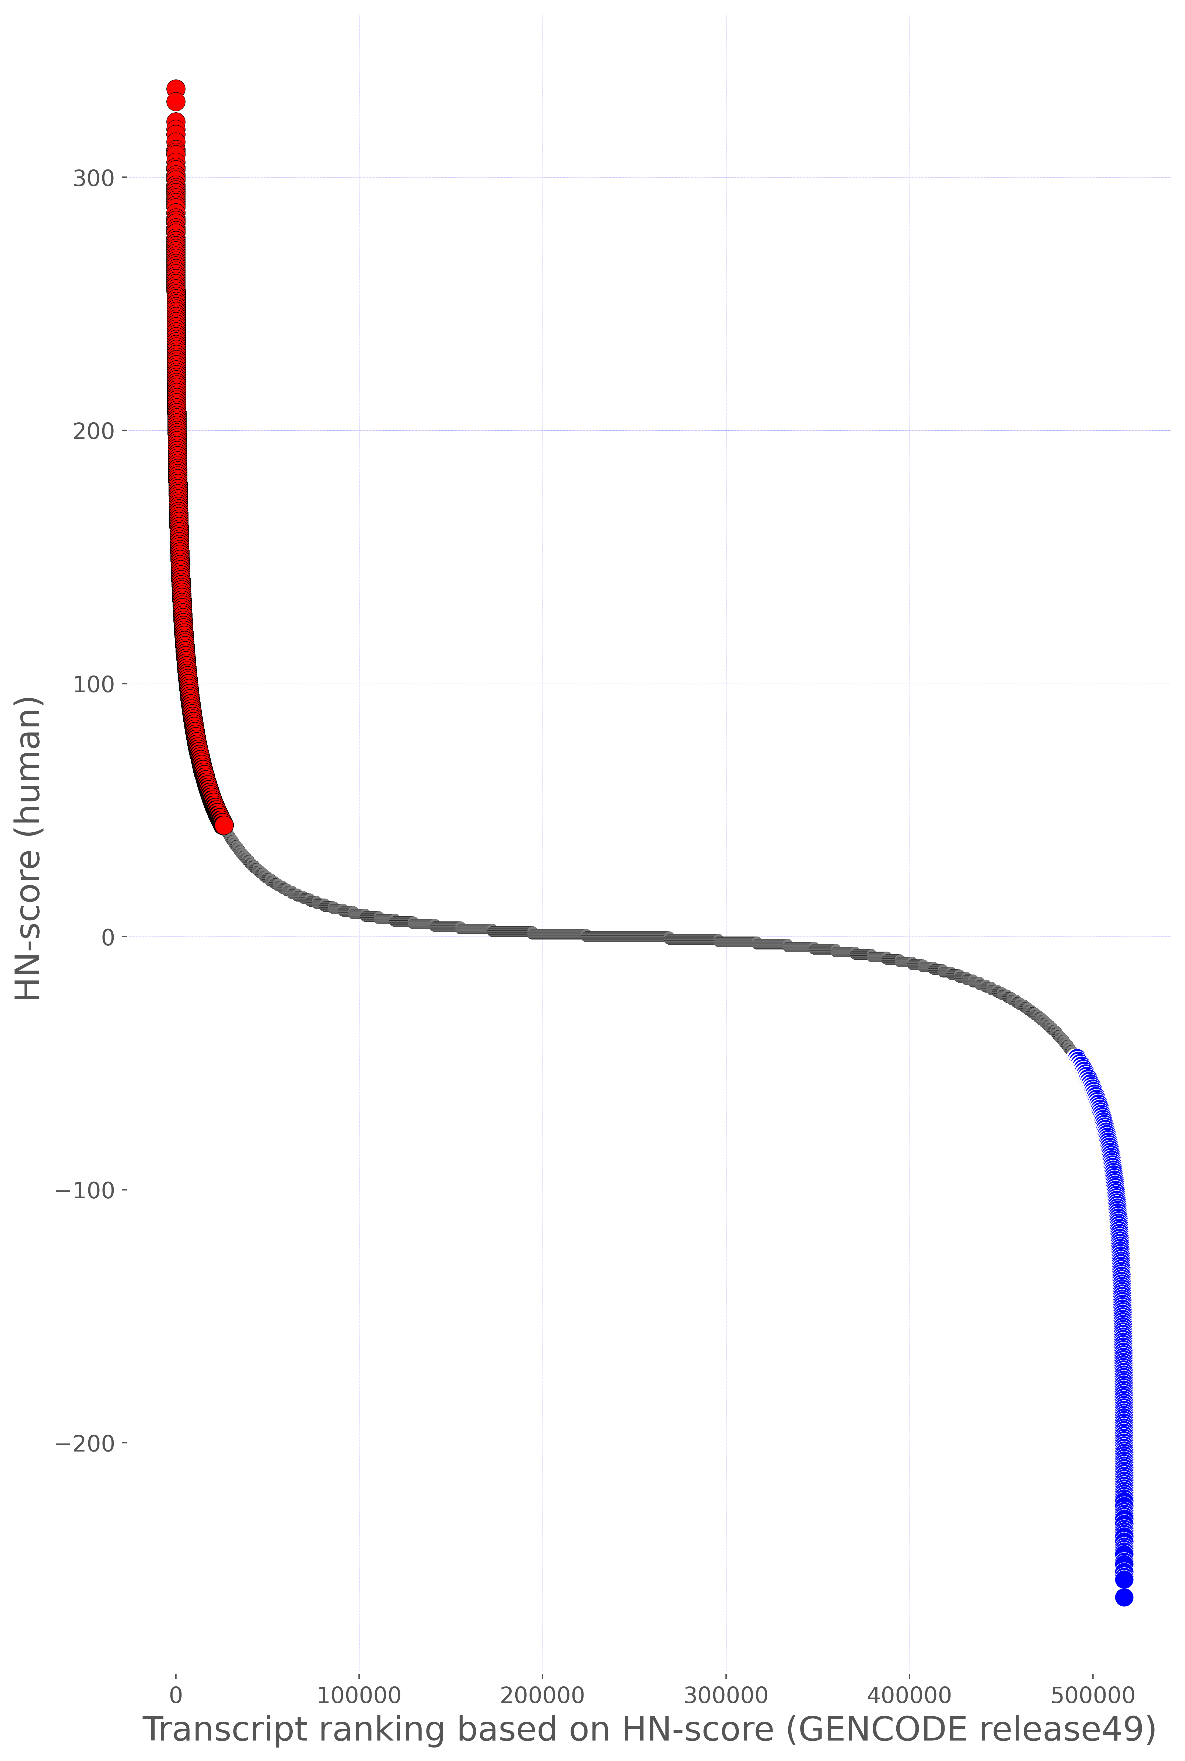
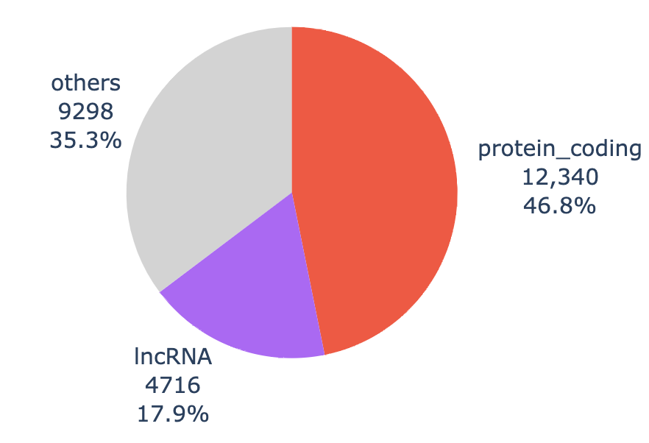
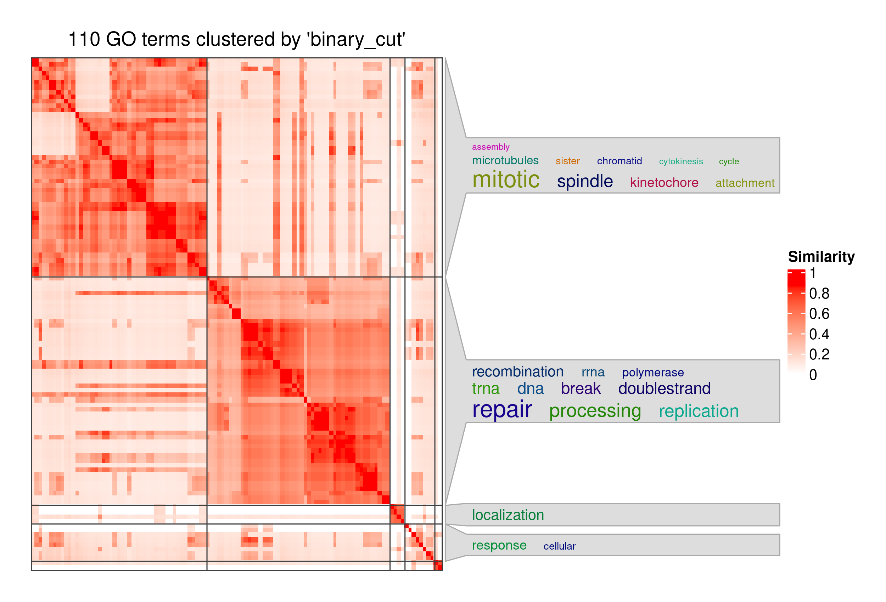
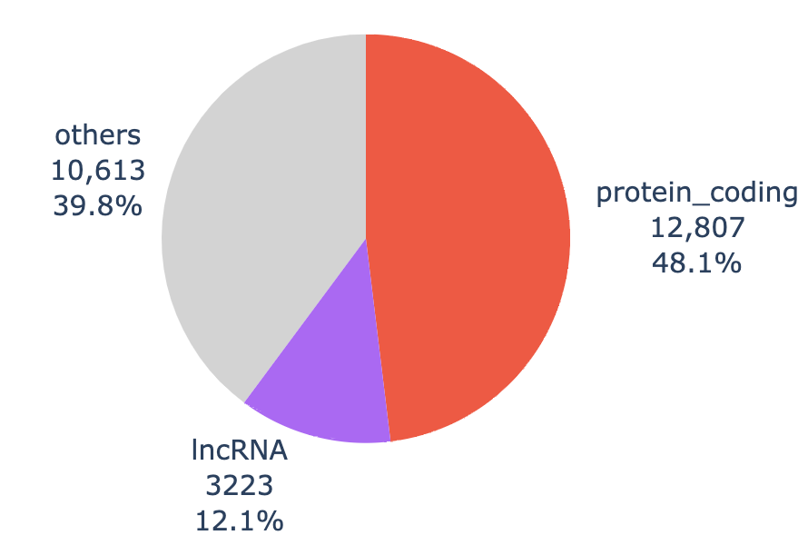
(D)
(A)
(B)
Upregulated Transcript Group
207 enriched terms
GO:0006412: translation
2 enriched terms
GO:0000395: mRNA 5'-splice site recognition
(E)
(C)
Downregulated Transcript Group
110 enriched terms
1 enriched term
GO:0006396: RNA processing

