Slide 1
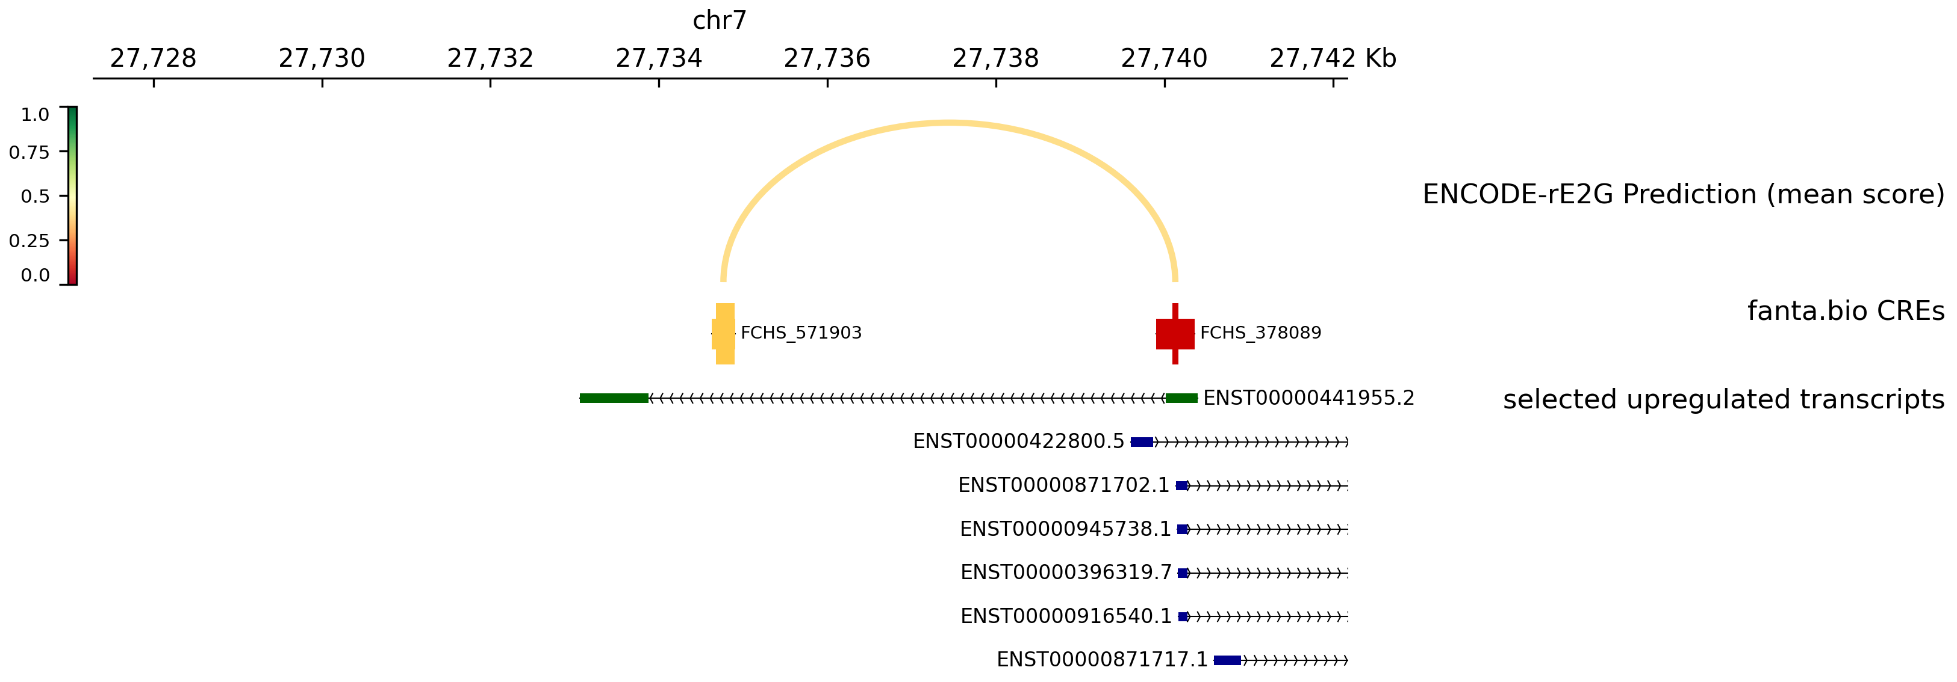
TAX1BP1-AS
TAX1BP1
← MANE Select transcript

