Slide 1
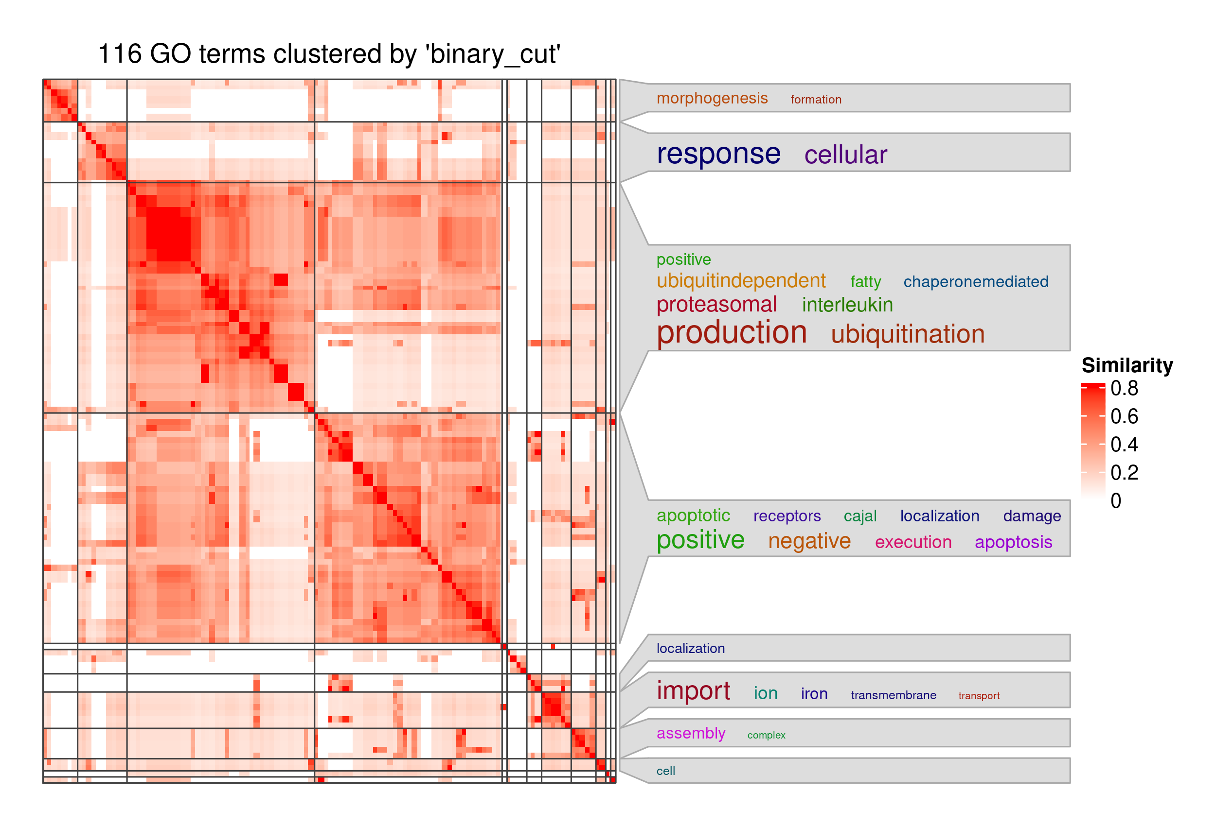
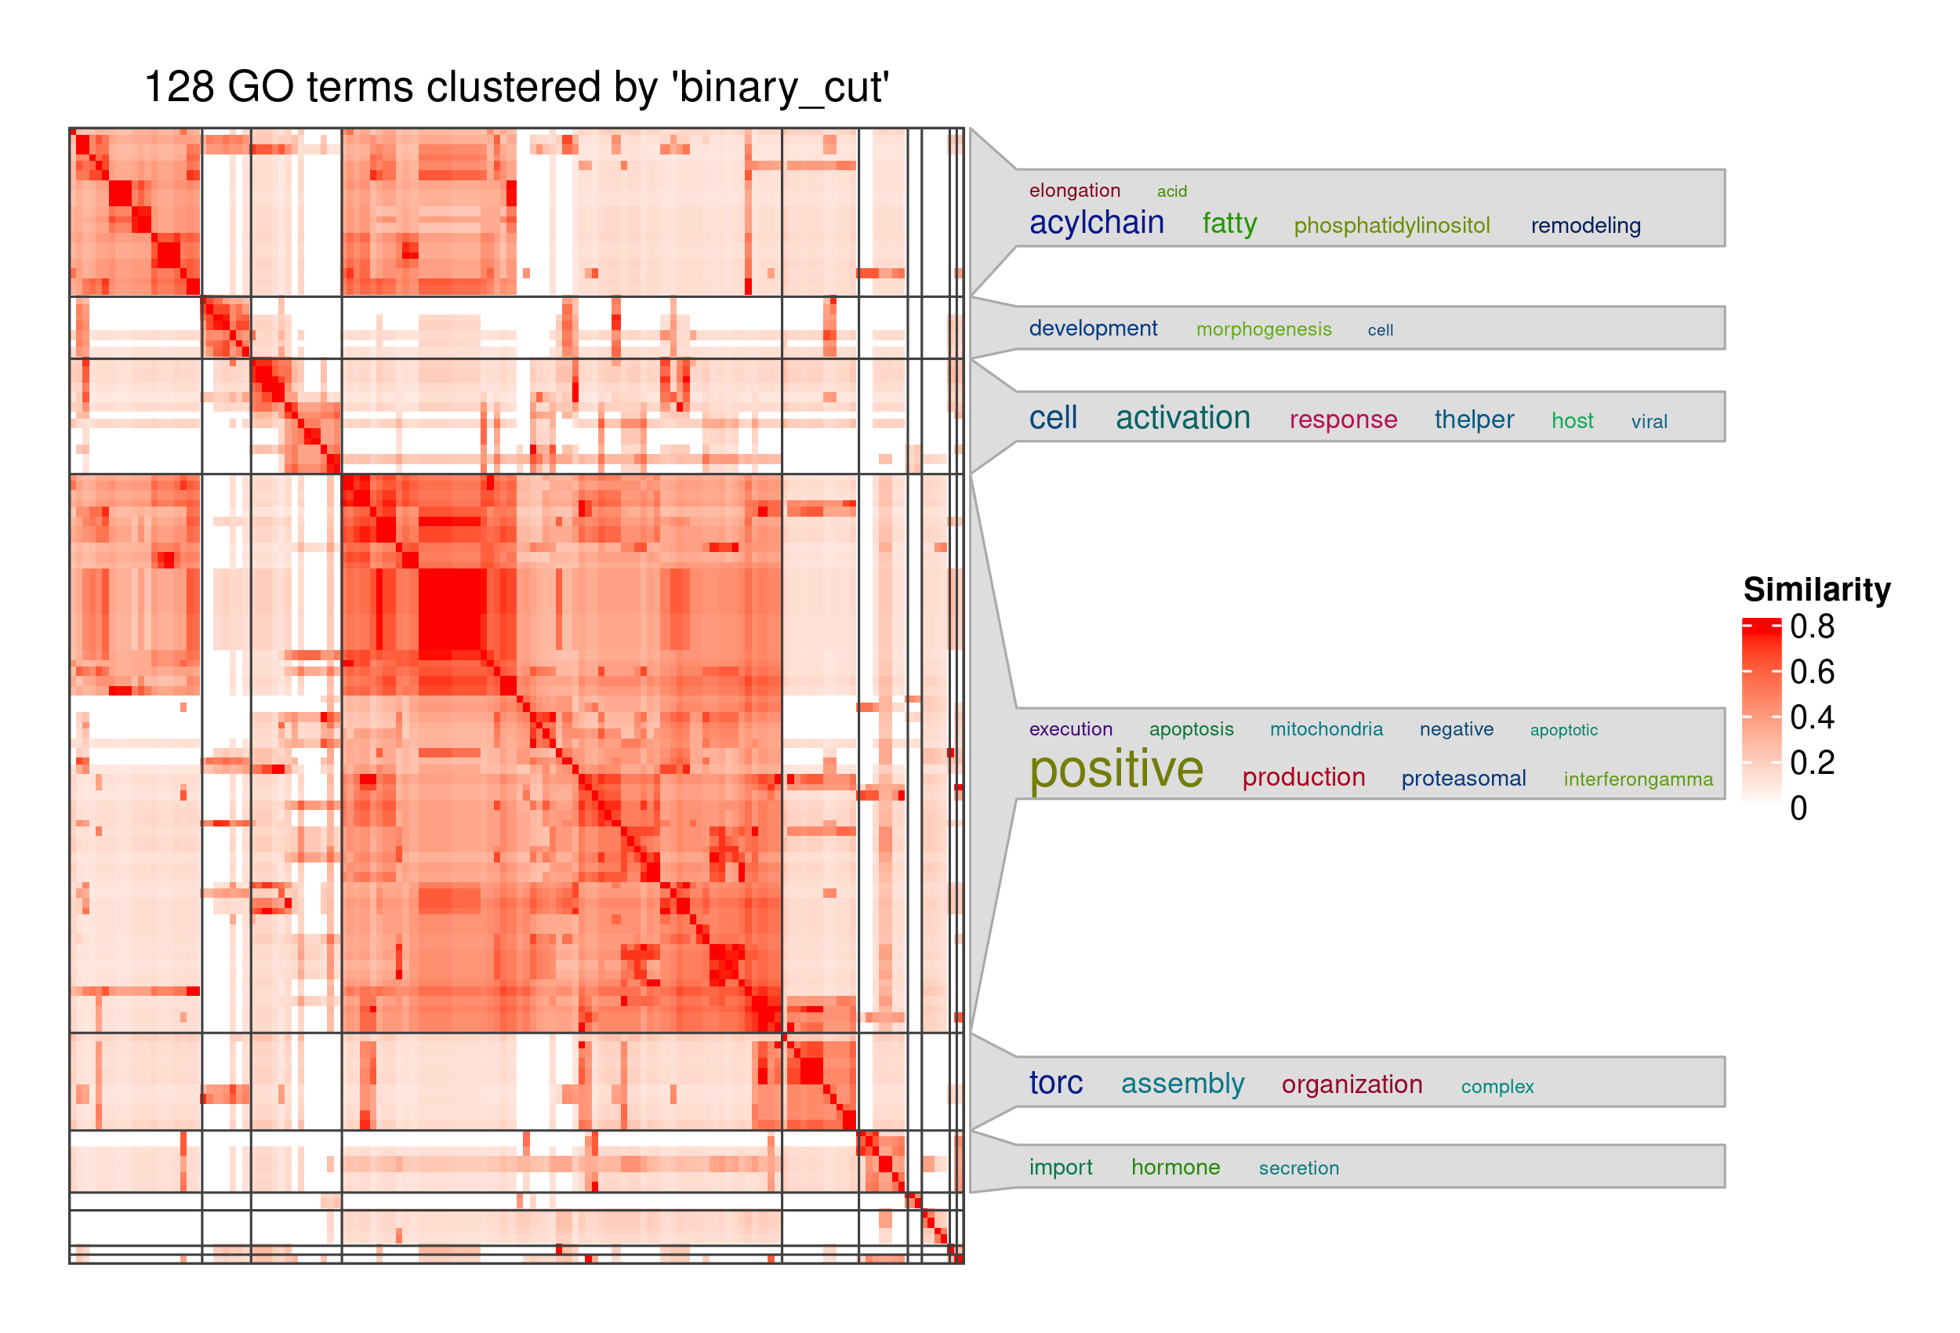
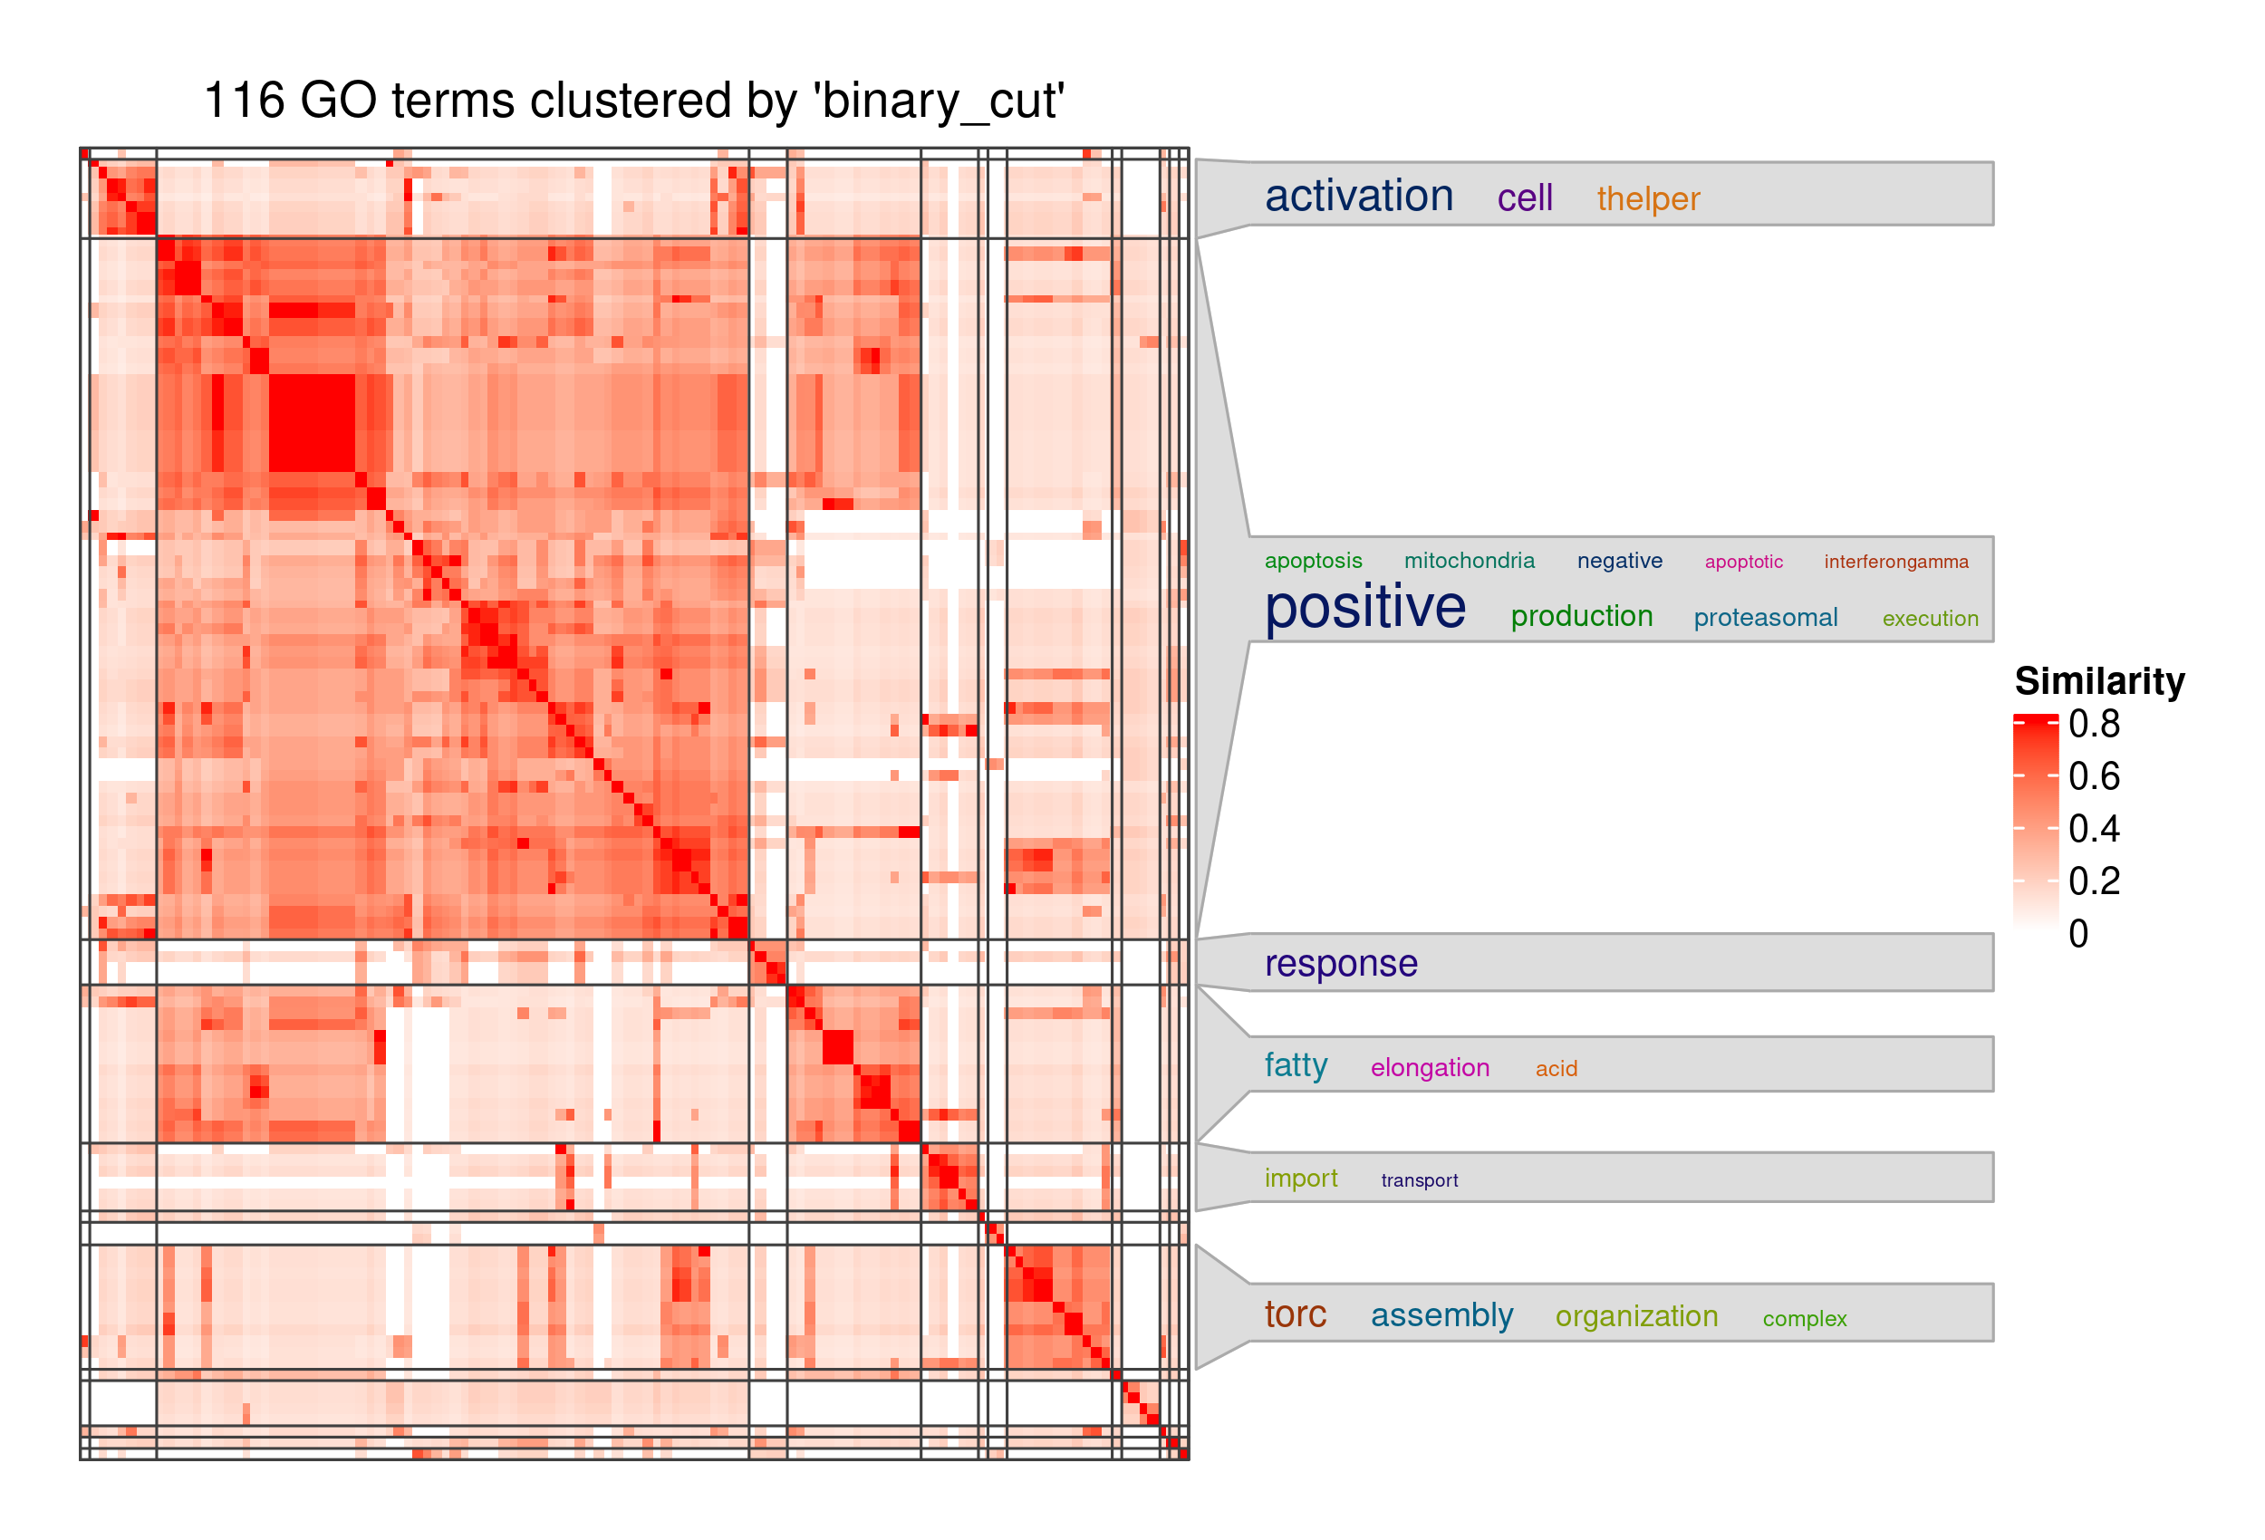
(C)
Diff Analysis (ChIP-seq; HSF1) DPR
+ HSF1 motif
+ up5p proximal CRE-transcript
(A)
Diff Analysis (ATAC-seq) DPR
+ up5p proximal CRE-transcript
(B)
Diff Analysis (ChIP-seq; HSF1) DPR
+ up5p proximal CRE-transcript

