Slide 1
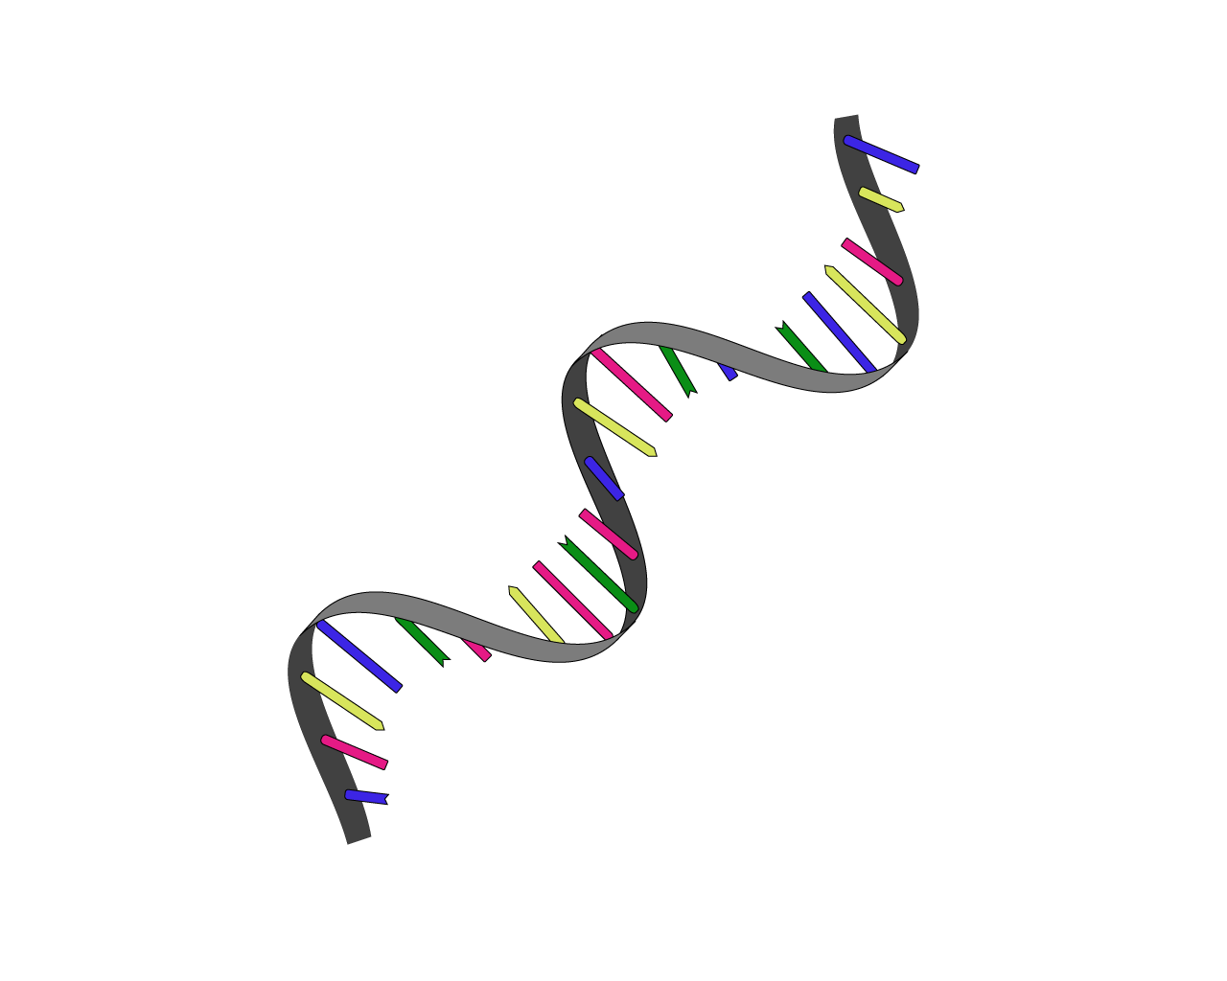

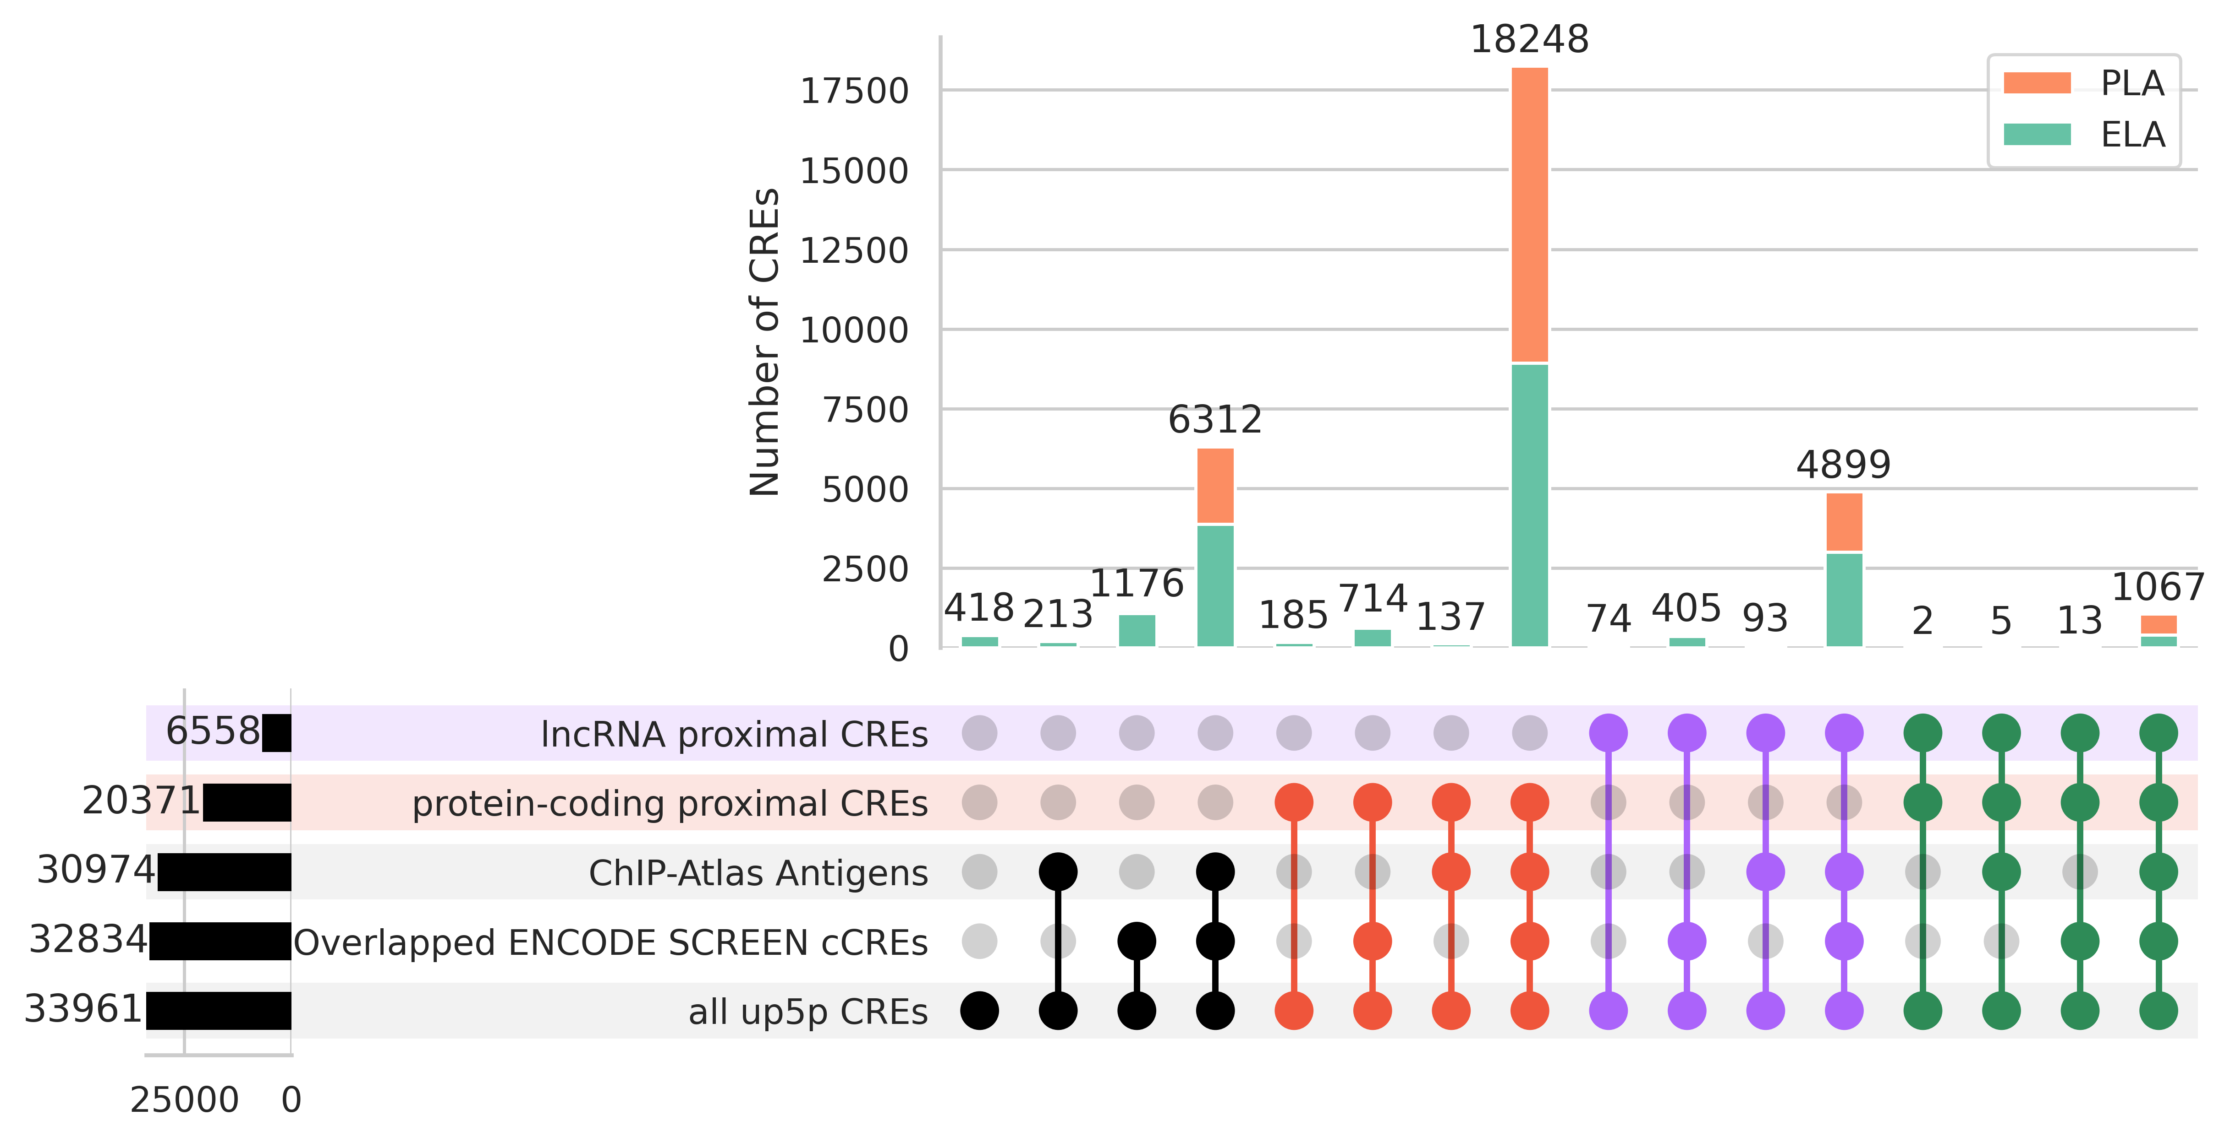
(A)
Meta-analysis of
heat-stressed transcriptome
Upregulated Transcript Group
Transcript
CRE
pair
①
26,354 transcripts
(4,716 transcripts)
CRE
33,961 CREs
Transcript
Transcript- proximal CRE link
21,696 transcripts
TSS ± 500 bp
②
21,696 transcripts → 63,099 unique transcript-CRE pairs
(3,657 transcripts → 9,221 unique transcript-CRE pairs)
(e.g., ENST00000309758.6 - FCHS_28105)
③
Classification & Characterization
(B)
Data resources
integrated in fanta.bio
protein-coding
proximal CREs
lncRNA
proximal CREs
protein-coding & lncRNA
common proximal CREs

