Slide 1
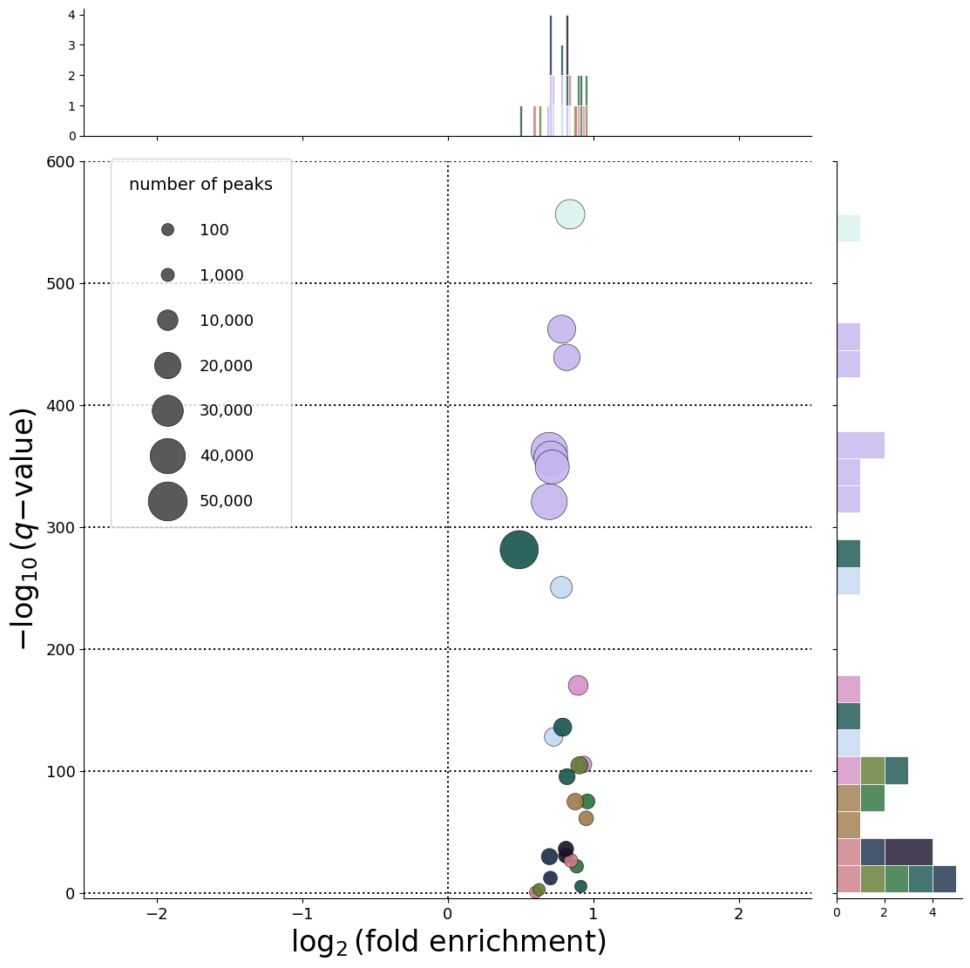
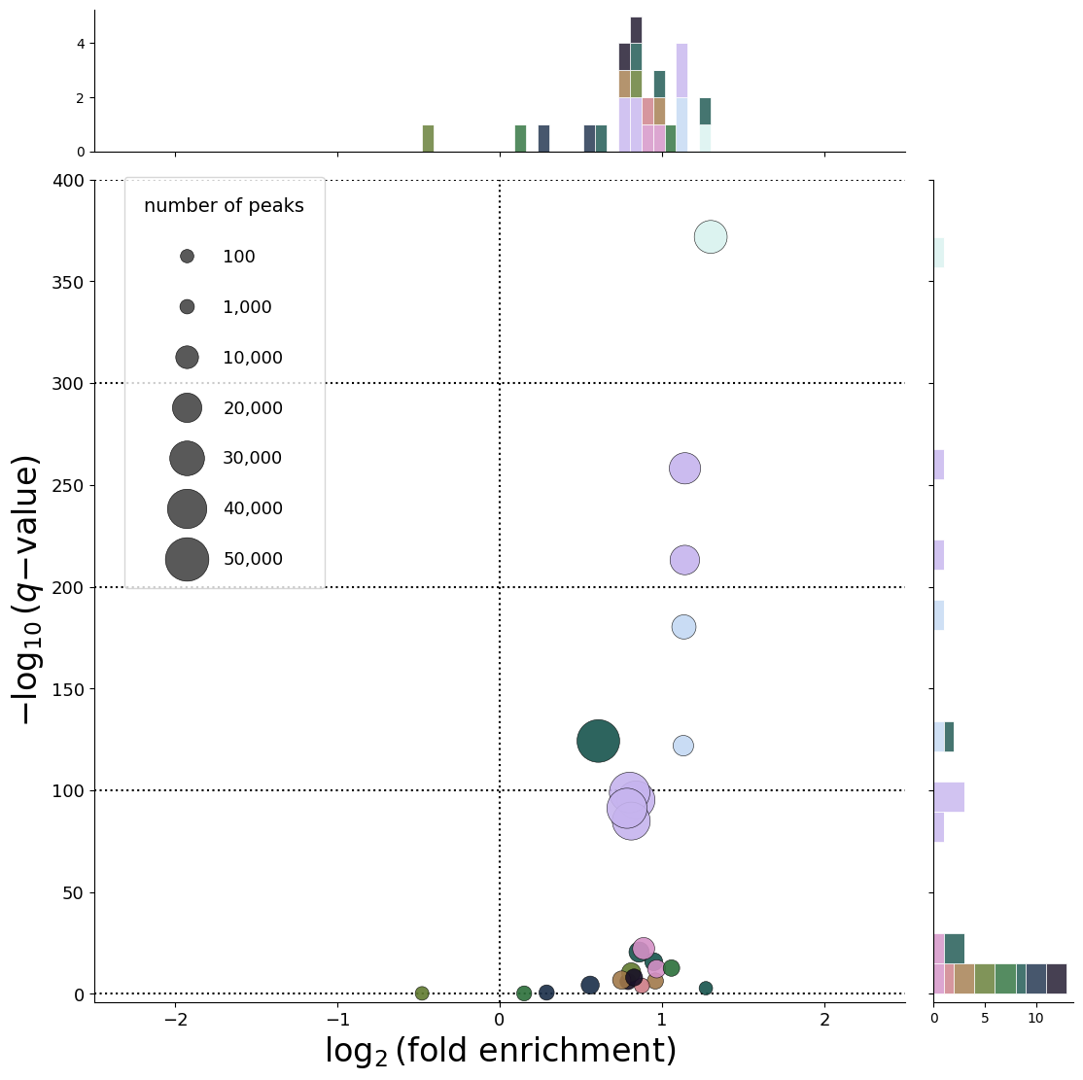
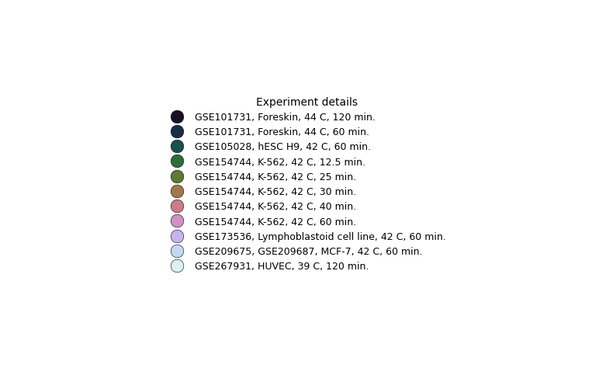
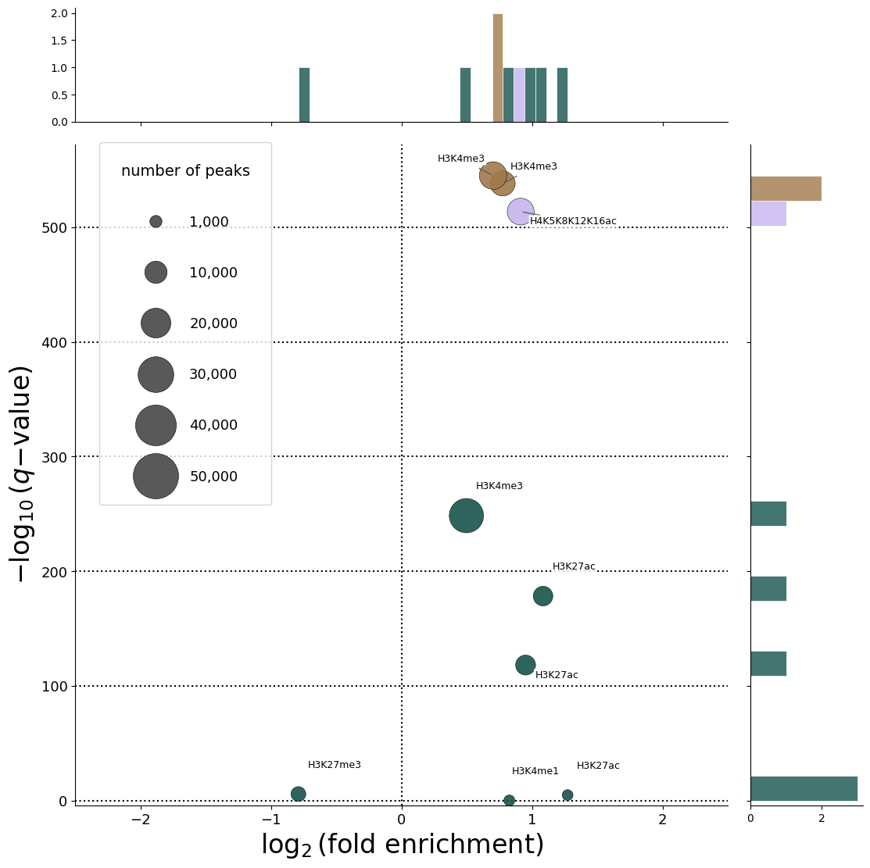
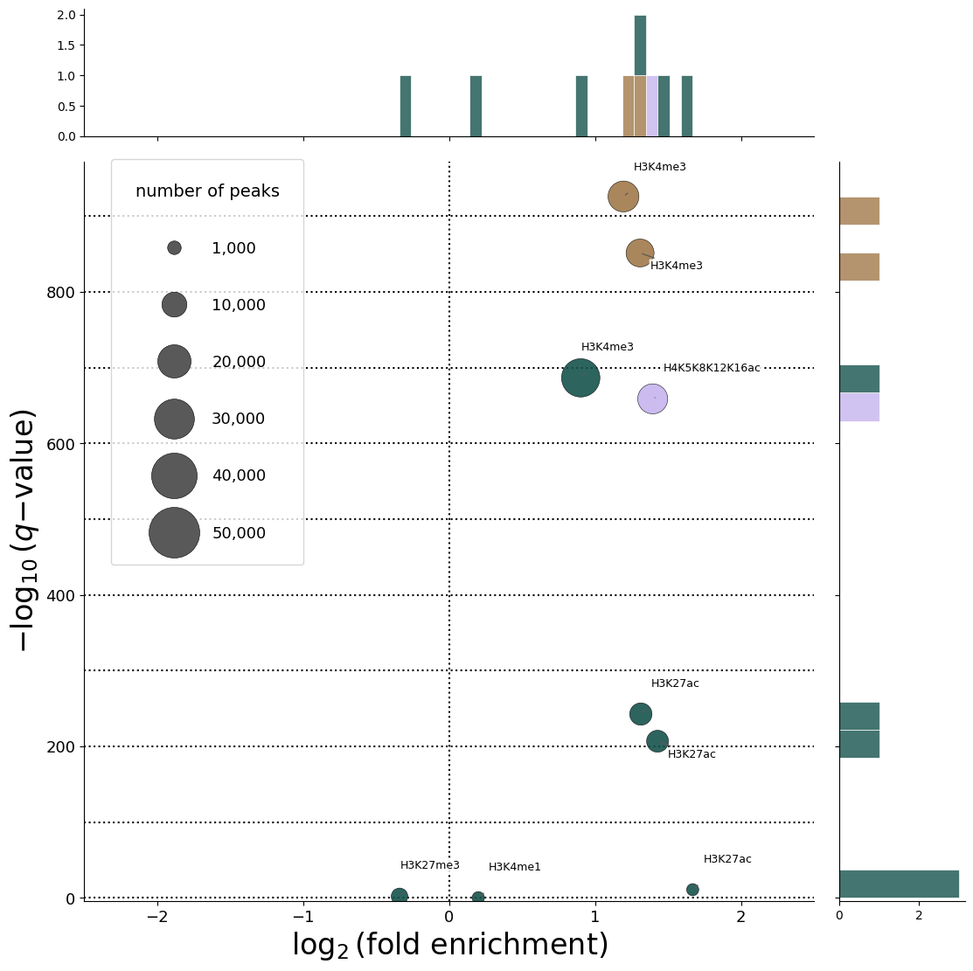

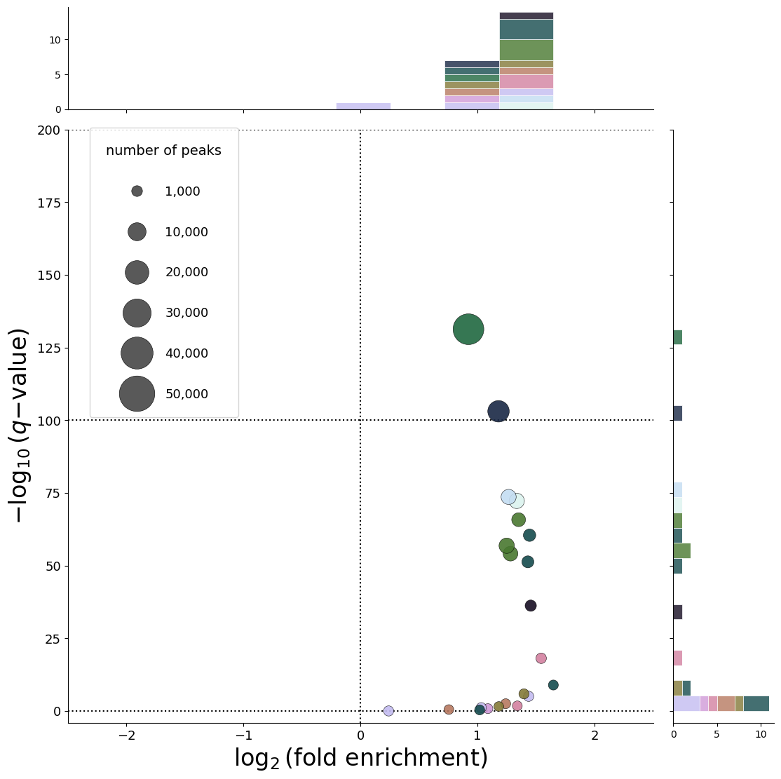
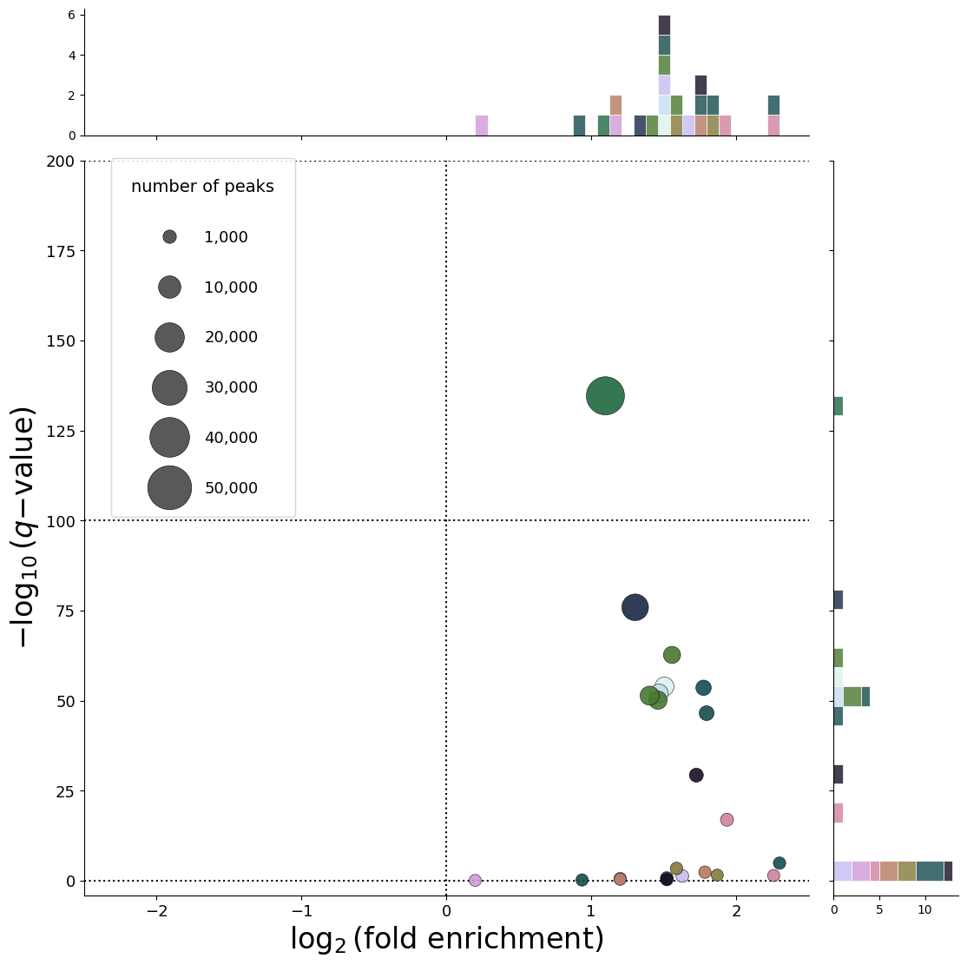
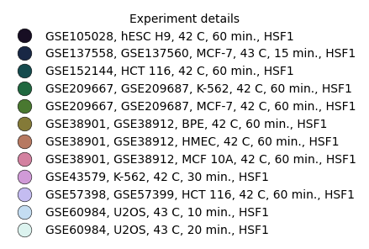
33,961 CREs
Transcript
CRE
Promoter Level Activity (PLA)
(14,620 CREs)
Enhancer Level Activity (ELA)
(19,341 CREs)
(A)
(B)
HS-related
ATAC-seq
(C)
(D)
HS-related
ChIP-seq
(histone)
(E)
(F)
HS-related
ChIP-seq
(HSF1)

