Slide 1




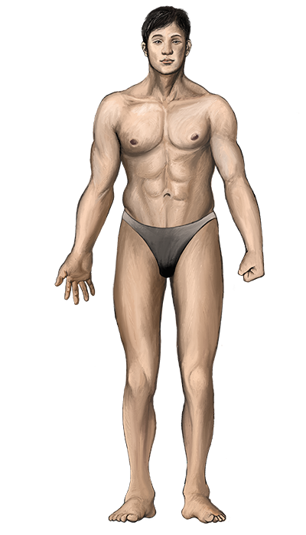

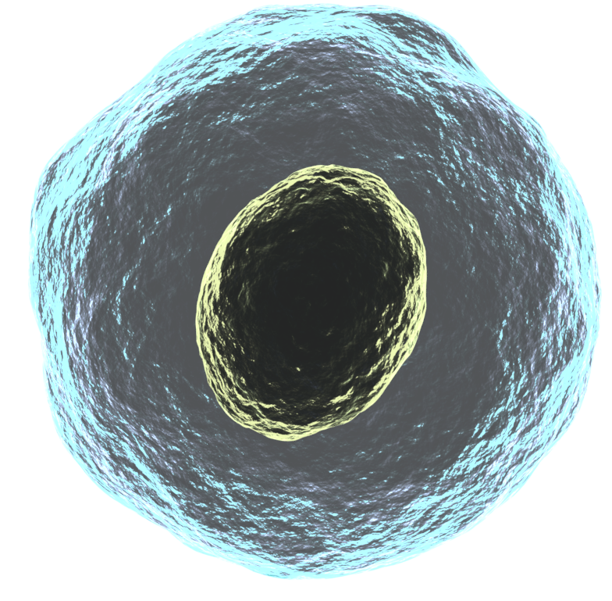



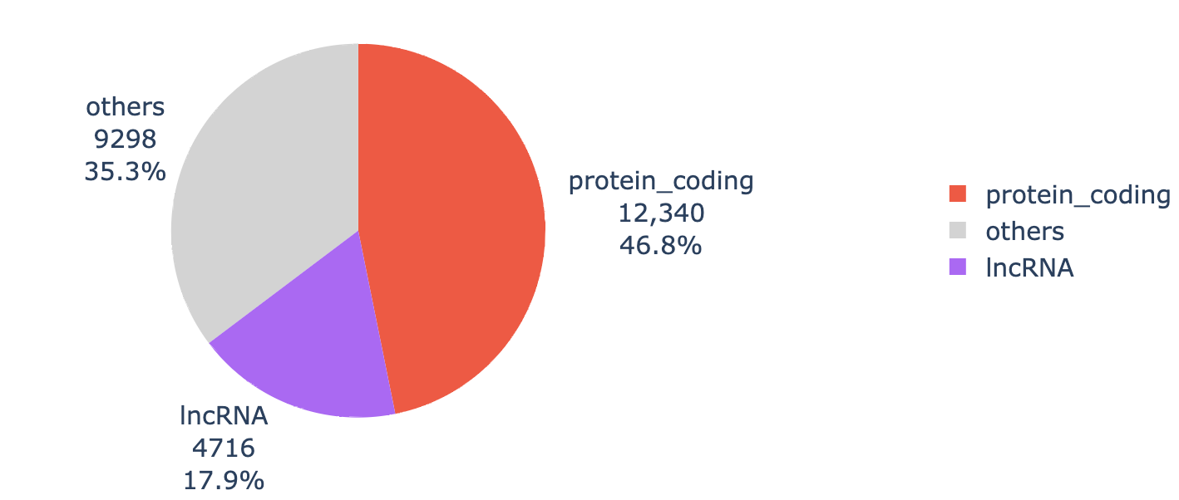

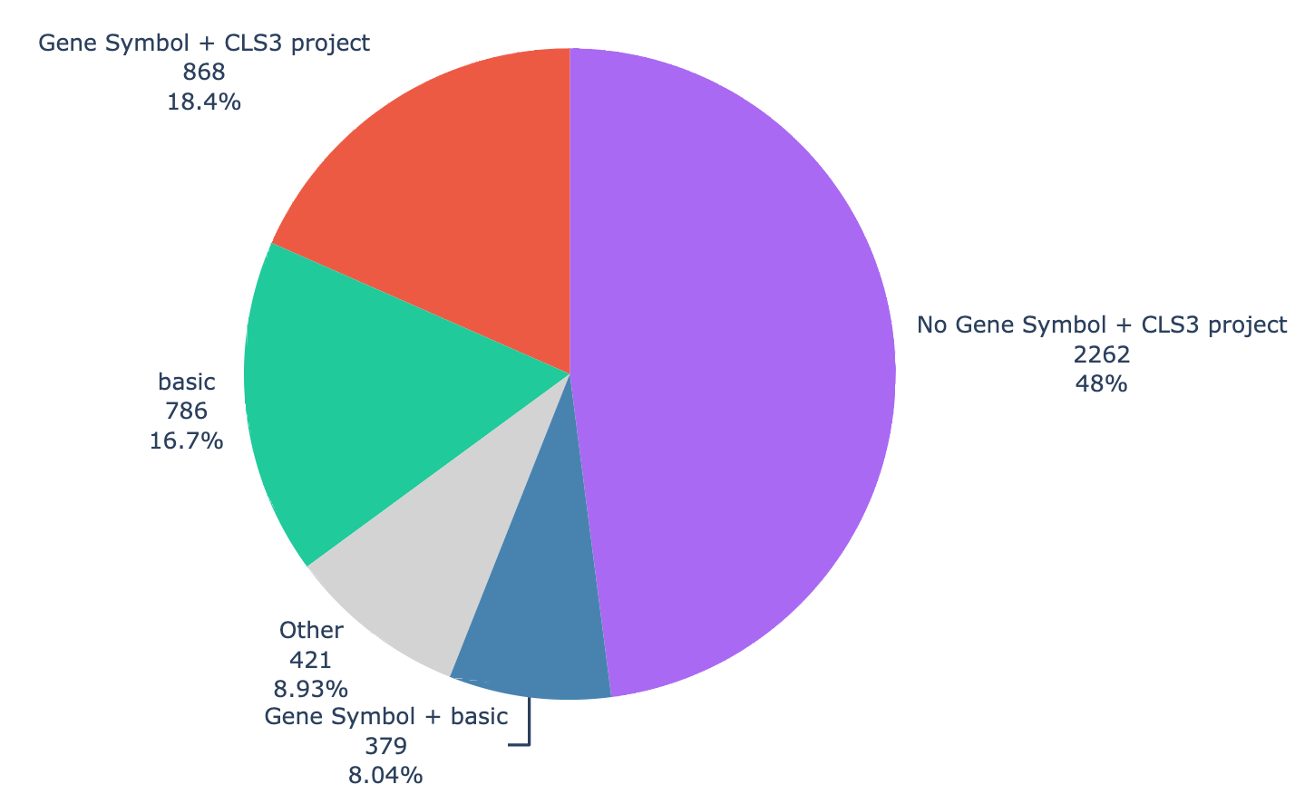
Cis-regulatory Element (CRE) Information
(2) Integration with
CRE Information
(4) Prediction of
Enhancer-Promoter Interactions
Using ENCODE-rE2G and
HS Related Epigenome Datasets
Cap Analysis of Gene Expression (CAGE)-based cCRE catalog
(3) Detection of Differentially
Peaked Region (DPR) using
ChIP-Atlas Datasets
ENCODE-rE2G
Transcript-CRE Pair Generation
CRE
33,961 CREs
HS-related ATAC-seq
Input
Enhancer-Gene promoter
Interaction under
heat-stress condition
Transcript
DPR
HS-related ATAC-seq
HS-related ChIP-seq
HS-related Hi-C
Heat stress (HS) related
Public bulk RNA-sequencing
(RNA-seq) Data
Promoter Level Activity (PLA): 14,620
Enhancer Level Activity (ELA): 19,341
CRE
HS-related ChIP-seq
21,696 transcripts
(3,657 lncRNAs)
63,099 unique
transcript-CRE pairs
Antigen: Heat Shock
Factor 1 (HSF1)
Transcription Start Site (TSS) ± 500 bp
These datasets have already been processed by ChIP-Atlas.
CRE
CRE
Transcript
53 Unique Projects
Transcript Information
(1) Quantification using
GENCODE release 49
(reference transcript)
(5) Integration of
RNACentral Metadata
Selection of Upregulated Transcript Lists
Key Point:
Prioritize selecting transcripts that are consistently upregulated across diverse samples, sequence platform and experimental conditions.
26,354 Upregulated Transcripts
LncRNA Transcripts
e.g., ENST00000701343
→ URS0002A39AA9_9606

