Slide 1
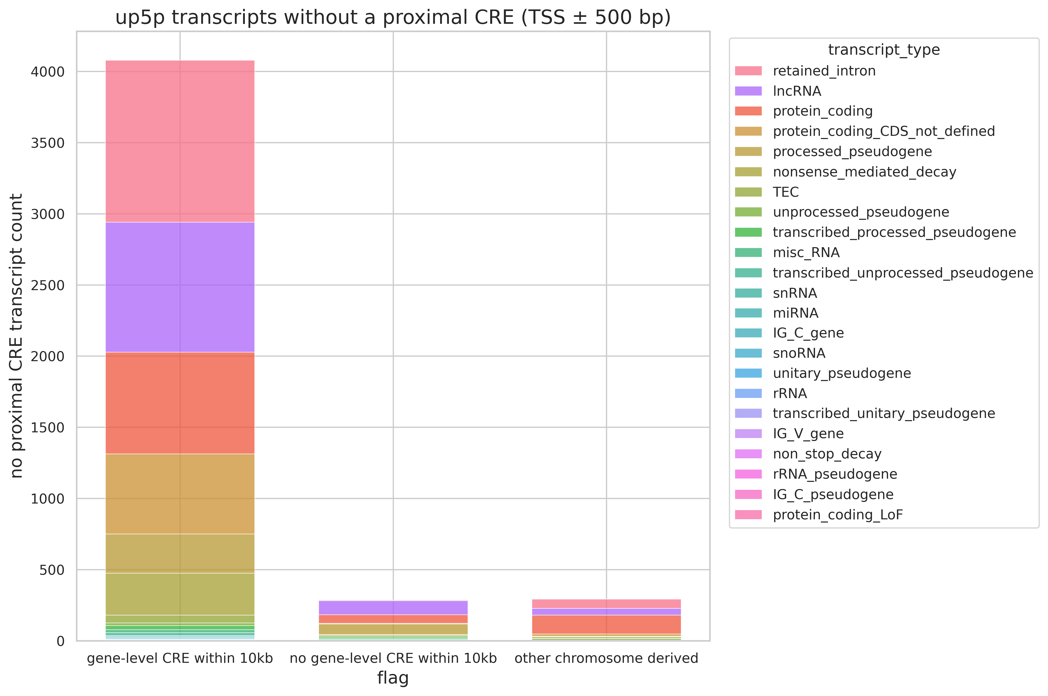
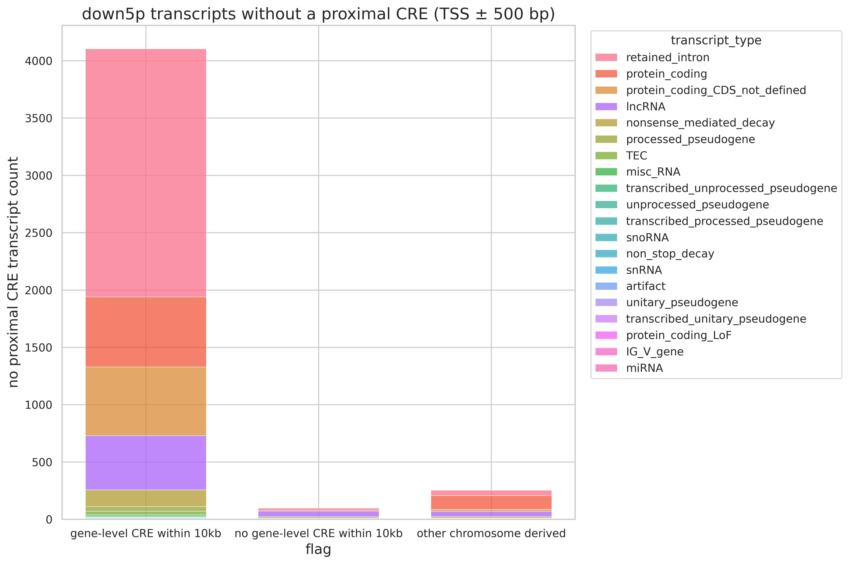
(A)
Upregulated Transcript Group
(B)
Downregulated Transcript Group

