Slide 1
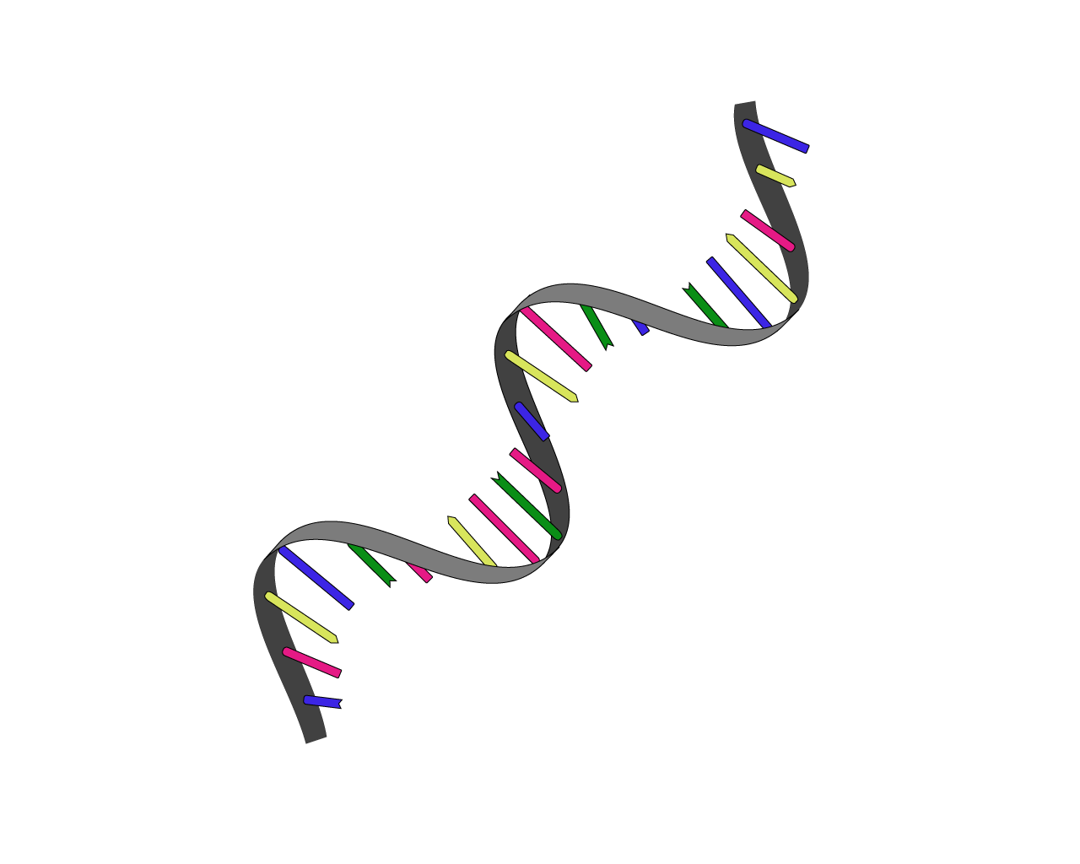

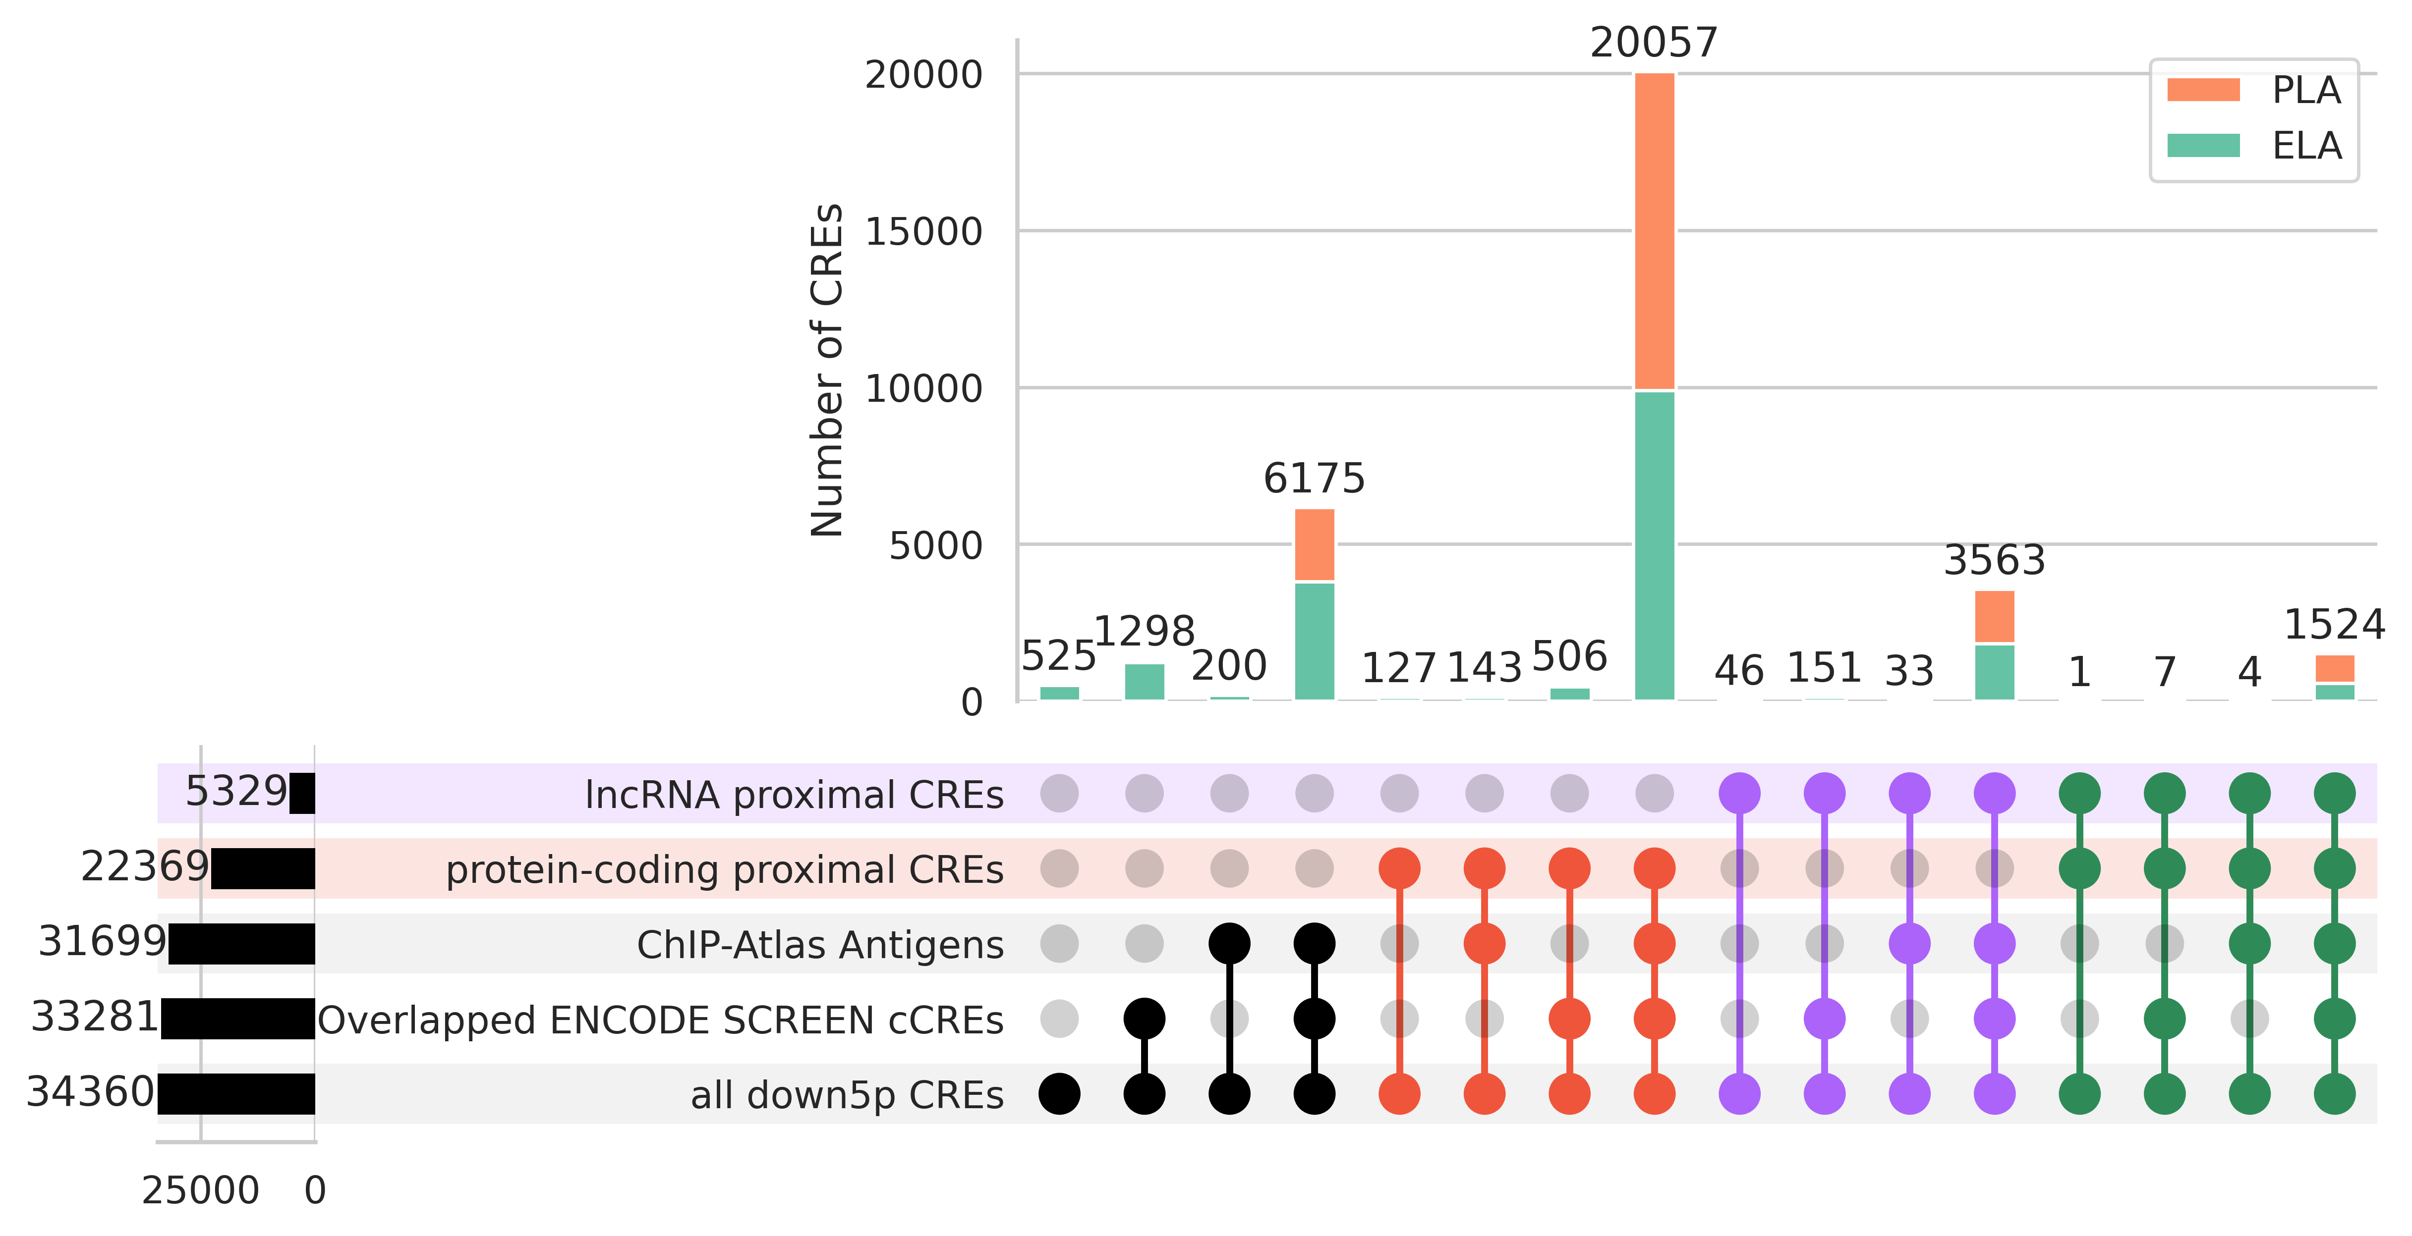
(A)
Meta-analysis of
heat-stressed transcriptome
Downregulated Transcript Group
CRE
Transcript
pair
①
26,643 transcripts
(3,223 transcripts)
CRE
34,360 CREs
Transcript
Transcript- proximal CRE link
22,185 transcripts
TSS ± 500 bp
②
22,185 transcripts → 66,960 unique transcript-CRE pairs
(2,653 transcripts → 8,006 unique transcript-CRE pairs)
③
Classification & Characterization
(B)
Data resources
integrated in fanta.bio
protein-coding
proximal CREs
lncRNA
proximal CREs
protein-coding & lncRNA
common proximal CREs

