Slide 1
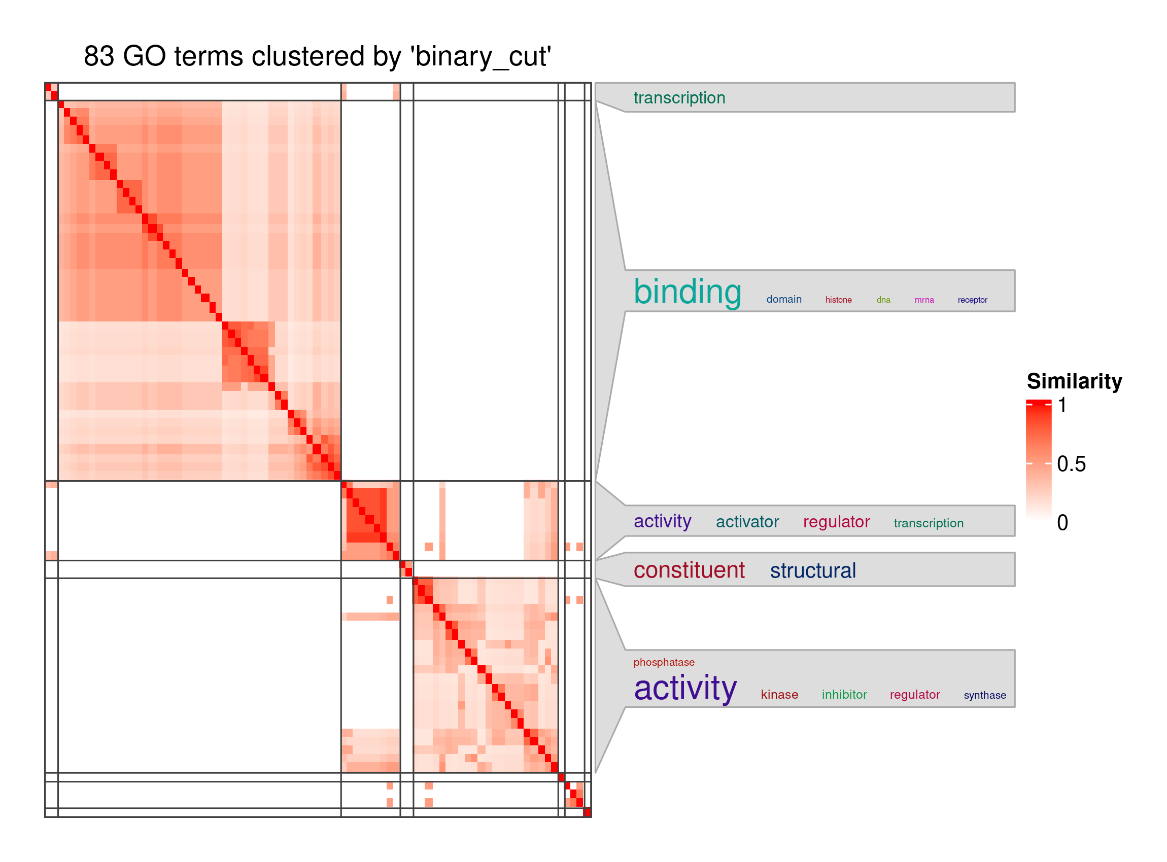
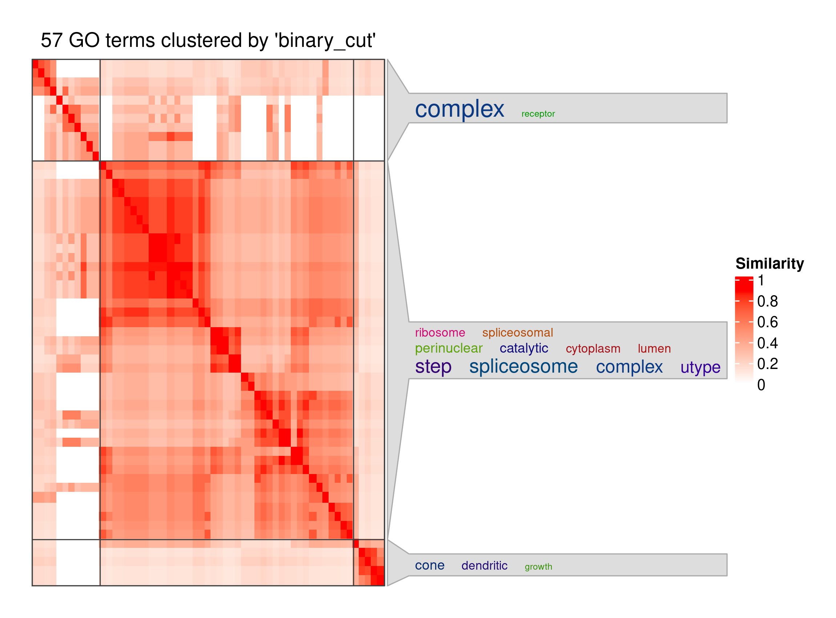
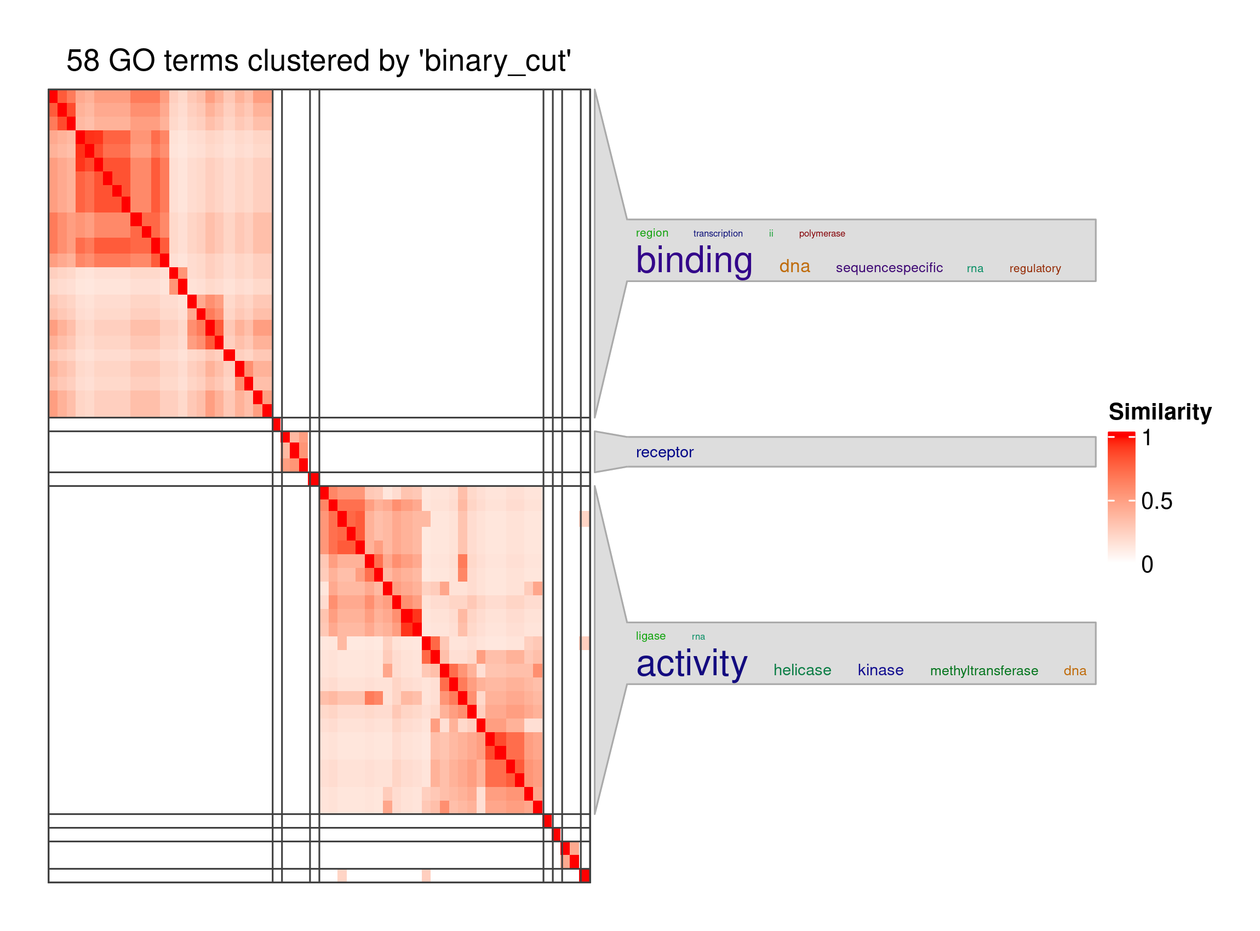
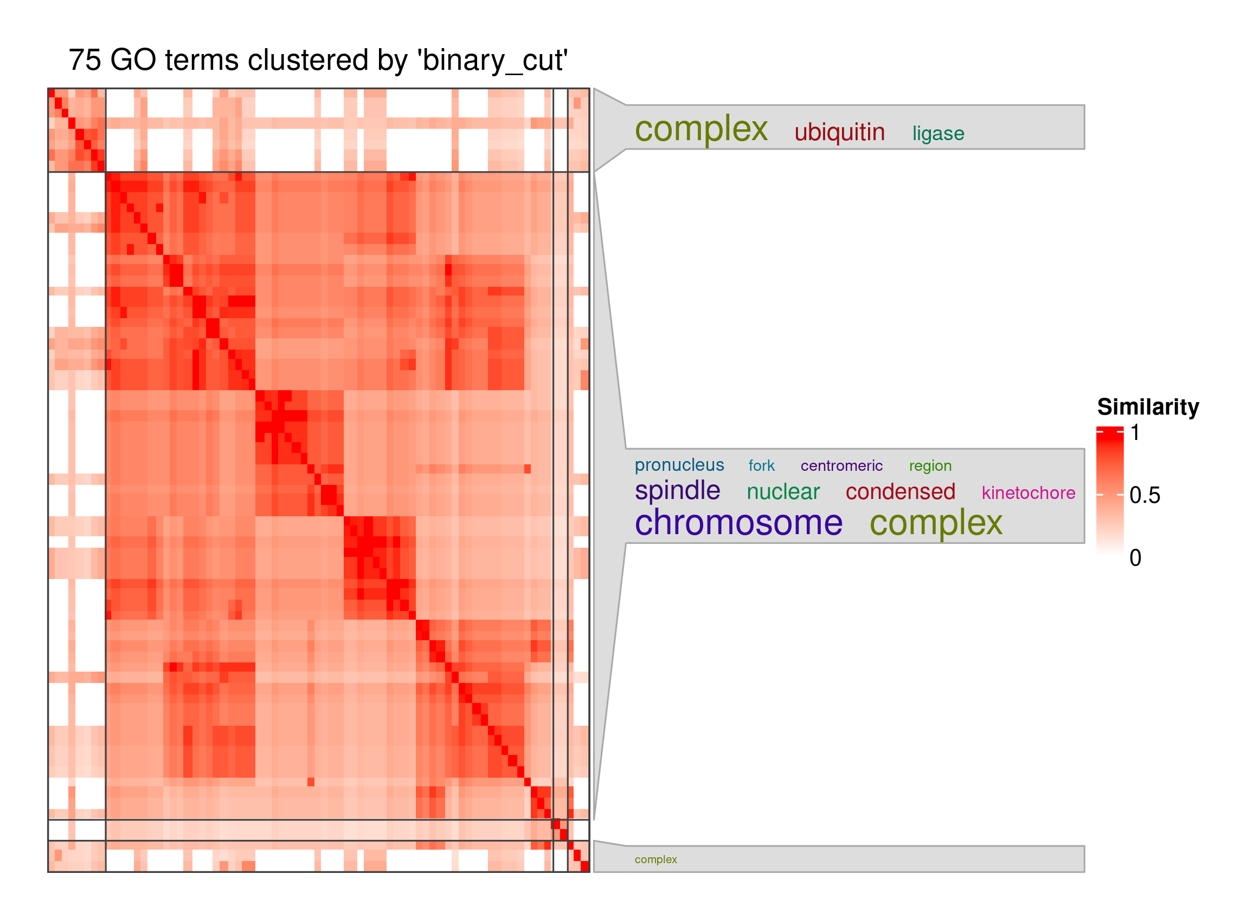
Molecular Function (MF)
Cellular Component (CC)
(A)
(B)
Upregulated
Transcript
Group
(protein-coding)
(C)
Molecular Function (MF)
(D)
Cellular Component (CC)
Downregulated
Transcript
Group
(protein-coding)

