Slide 1
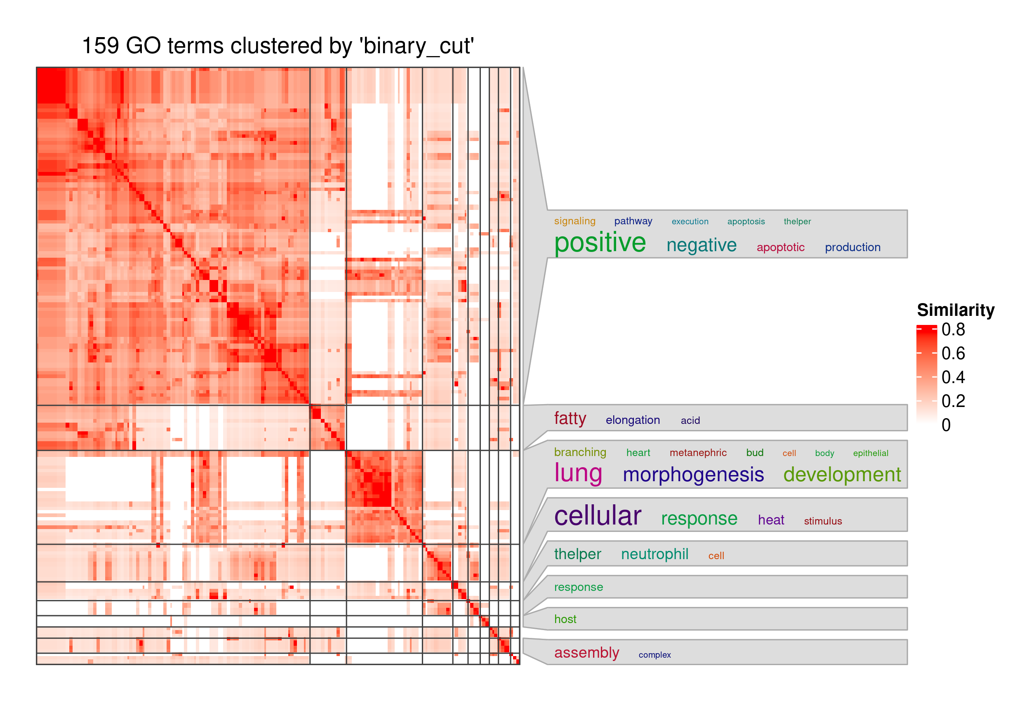
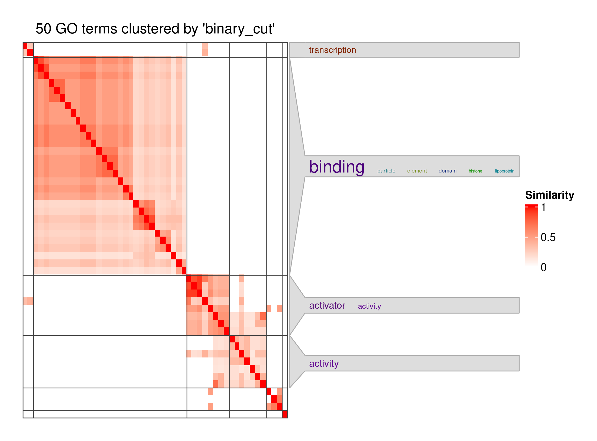
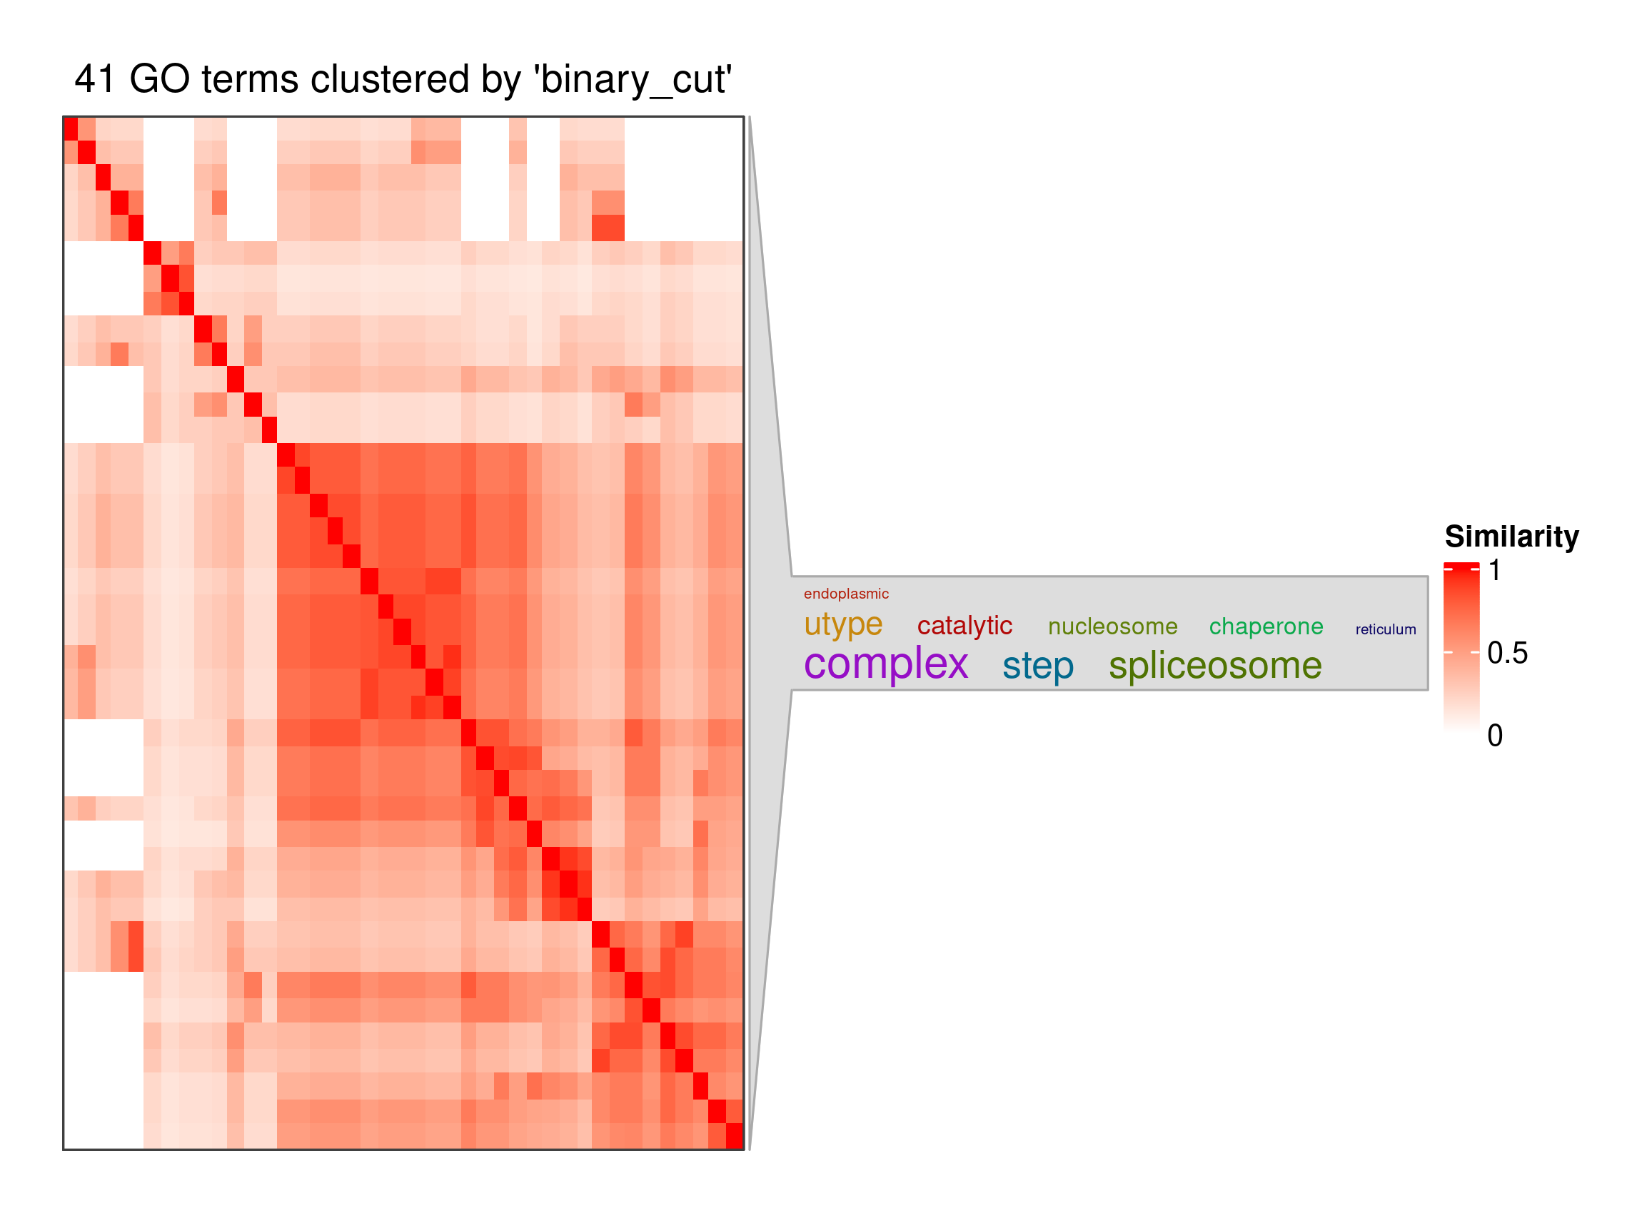
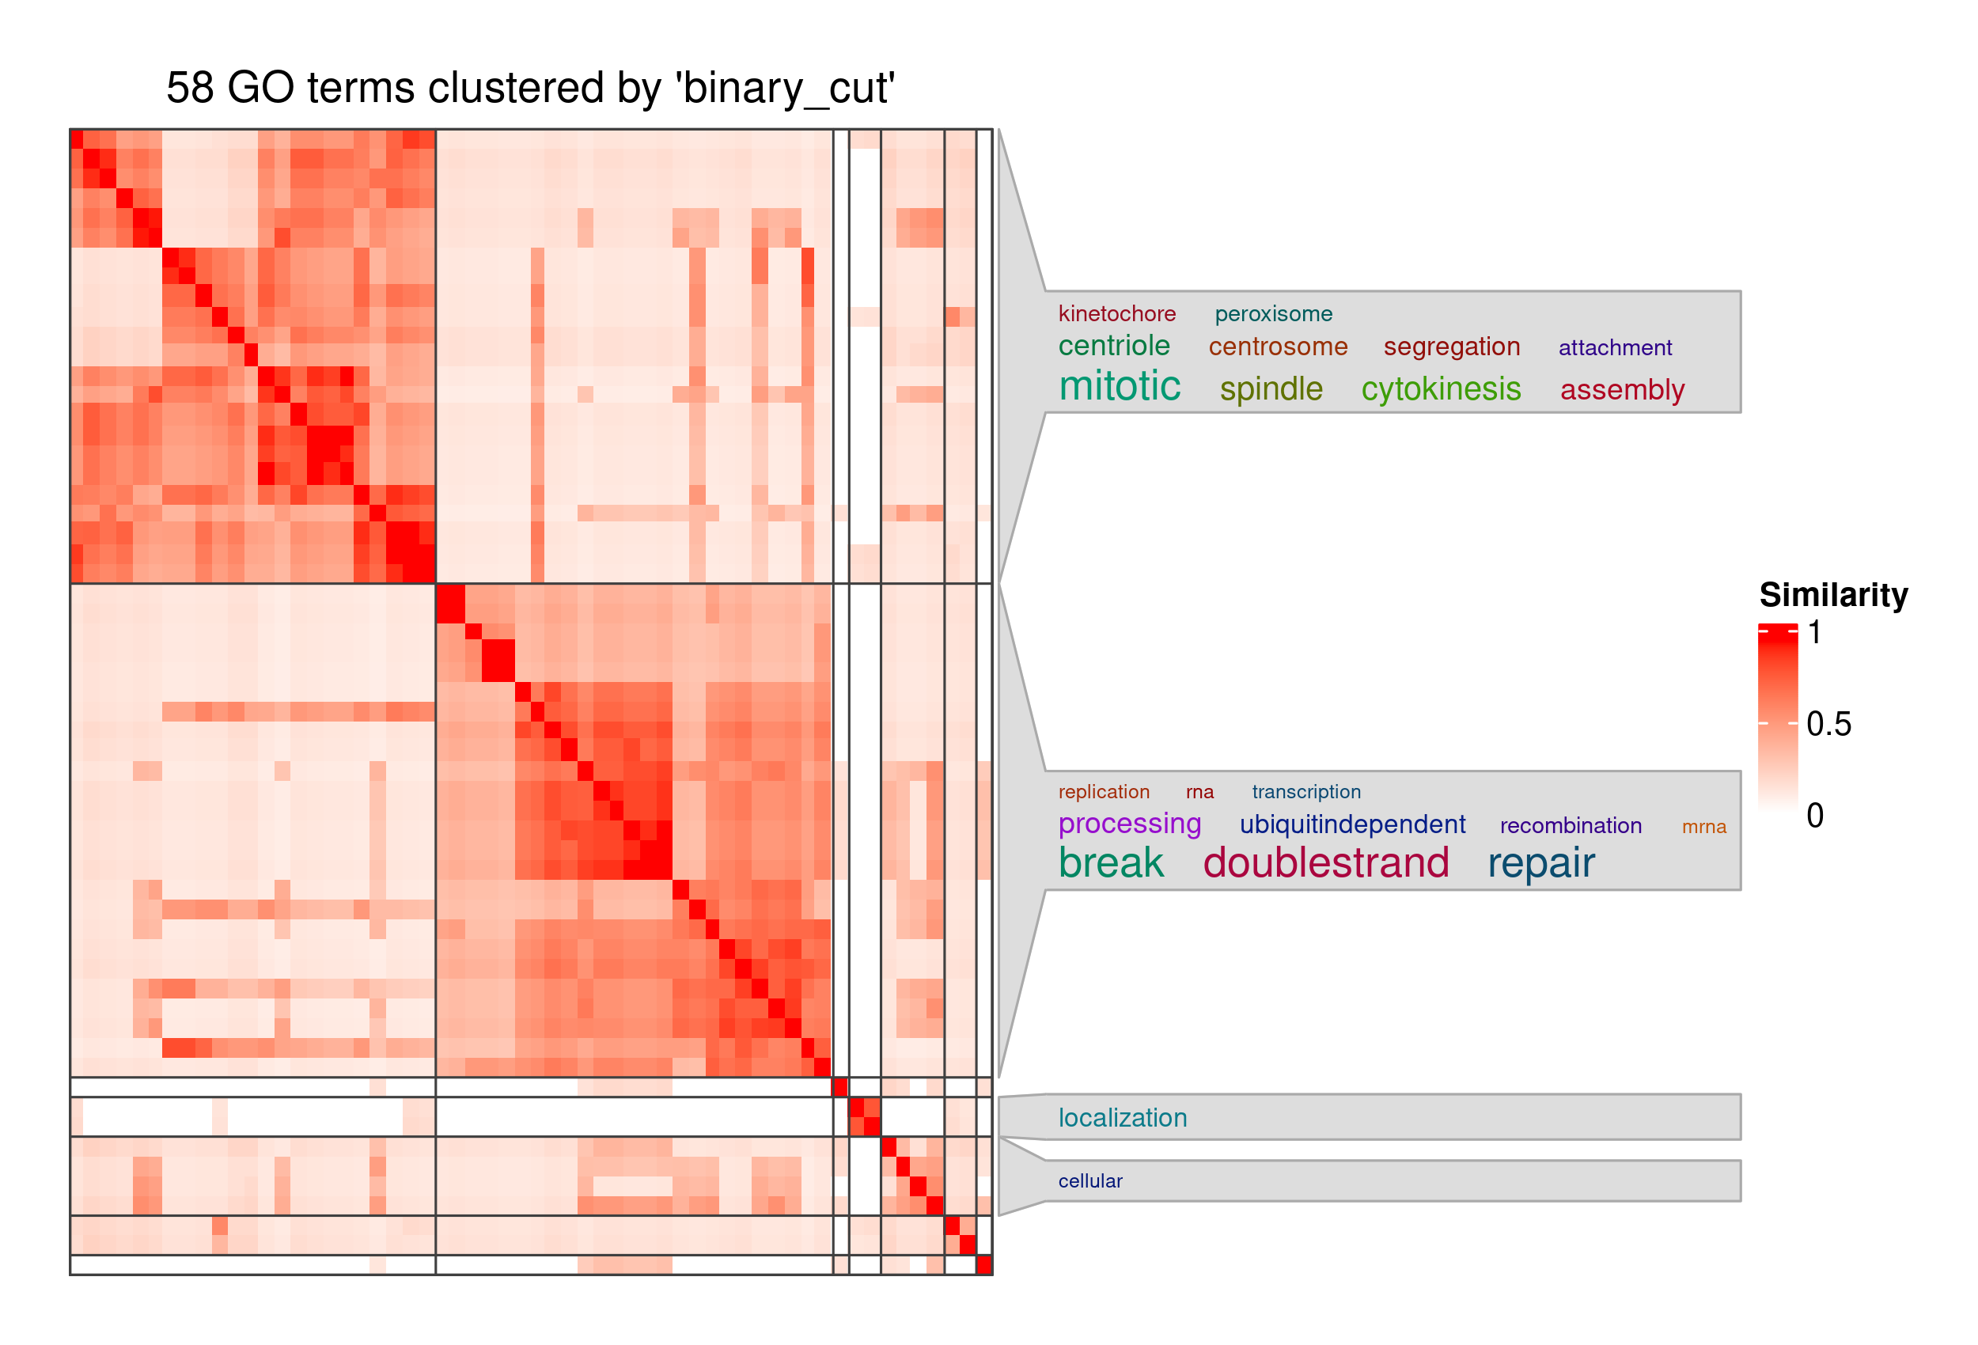
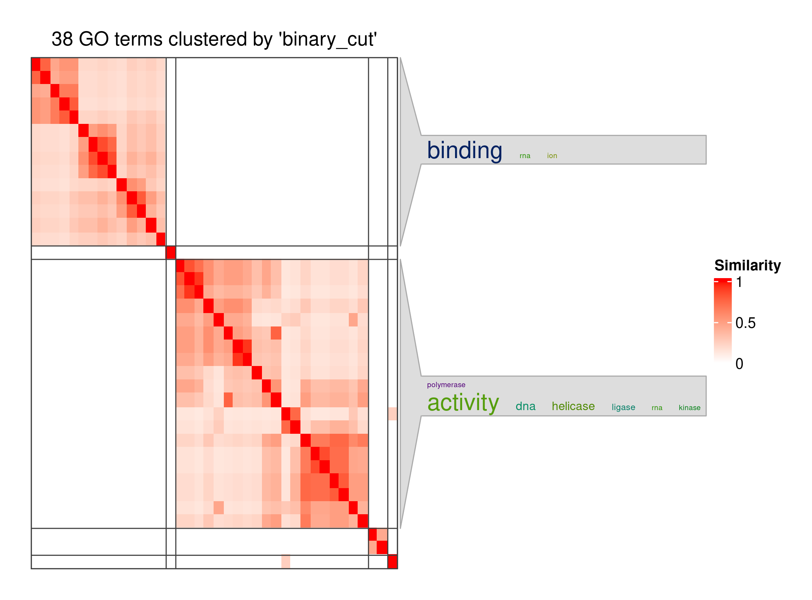
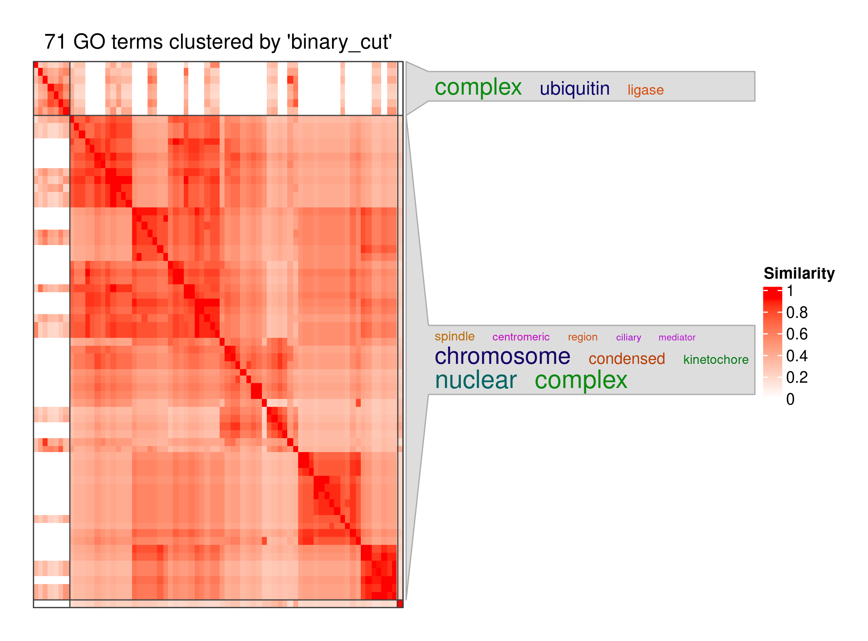
(A)
Biological Process (BP)
(B)
Molecular Function (MF)
(C)
Cellular Component (CC)
Upregulated
Transcript
Group
(protein-coding)
(D)
Biological Process (BP)
(E)
Molecular Function (MF)
(F)
Cellular Component (CC)
Downregulated
Transcript
Group
(protein-coding)

