Slide 1
Adaptive resource management
Adaptive Resource Management for CPU and GPU Applications on NVIDIA Jetson TX2 Board
Byeongkeon, Kihoon, Yongtae
Summer 2019
Notes:
Hello everyone~ Last time, I felt our project name is too long. So we fix it.
Okay Our project is Adaptive resource management. Then let’s start.

Slide 2
Overview
Introduction
MARS Framework (Yongtae)
MARS Benchmarks (Kihoon)
MARS Policies (Byeongkeon)
Conclusion
Notes:
We'll do the introductions, the presentation of Yongtae, Kihoon, Byeonkeon.

Slide 3
INTRODUCTION
Notes:
I'm going to explain the background of our research.

Slide 4

Why? - problem
Power Wall
Moore’s Law
- the number of transistors on a microchip doubles every two years
Notes:
You know moore’s law?
The Moore’s law predicts that the number of transistors in integrated circuits doubles about every two years.
The Moore’s law has proved accurate for several decades, but it’s no longer possible to keep packing more transistors in the same chip area without significantly increasing the power density, so called "power wall"

Slide 5

Why? - solution
How to improve power efficiency?
How do I manage power?
How do I measure the core usage?
…
Notes:
So we use a program called MARS to solve these problems.

Slide 6
Our project
Our research is to develop MARS
Notes:
Our research is to develop MARS, a resource adaptive management.
I'll explain it briefly in the next step.

Slide 7
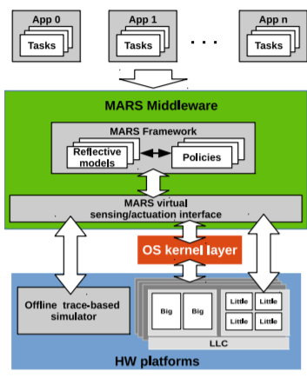
MARS
MARS
Middleware for Adaptive-Reflective Systems
sensing information (e.g., readings from performance counters, power sensors, etc.) to assess the current system state
Policies and models obtain sensing information and perform actuations though the Virtual Sensing/Actuation Interface
Figure 1 : MARS Overview
Notes:
Adaptive-reflective system is the software that evaluates its own behavior from sensors and changes behavior when the policy and model determine that better functionality or performance is possible.

Slide 8
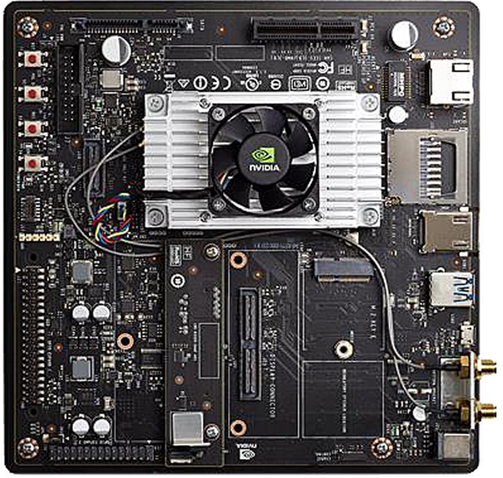
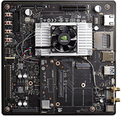
Project Overview
MARS
Byeongkeon
Policy
Yongtae
Kihoon
Client
Server
APP
H/W
CPU
GPU
Notes:
We used the nvidia board for this project.
My part is developing mars framework
Byeongkeon part is developing mars policy
Kihoon part is developing mars benchmark

Slide 9
MARS FRAMEWORK (Yongtae)
Notes:
(직접넘기기)
From now on, I will explain my project.

Slide 10

My Project
MARS
Client
MARS
Client
MARS
Client
Server
MARS
Client
Notes:
(직접 넘기기)
I will introduce what I made during this project.
I made a interface to control MARS or get information in MARS on multiple boards.

Slide 11
Setting MARS
MARS
Client
MARS
Client
MARS
Client
Server
MARS
Client
Notes:
SKIP

Slide 12
Setting MARS
Host
Jetson TX2 board
MARS
Remote Synchronization
Execution Interface
Compiler
MARS
A cross compiler is necessary to compile code for multiple platforms from one development host.
Notes:
(직접넘기기)
I started installing Mars on the board.
We installed MARS on the board using a cross-compiler.
A cross compiler is a compiler capable of creating executable code for other platform.
A cross compiler is necessary to compile code for multiple platforms from one development host.
So that is reason why we used cross compiler.

Slide 13
Server to Board Communication
TCP
Transmission Control Protocol
MARS
Client
Server
Notes:
(직접넘기기)
A lot of communication are needed between the server and the board.
So I made a communication program using TCP.

Slide 14
Server to Board Communication
MARS
Client
MARS
Client
Server
Notes:
SKIP

Slide 15
Server to Board Communication
MARS
Client
Multi Processing
the use of two or more
central processing units
(CPUs) within a single
computer system.
MARS
Client
MARS
Client
Server
MARS
Client
Notes:
(직접넘기기)
And mulit processing was used to conduct one to many conversation, not one to one conversation.
This allows communication with several boards at the same time.

Slide 16
Board to MARS Communication
MARS
Client
MARS
Client
MARS
Client
Server
MARS
Client
Notes:
SKIP

Slide 17
Board to MARS Communication
MARS
Client
MARS
Client
Notes:
SKIP

Slide 18
Board to MARS Communication
MARS
Client
Shared Memory
Notes:
SKIP

Slide 19
Board to MARS Communication
MARS
Client
IPC(Inter Process Communication)
is a mechanism which allows
processes to communicate each other and synchronize their actions.
Shared Memory
Notes:
(직접넘기기)
There was a need communication between the MARS and the client process.
So I studied IPC and I made program which creates shared memory and sends or receives information though it.
As a result, it is possible to activate MARS or obtain results from MARS through the client process.

Slide 20
My Project
MARS
Client
Shared Memory
MARS
Client
Shared Memory
MARS
Client
MARS
Client
Shared Memory
Server
Shared Memory
Notes:
So I made a proto type program that MARS on multiple boards are available on the server.
And two days ago, I had a demo test with professor.
During this project, It is a opportunity to study network and Linux system.
I finish my presentation. Thank you.

Slide 21
MARS BENCHMARKS (KIHOON)

Slide 22
Benchmark
What is benchmark?
Program for measure the relative performance of an object
to improve energy efficiency
In this project, use benchmark for
improve heartbeat annotation and measurement
on Jetson TX2 Board

Slide 23
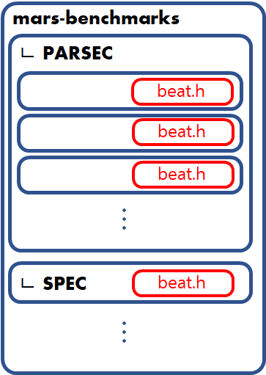
MARS-Benchmarks
Benchmarks annotated with Heartbeats - PARSEC / SPEC / MiBench
> PARSEC etc. in mars-benckmarks are only for CPU now
> Extending this to include GPU workloads

Slide 24
MARS-Benchmarks
Benchmarks annotated with Heartbeats - PARSEC / SPEC / MiBench
#include </workspace/mars/src/runtime/uapi/beats.h> const int period_ms = 10; // 211
for auto int time_start = _task_beat_current_timestamp_ms();; for task_beat(beats);
auto int time_total = _task_beat_current_timestamp_ms() - time_start; if(time_total < period_ms) usleep((period_ms - time_total)*1000);
void FP_tree::beats_debug() { std::cout << "Done with " << task_beat_read_total(beats) << " beats, rate = " << task_beat_read_total_rate(info,beats) << " beats/s, tgt = " << task_beat_read_tgt_rate(info,beats) <<" beats/s\n"; }
Insert into code to test performance

Slide 25
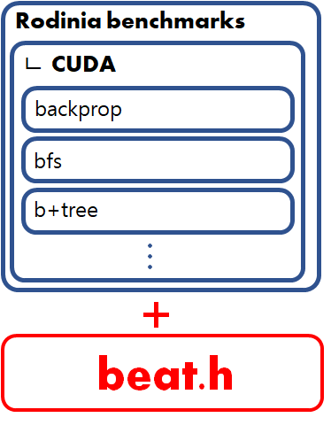
MARS-Benchmarks (updated)
Rodinia benchmarks
To support CPU cores
Insert beat.h & heartbeat codes
Extract from mars-benchmarks

Slide 26
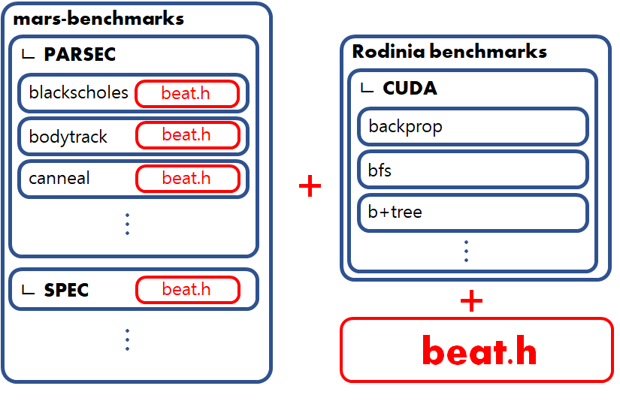
MARS-Benchmarks (updated)
Rodinia benchmarks
Change PATH
& ENVI

Slide 27
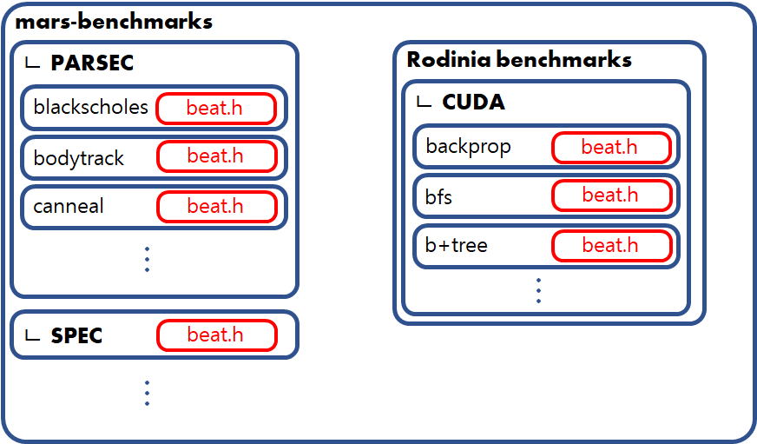
MARS-Benchmarks (updated)
Rodinia benchmarks
support
Video processing
Neural networks

Slide 28
MARS POLICY (BYEONGKEON)

Slide 29


MARS Policy
Frequency Control
No, I can give you 1000 mW and hurry up!
Please give me 100 mW!

Slide 30


MARS Policy
Frequency Control
No, I can’t..
No,
You MUST do!

Slide 31


MARS Policy
Frequency Control
Yuck
Oh my GOD!!

Slide 32
MARS Policy
Why?
- Embedded devices have limited memory and power
- We should reduce wasted power

Slide 33
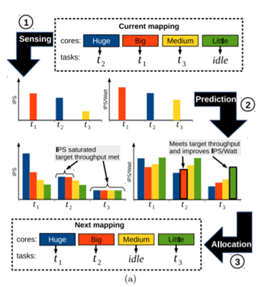
MARS Policy
Reference
SPRATA : Heterogeneous Task allocation
Runtime sensing
Prediction
Task allocation
Motivation : How to apply machine learning to System fields

Slide 34
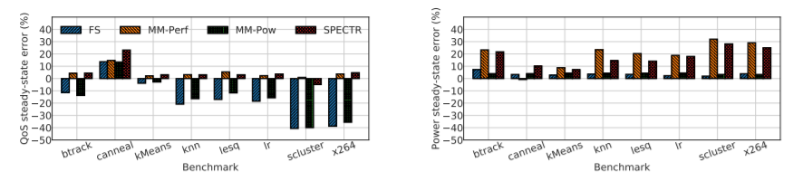
MARS Policy
Reference
SPECTR : Performance Measure
QoS (Quality of Service)
Power Error
Motivation : How to measure the performance of our experiments

Slide 35
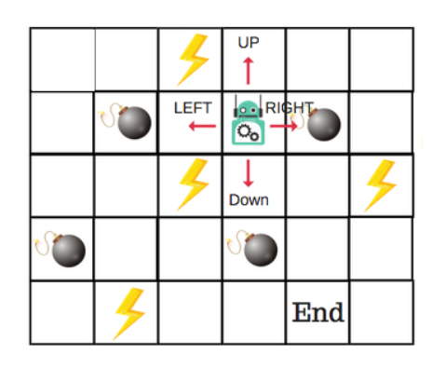
MARS Policy
Q learning
Actions, States, Rewards should be defined
Actions : Go left, right, up, down
States : The location of Robot
Rewards : Bomb(-100), Energy(5), End(100), blank(0)

Slide 36
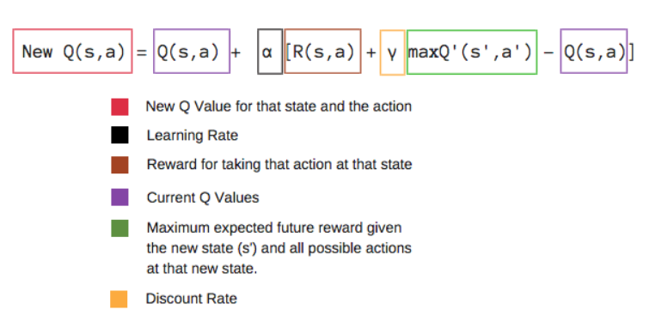
MARS Policy
Q learning (Bellman Rewards Equation)
Action Location | up | left | down | right
(0,0) | 0 | 0 | 0 | 0
(0,1) | 0 | 0 | 0 | 0
(0,2) | 0 | 0 | 0 | 0
(0,3) | 0 | 0 | 0 | 0
(0,4) | 0 | 0 | 0 | 0
(0,5) | 0 | 0 | 0 | 0
(1,0) | 0 | 0 | 0 | 0

Slide 37
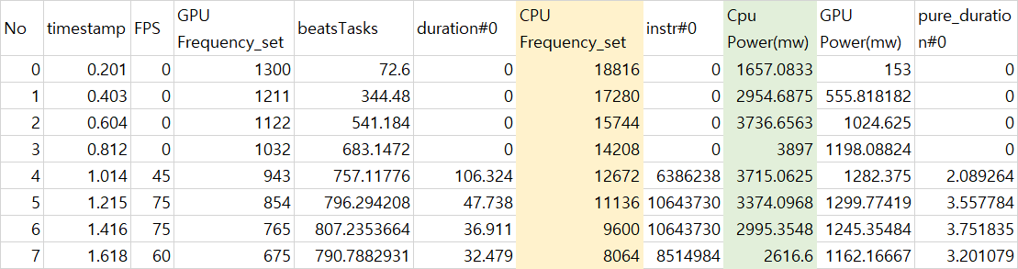
MARS Policy
Q learning on MARS
Action : Increasing or decreasing frequency
State : Current CPU Frequency (12 steps)
Rewards : Power consumption or Executed instruction per power consumped.

Slide 38
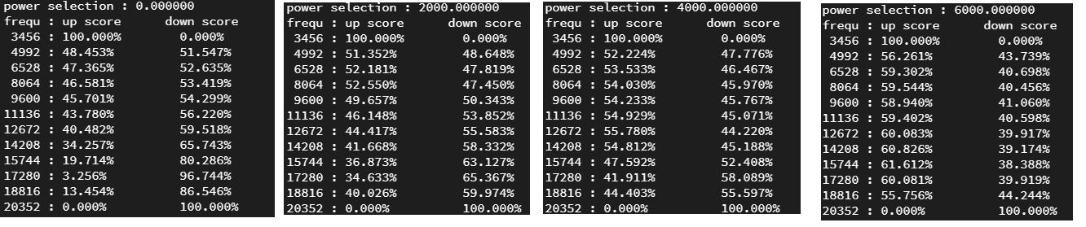
MARS Policy
Results
Epochs : 100
Data : 300 datas

Slide 39
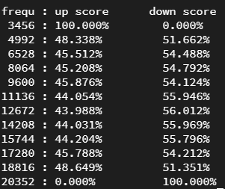
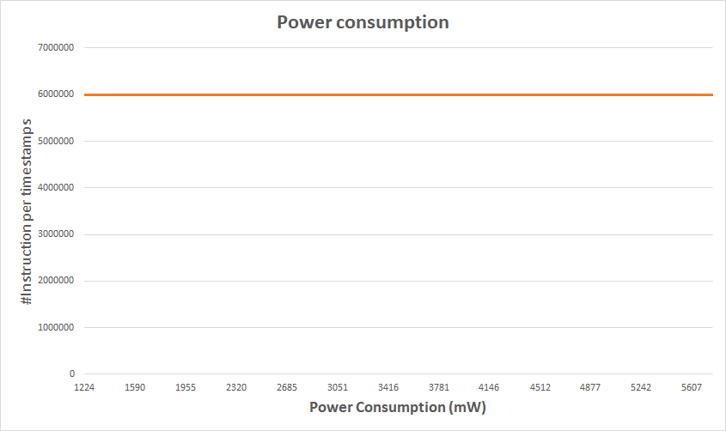
MARS Policy
Results (Example 1)
Rewards : Power Efficiency (#Inst per Power consumption)
Application tendency
Learning Result

Slide 40
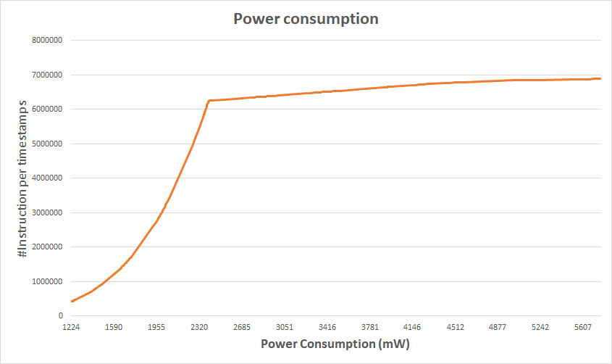
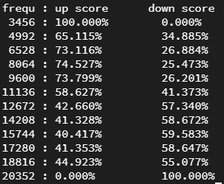
MARS Policy
Results (Example 2)
Rewards : Power Efficiency (#Inst per Power consumption)
Application tendency
Learning Result

Slide 41
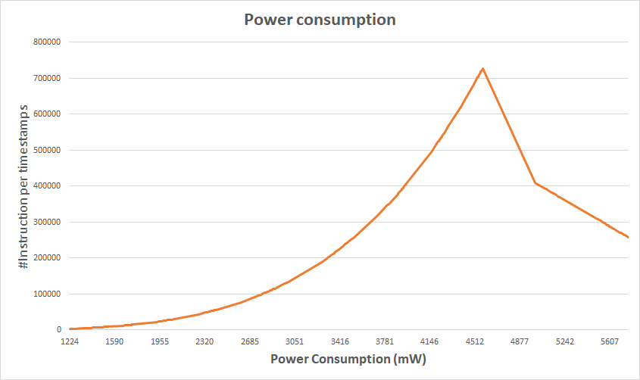
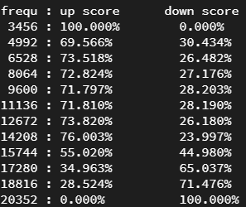
MARS Policy
Results (Example 3)
Rewards : Power Efficiency (#Inst per Power consumption)
Application tendency
Learning Result

Slide 42
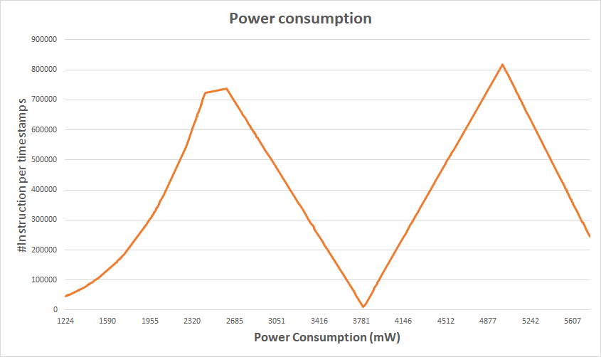
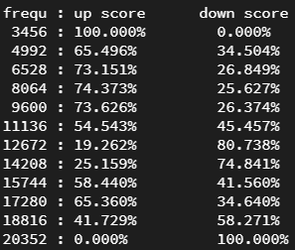
MARS Policy
Results (Example 4)
Rewards : Power Efficiency (#Inst per Power consumption)
Application tendency
Learning Result

Slide 43
MARS Policy
Tentative Future Works
Action : Holding frequency (+0, -0), or modifying N steps (+N, -N)
State : GPU frequency (14 steps)
Rewards : Real-time rewards for each run

Slide 44
Conclusion

Slide 45
Conclusion
Multiple MARS maintained by one server
Reinforcement learning can save power consumption at runtime
Support GPU cores about heartbeat measuring

Slide 46
Q & A
Notes:
질문 드루와

