Slide 1

Hotel from san Francisco and Los Angeles

Slide 2
Compare the hotels rate between San Francisco and Los Angeles
Check which city has the best hotels to stay
Check which city has more hotels

Slide 3
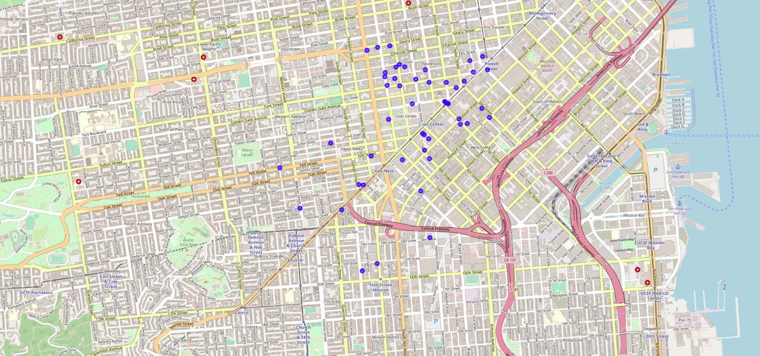
Data acquisition
Hotels within 1 mile of San Francisco

Slide 4
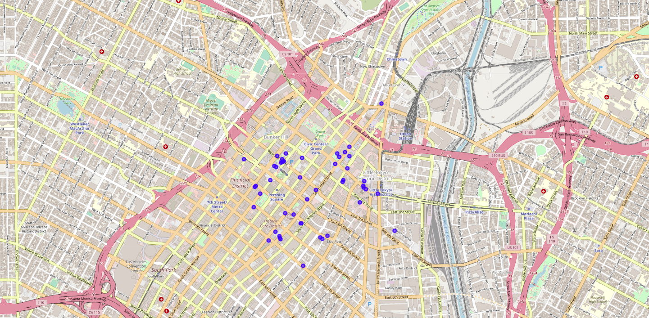
Data acquisition
Hotels within 1 mile of Los Angeles

Slide 5
Data acquisition and cleaning
Hotel names
Remove hotels that haven’t been rated

Slide 6
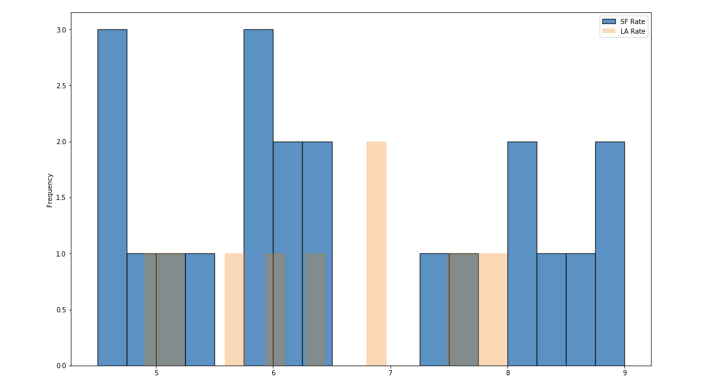
Hotel Rate Distribution
San Francisco doesn’t have any hotels in the rate range: 6.5 to 7.25.
The rate distribution of the San Francisco hotels shows either low or kinda high. We can presume the wealth gap between the rich and the poor in San Francisco is large.

Slide 7
Conclusion and future directions
San Francisco has extreme good and bad hotels. Los Angeles doesn’t have many hotels as San Francisco has, but its hotel rate distribution is evenly good.
Capture price of the hotels
Extend the searching area

