Slide 1
Word Segmentation
Remove punctuation and specific symbols
Word Embedding

Slide 2
Softmax
Fully connected layer
Fully connected layer
LSTM/GRU Layer
W
W
W
W
W
U
U
U
...
U
Word Embedding
Comment n
...
Trump
is
the
...
States

Slide 3
Encoder Hidden States
…
Source Text

Slide 4
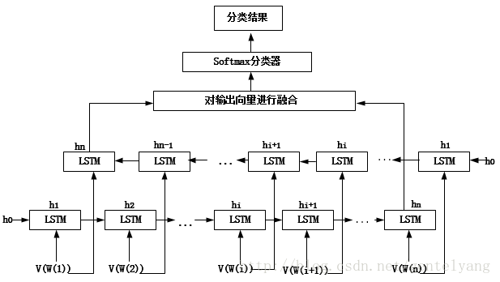
hn
hn-1
hn-2
h1
... ...
h0
h1
h2
h3
hn
h0
... ...
W(1)
W(2)
W(3)
W(n)

Slide 5

Output Results
Dense Layer
Fully Connected Layer
Fully Connected Layer
Merge
GlobalMaxPool1D
hn
hn-1
hn-2
h1
Bi-LSTM / Bi-GRU Layer
... ...
h0
h1
h2
h3
hn
h0
... ...
W(1)
W(2)
W(3)
W(n)
Source Text

