Slide 1
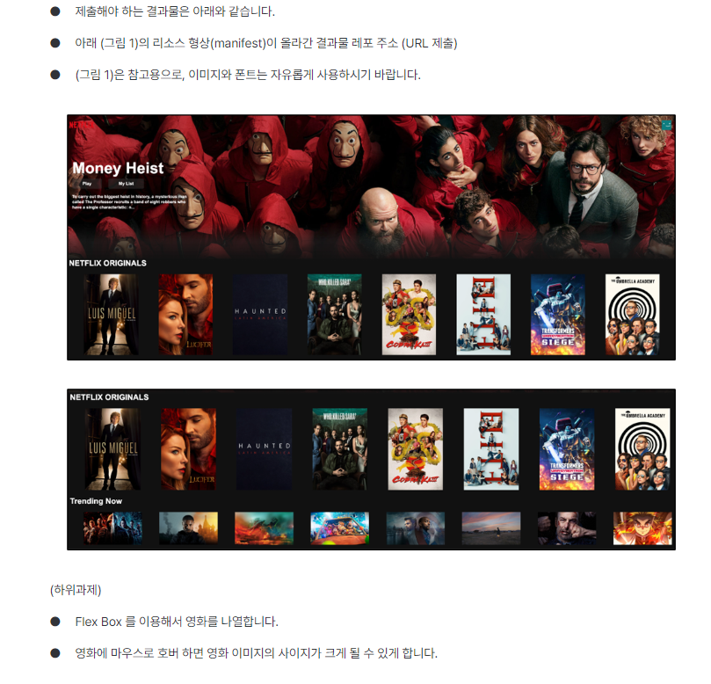
Header
Header-button
Header-button
Header-buttons
Header-recommend-video-title
Header-recommend-video-info
Header-recommend-video-button
Header-recommend-video
Header-recommend-video-img
Header-recommend-video-description
video-type-title
Video-container
Video-poster
Video-poster-container
Video-content

