Slide 1


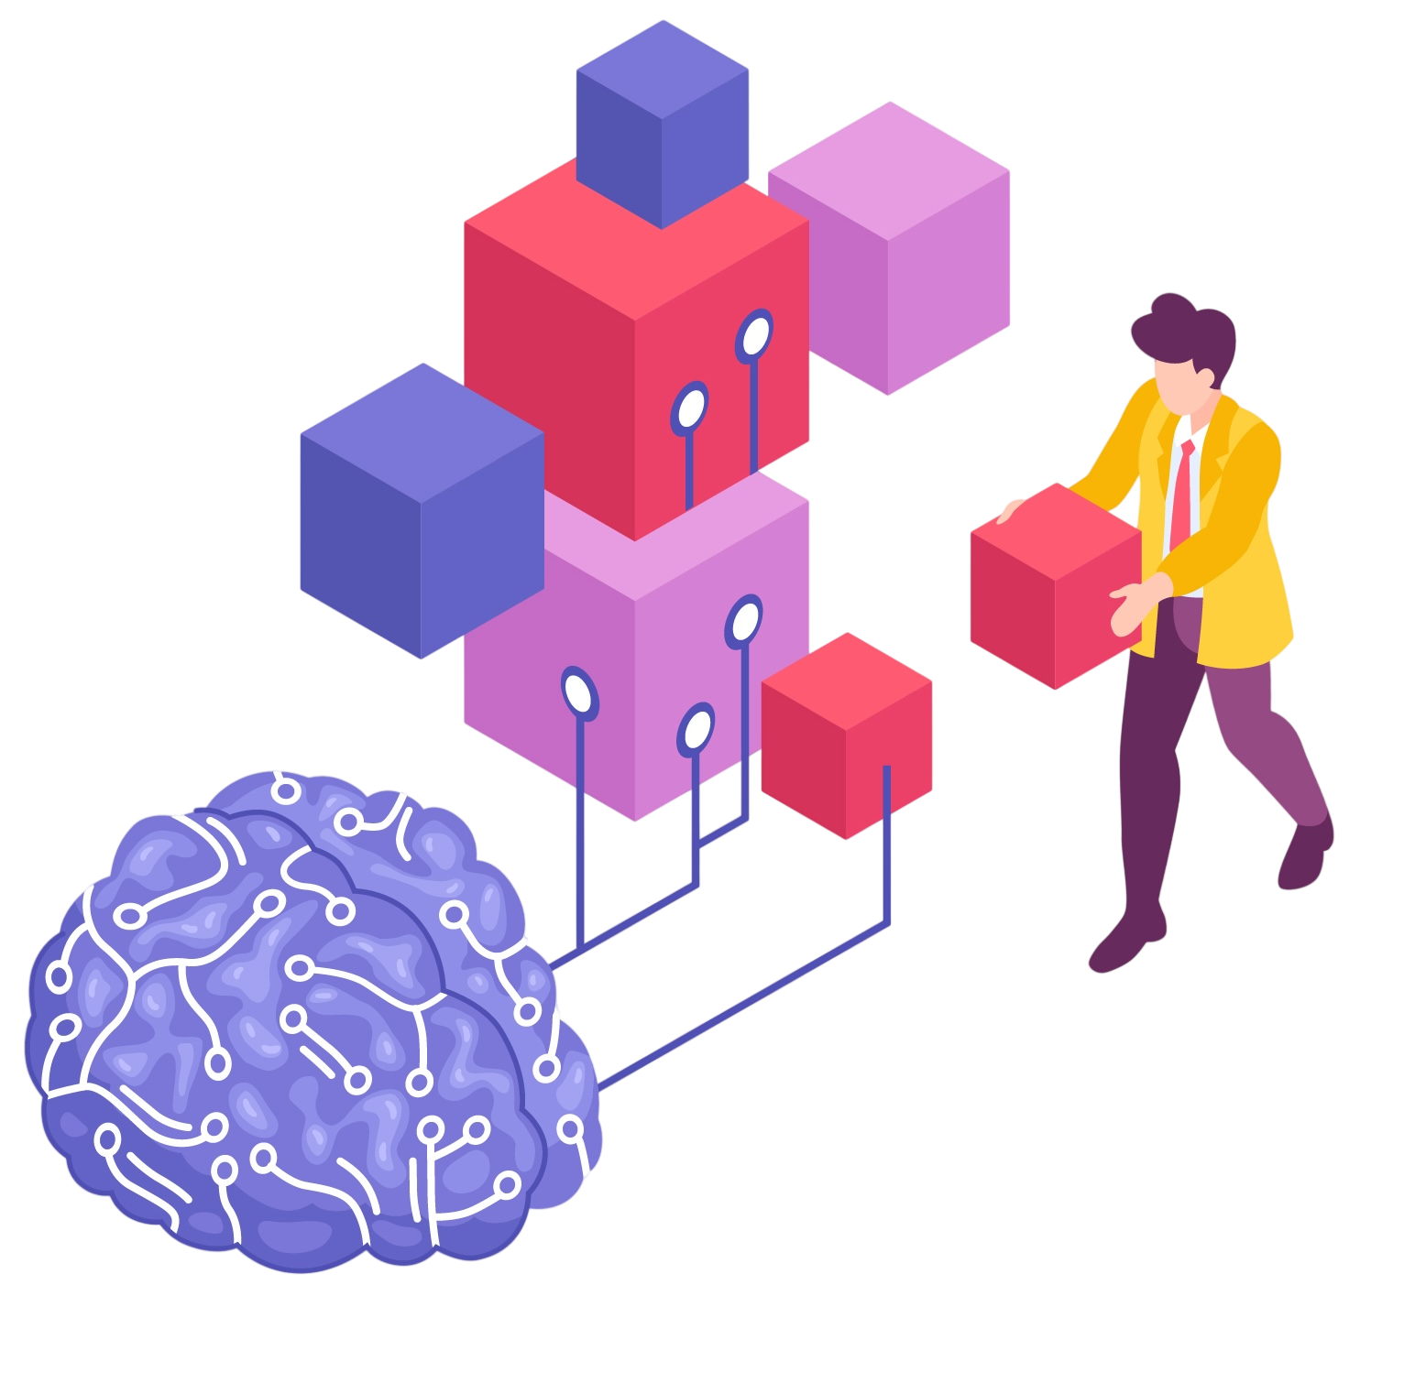
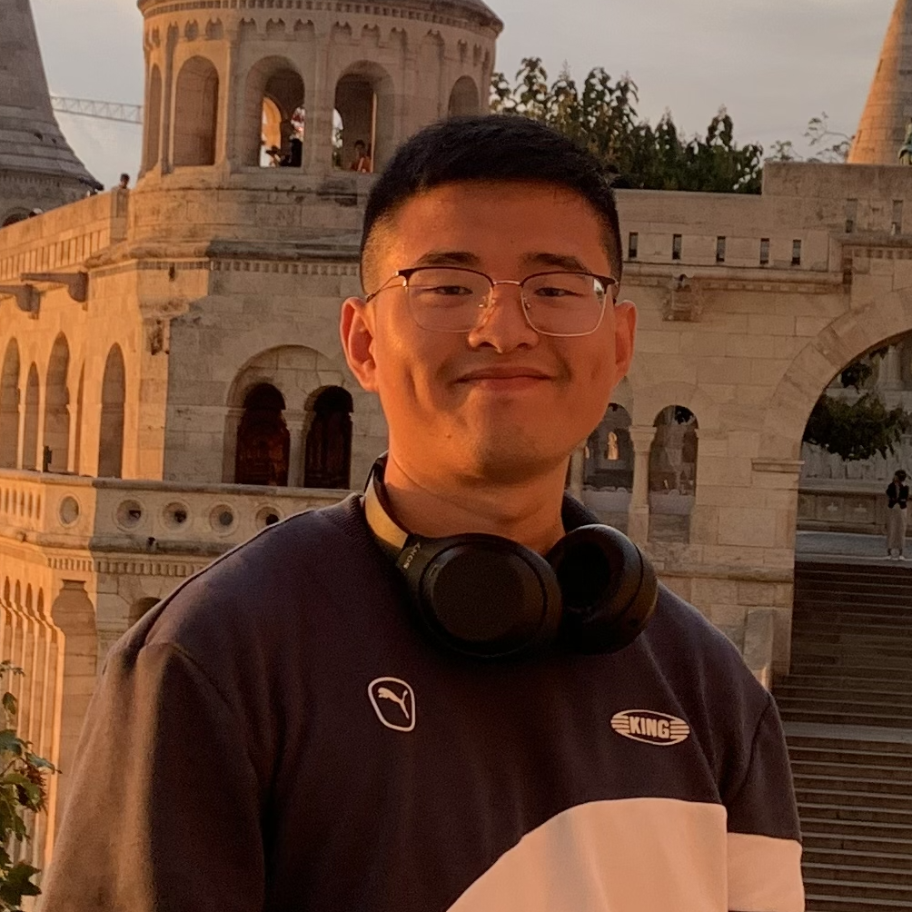
Building Trustworthy NLP Systems That Serve Real Domains
Yong Cao
Postdoc
University of Tübingen
Tübingen AI Center
2026-07-12

Slide 2
My Research Roadmap
About Me

