Slide 1
Automatic Defect Detection in Manufacturing Using VGG
MSCS3806-1: Advanced Topics in AI & Machine Learning Team: Yongchun Chen, Zhuochen Dai Professor: Yutao He

Slide 2
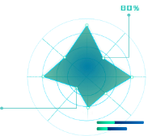

Abstract
Automating defect detection in manufacturing components is essential for improving product quality and reducing reliance on manual inspections. Our project presents an approach using a VGG16-based convolutional neural network model to identify defects in manufacturing components from images, focusing on anomalies such as scratches, dents, and stains. The MVTec Anomaly Detection (AD) dataset is utilized for training and evaluation, specifically the 'bottle' category. The model achieves high accuracy in distinguishing between defect-free and defective components, significantly enhancing the quality control process.

Slide 3
Introduction
In manufacturing, maintaining product quality is paramount. Traditional manual inspection methods are labor-intensive and prone to human error. Automated defect detection using deep learning offers a promising solution to enhance inspection efficiency and accuracy. This paper explores the use of the VGG16 convolutional neural network for detecting defects in manufacturing components.

Slide 4
Related Work
Traditional Approaches: - Image processing techniques such as edge detection, texture analysis, and pattern recognition. - Limitations in handling variability and complexity of real-world manufacturing defects. Early Neural Networks: - Initial attempts with shallow neural networks. - Introduction of convolutional neural networks (CNNs) for learning hierarchical feature representations.

Slide 5
Related Work
Convolutional Neural Networks (CNNs): - Revolutionized image classification tasks. - Examples: AlexNet, VGG, ResNet, Inception. VGG Architecture: - Use of small (3x3) convolutional filters. - Achieved top performance on ImageNet dataset. - Widely adopted for various image classification tasks.
Applications in Defect Detection: - Successful applications in detecting surface defects in steel, anomalies in semiconductor manufacturing, and quality inspection in food production. Focus on using VGG16 convolutional neural network for detecting defects in manufacturing components.

Slide 6
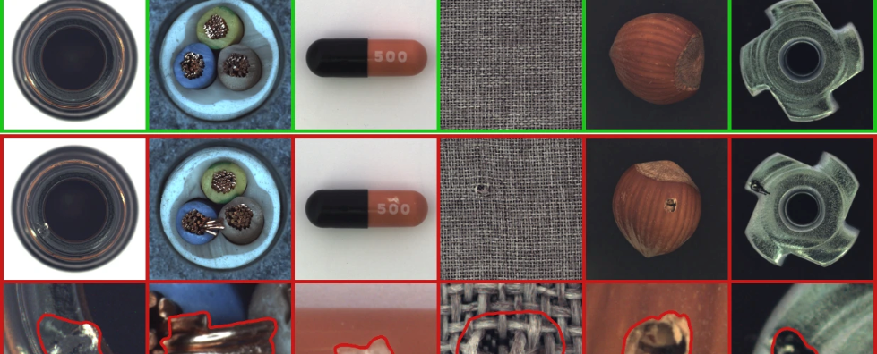
Methodology
Dataset: - MVTec Anomaly Detection (AD) dataset. - Categories: objects (e.g., bottle, cable) and textures (e.g., carpet, grid). - Train, test, and ground truth subsets. Data Preparation: - Mount Google Drive to access the dataset. - Resize images to 224x224 pixels and normalize pixel values. - Split dataset into training and testing sets.

Slide 7
Methodology
Model Architecture: - VGG16 model pre-trained on ImageNet. - Custom layers added for binary classification (defect-free vs. defective). Model Training: - Early stopping and model checkpointing to prevent overfitting. - Metrics: Training Accuracy, Test Accuracy.

Slide 8
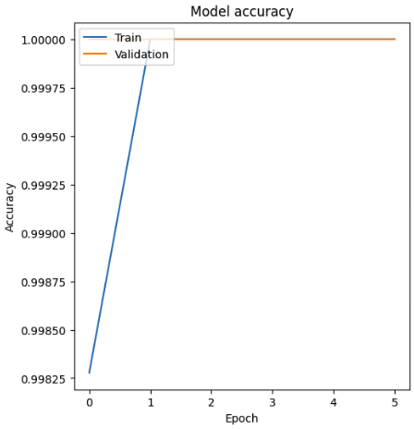
Results and Discussion
Model Performance: - High accuracy on test set. - Metrics observed: Training Accuracy, Test Accuracy. Visualization: - Graphical representation of model accuracy and loss.

Slide 9
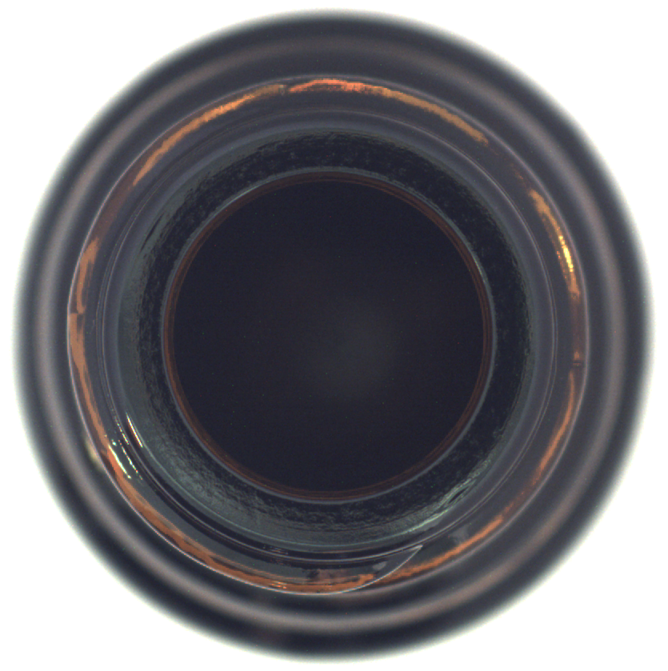
Results and Discussion
Discussion: - Not high accuracy in defect detection. - Improvements in quality control process. - Need for more diverse and defective samples in the training set.
Result: This is a Good component!

Slide 10
Conclusion
This study demonstrates the effectiveness of using a VGG-based model for automatic defect detection in manufacturing components. The model significantly reduces the need for manual inspection, thus enhancing the overall quality control process. Future work will focus on expanding the dataset and exploring other deep learning architectures to further improve detection accuracy.
thus enhancing the overall quality control process. Future work will focus on expanding the dataset and exploring other deep learning architectures to further improve detection accuracy.

Slide 11
Challenges and Issues
Parameter Tuning: - Finding optimal parameters like learning rate and batch size. Dataset Size and Complexity: - Computational challenges in processing large datasets. Class Imbalance: - Mitigating bias towards majority class. Model Generalization: - Ensuring model performs well on unseen data. Evaluation Metrics: - Using metrics like precision, recall, and F1-score.

Slide 12
Future Work
Hyperparameter optimization. Enhanced data processing with more powerful resources. Techniques to balance the dataset. Experimentation with different regularization techniques. Exploration of advanced architectures and transfer learning techniques.

Slide 13
References
1. Simonyan, K., & Zisserman, A. (2015). Very Deep Convolutional Networks for Large-Scale Image Recognition. arXiv:1409.1556v6. 2. MVTec AD Dataset. Available: https://www.mvtec.com/company/research/datasets/mvtec-ad 3. He, K., Zhang, X., Ren, S., & Sun, J. (2016). Deep Residual Learning for Image Recognition. In Proc. IEEE Conference on Computer Vision and Pattern Recognition (CVPR), pp. 770-778. 4. Szegedy, C., Liu, W., Jia, Y., Sermanet, P., Reed, S., Anguelov, D., Erhan, D., Vanhoucke, V., & Rabinovich, A. (2015). Going Deeper with Convolutions. In Proc. IEEE Conference on Computer Vision and Pattern Recognition (CVPR), pp. 1-9. 5. Zhang, B., Guo, Z., Zhang, L., & Liu, S. (2018). A VGG16-Based Faster R-CNN Model for Steel Surface Defect Detection. Sensors, 18(1), 252. 6. Ren, Y., Liu, C., & Zhang, X. (2019). Surface Defect Detection for Industrial Products Using a Deep Learning Approach. IEEE Transactions on Instrumentation and Measurement, 68(12), 4525-4536.

