Slide 1


NCS Capstone Project
Tan Yong Ding

Slide 2


Overview
Aims and Objectives
Requirements
Use Case
Database Design
API analysis
Postman Documentation
Future Work
Conclusion

Slide 3
Aims and Objectives
ABC-University to provide students a quiz application platform for them to practice and learn
Technologies used: Java 8, Spring Boot, Spring REST, Spring Data JPA, MySQL Database, Micro Services, Eureka Server and Client

Slide 4
Requirements
Stakeholders: Students, Admins
Students can select a test based on a list of categories and difficulties
Each test must consist of 20 questions from that selected category and difficulty
After the test submission, the student will be able to see their score percentage and the amount of scorers above and below them
Students can view their past records of all tests completed
Students are only able to access all these services after a validated login

Slide 5
Requirements
Admin is able to view all of the students’ tests records
Admin is able to filter these records based on a list of categories and difficulties
Admin is able to sort these records as well
Admin is only able to access these services after a validated login

Slide 6
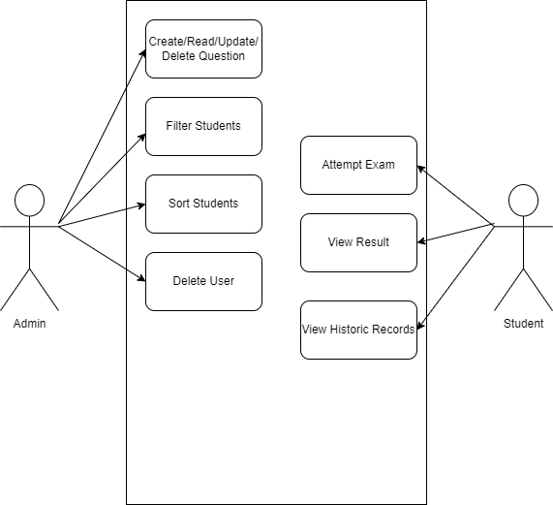
Use Case

Slide 7
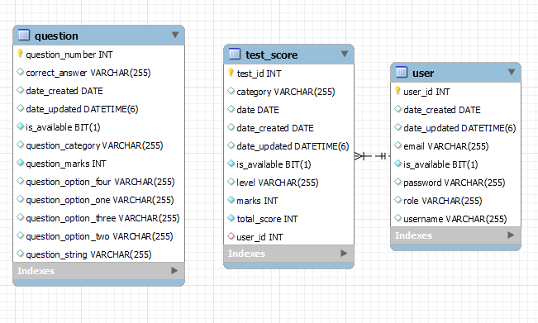
Database Design

Slide 8
Public APIs
PostMapping- Register
PostMapping- Login
GetMapping- Get Exam Questions

Slide 9
PostMapping- Register
Takes in a User body which contains 4 parameters: username, password, role and email. Checks if the password conforms to a valid password standard. Checks if the username and email already exists in the database. If everything is successful, a message stating success will be returned to the user.
PostMapping- Login
Takes in a User body which contains 2 parameters: username and password. The authentication manager will determine if the credentials are valid. If successful, it will return a jwt token to the frontend. A failed login will throw an InvalidCredentialsException.
GetMapping- Get Exam Questions
Takes in two request parameters: category and level. These are required and will determine the twenty questions that will be returned to the user. Twenty questions will be randomly selected from the list of valid questions and returned to the frontend.

Slide 10
Admin APIs
GetMapping- Get all users by roles
GetMapping- Get user by their id
PutMapping- Edit a student’s details by their id
DeleteMapping- Deletes a student
GetMapping- Get test’s details by its id
GetMapping- Get all tests details by studentId
PutMapping- Edit test’s details by its id
DeleteMapping- Delete a test by its id

Slide 11
GetMapping- Get all users by roles
Takes in a path variable which is the role and returns a list of user which has that role.
GetMapping- Get user by their id
Takes in a path variable which is the userId and returns the user which has that userId.
PutMapping- Edit a user’s details by their id
Takes in a User body which can contain two variables: password and email. The API first checks if the user with the id exists following by checking whether the email has been used. A successful edit will return a success message to the frontend.
DeleteMapping- Deletes a student
Takes in a path variable which is the userId. The API checks if the student exists and whether the student has test scores. The student can only be deleted if they do not have any test scores. A successful deletion will return a success message to the frontend.

Slide 12
GetMapping- Get test’s details by its id
Takes in a path variable which is the testId and returns the test details if it exists in the database.
GetMapping- Get all tests details by studentId
Takes in a path variable which is the studentId and returns all of the test score details by the student if the studentId exists and the student has test scores.
PutMapping- Edit test’s details by its id
Takes in a test score body and a path variable id. The API first checks if the test score exists and updates the existing test score with the variables found in the test score body. A success message will be sent upon successful update.
DeleteMapping- Delete a test by its id
Takes in a path variable which is the test score id. The API checks if the test score exists and will proceed to delete it if it does. A success message will be sent upon successful deletion.

Slide 13
Admin APIs
GetMapping- Filters students by their average test score
GetMapping- Sorts students by their test category
PostMapping- Create Question
GetMapping- Get Question by its id
GetMapping- Get all questions by their category
PutMapping- Edit a question by its id
DeleteMapping- Deletes a question by its id

Slide 14
GetMapping- Filters students by their average test score
This API reads all of the students scores which includes all categories and levels. It then sums all the marks obtained and averages it by the amount of tests taken. Following that, each student will get assigned their average test score and the list of students will get returned to the frontend.
GetMapping- Sorts students by their test category
Takes in a parameter called category. This API will extract all the test under the stated category and assign it to each student accordingly. A list of students with the respective test scores will be returned to the frontend.
PostMapping- Create Question
Takes in a Question body. The admin will be required to enter all the variables of the Question object in the request body for it to be valid. A successful creation of the question will return the question object back to the frontend.

Slide 15
GetMapping- Get Question by its id
Takes in a path variable id. The API will attempt to find the question from the database using the id and will return the question object if it exists.
GetMapping- Get all questions by their category
Takes in a request parameter called category. The API will attempt to find all of the questions in the database under the stated category. It will return the list of questions if it is not empty.
PutMapping- Edit a question by its id
Takes in a Question object as a request body and a path variable id. The API will first attempt to check whether a question with the stated id exists in the database. After that, it will edit the question using the variables from the request body. A successful edit will return a success message to the frontend.
DeleteMapping- Deletes a question by its id
Takes in a path variable id. The API will try to find the question from the database using its id and will proceed to delete it if it exists. A success message will be sent to the frontend upon successful deletion.

Slide 16
Student APIs
GetMapping- Results
PostMapping- Answers

Slide 17
GetMapping- Results
It gets the student’s username from the jwt passed in. The API will proceed to get the list of test scores unique to the student and return it to the frontend if it is not empty.
PostMapping- Answers
The student will post a request body of an arraylist<integer> of their answers. The API will proceed to cross-check the student’s answers with the correct answers and tally up the score. From there, the API will also check the other students who have done the same quiz under the same category and level. If there are any students who have scored higher or lower than the current student, the number will be sent as a response to the frontend along with the current student’s test score results.

Slide 18
Postman Documentation
https://documenter.getpostman.com/view/17791395/UzXRRb3y

Slide 19
Future Work
Create Junit Test Cases for all the APIs
Create Angular FrontEnd to complement the backend services
Further improve code quality and design

Slide 20
Conclusion
This project has helped me to further understand the workflow of a web application development from start to finish. Given the requirements, I had spent some time designing the necessary APIs for them as well as adding more that I deemed necessary. The database design was equally crucial as well because it sets the foundation of the app and any needless or incorrect variables could pose a problem when testing the APIs out. Since this was my first time using microservices, I had issues setting up the Eureka server along with its clients. Thanks to the instructor and some help from stackoverflow, I managed to figure out how to set them up and their operation procedures. I am glad that I was given the chance to work on this project and am looking forward to working on even more projects.

