Slide 1


NCS Capstone Project
Tan Yong Ding

Slide 2


Overview
Aims and Objectives
Requirements
Use Case
Database Design
In-depth API study
Conclusion

Slide 3
Aims and Objectives
ABC-University to provide students a quiz application platform for them to practice and learn
Technologies used: Java 8, Spring Boot, Spring REST, Spring Data JPA, MySQL Database, Micro Services, Eureka Server and Client

Slide 4
Requirements
Stakeholders: Students, Admins
Students can select a test based on a list of categories and difficulties
Each test must consist of 20 questions from that selected category and difficulty
After the test submission, the student will be able to see their score percentage and the amount of scorers above and below them
Students can view their past records of all tests completed
Students are only able to access all these services after a validated login

Slide 5
Requirements
Admin is able to view all of the students’ tests records
Admin is able to filter these records based on a list of categories and difficulties
Admin is able to sort these records as well
Admin is only able to access these services after a validated login

Slide 6
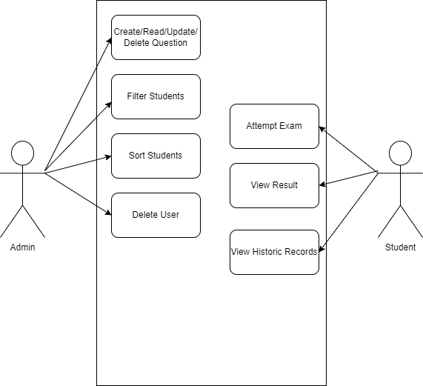
Use Case

Slide 7
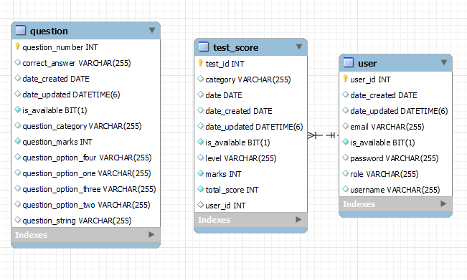
Database Design

Slide 9
Public APIs
PostMapping- Register
PostMapping- Login
GetMapping- Get Exam Questions

Slide 10
Admin APIs
GetMapping- Get all users by roles
GetMapping- Get user by their id
PutMapping- Edit a student’s details by their id
DeleteMapping- Deletes a student
GetMapping- Get test’s details by its id
PutMapping- Edit test’s details by its id
DeleteMapping- Delete a test by its id

Slide 11
Admin APIs
GetMapping- Filters students by their average test score
GetMapping- Sorts students by their test category
PostMapping- Create Question
GetMapping- Get Question by its id
GetMapping- Get all questions by their category
PutMapping- Edit a question by its id
DeleteMapping- Deletes a question by its id

Slide 12
Student APIs
GetMapping- Results
PostMapping- Answers

Slide 13
Conclusion
This project has helped me to further understand the workflow of a web application development from start to finish. Given the requirements, I had spent some time designing the necessary APIs for them as well as adding more that I deemed necessary. The database design was equally crucial as well because it sets the foundation of the app and any needless or incorrect variables could pose a problem when testing the APIs out. Since this was my first time using microservices, I had issues setting up the Eureka server along with its clients. Thanks to the instructor and some help from stackoverflow, I managed to figure out how to set them up and their operation procedures. I am glad that I was given the chance to work on this project and am looking forward to working on even more projects.

