Slide 1
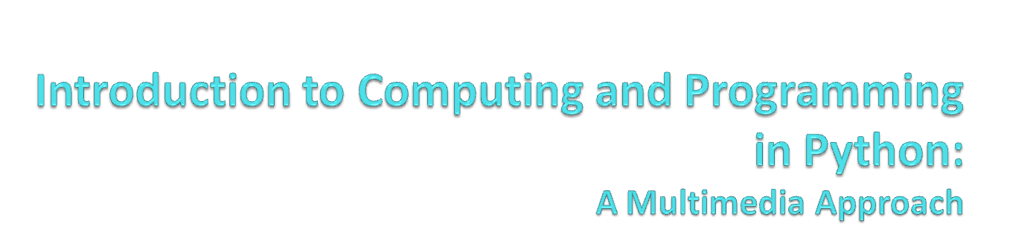
Chapter 6: Modifying Sounds Using Loops
Notes:
With thanks to John Sanders of Suffolk University for contributions to these slides!

Slide 2

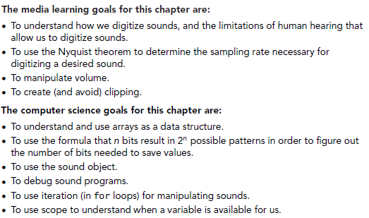

Slide 3
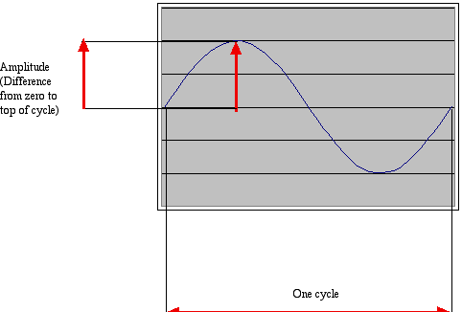
How sound works:
Acoustics, the physics of sound
Sounds are waves of air pressure
  Sound comes in cycles
  The frequency of a wave is the number of cycles per second (cps), or Hertz
    Complex sounds have more than one frequency in them.
  The amplitude is the maximum height of the wave

Slide 4
Volume and Pitch:
Psychoacoustics, the psychology of sound
Our perception of volume is related (logarithmically) to changes in amplitude
  If the amplitude doubles, it’s about a 3 decibel (dB) change
Our perception of pitch is related (logarithmically) to changes in frequency
  Higher frequencies are perceived as higher pitches
  We can hear between 5 Hz and 20,000 Hz (20 kHz)
  A above middle C is 440 Hz

Slide 5
“Logarithmically?”
It’s strange, but our hearing works on ratios not differences, e.g., for pitch.
  We hear the difference between 200 Hz and 400 Hz, as the same as 500 Hz and 1000 Hz
  Similarly, 200 Hz to 600 Hz, and 1000 Hz to 3000 Hz
Intensity (volume) is measured as watts per meter squared
  A change from 0.1W/m2 to 0.01 W/m2, sounds the same to us as 0.001W/m2 to 0.0001W/m2

Slide 6
Decibel is a logarithmic measure
A decibel is a ratio between two intensities:
10 * log10(I1/I2)
  As an absolute measure, it’s in comparison to threshold of audibility
  0 dB can’t be heard.
  Normal speech is 60 dB.
  A shout is about 80 dB

Slide 7

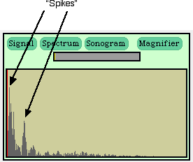

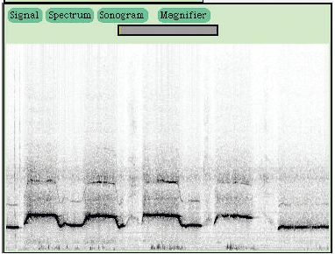
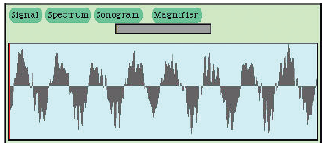
Fourier transform (FFT)
Click here to see viewers while recording
Notes:
I usually bring in a couple musical instruments (harmonica, thumb piano, ukelele, flute) to show how they have different FFT “signature” (different spikes).

Slide 8
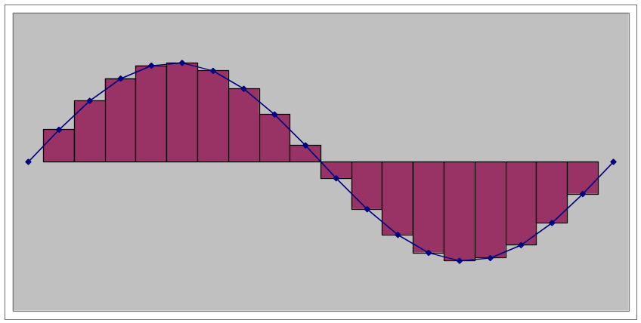
Digitizing Sound: How do we get that into numbers?
Remember in calculus, estimating the curve by creating rectangles?
We can do the same to estimate the sound curve
  Analog-to-digital conversion (ADC) will give us the amplitude at an instant as a number: a sample
  How many samples do we need?

Slide 9
Nyquist Theorem
We need twice as many samples as the maximum frequency in order to represent (and recreate, later) the original sound.
The number of samples recorded per second is the sampling rate
  If we capture 8000 samples per second, the highest frequency we can capture is 4000 Hz
    That’s how phones work
  If we capture more than 44,000 samples per second, we capture everything that we can hear (max 22,000 Hz)
    CD quality is 44,100 samples per second

Slide 10
Digitizing sound in the computer
Each sample is stored as a number (two bytes)
What’s the range of available combinations?
  16 bits, 216 = 65,536
  But we want both positive and negative values
    To indicate compressions and rarefactions.
  What if we use one bit to indicate positive (0) or negative (1)?
  That leaves us with 15 bits
  15 bits, 215 = 32,768
  One of those combinations will stand for zero
    We’ll use a “positive” one, so that’s one less pattern for positives

Slide 11
Two’s Complement Numbers
011 +3 Imagine there are only 3 bits
010 +2 we get 2³ = 8 possible values
001 +1 Subtracting 1 from 2 we borrow 1
000 0
111 -1 Subtracting 1 from 0 we borrow 1’s
110 -2 which turns on the high bit for all
101 -3 negative numbers
100 -4

Slide 12
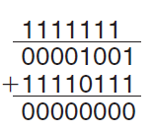
Two’s complement numbers can be simply added
Adding -9 (11110111) and 9 (00001001)

Slide 13
+/- 32K
Each sample can be between -32,768 and 32,767
Why such a bizarre number?
Because 32,768 + 32,767 + 1 = 2¹⁶
< 0
> 0
i.e. 16 bits, or 2 bytes
0
Compare this to 0...255 for light intensity
(i.e. 8 bits or 1 byte)

Slide 14
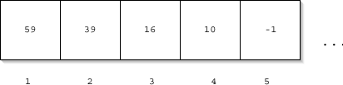
Sounds as arrays
Samples are just stored one right after the other in the computer’s memory
That’s called an array
  It’s an especially efficient (quickly accessed) memory structure
(Like pixels in a picture)

Slide 15
Working with sounds
We’ll use pickAFile and makeSound.
  We want .wav files
We’ll use getSamples to get all the sample objects out of a sound
We can also get the value at any index with getSampleValueAt
Sounds also know their length (getLength) and their sampling rate (getSamplingRate)
Can save sounds with writeSoundTo(sound, "file.wav")

Slide 16

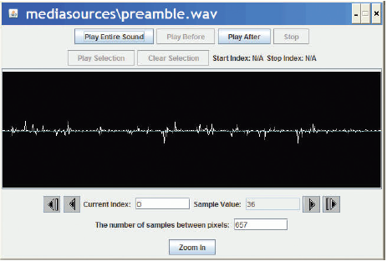
>>> filename=pickAFile()
>>> print filename
/Users/guzdial/mediasources/preamble.wav
>>> sound=makeSound(filename)
>>> print sound
Sound of length 421109
>>> samples=getSamples(sound)
>>> print samples
Samples, length 421109
>>> print getSampleValueAt(sound,1)
36
>>> print getSampleValueAt(sound,2)
29
>>> explore(sound)

Slide 17
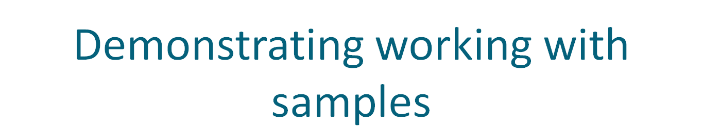
>>> print getLength(sound)
220568
>>> print getSamplingRate(sound)
22050.0
>>> print getSampleValueAt(sound,220568)
68
>>> print getSampleValueAt(sound,220570)
I wasn't able to do what you wanted.
The error java.lang.ArrayIndexOutOfBoundsException has occurred
Please check line 0 of
>>> print getSampleValueAt(sound,1)
36
>>> setSampleValueAt(sound,1,12)
>>> print getSampleValueAt(sound,1)
12

Slide 18
Working with Samples
We can get sample objects out of a sound with getSamples(sound) or getSampleObjectAt(sound,index)
A sample object remembers its sound, so if you change the sample object, the sound gets changed.
Sample objects understand getSample(sample) and setSample(sample,value)

Slide 19

>>> soundfile=pickAFile()
>>> sound=makeSound(soundfile)
>>> sample=getSampleObjectAt(sound,1)
>>> print sample
Sample at 1 value at 59
>>> print sound
Sound of length 387573
>>> print getSound(sample)
Sound of length 387573
>>> print getSample(sample)
59
>>> setSample(sample,29)
>>> print getSample(sample)
29

Slide 20
“But there are thousands of these samples!”
How do we do something to these samples to manipulate them, when there are thousands of them per second?
We use a loop and get the computer to iterate in order to do something to each sample.
An example loop:
for sample in getSamples(sound):
value = getSample(sample)
setSample(sample,value)

Slide 21

def increaseVolume(sound):
for sample in getSamples(sound):
value = getSampleValue(sample)
setSampleValue(sample,value * 2)
Using it:
>>> f="/Users/guzdial/mediasources/gettysburg10.wav"
>>> s=makeSound(f)
>>> increaseVolume(s)
>>> play(s)
>>> writeSoundTo(s, "/Users/guzdial/mediasources/louder-g10.wav")

Slide 22
How did that work?
When we evaluate increaseVolume(s), the function increaseVolume is executed
  The sound in variable s becomes known as sound
  sound is a placeholder for the sound object s.
>>> f=pickAFile()
>>> s=makeSound(f)
>>> increaseVolume(s)
def increaseVolume(sound):
for sample in getSamples(sound):
value = getSampleValue(sample)
setSampleValue(sample,value * 2)

Slide 23
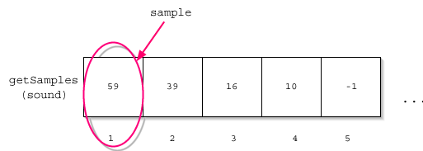
Starting the loop
getSamples(sound) returns a sequence of all the sample objects in the sound.
The for loop makes sample be the first sample as the block is started.
def increaseVolume(sound):
for sample in getSamples(sound):
value = getSampleValue(sample)
setSampleValue(sample,value * 2)
Compare:
for pixel in getPixels(picture):

Slide 24

Executing the block
We get the value of the sample named sample.
We set the value of the sample to be the current value (variable value) times 2
def increaseVolume(sound):
for sample in getSamples(sound):
value = getSampleValue(sample)
setSampleValue(sample,value * 2)

Slide 25
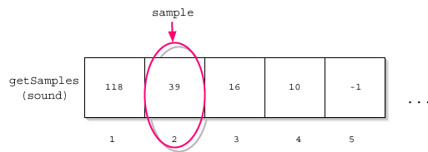
Next sample
Back to the top of the loop, and sample will now be the second sample in the sequence.
def increaseVolume(sound):
for sample in getSamples(sound):
value = getSampleValue(sample)
setSampleValue(sample,value * 2)

Slide 26

And increase that next sample
We set the value of this sample to be the current value (variable value) times 2.
def increaseVolume(sound):
for sample in getSamples(sound):
value = getSampleValue(sample)
setSampleValue(sample,value * 2)

Slide 27
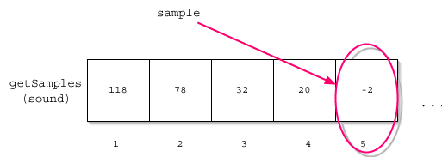
And on through the sequence
The loop keeps repeating until all the samples are doubled
def increaseVolume(sound):
for sample in getSamples(sound):
value = getSampleValue(sample)
setSampleValue(sample,value * 2)

Slide 28
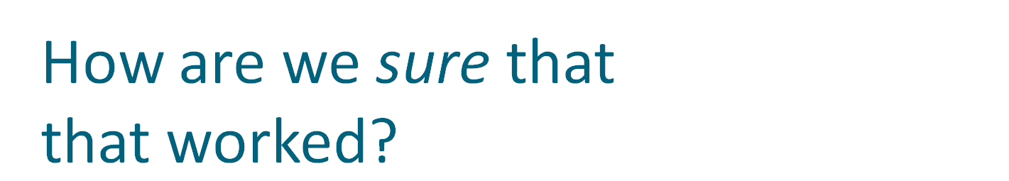

>>> print s
Sound of length 220567
>>> print f
/Users/guzdial/mediasources/gettysburg10.wav
>>> soriginal=makeSound(f)
>>> print getSampleValueAt(s,1)
118
>>> print getSampleValueAt(soriginal,1)
59
>>> print getSampleValueAt(s,2)
78
>>> print getSampleValueAt(soriginal,2)
39
>>> print getSampleValueAt(s,1000)
-80
>>> print getSampleValueAt(soriginal,1000)
-40
Here we’re comparing the modified sound s to a copy of the original sound soriginal

Slide 29

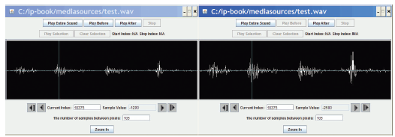
The right side does look like it’s larger.

Slide 30

def decreaseVolume(sound):
for sample in getSamples(sound):
value = getSampleValue(sample)
setSampleValue(sample,value * 0.5)
This works just like increaseVolume, but we’re lowering each sample by 50% instead of doubling it.
Notes:
Be sure to actually do this!

Slide 31
We can make this generic
By adding a parameter, we can create a general changeVolume that can increase or decrease volume.
def changeVolume(sound , factor):
for sample in getSamples(sound):
value = getSampleValue(sample)
setSampleValue(sample ,value * factor)

Slide 32

def increaseVolume(sound):
for sample in getSamples(sound):
value = getSampleValue(sample)
setSampleValue(sample, value*2)
def increaseRed(picture):
for p in getPixels(picture):
value=getRed(p)
setRed(p,value*1.2)
def decreaseVolume(sound):
for sample in getSamples(sound):
value = getSampleValue(sample)
setSampleValue(sample, value*0.5)
def decreaseRed(picture):
for p in getPixels(picture):
value=getRed(p)
setRed(p,value*0.5)

Slide 33
Does increasing the volume change the volume setting?
No
  The physical volume setting indicates an upper bound, the potential loudest sound.
  Within that potential, sounds can be louder or softer
    They can fill that space, but might not.
(Have you ever noticed how commercials are always louder than regular programs?)
  Louder content attracts your attention.
  It maximizes the potential sound.

Slide 34
Maximizing volume
How, then, do we get maximal volume?
  (e.g. automatic recording level)
It’s a three-step process:
  First, figure out the loudest sound (largest sample).
  Next, figure out how much we have to increase/decrease that sound to fill the available space
    We want to find the amplification factor amp, where amp * loudest = 32767
    In other words: amp = 32767/loudest
  Finally, amplify each sample by multiplying it by amp

Slide 35

This loop finds the loudest
sample
def normalize(sound):
largest = 0
for s in getSamples(sound):
largest = max(largest, getSampleValue(s))
amplification = 32767.0 / largest
print "Largest sample value in original sound was", largest
print ”Amplification multiplier is", amplification
for s in getSamples(sound):
louder = amplification * getSampleValue(s)
setSampleValue(s, louder)
Q: Why 32767?
A: Later…
This loop actually amplifies
the sound

Slide 36
Max()
max() is a function that takes any number of inputs, and always returns the largest.
There is also a function min() which works similarly but returns the minimum
>>> print max(1,2,3)
3
>>> print max(4,67,98,-1,2)
98

Slide 37
Or: use if instead of max
Instead of finding max of
all samples, check each in
turn to see if it’s the largest
so far
def normalize(sound):
largest = 0
for s in getSamples(sound):
if getSampleValue(s) > largest:
largest = getSampleValue(s)
amplification = 32767.0 / largest
print "Largest sample value in original sound was", largest
print ”Amplification factor is", amplification
for s in getSamples(sound):
louder = amplification * getSampleValue(s)
setSampleValue(s, louder)

Slide 38
Aside: positive and negative extremes assumed to be equal
We’re making an assumption here that the maximum positive value is also the maximum negative value.
  That should be true for the sounds we deal with, but isn’t necessarily true
Try adding a constant to every sample.
  That makes it non-cyclic
    I.e. the compressions and rarefactions in the sound wave are not equal
  But it’s fairly subtle what’s happening to the sound.

Slide 39
Why 32767.0, not 32767?
Why do we divide out of 32767.0 and not just simply 32767?
  Because of the way Python handles numbers
  If you give it integers, it will only ever compute integers.
>>> print 1.0/2
0.5
>>> print 1.0/2.0
0.5
>>> print 1/2
0

Slide 40
Avoiding clipping
Why are we being so careful to stay within range? What if we just multiplied all the samples by some big number and let some of them go over 32,767?
The result then is clipping
  Clipping: The awful, buzzing noise whenever the sound volume is beyond the maximum that your sound system can handle.
Notes:
Be sure to generate some clipping here!

Slide 41
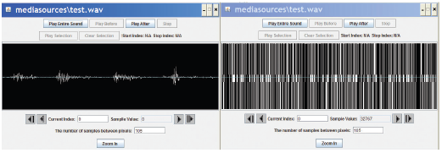
All clipping, all the time
def onlyMaximize(sound):
for sample in getSamples(sound):
value = getSampleValue(sample)
if value > 0:
setSampleValue(sample, 32767)
if value < 0:
setSampleValue(sample, -32768)

Slide 42
Processing only part of the sound
What if we wanted to increase or decrease the volume of only part of the sound?
Q: How would we do it?
A: We’d have to use a range() function with our for loop
  Just like when we manipulated only part of a picture by using range() in conjunction with getPixels()

