Slide 1
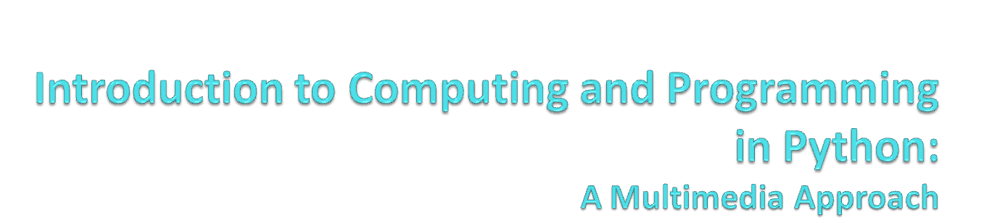
Chapter 7:
Modifying Samples in a Range
Notes:
Thanks to John Sanders of Suffolk University for contributions to these slides!

Slide 2

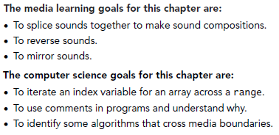

Slide 3
Knowing where we are in the sound
More complex operations require us to know where we are in the sound, which sample
  Not just process all the samples exactly the same
Examples:
  Reversing a sound
    It’s just copying, like we did with pixels
  Changing the frequency of a sound
    Using sampling, like we did with pixels
  Splicing sounds

Slide 4

>>> print range(1,3)
[1, 2]
>>> print range(3,1)
[]
>>> print range(-1,5)
[-1, 0, 1, 2, 3, 4]
>>> print range(1,100)
[1, 2, 3, 4, 5, 6, 7, 8, 9, 10, 11, … 99]

Slide 5

def increaseVolumeByRange(sound):
for sampleNumber in range(0, getLength(sound)):
value = getSampleValueAt(sound, sampleNumber)
setSampleValueAt(sound, sampleNumber, value * 2)
This really is the same as:
def increaseVolume(sound):
for sample in getSamples(sound):
value = getSample(sample)
setSample(sample,value * 2)

Slide 6

The index lets us modify parts of the sound now - e.g. here we increase the volume in the first half, and then decrease it in the second half.
def increaseAndDecrease(sound):
length = getLength(sound)
for index in range(0, length/2):
value = getSampleValueAt(sound, index)
setSampleValueAt(sound, index, value*2)
for sampleIndex in range(length/2, length):
value = getSampleValueAt(sound, index)
setSampleValueAt(sound, index, value*0.2)

Slide 7

Square brackets ([ ]) are standard notation for arrays (or lists). To access a single array element at position index, we use array[index]
>>> myArray = range(0, 100)
>>> print myArray[0]
0
>>> print myArray[1]
1
>>> print myArray[99]
99

Slide 8
Splicing Sounds
Splicing gets its name from literally cutting and pasting pieces of magnetic tape together
Doing it digitally is easy (in principle), but painstaking
The easiest kind of splicing is when the component sounds are in separate files.
All we need to do is copy each sound, in order, into a target sound.
Here’s a recipe that creates the start of a sentence, “Guzdial is …” (You may complete the sentence.)

Slide 9
Splicing whole sound files
def merge():
guzdial = makeSound(getMediaPath("guzdial.wav"))
isSound = makeSound(getMediaPath("is.wav"))
target = makeSound(getMediaPath("sec3silence.wav"))
index = 0
for source in range(0, getLength(guzdial)):
value = getSampleValueAt(guzdial, source)
setSampleValueAt(target, index, value)
index = index + 1
for source in range(0, int(0.1*getSamplingRate(target))):
setSampleValueAt(target, index, 0)
index = index + 1
for source in range(0, getLength(isSound)):
value = getSampleValueAt(isSound, source)
setSampleValueAt(target, index, value)
index = index + 1
normalize(target)
play(target)
return target

Slide 10
How it works
Creates sound objects for the words “Guzdial”, “is” and the target silence
Set target’s index to 0, then let each loop increment index and end the loop by leaving index at the next empty sample ready for the next loop
The 1st loop copies “Guzdial” into the target
The 2nd loop creates 0.1 seconds of silence
The 3rd loop copies “is” into the target
Then we normalize the sound to make it louder

Slide 11
Splicing words into a speech
Say we want to splice pieces of speech together:
  We find where the end points of words are
  We copy the samples into the right places to make the words come out as we want them
  (We can also change the volume of the words as we move them, to increase or decrease emphasis and make it sound more natural.)

Slide 12
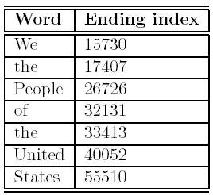
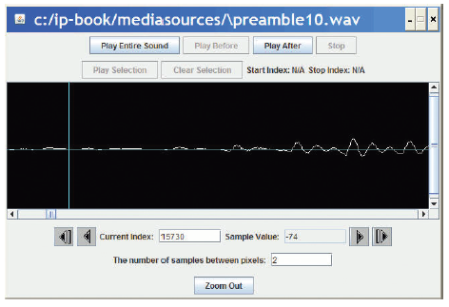
Finding the word end-points
Using MediaTools and play before/after cursor, we can figure out the index numbers where each word ends
We want to splice a copy of the word “United” after “We the” so that it says, “We the United People of the United States”.

Slide 13
Now, it’s all about copying
We have to keep track of the source and target indices, srcSample and destSample
destSample = Where-the-incoming-sound-should-start
for srcSample in range(startingPoint, endingPoint):
sampleValue = getSampleValueAt(source, srcSample)
setSampleValueAt(dest, destSample, sampleValue)
destSample = destSample + 1

Slide 14

def splicePreamble():
file = getMediaPath(“preamble10.wav”)
source = makeSound(file)
target = makeSound(file) # This will be the newly spliced sound
targetIndex =17408 # targetIndex starts at just after "We the" in the new sound
for sourceIndex in range( 33414, 40052): # Where the word "United" is in the sound
setSampleValueAt(target, targetIndex, getSampleValueAt(source, sourceIndex))
targetIndex = targetIndex + 1
for sourceIndex in range(17408, 26726): # Where the word "People" is in the sound
setSampleValueAt(target , targetIndex, getSampleValueAt(source, sourceIndex))
targetIndex = targetIndex + 1
for index in range(0, 1000): #Stick some quiet space after that
setSampleValueAt(target, targetIndex, 0)
targetIndex = targetIndex + 1
play(target) #Let's hear and return the result
return target

Slide 15
What’s going on here?
First, set up a source and target.
Next, we copy “United” (samples 33414 to 40052) after “We the” (sample 17408)
  That means that we end up at 17408+(40052-33414) =
  17408+6638=24046
  Where does “People” start?
Next, we copy “People” (17408 to 26726) immediately afterward.
  Do we have to copy “of” to?
  Or is there a pause in there that we can make use of?
Finally, we insert a little (1/1441th of a second) of space – 0’s

Slide 16
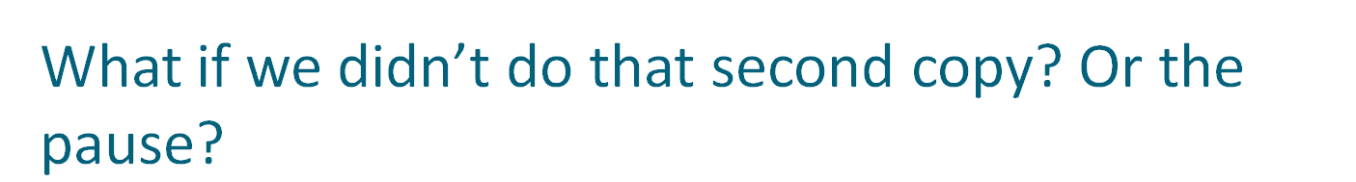
def spliceSimpler():
file = getMediaPath(“preamble10.wav”)
source = makeSound(file)
target = makeSound(file) # This will be the newly spliced sound
targetIndex =17408 # targetIndex starts at just after "We the" in the new sound
for sourceIndex in range( 33414, 40052): # Where the word "United" is in the sound
setSampleValueAt(target, targetIndex, getSampleValueAt(source, sourceIndex))
targetIndex = targetIndex + 1
# Let's hear and return the result
play(target)
return target

Slide 17

We can simplify those splicing functions if we had a general clip method that took a start and end index and returned a new sound clip with just that part of the original sound in it.
def clip(source, start, end):
target = makeEmptySound(end - start)
tIndex = 0
for sIndex in range(start, end):
value = getSampleValueAt(source, sIndex)
setSampleValueAt(target, tIndex, value)
tIndex = tIndex + 1
return target

Slide 18

We can also simplify splicing if we had a general copy method that took a source and target sounds and copied the source into the target starting at a specified target location.
def copy(source, target, start):
tIndex = start
for sIndex in range(0, getLength(source)):
value = getSampleValueAt(source, sIndex)
setSampleValueAt(target, tIndex, value)
tIndex = tIndex + 1

Slide 19

Now we can use these functions to insert “United” into the preamble in a much simpler way.
def createNewPreamble():
file = getMediaPath("preamble10.wav")
preamble = makeSound(file) # old preamble
united = clip(preamble, 33414, 40052) # "United"
start = clip(preamble, 0, 17407) # "We the"
end = clip(preamble, 17408, 55510) # the rest
len = getLength(start) + getLength(united)
len = len + getLength(end) # length of everything
newPre = makeEmptySound(len) # new preamble
copy(start, newPre, 0)
copy(united, newPre, getLength(start))
copy(end, newPre, getLength(start)+getLength(united))
return newPre

Slide 20
Changing the splice
What if we wanted to increase or decrease the volume of an inserted word?
  Simple! Multiply each sample by something as it’s pulled from the source.
Could we do something like slowly increase volume (emphasis) or normalize the sound?
  Sure! Just like we’ve done in past programs, but instead of working across all samples, we work across only the samples in that sound!

Slide 21
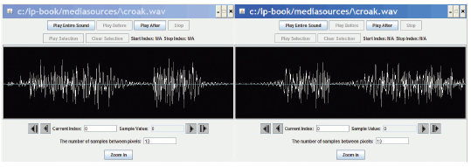
Reversing Sounds
We can also modify sounds by reversing them
def reverse(source):
target = makeEmptySound(getLength(source))
sourceIndex = getLength(source) - 1 # start at end
for targetIndex in range(0, getLength(target)):
value = getSampleValueAt(source, sourceIndex)
setSampleValueAt(target, targetIndex, value)
sourceIndex = sourceIndex - 1 # move backwards
return target

Slide 22
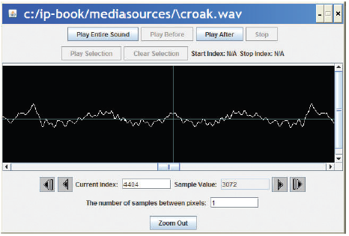
Mirroring
We can mirror sounds in exactly the same way we mirrored pictures
def mirrorSound(sound):
len = getLength(sound)
mirrorpoint = len/2
for index in range(0, mirrorpoint):
left = getSampleObjectAt(sound, index)
right = getSampleObjectAt(sound, len-index-1)
value = getSampleValue(left)
setSampleValue(right, value)

