Slide 1
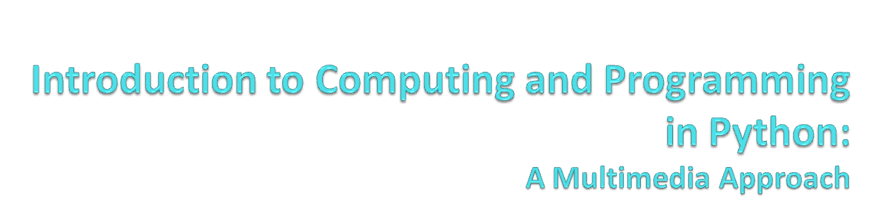
Chapter 8: Making Sounds by Combining Pieces
Notes:
With thanks to John Sanders of Suffolk University for contributions to these slides!

Slide 2

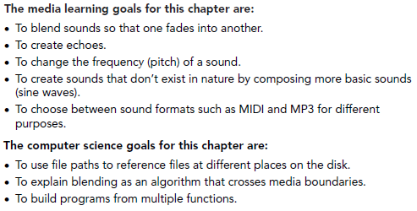

Slide 3

We know that natural sounds are often the combination of multiple sounds.
Adding waves in physics or math is hard.
In computer science, it’s easy! Simply add the samples at the same index in the two waves:
for srcSample in range(0, getLength(source)):
destValue=getSampleValueAt(dest, srcSample)
srcValue=getSampleValueAt(source, srcSample)
setSampleValueAt(source, srcSample, srcValue+destValue)

Slide 4
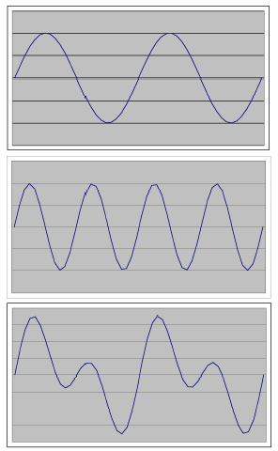

a
The first two are sine waves generated in Excel.
The third is just the sum of the first two columns.
b
a + b = c

Slide 5
Uses for adding sounds
We can mix sounds
  We even know how to change the volumes of the two sounds, even over time (e.g., fading in or fading out)
We can create echoes
We can add sine (or other) waves together to create kinds of instruments/sounds that do not physically exist, but which sound interesting and complex

Slide 6

def addSoundInto(sound1, sound2):
for sampleNmr in range(0, getLength(sound1)):
sample1 = getSampleValueAt(sound1, sampleNmr)
sample2 = getSampleValueAt(sound2, sampleNmr)
setSampleValueAt(sound2, sampleNmr, sample1 + sample2)
Notice that this adds sound1 and sound2 by adding sound1 into sound2

Slide 7
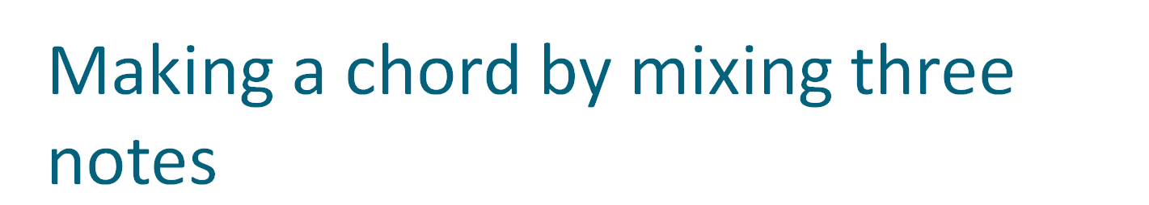
>>> c4=makeSound(getMediaPath("bassoon-c4.wav"))
>>> e4=makeSound(getMediaPath("bassoon-e4.wav"))
>>> g4=makeSound(getMediaPath("bassoon-g4.wav"))
>>> addSoundInto(e4,c4)
>>> play(c4)
>>> addSoundInto(g4,c4)
>>> play(c4)
Notes:
Really do this – it’s fun!

Slide 8

def makeChord(sound1, sound2, sound3):
for index in range(0, getLength(sound1)):
s1Sample = getSampleValueAt(sound1, index)
setSampleValueAt(sound1, index, s1Sample )
if index > 1000:
s2Sample = getSampleValueAt(sound2, index - 1000)
setSampleValueAt(sound1, index, s1Sample + s2Sample)
if index > 2000:
s3Sample = getSampleValueAt(sound3, index - 2000)
setSampleValueAt(sound1, index, s1Sample + s2Sample + s3Sample)
Note that in this version we’re adding into sound1!
Add in sound2 after 1000 samples
Add in sound3 after 2000 samples
Notes:
Play with the delay here.

Slide 9

def echo(sndFile, delay):
s1 = makeSound(sndFile)
s2 = makeSound(sndFile)
for index in range(delay, getLength(s1)):
echo = 0.6*getSampleValueAt(s2, index-delay)
combo = getSampleValueAt(s1, index) + echo
setSampleValueAt(s1, index, combo)
play(s1)
return s1
This creates a delayed echo sound, multiplies it by 0.6 to make it fainter and then adds it into the original sound.

Slide 10

def echoes(sndFile, delay, num):
s1 = makeSound(sndFile)
ends1 = getLength(s1)
ends2 = ends1 + (delay * num) # convert samples
secs = int(ends2/getSamplingRate(s1)) # to secs
s2 = makeEmptySound(secs + 1)
amp = 1.0 # make amplitude smaller for each echo
for echoCount in range(0, num):
amp = amp * 0.6 # amplitude 60% smaller each time
for posns1 in range(0, ends1):
posns2 = posns1 + (delay*echoCount)
val1 = getSampleValueAt(s1, posns1)*amp
val2 = getSampleValueAt(s2, posns2)
setSampleValueAt(s2, posms2, val1 + val2)
play(s2)
return s2

Slide 11
How sampling keyboards work
They have a huge memory with recordings of lots of different instruments played at different notes
When you press a key on the keyboard, the recording closest to the note you just pressed is selected, and then the recording is shifted to exactly the note you requested.
The shifting is a generalization of the half/double functions we saw earlier.

Slide 12

Why +1 here?
Here’s the piece that does the doubling
def double(source):
len = getLength(source) / 2 + 1
target = makeEmptySound(len)
targetIndex = 0
for sourceIndex in range(0, getLength( source), 2):
value = getSampleValueAt( source, sourceIndex)
setSampleValueAt( target, targetIndex, value)
targetIndex = targetIndex + 1
play(target)
return target

Slide 13

This is how a sampling synthesizer works!
def half(source):
target = makeEmptySound(getLength(source) * 2)
sourceIndex = 0
for targetIndex in range(0, getLength( target)):
value = getSampleValueAt( source, int(sourceIndex))
setSampleValueAt( target, targetIndex, value)
sourceIndex = sourceIndex + 0.5
play(target)
return target
Here’s the piece that does the halving

Slide 14
Can we generalize shifting a sound into other frequencies?
This way does NOT work:
def shift(source, factor):
target = makeEmptySound(getLength(source))
sourceIndex = 0
for targetIndex in range(0, getLength( target)):
value = getSampleValueAt( source, int(sourceIndex))
setSampleValueAt( target, targetIndex, value)
sourceIndex = sourceIndex + factor
play(target)
return target

Slide 15

It’ll work for shifting down, but not shifting up. Why?
>>> hello=pickAFile()
>>> print hello
/Users/guzdial/mediasources/hello.wav
>>> lowerhello=shift(hello,0.75)
>>> higherhello=shift(hello,1.5)
I wasn't able to do what you wanted.
The error java.lang.ArrayIndexOutOfBoundsException has occured
Please check line 7 of /Users/guzdial/shift-broken.py

Slide 16
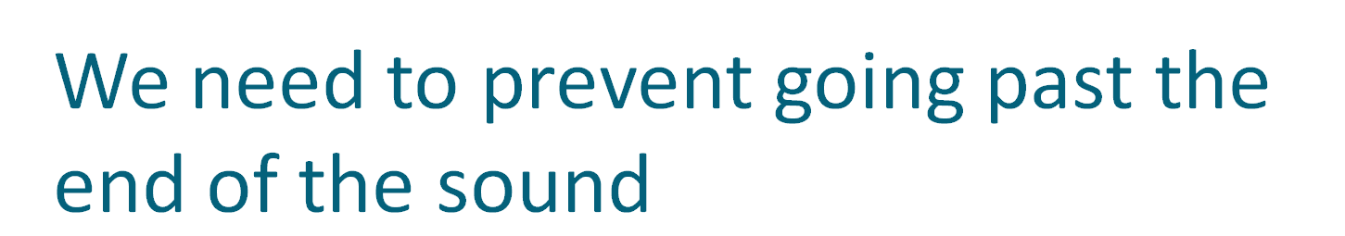
def shift(source, factor):
target = makeEmptySound(getLength(source))
sourceIndex = 0
for targetIndex in range(0, getLength( target)):
value = getSampleValueAt( source, int(sourceIndex))
setSampleValueAt( target, targetIndex, value)
sourceIndex = sourceIndex + factor
if sourceIndex > getLength(source):
sourceIndex = 0
play(target)
return target

Slide 17


For a desired frequency f we want a sampling interval like this:

Slide 18
How the original sound synthesizers worked
What if we added pure sine waves?
  We can generate a sound that is just a single tone (see the book)
  We can then add them together (perhaps manipulating their volume) to create sounds that don’t exist in nature
Don’t have to use just sine waves
  Waves that are square or triangular (seriously!) can be heard and have interesting dynamics
  We can add together waves of lots of types to create unique sounds that can’t be created by physical instruments
We call this additive synthesis
  Additive synthesis as-is isn’t used much anymore

Slide 19
Sampling as an Algorithm
Think about the similarities between:
  Halving the sound’s frequency and
  scaling a picture larger.
  Doubling the sound’s frequency and
  scaling a picture smaller.

Slide 20

def half(filename):
source = makeSound(filename)
target = makeSound(filename)
sourceIndex = 1
for targetIndex in range(1, getLength( target)+1):
setSampleValueAt( target, targetIndex,
getSampleValueAt( source,
int(sourceIndex)))
sourceIndex = sourceIndex + 0.5
play(target)
return target
def copyBarbsFaceLarger():
# Set up the source and target pictures
barbf=getMediaPath("barbara.jpg")
barb = makePicture(barbf)
canvasf = getMediaPath("7inX95in.jpg")
canvas = makePicture(canvasf)
# Now, do the actual copying
sourceX = 45
for targetX in range(100,100+((200-45)*2)):
sourceY = 25
for targetY in range(100,100+((200-25)*2)):
color = getColor(
getPixel(barb,int(sourceX),int(sourceY)))
setColor(getPixel(canvas,targetX,targetY), color)
sourceY = sourceY + 0.5
sourceX = sourceX + 0.5
show(barb)
show(canvas)
return canvas

Slide 21
Our programs (functions) implement algorithms
Algorithms are descriptions of behavior for solving a problem.
A program (our Python functions) is an executable interpretations of algorithms.
The same algorithm can be implemented in many different languages.
  The same algorithm can be applied to many different data sets with similar results.

Slide 22
Both of these functions implement a sampling algorithm
Both of them do very similar things:
Get an index to a source
Get an index to a target
For all the elements that we want to process:
  Copy an element from the source at the integer value of the source index
  to the target at the target index
  Increment the source index by 1/2
Return the target when completed
This is a description of the algorithm.

Slide 23
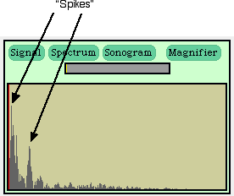
Adding sine waves to make something completely new
We saw earlier that complex sounds (like the sound of your voice or a trumpet) can be seen as being a sum of sine waves.
We can create complex sounds by summing sine waves.
These are sounds made by mathematics, by invention, not based on anything in nature.

Slide 24
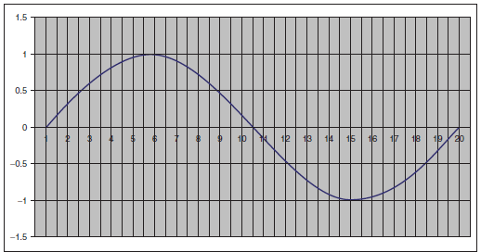

Basic idea: Build a sine wave
If we want a 440 Hz sound wave, then we need one of these cycles every 1/440th of a second.
We need to break this wave into the number of pieces in our sampling rate.

Slide 25

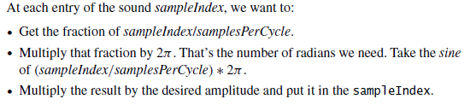

Slide 26
Our Code
def sineWave(freq ,amplitude ):
# Get a blank sound
mySound = getMediaPath(’sec1silence.wav’)
buildSin = makeSound(mySound)
# Set sound constant
sr = getSamplingRate(buildSin) # sampling rate
interval = 1.0/ freq # Make sure it’s floating point
samplesPerCycle = interval * sr # samples per cycle
maxCycle = 2 * pi
for pos in range (0, getLength(buildSin )):
rawSample = sin((pos / samplesPerCycle) * maxCycle)
sampleVal = int(amplitude*rawSample)
setSampleValueAt(buildSin ,pos ,sampleVal)
return buildSin

Slide 27
Adding pure sine waves together
>>> f440=sineWave (440 ,2000)
>>> f880=sineWave (880 ,4000)
>>> f1320=sineWave (1320 ,8000)
>>> addSounds(f880 ,f440)
>>> addSounds(f1320 ,f440)
>>> play(f440)
>>> explore(f440)
>>> just440=sineWave (440 ,2000)
>>> play(just440)
>>> explore(f440)
Adding together 440Hz, 880Hz, and 1320Hz, with increasing amplitudes.
Comparing to a 440Hz wave

Slide 28
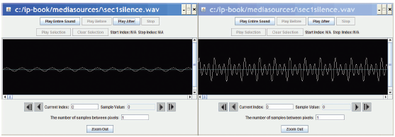
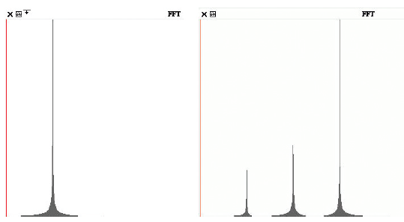
Comparing the waves
Left, 440 Hz; Right, combined wave.
In Explorer
In the Spectrum view in
MediaTools
440, 880, 1320

Slide 29
Making more complicated waves
Using square waves, instead of sine waves, can be a richer sound
# use float since interval is fl point
samplesPerCycle = interval * samplingRate
# we need to switch every half-cycle
samplesPerHalfCycle = int(samplesPerCycle / 2)
sampleVal = amplitude
s = 1
i = 1
for s in range (0, getLength(square)):
# if end of a half-cycle
if (i > samplesPerHalfCycle):
# reverse the amplitude every half-cycle
sampleVal = sampleVal * -1
# and reinitialize the half-cycle counter
i = 0
setSampleValueAt(square,s,sampleVal)
i = i + 1
return(square)
def squareWave(freq,amplitude):
# Get a blank sound
mySound = getMediaPath("sec1silence.wav")
square = makeSound(mySound)
# Set music constants
samplingRate = getSamplingRate(square)
seconds = 1 # play for 1 second
# Build tools for this wave
# seconds per cycle
interval = 1.0 * seconds / freq

Slide 30
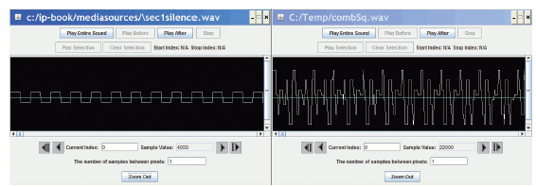
Building sounds with square waves
>>> sq440=squareWave(440,4000)
>>> play(sq440)
>>> sq880=squareWave(880,8000)
>>> sq1320=squareWave(1320,10000)
>>> writeSoundTo(sq440,"square440.wav")
>>> addSounds(sq880,sq440)
>>> addSounds(sq1320,sq440)
>>> play(sq440)
>>> writeSoundTo(sq440,"squarecombined440.wav")
Basic square wave
Summed square wave

Slide 31
Sound synthesis techniques
Adding sine and square (and triangle) waves is additive sound synthesis.
Most common modern synthesis technique is frequency modulation (FM) synthesis.
  Much richer sound.
Just about any way you can imagine to fill a sound mathematically can lead to an interesting synthesis technique.
  Create random noise, then filter parts out: Subtractive synthesis

Slide 32
Adding envelopes
Most real synthesizers today also allow you to manipulate envelopes
  An envelope is a definition of how quickly the aspects of the sound change over time
  For example, the rise in volume (attack), how the volume is sustained over time (sustain), how quickly the sound decays (decay): The ASD envelope
Pianos tend to attack quickly, then decay quickly (without pedals)
Flutes tend to attack slowly and sustain as long as you want.

Slide 33
Why write sound programs?
“Aren’t there audio tools that can do many of these things?”
Sure, and that’s good enough…if that’s good enough.
  If you just want to use a sound, then simply using tools to generate the noise/instrument/sound you want is fine.

Slide 34
Communicating process
What if you want to tell someone else how you got that sound, so that they can replicate the process, or even modify the sound in some way, or make it better?
You could write down all the steps in a sound application tool.
  Tedious, error prone.
Or you could provide a program.
  A succinct, executable definition of a process.

Slide 35
What is MP3?
MP3 files are files encoded according to the MPEG-3 standard.
They are audio files, but they are compressed in special ways.
  They use a model of how we hear to get rid of some of the sound.
    If there is a soft sound at the same time as a loud sound, don’t record the soft sound
  They use various compression techniques to make the sound smaller.
WAV files are compressed, but not as much, and don’t use any smart models to make themselves smaller.

Slide 36
What is MIDI?
MIDI is a standard for encoding music, not sound.
  MIDI literally encodes “For this instrument (track), turn key #42 on” then later “For this instrument (track), turn key #31 off.”
The quality of the actual sound depends entirely on the synthesizer—the quality of the instrument generation (whether recorded or synthesized).
MIDI files tend to be very, very small.
  Each MIDI instruction (“Play key #42 track 7”) is only about five bytes long.
  Not thousands of bytes long.

Slide 37
Playing MIDI in JES
The function playNote allows you to play MIDI piano with JES.
playNote takes three inputs:
  A note number
    Not a frequency—it’s literally the piano key number
    C in the first octave is 1, C# is 2, C in the fourth octave is 60, D in the fourth octave is 62.
  A duration in milliseconds (1/1000 of a second)
  An intensity (0-127)
    Literally, how hard the key is pressed

Slide 38
MIDI Example
def song():
playNote(60,200,127)
playNote(62,500,127)
playNote(64,800,127)
playNote(60,600,127)
for i in range(1,2):
playNote(64,120,127)
playNote(65,120,127)
playNote(67,60,127)
Notes:
Try playing with the parameters here – more repetition, longer notes, different notes

