Slide 1
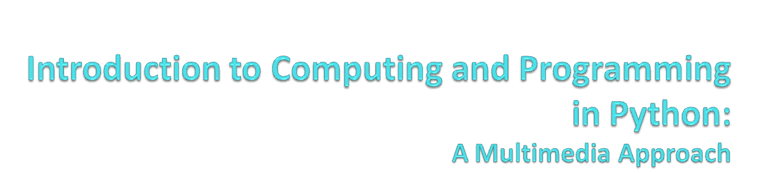
Chapter 9:
Building Bigger Programs
Notes:
Thanks to John Sanders of Suffolk University for contributions to these slides!

Slide 2

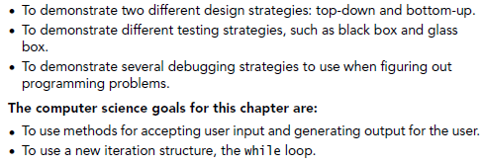

Slide 3
How to Design Larger Programs
Building something larger requires good software engineering.
  Top-down: Start from requirements, then identify the pieces to write, then write the pices.
  Bottom-up: Start building pieces you know, test them, combine them, and keep going until you have your program
  Debugging: Programming is “the art of debugging a blank sheet of paper.”
  Testing: Because nothing complicated and man-made is flawless.
  Maintenance: By far, the most expensive part of any program.

Slide 4
Top-Down Design
Start from a problem statement.
What are you trying to do?
Refine the problem statement.
Use hierarchical decomposition to define subparts.
Refine until you know how to write the programs.
Use procedural abstraction so that higher-level functions are written in terms of lower-level.

Slide 5
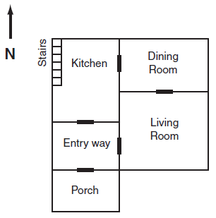
Example Top-Down Design:
An Adventure Game
Top-level function:
Tell the user how to play the game.
Describe the room.
Get the player’s command.
Figure out the next room.
Return to Step 2, until the user Quits.

Slide 6
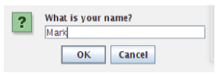

Two new functions
printNow(): Takes a string as input, and prints it on the Command Area immediately.
  Print waits until the program is done.
requestString(): Takes a prompt string as input, accepts a string from the user in a dialog window, then returns the user’s input.

Slide 7
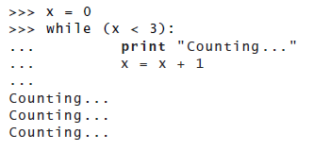
An important new loop
How do we keep going, indefinitely, until the user says “quit”?
  A while loop repeats a block until a test becomes false.

Slide 8
Writing the top level function
This function makes sense, even without knowing the lower level functions.
It is decoupled from the lower-level.
Working directly from our earlier outline.
def playGame ():
  location = "Porch"
showIntroduction ()
while not (location == "Exit") :
showRoom(location)
direction = requestString("Which direction?")
location = pickRoom(direction , location)

Slide 9
Writing the subfunctions
def showIntroduction ():
printNow("Welcome to the Adventure House!")
printNow("In each room , you will be told which directions you can go.")
printNow("You can move north , south , east , or west by typing that direction.")
printNow("Type help to replay this introduction.")
printNow("Type quit or exit to end the program.")
def showRoom(room ):
if room == "Porch":
showPorch ()
if room == "Entryway":
showEntryway ()
if room == "Kitchen":
showKitchen ()
if room == "LivingRoom":
showLR ()
if room == "DiningRoom":
showDR ()

Slide 10
pickRoom()
def pickRoom(direction , room ):
if (direction == "quit") or (direction == "exit"):
printNow("Goodbye!")
return "Exit"
if direction == "help":
showIntroduction ()
return room
if room == "Porch":
if direction == "north":
return "Entryway"
if room == "Entryway":
if direction == "north":
return "Kitchen"
if direction == "east":
return "LivingRoom"
if direction == "south":
return "Porch"
return "LivingRoom"

Slide 11
Rest of pickRoom()
if room == "Kitchen":
if direction == "east":
return "DiningRoom"
if direction == "south":
return "Entryway"
if room == "LivingRoom":
if direction == "west":
return "Entryway"
if direction == "north":
return "DiningRoom"
if room == "DiningRoom":
if direction == "west":
return "Kitchen"
if direction == "south":

Slide 12
Each room (function) describes itself
def showPorch():
printNow("You are on the porch of a frightening looking house.")
printNow("The windows are broken. It’s a dark and stormy night.")
printNow("You can go north into the house. If you dare.")
def showEntryway():
printNow("You are in the entry way of the house. There are cobwebs in the corner.")
printNow("You feel a sense of dread.")
printNow("There is a passageway to the north and another to the east.")
printNow("The porch is behind you to the south.")

Slide 13
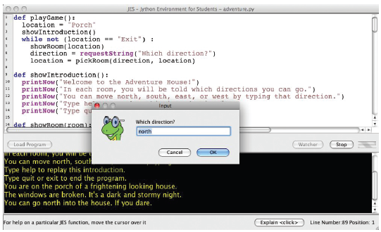
Running our program (so-far)
>>> playGame ()
Welcome to the Adventure House!
In each room , you will be told which directions you
can go.
You can move north , south , east , or west by typing that
direction.
Type help to replay this introduction.
Type quit or exit to end the program.
You are on the porch of a frightening looking house.

Slide 14


Testing our program
Try both expected,
and unexpected input.
We should return something reasonable in response to unreasonable input.

Slide 15
Returning a reasonable response to unreasonable pickRoom() input
def pickRoom(direction , room ):
  if (direction == "quit") or (direction == "exit"):
printNow("Goodbye!")
return "Exit"
if direction == "help":
showIntroduction ()
return room
…
if room == "DiningRoom":
if direction == "west":
return "Kitchen"
if direction == "south":
return "LivingRoom"
printNow("You can’t (or don’t want to) go in that direction.")
return room #Stay in current room

Slide 16
Now we handle unexpected input better
>>> pickRoom(’north ’,’Porch ’)
You can’t (or don’t want to) go in that direction.
’Porch ’
>>> pickRoom(’Entryway ’,’Porch ’)
You can’t (or don’t want to) go in that direction.
’Porch ’

Slide 17
Tips on Debugging
Learn to trace code
Print statements are your friends
Don’t be afraid to change the program
  Use comments to “remove” parts temporarily when testing.

Slide 18

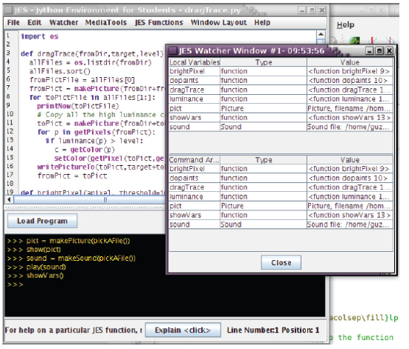

Slide 19
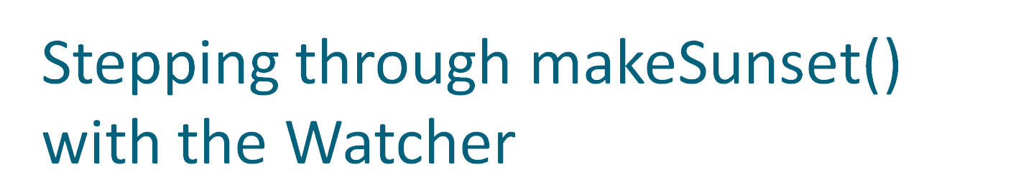
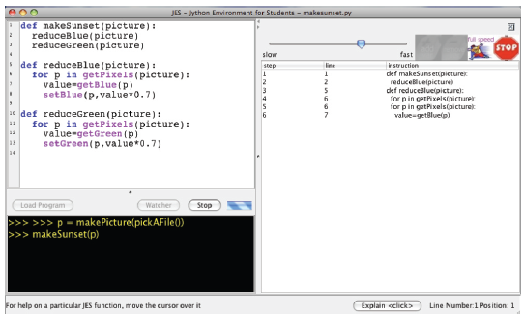

Slide 20
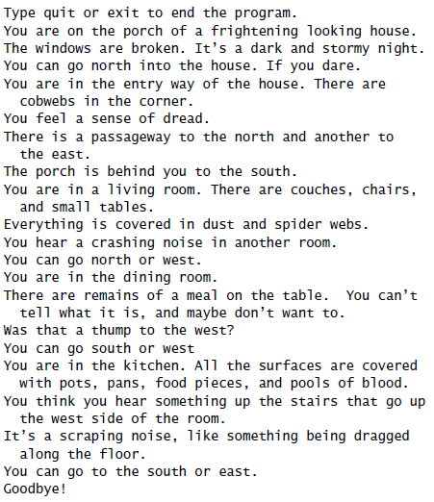
Improving the Adventure Game
When testing, we discover:
  It’s hard to tell which room was which when playing the game.
  We can’t figure out what we typed where.

Slide 21
Improving showRoom()
def showRoom(room ):
printNow("===========")
if room == "Porch":
showPorch ()
if room == "Entryway":
showEntryway ()
if room == "Kitchen":
showKitchen ()
if room == "LivingRoom":
showLR ()
if room == "DiningRoom":
showDR ()

Slide 22
Improving playGame()
def playGame ():
location = "Porch"
showIntroduction ()
while not (location == "Exit") :
showRoom(location)
direction = requestString("Which direction?")
printNow("You typed: "+direction)
location = pickRoom(direction , location)

Slide 23
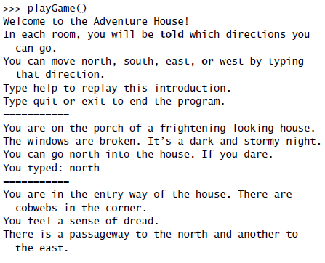
Better game play

Slide 24
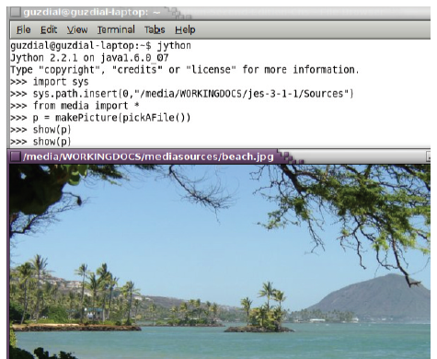
Running programs outside of JES
Once you make a larger program, you may want to run it in Jython directly.
  Import sys
  Insert the JES sources into your sys.path
  From media import *
That’s it!

