Slide 1
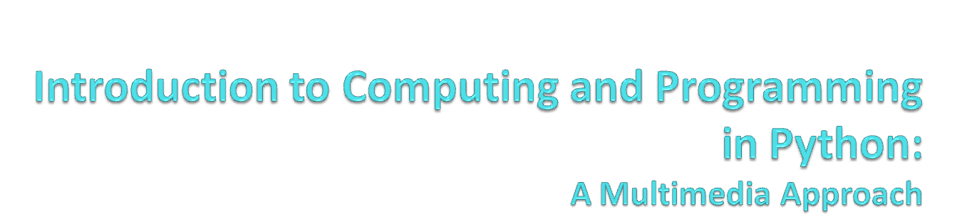
Chapter 10:
Creating and Modifying Text
Notes:
Thanks to John Sanders of Suffolk University for contributions to these slides!

Slide 2

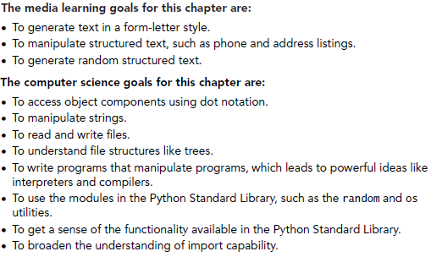

Slide 3
Text
Text is the universal medium
  We can convert any other media to a text representation.
  We can convert between media formats using text.
  Text is simple.
Like sound, text is usually processed in an array—a long line of characters
We refer to one of these long line of characters as strings.
  In many (especially older) programming languages, text is actually manipulated as arrays of characters. It’s horrible! Python actually knows how to deal with strings.

Slide 4
Strings
Strings are defined with quote marks.
Python actually supports three kinds of quotes:
  >>> print 'this is a string'
  this is a string
  >>> print "this is a string"
  this is a string
  >>> print """this is a string"""
  this is a string
Use the right one that allows you to embed quote marks you want
  >>> aSingleQuote = " ' "
  >>> print aSingleQuote
  '

Slide 5
Why would you want to use triple quotes?
To have long quotations with returns and such inside them.
>>> print aLongString()
This is a
long
string
>>>
def aLongString():
return """This is a
long
string"""

Slide 6
Encodings for strings
Strings are just arrays of characters
In most cases, characters are just single bytes.
  The ASCII encoding standard maps between single byte values and the corresponding characters
More recently, characters are two bytes.
  Unicode uses two bytes per characters so that there are encodings for glyphs (characters) of other languages
  Java uses Unicode. The version of Python we are using is based in Java, so our strings are actually using Unicode.

Slide 7
ASCII encoding through ord()
>>> str = "Hello"
>>> for char in str:
... print ord(char)
...
72
101
108
108
111

Slide 8
There are more characters than we can type
Our keyboards don’t have all the characters available to us, and it’s hard to type others into strings.
  Backspace?
  Return?
  ﻮ ?
We use backslash escapes to get other characters in to strings

Slide 9
Backslash escapes
“\b” is backspace
“\n” is a newline (pressing the Enter key)
“\t” is a tab
“\uXXXX” is a Unicode character, where XXXX is a code and each X can be 0-9 or A-F.
  http://www.unicode.org/charts/
  Must precede the string with “u” for Unicode to work

Slide 10
Testing strings
>>> print "hello\tthere\nMark"
hello there
Mark
>>> print u"\uFEED"
ﻭ
>>> print u"\u03F0"
ϰ
>>> print "This\bis\na\btest"
This_x0008_is
a_x0008_test

Slide 11
Manipulating strings
We can add strings and get their lengths using the kinds of programming features we’ve seen previously.
>>> hello = "Hello"
>>> print len(hello)
5
>>> mark = ", Mark"
>>> print len(mark)
6
>>> print hello+mark
Hello, Mark
>>> print len(hello+mark)
11

Slide 12
Getting parts of strings
We use the square bracket “[]” notation to get parts of strings.
string[n] gives you the n^{th} character in the string
string[n:m] gives you the n^{th} up to (but not including) the m^{th} character.

Slide 13
Getting parts of strings
>>> hello = "Hello"
>>> print hello[1]
e
>>> print hello[0]
H
>>> print hello[2:4]
ll
H
e
l
l
o
0
1
2
3
4

Slide 14
Start and end assumed if not there
>>> print hello
Hello
>>> print hello[:3]
Hel
>>> print hello[3:]
lo
>>> print hello[:]
Hello

Slide 15
Dot notation
All data in Python are actually objects
Objects not only store data, but they respond to special functions that only objects of the same type understand.
We call these special functions methods
  Methods are functions known only to certain objects
To execute a method, you use dot notation
  Object.method()

Slide 16
Capitalize is a method known only to strings
>>> test="this is a test."
>>> print test.capitalize()
This is a test.
>>> print capitalize(test)
A local or global name could not be found.
NameError: capitalize
>>> print 'this is another test'.capitalize()
This is another test
>>> print 12.capitalize()
A syntax error is contained in the code -- I can't read it as Python.

Slide 17
Useful string methods
startswith(prefix) returns true if the string starts with the given suffix
endswith(suffix) returns true if the string ends with the given suffix
find(findstring) and find(findstring,start) and find(findstring,start,end) finds the findstring in the object string and returns the index number where the string starts. You can tell it what index number to start from, and even where to stop looking. It returns -1 if it fails.
There is also rfind(findstring) (and variations) that searches from the end of the string toward the front.

Slide 18
Demonstrating startswith
>>> letter = "Mr. Mark Guzdial requests the pleasure of your company..."
>>> print letter.startswith("Mr.")
1
>>> print letter.startswith("Mrs.")
0
Remember that Python sees “0” as false and anything else (including “1”) as true

Slide 19
Demonstrating endswith
>>> filename="barbara.jpg"
>>> if filename.endswith(".jpg"):
... print "It's a picture"
...
It's a picture

Slide 20
Demonstrating find
>>> print letter
Mr. Mark Guzdial requests the pleasure of your company...
>>> print letter.find("Mark")
4
>>> print letter.find("Guzdial")
9
>>> print len("Guzdial")
7
>>> print letter[4:9+7]
Mark Guzdial
>>> print letter.find("fred")
-1

Slide 21
Interesting string methods
upper() translates the string to uppercase
lower() translates the string to lowercase
swapcase() makes all upper->lower and vice versa
title() makes just the first characters uppercase and the rest lower.
isalpha() returns true if the string is not empty and all letters
isdigit() returns true if the string is not empty and all numbers
Notes:
Do all of these in the command area

Slide 22
Replace method
>>> print letter
Mr. Mark Guzdial requests the pleasure of your company...
>>> letter.replace("a","!")
'Mr. M!rk Guzdi!l requests the ple!sure of your comp!ny...'
>>> print letter
Mr. Mark Guzdial requests the pleasure of your company...

Slide 23
Strings are sequences
>>> for i in "Hello":
... print i
...
H
e
l
l
o

Slide 24
Lists
We’ve seen lists before—that’s what range() returns.
Lists are very powerful structures.
  Lists can contain strings, numbers, even other lists.
  They work very much like strings
    You get pieces out with []
    You can add lists together
    You can use for loops on them
  We can use them to process a variety of kinds of data.

Slide 25
Demonstrating lists
>>> mylist = ["This","is","a", 12]
>>> print mylist
['This', 'is', 'a', 12]
>>> print mylist[0]
This
>>> for i in mylist:
... print i
...
This
is
a
12
>>> print mylist + ["Really!"]
['This', 'is', 'a', 12, 'Really!']

Slide 26
Useful methods to use with lists:
But these don’t work with strings
append(something) puts something in the list at the end.
remove(something) removes something from the list, if it’s there.
sort() puts the list in alphabetical order
reverse() reverses the list
count(something) tells you the number of times that something is in the list.
max() and min() are functions (we’ve seen them before) that take a list as input and give you the maximum and minimum value in the list.
Notes:
Do all of these in the command area

Slide 27
Converting from strings to lists
>>> print letter.split(" ")
['Mr.', 'Mark', 'Guzdial', 'requests', 'the', 'pleasure', 'of', 'your', 'company...']

Slide 28
Extended Split Example
def phonebook():
return """
Mary:893-0234:Realtor:
Fred:897-2033:Boulder crusher:
Barney:234-2342:Professional bowler:"""
def phones():
phones = phonebook()
phonelist = phones.split('\n')
newphonelist = []
for list in phonelist:
newphonelist = newphonelist + [list.split(":")]
return newphonelist
def findPhone(person):
for people in phones():
if people[0] == person:
print "Phone number for",person,"is",people[1]

Slide 29
Running the Phonebook
>>> print phonebook()
Mary:893-0234:Realtor:
Fred:897-2033:Boulder crusher:
Barney:234-2342:Professional bowler:
>>> print phones()
[[''], ['Mary', '893-0234', 'Realtor', ''], ['Fred', '897-2033', 'Boulder crusher', ''], ['Barney', '234-2342', 'Professional bowler', '']]
>>> findPhone('Fred')
Phone number for Fred is 897-2033

Slide 30
Strings have no font
Strings are only the characters of text displayed “WYSIWYG” (What You See is What You Get)
  WYSIWYG text includes fonts and styles
The font is the characteristic look of the letters in all sizes
The style is typically the boldface, italics, underline, and other effects applied to the font
  In printer’s terms, each style is its own font

Slide 31
Encoding font information
Font and style information is often encoded as style runs
  A separate representation from the string
  Indicates bold, italics, or whatever style modification; start character; and end character.
The old brown fox runs.
Could be encoded as:
"The old brown fox runs."
[[bold 0 6] [italics 5 12]]

Slide 32
How do we encode all that?
Is it a single value? Not really.
Do we encode it all in a complex list? We could.
How do most text systems handle this?
  As objects
    Objects have data, maybe in many parts.
    Objects know how to act upon their data.
    Objects’ methods may be known only to that object, or may be known by many objects, but each object performs that method differently.

Slide 33
What can we do with all this?
Answer: Just about anything!
Strings and lists are about as powerful as one gets in Python
  By “powerful,” we mean that we can do a lot of different kinds of computation with them.
Examples:
  Pull up a Web page and grab information out of it, from within a function.
  Find a nucleotide sequence in a string and print its name.
  Manipulate functions’ source
But first, we have to learn how to manipulate files…

Slide 34

Files: Places to put strings and other stuff
Files are these named large collections of bytes.
Files typically have a base name and a suffix
  barbara.jpg has a base name of “barbara” and a suffix of “.jpg”
Files exist in directories (sometimes called folders)
Tells us that the file “640x480.jpg” is in the folder “mediasources” in the folder “ip-book” on the disk “C:”

Slide 35
Directories
Directories can contain files or other directories.
There is a base directory on your computer, sometimes called the root directory
A complete description of what directories to visit to get to your file is called a path

Slide 36
We call this structure a “tree”
C:\
C:\ is the root of the tree.
It has branches, each of which is a directory
Any directory (branch) can contain more directories (branches) and files (leaves)
Documents and Settings
Windows
Mark Guzdial
mediasources
cs1315
640x480.jpg

Slide 37
Why do I care about all this?
If you’re going to process files, you need to know where they are (directories) and how to specify them (paths).
If you’re going to do movie processing, which involves lots of files, you need to be able to write programs that process all the files in a directory (or even several directories) without having to write down each and every name of the files.

Slide 38
Using lists to represent trees
>>> tree = [["Leaf1","Leaf2"],[["Leaf3"],["Leaf4"],"Leaf5"]]
>>> print tree
[['Leaf1', 'Leaf2'], [['Leaf3'], ['Leaf4'], 'Leaf5']]
>>> print tree[0]
['Leaf1', 'Leaf2']
>>> print tree[1]
[['Leaf3'], ['Leaf4'], 'Leaf5']
>>> print tree[1][0]
['Leaf3']
>>> print tree[1][1]
['Leaf4']
>>> print tree[1][2]
Leaf5
Leaf5
Leaf1
Leaf3
Leaf4
Leaf2
The Point: Lists allow us to represent complex relationships, like trees

Slide 39
How to open a file
For reading or writing a file (getting characters out or putting characters in), you need to use open
open(filename,how) opens the filename.
  If you don’t provide a full path, the filename is assumed to be in the same directory as JES.
how is a two character string that says what you want to do with the string.
  “rt” means “read text”
  “wt” means “write text”
  “rb” and “wb” means read or write bytes
    We won’t do much of that

Slide 40
Methods on files:
Open returns a file object
open() returns a file object that you use to manipulate the file
  Example: file=open(“myfile”,”wt”)
file.read() reads the whole file as a single string.
file.readlines() reads the whole file into a list where each element is one line.
  read() and readlines() can only be used once without closing and reopening the file.
file.write(something) writes something to the file
file.close() closes the file—writes it out to the disk, and won’t let you do any more to it without re-opening it.

Slide 41
Reading a file
>>> program=pickAFile()
>>> print program
C:\Documents and Settings\Mark Guzdial\My Documents\py-programs\littlepicture.py
>>> file=open(program,"rt")
>>> contents=file.read()
>>> print contents
def littlepicture():
canvas=makePicture(getMediaPath("640x480.jpg"))
addText(canvas,10,50,"This is not a picture")
addLine(canvas,10,20,300,50)
addRectFilled(canvas,0,200,300,500,yellow)
addRect(canvas,10,210,290,490)
return canvas
>>> file.close()

Slide 42
Reading a file by lines
>>> file=open(program,"rt")
>>> lines=file.readlines()
>>> print lines
['def littlepicture():\n', ' canvas=makePicture(getMediaPath("640x480.jpg"))\n', ' addText(canvas,10,50,"This is not a picture")\n', ' addLine(canvas,10,20,300,50)\n', ' addRectFilled(canvas,0,200,300,500,yellow)\n', ' addRect(canvas,10,210,290,490)\n', ' return canvas']
>>> file.close()

Slide 43
Silly example of writing a file
>>> writefile = open("myfile.txt","wt")
>>> writefile.write("Here is some text.")
>>> writefile.write("Here is some more.\n")
>>> writefile.write("And now we're done.\n\nTHE END.")
>>> writefile.close()
>>> writefile=open("myfile.txt","rt")
>>> print writefile.read()
Here is some text.Here is some more.
And now we're done.
THE END.
>>> writefile.close()
Notice the \n to make new lines

Slide 44
How you get spam
def formLetter(gender ,lastName ,city ,eyeColor ):
file = open("formLetter.txt","wt")
file.write("Dear ")
if gender =="F":
file.write("Ms. "+lastName+":\n")
if gender =="M":
file.write("Mr. "+lastName+":\n")
file.write("I am writing to remind you of the offer ")
file.write("that we sent to you last week. Everyone in ")
file.write(city+" knows what an exceptional offer this is!")
file.write("(Especially those with lovely eyes of"+eyeColor+"!)")
file.write("We hope to hear from you soon .\n")
file.write("Sincerely ,\n")
file.write("I.M. Acrook , Attorney at Law")
file.close ()

Slide 45
Trying out our spam generator
>>> formLetter("M","Guzdial","Decatur","brown")
Dear Mr. Guzdial:
I am writing to remind you of the offer that we
sent to you last week. Everyone in Decatur knows what
an exceptional offer this is!(Especially those with
lovely eyes of brown!)We hope to hear from you soon.
Sincerely,
I.M. Acrook,
Attorney at Law
Only use this power for good!

Slide 46
Writing a program to write programs
First, a function that will automatically change the text string that the program “littlepicture” draws
As input, we’ll take a new filename and a new string.
We’ll find() the addText, then look for the first double quote, and then the final double quote.
Then we’ll write out the program as a new string to a new file.

Slide 47
Changing the little program automatically
def changeLittle(filename,newstring):
# Get the original file contents
programfile=r"C:\Documents and Settings\Mark Guzdial\My Documents\py-programs\littlepicture.py"
file = open(programfile,"rt")
contents = file.read()
file.close()
# Now, find the right place to put our new string
addtext = contents.find("addText")
firstquote = contents.find('"',addtext) #Double quote after addText
endquote = contents.find('"',firstquote+1) #Double quote after firstquote
# Make our new file
newfile = open(filename,"wt")
newfile.write(contents[:firstquote+1]) # Include the quote
newfile.write(newstring)
newfile.write(contents[endquote:])
newfile.close()
Notes:
Be sure to walk through this at the command line

Slide 48
changeLittle("sample.py","Here is a sample of changing a program")
Original:
Modified:
def littlepicture():
canvas=makePicture(getMediaPath("640x480.jpg"))
addText(canvas,10,50,"This is not a picture")
addLine(canvas,10,20,300,50)
addRectFilled(canvas,0,200,300,500,yellow)
addRect(canvas,10,210,290,490)
return canvas
def littlepicture():
canvas=makePicture(getMediaPath("640x480.jpg"))
addText(canvas,10,50,"Here is a sample of changing a program")
addLine(canvas,10,20,300,50)
addRectFilled(canvas,0,200,300,500,yellow)
addRect(canvas,10,210,290,490)
return canvas

Slide 49
That’s how vector-based drawing programs work!
Editing a line in AutoCAD doesn’t change the pixels.
It changes the underlying representation of what the line should look like.
It then runs the representation and creates the pixels all over again.
Is that slower?
  Who cares? (Refer to Moore’s Law…)

Slide 50
Finding data on the Internet
The Internet is filled with wonderful data, and almost all of it is in text!
Later, we’ll write functions that directly grab files from the Internet, turn them into strings, and pull information out of them.
For now, let’s assume that the files are on your disk, and let’s process them from there.

Slide 51
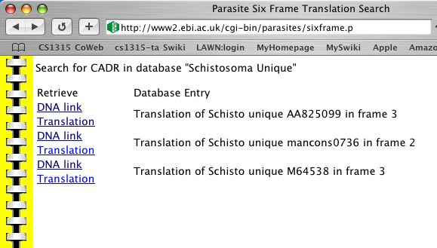
Example: Finding the nucleotide sequence
There are places on the Internet where you can grab DNA sequences of things like parasites.
What if you’re a biologist and want to know if a sequence of nucleotides that you care about is in one of these parasites?
We not only want to know “yes” or “no,” but which parasite.

Slide 52
What the data looks like
>Schisto unique AA825099
gcttagatgtcagattgagcacgatgatcgattgaccgtgagatcgacga
gatgcgcagatcgagatctgcatacagatgatgaccatagtgtacg
>Schisto unique mancons0736
ttctcgctcacactagaagcaagacaatttacactattattattattatt
accattattattattattattactattattattattattactattattta
ctacgtcgctttttcactccctttattctcaaattgtgtatccttccttt

Slide 53
How are we going to do it?
First, we get the sequences in a big string.
Next, we find where the small subsequence is in the big string.
From there, we need to work backwards until we find “>” which is the beginning of the line with the sequence name.
From there, we need to work forwards to the end of the line. From “>” to the end of the line is the name of the sequence
  Yes, this is hard to get just right. Lots of debugging prints.

Slide 54
The code that does it
def findSequence(seq):
sequencesFile = getMediaPath("parasites.txt")
file = open(sequencesFile,"rt")
sequences = file.read()
file.close()
# Find the sequence
seqloc = sequences.find(seq)
#print "Found at:",seqloc
if seqloc <> -1:
# Now, find the ">" with the name of the sequence
nameloc = sequences.rfind(">",0,seqloc)
#print "Name at:",nameloc
endline = sequences.find("\n",nameloc)
print "Found in ",sequences[nameloc:endline]
if seqloc == -1:
print "Not found"

Slide 55
Why -1?
If .find or .rfind don’t find something, they return -1
  If they return 0 or more, then it’s the index of where the search string is found.
What’s “<>”?
  That’s notation for “not equals”
  You can also use “!=“

Slide 56
Running the program
>>> findSequence("tagatgtcagattgagcacgatgatcgattgacc")
Found in >Schisto unique AA825099
>>> findSequence("agtcactgtctggttgaaagtgaatgcttccaccgatt")
Found in >Schisto unique mancons0736

Slide 57
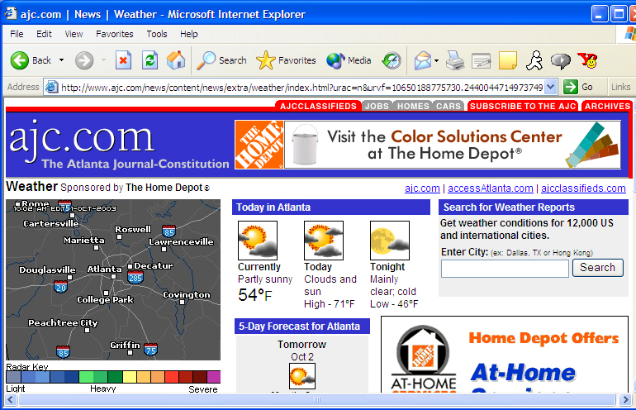
Example: Get the temperature
The weather is always available on the Internet.
Can we write a function that takes the current temperature out of a source like http://www.ajc.com/weather or http://www.weather.com?

Slide 58
The Internet is mostly text
Text is the other unimedia.
Web pages are actually text in the format called HTML (HyperText Markup Language)
  HTML isn’t a programming language,
  it’s an encoding language.
  It defines a set of meanings for certain characters, but one can’t program in it.
We can ignore the HTML meanings for now, and just look at patterns in the text.

Slide 59
Where’s the temperature?
The word “temperature” doesn’t really show up.
But the temperature always follows the word “Currently”, and always comes before the “<b>&deg;</b>”
<td ><img
src="/shared-local/weather/images/ps.gif" width="48" height="48" border="0"><font size=-2><br></font><font
size="-1" face="Arial, Helvetica, sans-serif"><b>Currently</b><br>
Partly sunny<br>
<font size="+2">54<b>&deg;</b></font><font face="Arial, Helvetica, sans-serif" size="+1">F</font></font></td>
</tr>

Slide 60
We can use the same algorithm we’ve seen previously
Grab the content out of a file in a big string.
  (We’ve saved the HTML page previously.
  Soon, we’ll see how to grab it directly.)
Find the starting indicator (“Currently”)
Find the ending indicator (“<b>&deg;”)
Read the previous characters

Slide 61
Finding the temperature
def findTemperature():
weatherFile = getMediaPath("ajc-weather.html")
file = open(weatherFile,"rt")
weather = file.read()
file.close()
# Find the Temperature
curloc = weather.find("Currently")
if curloc <> -1:
# Now, find the "<b>&deg;" following the temp
temploc = weather.find("<b>&deg;",curloc)
tempstart = weather.rfind(">",0,temploc)
print "Current temperature:",weather[tempstart+1:temploc]
if curloc == -1:
print "They must have changed the page format -- can't find the temp"

Slide 62
Adding new capabilities: Modules
What we need to do is to add capabilities to Python that we haven’t seen so far.
We do this by importing external modules.
A module is a file with a bunch of additional functions and objects defined within it.
  Some kind of module capability exists in virtually every programming language.
By importing the module, we make the module’s capabilities available to our program.
  Literally, we are evaluating the module, as if we’d typed them into our file.

Slide 63
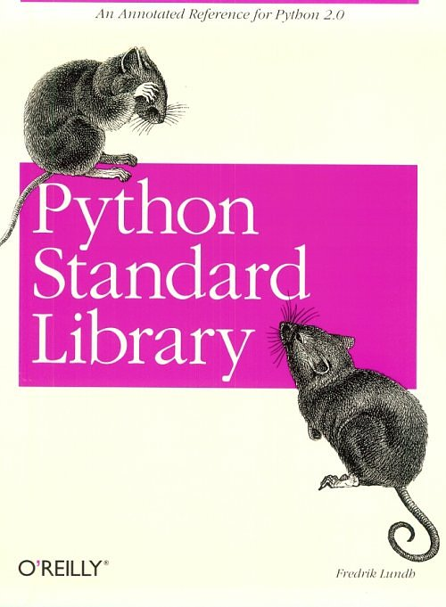
Python’s Standard Library
Python has an extensive library of modules that come with it.
The Python standard library includes modules that allow us to access the Internet, deal with time, generate random numbers, and…access files in a directory.

Slide 64
Accessing pieces of a module
We access the additional capabilities of a module using dot notation, after we import the module.
How do you know what pieces are there?
  Check the documentation.
  Python comes with a Library Guide.
  There are books like Python Standard Library that describe the modules and provide examples.

Slide 65
The OS Module
The OS module offers a number of powerful capabilities for dealing with files, e.g., renaming files, finding out when a file was last modified, and so on.
We start accessing the OS module by typing:
  import os
The function that knows about directories is listdir(), used as os.listdir()
  listdir takes a path to a directory as input.

Slide 66
Using os.listdir
>>> import os
>>> print getMediaPath("barbara.jpg")
C:\Documents and Settings\Mark Guzdial\My Documents\mediasources\barbara.jpg
>>> print getMediaPath("pics")
Note: There is no file at C:\Documents and Settings\Mark Guzdial\My Documents\mediasources\pics
C:\Documents and Settings\Mark Guzdial\My Documents\mediasources\pics
>>> print os.listdir("C:\Documents and Settings\Mark Guzdial\My Documents\mediasources\pics")
['students1.jpg', 'students2.jpg', 'students5.jpg', 'students6.jpg', 'students7.jpg', 'students8.jpg']

Slide 67
Writing a program to title pictures
We’ll input a directory
We’ll use os.listdir() to get each filename in the directory
  We’ll open the file as a picture.
  We’ll title it.
  We’ll save it out as “titled-” and the filename.

Slide 68
Titling Pictures
import os
def titleDirectory(dir):
for file in os.listdir(dir):
picture = makePicture(file)
addText(picture,10,10,"This is from My CS CLass")
writePictureTo(picture,"titled-"+file)

Slide 69
Okay, that didn’t work
>>> titleDirectory("C:\Documents and Settings\Mark Guzdial\My Documents\mediasources\pics")
makePicture(filename): There is no file at students1.jpg
An error occurred attempting to pass an argument to a function.

Slide 70
Why not?
Is there a file where we tried to open the picture?
Actually, no. Look at the output of os.listdir() again
>>> print os.listdir("C:\Documents and Settings\Mark Guzdial\My Documents\mediasources\pics")
['students1.jpg', 'students2.jpg', 'students5.jpg', 'students6.jpg', 'students7.jpg', 'students8.jpg']
The strings in the list are just the base names
  No paths

Slide 71
Creating paths
If the directory string is in the placeholder variable dir, then dir+file is the full pathname, right?
Close—you still need a path delimiter, like “/”
  But it’s different for each platform!
  Python gives us a notation that works: “//” is as a path delimiter for any platform.
  So: dir+”//”+file

Slide 72
A Working Titling Program
import os
def titleDirectory(dir):
for file in os.listdir(dir):
print "Processing:",dir+"//"+file
picture = makePicture(dir+"//"+file)
addText(picture,10,10,"This is from My CS Class")
writePictureTo(picture,dir+"//"+"titled-"+file)

Slide 73
Showing it work
>>> titleDirectory("C:\Documents and Settings\Mark Guzdial\My Documents\mediasources\pics")
Processing: C:\Documents and Settings\Mark Guzdial\My Documents\mediasources\pics//students1.jpg
Processing: C:\Documents and Settings\Mark Guzdial\My Documents\mediasources\pics//students2.jpg
Processing: C:\Documents and Settings\Mark Guzdial\My Documents\mediasources\pics//students5.jpg
Processing: C:\Documents and Settings\Mark Guzdial\My Documents\mediasources\pics//students6.jpg
Processing: C:\Documents and Settings\Mark Guzdial\My Documents\mediasources\pics//students7.jpg
Processing: C:\Documents and Settings\Mark Guzdial\My Documents\mediasources\pics//students8.jpg
>>> print os.listdir("C:\Documents and Settings\Mark Guzdial\My Documents\mediasources\pics")
['students1.jpg', 'students2.jpg', 'students5.jpg', 'students6.jpg', 'students7.jpg', 'students8.jpg', 'titled-students1.jpg', 'titled-students2.jpg', 'titled-students5.jpg', 'titled-students6.jpg', 'titled-students7.jpg', 'titled-students8.jpg']

Slide 74


Inserting a copyright on pictures

Slide 75
What if you want to make sure you’ve got JPEG files?
import os
def titleDirectory(dir):
for file in os.listdir(dir):
print "Processing:",dir+"//"+file
if file.endswith(".jpg"):
picture = makePicture(dir+"//"+file)
addText(picture,10,10,"This is from My CS Class")
writePictureTo(picture,dir+"//"+"titled-"+file)

Slide 76
Say, if thumbs.db is there
>>> titleDirectory("C:\Documents and Settings\Mark Guzdial\My Documents\mediasources\pics")
Processing: C:\Documents and Settings\Mark Guzdial\My Documents\mediasources\pics//students1.jpg
Processing: C:\Documents and Settings\Mark Guzdial\My Documents\mediasources\pics//students2.jpg
Processing: C:\Documents and Settings\Mark Guzdial\My Documents\mediasources\pics//students5.jpg
Processing: C:\Documents and Settings\Mark Guzdial\My Documents\mediasources\pics//students6.jpg
Processing: C:\Documents and Settings\Mark Guzdial\My Documents\mediasources\pics//students7.jpg
Processing: C:\Documents and Settings\Mark Guzdial\My Documents\mediasources\pics//students8.jpg
Processing: C:\Documents and Settings\Mark Guzdial\My Documents\mediasources\pics//Thumbs.db
>>> print os.listdir("C:\Documents and Settings\Mark Guzdial\My Documents\mediasources\pics")
['students1.jpg', 'students2.jpg', 'students5.jpg', 'students6.jpg', 'students7.jpg', 'students8.jpg', 'Thumbs.db', 'titled-students1.jpg', 'titled-students2.jpg', 'titled-students5.jpg', 'titled-students6.jpg', 'titled-students7.jpg', 'titled-students8.jpg']

Slide 77
Another interesting module: Random
>>> import random
>>> for i in range(1,10):
... print random.random()
...
0.8211369314193928
0.6354266779703246
0.9460060163520159
0.904615696559684
0.33500464463254187
0.08124982126940594
0.0711481376807015
0.7255217307346048
0.2920541211845866

Slide 78
Randomly choosing words from a list
>>> for i in range(1,5):
... print random.choice(["Here", "is", "a", "list", "of", "words", "in","random","order"])
...
list
a
Here
list

Slide 79
Randomly generating language
Given a list of nouns,
verbs that agree in tense and number,
and object phrases that all match the verb,
We can randomly take one from each to make sentences.

Slide 80
Random sentence generator
import random
def sentence():
nouns = ["Mark", "Adam", "Angela", "Larry", "Jose", "Matt", "Jim"]
verbs = ["runs", "skips", "sings", "leaps", "jumps", "climbs", "argues", "giggles"]
phrases = ["in a tree", "over a log", "very loudly", "around the bush", "while reading the newspaper"]
phrases = phrases + ["very badly", "while skipping","instead of grading", "while typing on the Internet."]
print random.choice(nouns), random.choice(verbs), random.choice(phrases)

Slide 81
Running the sentence generator
>>> sentence()
Jose leaps while reading the newspaper
>>> sentence()
Jim skips while typing on the Internet.
>>> sentence()
Matt sings very loudly
>>> sentence()
Adam sings in a tree
>>> sentence()
Adam sings around the bush
>>> sentence()
Angela runs while typing on the Internet.
>>> sentence()
Angela sings around the bush
>>> sentence()
Jose runs very badly

Slide 82
How much smarter can we make this?
Can we have different kinds of lists so that, depending on the noun selected, picks the right verb list to get a match in tense and number?
How about reading input from the user, picking out key words, then generating an “appropriate response”?
if input.find(“mother”) <> -1:
print “Tell me more about your mother…”
Notes:
Demo eliza here.

Slide 83
Joseph Weizenbaum’s “Eliza”
Created a program that acted like a Rogerian therapist.
  Echoing back to the user whatever they said, as a question.
  It had rules that triggered on key words in the user’s statements.
  It had a little memory of what it had said before.
People really believed it was a real therapist!
  Convinced Weizenbaum of the dangers of computing.

Slide 84
Session with the “Doctor”
>>>My mother bothers me.
Tell me something about your family.
>>>My father was a caterpillar.
You seem to dwell on your family.
>>>My job isn't good either.
Is it because of your plans that you say your job is not good either?
Note that this is all generated automatically.

Slide 85

Many other Python Standard Libraries
datetime and calendar know about dates.
  What day of the week was the US Declaration of Independence signed? Thursday.
math knows about sin() and sqrt()
zipfile knows how to make and read .zip files
email lets you (really!) build your own spam program, or filter spam, or build an email tool for yourself.
SimpleHTTPServer is a complete working Web server.

