Slide 1
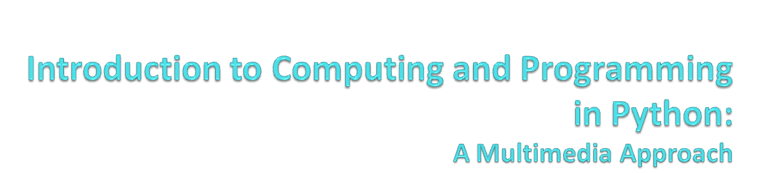
Chapter 16:
Topics in Computer Science: Object-Oriented Programming
Notes:
Thanks to John Sanders of Suffolk University for contributions to these slides!

Slide 2

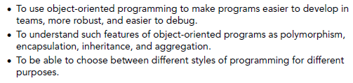

Slide 3
History of Objects: Where they came from
Start of the Story: Late 60's and Early 70's
  Windows are made of glass, mice are undesirable rodents
  Good programming = Procedural Abstraction
    Verb-oriented

Slide 4
Procedural Abstractions
Define tasks to be performed
Break tasks into smaller and smaller pieces
  Until you reach an implementable size
Define the data to be manipulated
Design how functions interact
  What's the input
  What's the output
Group functions into components (“modules" or "classes")
Write the code

Slide 5
Object-oriented programming
First goal: Model the objects of the world
  Noun-oriented
  Focus on the domain of the program
Phases
  Object-oriented analysis: Understand the domain
    Define an object-based model of it
  Object-oriented design: Define an implementation
    Design the solution
  Object-oriented programming: Build it

Slide 6
How’d we get from there to here?
Key ideas
  Master-drawings in Sketchpad
  Simulation “objects” in Simula
Alan Kay and a desire to make software better
  More robust, more maintainable, more scalable

Slide 7
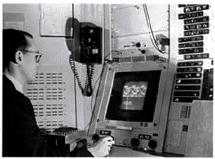
Birth of Objects, 1 of 2
Ivan Sutherland's Sketchpad, 1963

Slide 8
Sketchpad
First object-oriented drawing program
Master and instance drawings
  Draw a house
  Make an instance
  Add a chimney to the master
  Poof! The instance grows a chimney
Other interesting features
  1/3 Mile Square Canvas
  Invention of “rubber band” lines
  Simple animations

Slide 9
Birth of Objects, 2 of 2
Simula
  Simulation programming language from Norway, 1966
  Define an activity which can be instantiated as processes
  Each process has it own data and behavior
    In real world, objects don't mess with each others' internals directly
  (Simulated) Multi-processing
    No Universal Scheduler in the Real World

Slide 10
Alan Kay
U. Utah PhD student in 1966
  Read Sketchpad, Ported Simula
Saw “objects” as the future of computer science
His dissertation: Flex, an object-oriented personal computer
  A personal computer was a radical idea then

Slide 11
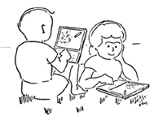
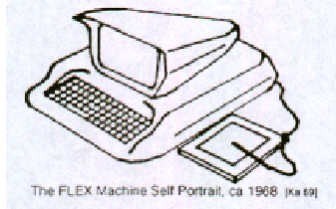
"A Personal Computer for Children of All Ages"
Flex, an object-oriented personal computer
Enabled by Moore's Law
  Imagining personal computing in 1969
Computer as meta-medium
  The first medium to encompass other media
A 1970’s depiction of students
using an object-oriented system based on Flex

Slide 12
Kay’s Insights
“Computer” as collection of Networked Computers
All software is simulating the real world
Biology as model for objects
  Bacterium has 120M of info, 1/500th of a Cell, and we have 1013 of these in us.
    Talk about processing power! Talk about managing complexity!
  What man-made things can scale like that?
    Stick a million dog houses together to get the Empire State Building?

Slide 13
Birth of Objects
Objects as models of real world entities
Objects as Cells
  Independent, indivisible, interacting—in standard ways
  Scales well
    Complexity: Distributed responsibility
    Robustness: Independent
    Supporting growth: Same mechanism everywhere
    Reuse: Provide services, just like in real world

Slide 14
Alan Kay’s Dynabook (1972)
Alan Kay sees the Computer as Man’s first metamedium
  A medium that can represent any other media: Animation, graphics, sound, photography, etc.
  Programming is yet another medium
The Dynabook is a (yet mythical) computer for creative metamedia exploration and reading
  Handheld, wireless network connection
  Writing (typing), drawing and painting, sound recording, music composition and synthesis
  End-user programming

Slide 15
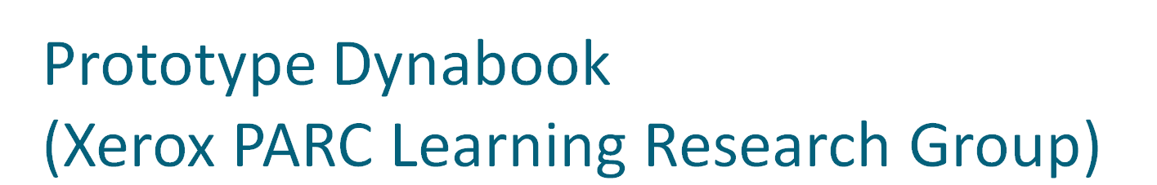
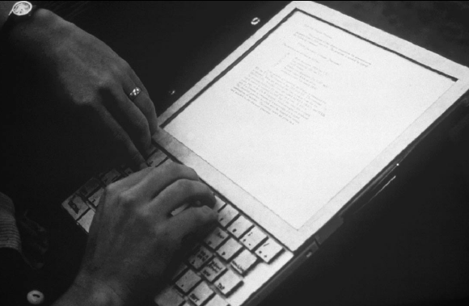

Slide 16
A Dynabook is for Learning
The Dynabook offers a new way to learn new kinds of things
  Dynamic systems (like evolution)
    Especially decentralized ones (Resnick, 1992)
  Knowledge representation (Papert, 1980)
  Programming (Kay & Goldberg, 1977)
But need a system for creative expression
  In a time when “windows” were made of glass, and “mice” were undesirable rodents

Slide 17
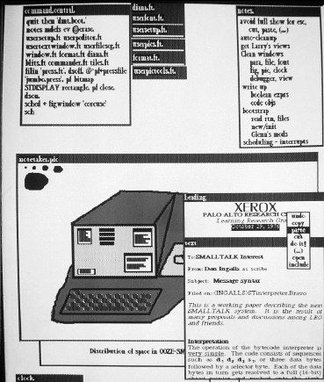

Smalltalk was the programming language invented for the Dynabook.
For the Dynabook, WIMP was invented:
  overlapping Windows
  Icons
  Menus
  mouse Pointer

Slide 18
A first Object: Logo Turtle
Dr. Seymour Papert at MIT invented the Turtle as a graphical and mathematical object to think with for the children’s programming language, Logo
A turtle is an object.
  Every turtle understands the same methods.
  Every turtle has the same fields or instance variables.
    Heading, body color, pen color, X and Y position.
    Yet each turtle can have its own values for these fields.

Slide 19
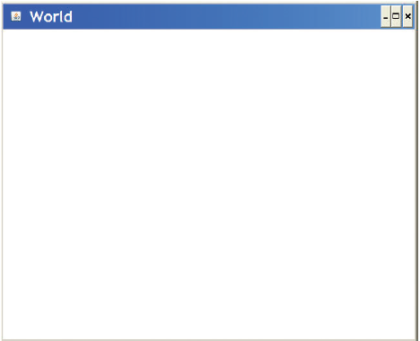
Using Turtles in Python
>>> makeWorld()

Slide 20
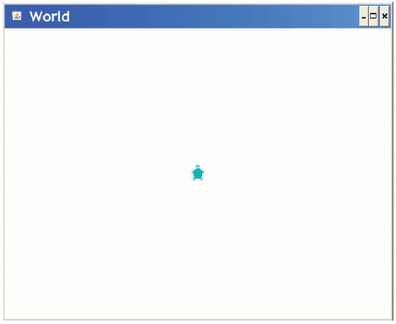
Adding a Turtle to our World
>>> earth = makeWorld ()
>>> tina = makeTurtle(earth)
>>> print tina
No name turtle at 320, 240 heading 0.0.

Slide 21
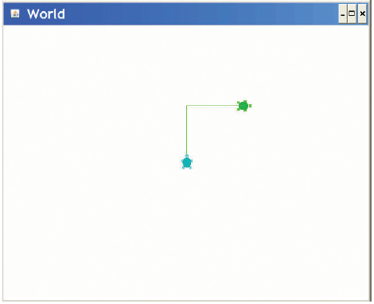
Sending multiple turtles messages
>>> sue = makeTurtle(earth)
>>> tina.forward ()
>>> tina.turnRight ()
>>> tina.forward ()
Sue stays put while Tina moves.
These are objects on which we execute methods.

Slide 22
Things turtles can do: Try it!
>>> turtleX.penUp ()
>>> turtleX.moveTo (0,0)
>>> turtleX.penDown ()
>>> turtleX.moveTo (639 ,479)
>>> worldX = makeWorld ()
>>> turtleX = makeTurtle(worldX)
>>> turtleX.setVisible(false) #don’t draw the turtle
>>> turtleX.penUp () # don’t draw the path
>>> turtleX.moveTo (0 ,240)
>>> turtleX.penDown () # draw the path
>>> turtleX.setPenWidth (100) # width of pen
>>> turtleX.setColor(blue)
>>> turtleX.turnRight ()
>>> turtleX.forward (300)
>>> turtleX.penUp () # don’t draw the path
>>> turtleX.setColor(red)
>>> turtleX.moveTo (400 ,0)
>>> turtleX.turnRight ()
>>> turtleX.setPenWidth (160)
>>> turtleX.penDown () # draw the path
>>> turtleX.forward (400)

Slide 23
Teaching Turtles new Tricks
class SmartTurtle(Turtle ):
def drawSquare(self ):
for i in range (0 ,4):
self.turnRight ()
self.forward ()
The class Turtle exists.
Here, we create a new kind of Turtle, a specialization called SmartTurtle, that knows how to draw squares.
drawSquare is a method that SmartTurtle instances understand.
All Python methods must accept self as the first parameter—self is the object receiving the message.

Slide 24
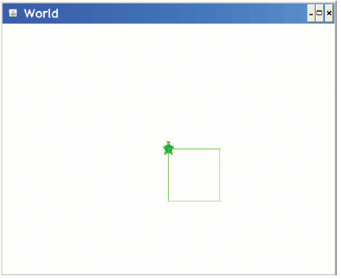
Trying our new method
>>> earth = World ()
>>> smarty = SmartTurtle(earth)
>>> smarty.drawSquare ()

Slide 25
More than one method
class SmartTurtle(Turtle ):
def drawSquare(self ):
for i in range (0 ,4):
self.turnRight ()
self.forward ()
def drawSquare(self , width ):
for i in range (0 ,4):
self.turnRight ()
self.forward(width)
Now SmartTurtle instances understand both how to drawSquare() and drawSquare(someWidth)

Slide 26
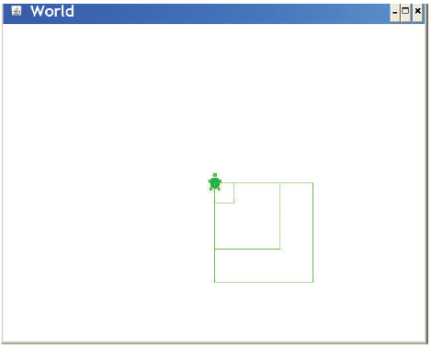
Trying the new methods
>>> mars = World ()
>>> tina = SmartTurtle(mars)
>>> tina.drawSquare (30)
>>> tina.drawSquare (150)
>>> tina.drawSquare (100)

Slide 27
Example on Making a Class from Scratch: SlideShow
Let’s build a program to show a slide show.
  It shows a picture.
  Then plays a corresponding sound.
    We’ll use the introduced-but-never-used blockingPlay() to make the execution wait until the sound is done.

Slide 28
Slideshow
def playslideshow():
pic = makePicture(getMediaPath("barbara.jpg"))
snd = makeSound(getMediaPath("bassoon-c4.wav"))
show(pic)
blockingPlay(snd)
pic = makePicture(getMediaPath("beach.jpg"))
snd = makeSound(getMediaPath("bassoon-e4.wav"))
show(pic)
blockingPlay(snd)
pic = makePicture(getMediaPath("santa.jpg"))
snd = makeSound(getMediaPath("bassoon-g4.wav"))
show(pic)
blockingPlay(snd)
pic = makePicture(getMediaPath("jungle2.jpg"))
snd = makeSound(getMediaPath("bassoon-c4.wav"))
show(pic)
blockingPlay(snd)

Slide 29
What’s wrong with this?
From Procedural Abstraction:
  We have duplicated code.
  We should get rid of it.
From Object-Oriented Programming:
  We have an object: A slide.

Slide 30
Defining an object
Objects know things.
  Data that is internal to the object.
  We often call those instance variables.
Objects can do things.
  Behavior that is internal to the object.
  We call functions that are specific to an object methods.
    But you knew that one already.
We access both of these using dot notation
  object.variable
  object.method()

Slide 31
The Slide Object
What does a slide know?
  It has a picture.
  It has a sound
What can a slide do?
  Show itself.
    Show its picture.
    (Blocking) Play its sound.

Slide 32
Classes
Objects are instances of classes in many object-oriented languages.
  Including Smalltalk, Java, JavaScript, and Python.
A class defines the data and behavior of an object.
  A class defines what all instances of that class know and can do.

Slide 33
We need to define a slide class
Easy enough:
class slide:
That wasn’t so hard was it?
What comes next?
  Some method for creating new slides.
  Some method for playing slides.

Slide 34
Creating new instances
We are going to create new instances by calling the class name as if it were a function.
  That will automatically create a new instance of the class.

Slide 35
Creating a slide
Let’s create a slide and give it a picture and sound instance variables.
>>> slide1=slide()
>>> slide1.picture = makePicture(getMediaPath("barbara.jpg"))
>>> slide1.sound = makeSound(getMediaPath("bassoon-c4.wav"))

Slide 36
Defining a show() method
To show a slide, we want to show() the picture and blockingPlay() the sound.
We define the function as part of the class block.
  So this is a def that gets indented.

Slide 37
Defining the method show()
Why self?
  When we say object.method(),
  Python finds the method in the object’s class,
  then calls it with the object as an input.
  Python style is to call that self.
    It’s the object itself.
class slide:
def show(self):
show(self.picture)
blockingPlay(self.sound)

Slide 38
Now we can show our slide
>>> slide1.show()
We execute the method using the same dot notation we’ve seen previously.
Does just what you’d expect it to do.
  Shows the picture.
  Plays the sound.

Slide 39
Making it simpler
Can we get rid of those picture and sound assignments?
What if we could call slide as if it were a real function, with inputs?
  Then we could pass in the picture and sound filenames as inputs.
We can do this, by defining what Java calls a constructor.
  A method that builds your object for you.

Slide 40
Making instances more flexibly
To create new instances with inputs, we must define a function named __init__
  That’s underscore-underscore-i-n-i-t-underscore-underscore.
  It’s the predefined name for a method that initializes new objects.
Our __init__ function will take three inputs:
  self, because all methods take that.
  And a picture and sound filename.
    We’ll create the pictures and sounds in the method.

Slide 41
Our whole slide class
class slide:
def __init__(self, pictureFile,soundFile):
self.picture = makePicture(pictureFile)
self.sound = makeSound(soundFile)
def show(self):
show(self.picture)
blockingPlay(self.sound)

Slide 42
The playslideshow()
def playslideshow():
slide1 = slide(getMediaPath("barbara.jpg"), getMediaPath("bassoon-c4.wav"))
slide2 = slide(getMediaPath("beach.jpg"),getMediaPath("bassoon-e4.wav"))
slide3 = slide(getMediaPath("santa.jpg"),getMediaPath("bassoon-g4.wav"))
slide4 = slide(getMediaPath("jungle2.jpg"),getMediaPath("bassoon-c4.wav"))
slide1.show()
slide2.show()
slide3.show()
slide4.show()

Slide 43
Using map with slides
Slides are now just objects, like any other kind of object in Python.
They can be in lists, for example.
Which means that we can use map.
We need a function:
def showSlide(aslide):
aslide.show()

Slide 44
PlaySlideShow with Map
def playslideshow():
slide1 = slide(getMediaPath("barbara.jpg"), getMediaPath("bassoon-c4.wav"))
slide2 = slide(getMediaPath("beach.jpg"),getMediaPath("bassoon-e4.wav"))
slide3 = slide(getMediaPath("santa.jpg"),getMediaPath("bassoon-g4.wav"))
slide4 = slide(getMediaPath("jungle2.jpg"),getMediaPath("bassoon-c4.wav"))
map(showSlide,[slide1,slide2,slide3,slide4])

Slide 45
The value of objects
Is this program easier to write?
  It certainly has less replication of code.
  It does combine the data and behavior of slides in one place.
    If we want to change how slides work, we change them in the definition of slides.
    We call that encapsulation: Combining data and behavior related to that data.
  Being able to use other objects with our objects is powerful.
    Being able to make lists of objects, to be able to use objects (like picture and sound) in our objects.
    We call that aggregation: Combining objects, so that there are objects in other objects.

Slide 46
We’ve been doing this already, of course.
You’ve been using objects already, everywhere.
Pictures, sounds, samples, colors—these are all objects.
We’ve been doing aggregation.
  We’ve worked with or talked about lists of pictures, sounds, pixels, and samples
The functions that we’ve been providing merely cover up the underlying objects.

Slide 47
Using picture as an object
>>> pic=makePicture(getMediaPath("barbara.jpg"))
>>> pic.show()

Slide 48
Slides and pictures both show()
Did you notice that we can say slide1.show() and pic.show()?
Show() generally means, in both contexts, “show the object.”
But what’s really happening is different in each context!
  Slides show pictures and play sounds.
  Pictures just show themselves.

Slide 49
Another powerful aspect of objects: Polymorphism
When the same method name can be applied to more than one object, we call that method polymorphic
  From the Greek “many shaped”
A polymorphic method is very powerful for the programmer.
  You don’t need to know exactly what method is being executed.
  You don’t even need to know exactly what object it is that you’re telling to show()
  You just know your goal: Show this object!

Slide 50
Uncovering the objects
This is how the show() function is defined in JES:
You can ignore the raise and if
  The key point is that the function is simply executing the method.
def show(picture):
if not picture.__class__ == Picture:
print "show(picture): Input is not a picture"
raise ValueError
picture.show()

Slide 51
Pictures and Colors have polymorphic methods, too
>>> pic=makePicture(getMediaPath("barbara.jpg"))
>>> pic.show()
>>> pixel = getPixel(pic,100,200)
>>> print pixel.getRed()
73
>>> color = pixel.getColor()
>>> print color.getRed()
73

Slide 52
We can get/set components at either level
getRed, getBlue, getGreen, setRed, setBlue, setGreen
  Are all defined for both colors and pixels
Why didn’t we define the functions to work with either?
  It’s somewhat confusing to have a globally-available function take two kinds of things as input: Colors or pixels.
  But it’s completely reasonable to have a method of the same name in more than one object.

Slide 53
More methods than functions
In general, there are many more methods defined in JES than there are functions.
Most specifically, there are a whole bunch of methods for drawing onto a picture that aren’t defined as functions.
  We simply ran out of time/energy to convert them all into functions.
  And we rationalized that it was easier to deal with the complexity at the level of methods than functions.

Slide 54
Overview of graphics methods
pic.addRect(color,x,y,width,height)
pic.addRectFilled(color,x,y,width,height)
pic.addOval(color,x,y,width,height)
pic.addOvalFilled(color,x,y,width,height)

Slide 55
Arcs
pic.addArc(color,x,y,width,height,startangle,arcangle)
pic.addArcFilled(color,x,y,width,height,startangle,arcangle)
  Make an arc for arcangle degrees, where startangle is the starting point. 0 = 3 o’clock.
    Positive arc is counter-clockwise, negative is clockwise
  Center of the circle is middle of the rectangle (x,y) with given height and width

Slide 56
Text
Text can have style, but only limited.
  Java limits it for cross-platform compatibility.
pic.addText(color,x,y,string)
pic.addTextWithStyle(color,x,y,string,style)
  Style is made by makeStyle(font,emph,size)
  Font is sansSerif, serf, or mono
  Emph is italic, bold, or plain.
    You can get italic, bold by italic+bold
  Size is a point size

Slide 57

Rectangles: Coloring lines and fills
>>> pic=makePicture (getMediaPath("640x480.jpg"))
>>> pic.addRectFilled (orange,10,10,100,100)
>>> pic.addRect (blue,200,200,50,50)
>>> pic.show()
>>> pic.writeTo("newrects.jpg")
writeTo() is polymorphic for both sounds and pictures.

Slide 58

Ovals
>>> pic=makePicture (getMediaPath("640x480.jpg"))
>>> pic.addOval (green,200,200,50,50)
>>> pic.addOvalFilled (magenta,10,10,100,100)
>>> pic.show()
>>> pic.writeTo("ovals.jpg")

Slide 59

Arcs and colored lines
>>> pic=makePicture (getMediaPath("640x480.jpg"))
>>> pic.addArc(red,10,10,100,100,5,45)
>>> pic.show()
>>> pic.addArcFilled (green,200,100,200,100,1,90)
>>> pic.repaint()
>>> pic.addLine(blue,400,400,600,400)
>>> pic.repaint()
>>> pic.writeTo("arcs-lines.jpg")

Slide 60
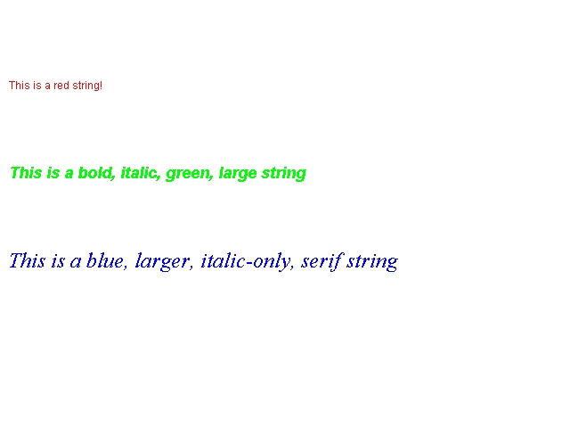
Text examples
>>> pic=makePicture (getMediaPath("640x480.jpg"))
>>> pic.addText(red,10,100,"This is a red string!")
>>> pic.addTextWithStyle (green,10,200,"This is a bold, italic, green, large string", makeStyle(sansSerif,bold+italic,18))
>>> pic.addTextWithStyle (blue,10,300,"This is a blue, larger, italic-only, serif string", makeStyle(serif,italic,24))
>>> pic.writeTo("text.jpg")

Slide 61

Sunset using methods
Any of our older functions will work just fine with methods.
def makeSunset(picture):
for p in getPixels(picture):
p.setBlue(p.getBlue()*0.7)
p.setGreen(p.getGreen()*0.7)

Slide 62
Backwards using methods
def backwards(filename):
source = makeSound(filename)
target = makeSound(filename)
sourceIndex = source.getLength()
for targetIndex in range(1,target.getLength()+1):
# The method is getSampleValue, not getSampleValueAt
sourceValue =source.getSampleValue(sourceIndex)
# The method is setSampleValue, not setSampleValueAt
target.setSampleValue(targetIndex,sourceValue)
sourceIndex = sourceIndex - 1
return target
To get the sample object, snd.getSampleObjectAt(index)

Slide 63
Why objects?
An important role for objects is to reduce the number of names that you have to remember.
  writeSoundTo() and writePictureTo() vs.
  sound.writeTo() and picture.writeTo()
They also make it easier to change data and behavior together.
  Think about changing the name of an instance variable. What functions do you need to change? Odds are good that they’re the ones right next to where you’re changing the variable.
Most significant power is in aggregation: Combining objects

Slide 64
Python objects vs. other objects
One of the key ideas for objects was “not messing with the innards.”
Not true in Python.
  We can always get at instance variables of objects.
It is true in other object-oriented languages.
  In Java or Smalltalk, instance variables are only accessible through methods (getPixel) or through special declarations (“This variable is public!”)

Slide 65
Inheritance
We can declare one class to be inherited by another class.
It provides instant polymorphism.
  The child class immediately gets all the data and behavior of the parent class.
The child can then add more than the parent class had.
  This is called making the child a specialization of the parent.
  A 3-D rectangle might know/do all that a rectangle does, plus some more:
class rectangle3D(rectangle):

Slide 66
Inheritance is a tradeoff
Inheritance is talked about a lot in the object-oriented world.
  It does reduce even further duplication of code.
  If you have two classes that will have many the same methods, then set up inheritance.
But in actual practice, inheritance doesn’t get used all that much, and can be confusing.

Slide 67
When should you use objects?
Define your own objects when you have:
  Data in groups, like both pictures and sounds.
  Behavior that you want to define over that group.
Use existing objects:
  Always—they’re very powerful!
  Unless you’re not comfortable with dot notation and the idea of methods.
    Then functions work just fine.

