Slide 1
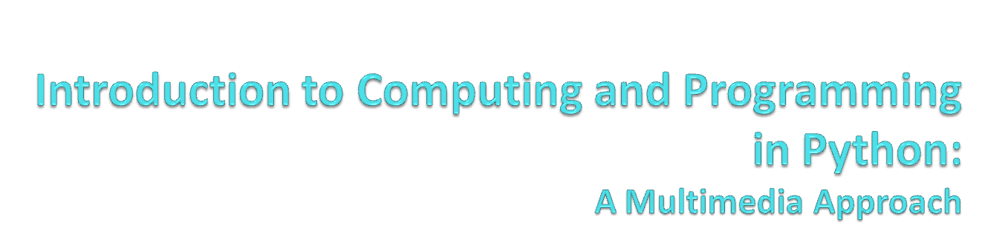
Chapter 2: Introduction to Programming

Slide 2
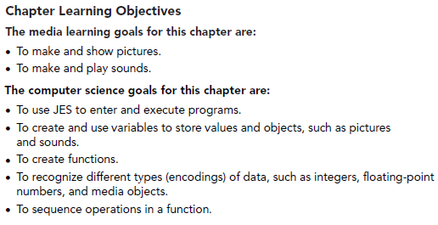
Chapter Learning Objectives

Slide 3


Installation
Installing JES and starting it up
  Go to http://www.mediacomputation.org and get the version of JES for your computer.
    If you know that you have a Java compiler (e.g., a “JDK” or an “IDE”)
  Windows users:
    Just copy the folder
    Double-click JES application
      If trouble, try jes2.bat or jes-customjava.bat
  Mac users:
    Just copy the folder
    Double-click JES application
There is always Help
  Lots and lots of excellent help

Slide 4
Much of programming is about naming
We name our data
  Data: The “numbers” we manipulate
  We call our names for data variables
We name our recipes
Quality of names determined much as in Philosophy or Math
  Enough words to describe what you need to describe
  Understandable

Slide 5
Naming our Encodings
We even name our encodings
  Sometimes referred to as types
  Numbers without decimals are called integers.
  Numbers with decimal points are called floating point or floats.
  Collections of letters are called strings.
Some programming languages are strongly typed
  A name has to be declared to have a type, before any data is associated with it

Slide 6

34,654.01
12.998
31,364
Floats
12
Integers
1.01
0.01
-12
Barbara Ericson
Mark
Inside the computer,
these are all just bits
85 5th Street NW
Strings

Slide 7
Our programs work with a variety of names
You will name your functions
  Just like functions you knew in math, like sine and gcd (Greatest Common Divisor)
You will name your data (variables)
You will name the data that your functions work on
  Inputs, like the 90 in sine(90)
Key: Names inside a function only have meaning while the function is being executed by the computer. (You’ll see what we mean.)

Slide 8
Names for things that are not in memory
A common name that you’ll deal with is a file name
  The program that deals with those is called the operating system, like Windows, MacOS, Linux
A file is a collection of bytes, with a name, that resides on some external medium, like a hard disk.
  Think of it as a whole bunch of space where you can put your bytes
Files are typed, typically with three letter extensions
  .jpg files are JPEG (pictures), .wav are WAV (sounds)

Slide 9
We will program in JES
JES: Jython Environment for Students
A simple editor (for entering in our programs or recipes): We’ll call that the program area
A command area for entering in commands for Python to execute.

Slide 10
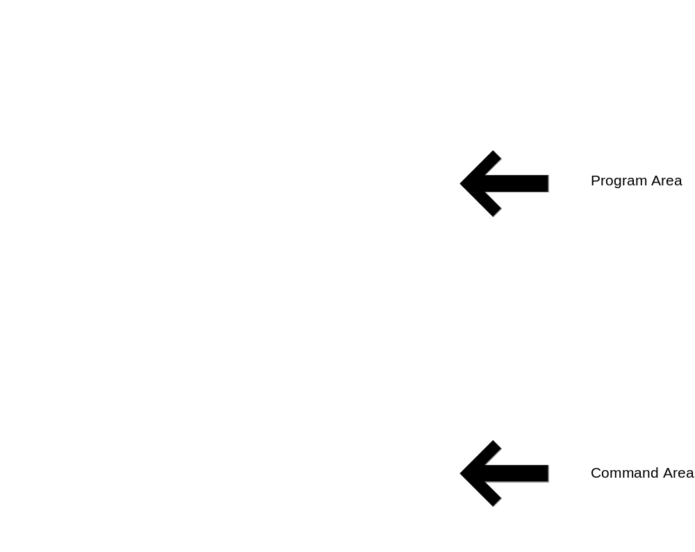
JES - Jython Environment for Students

Slide 11

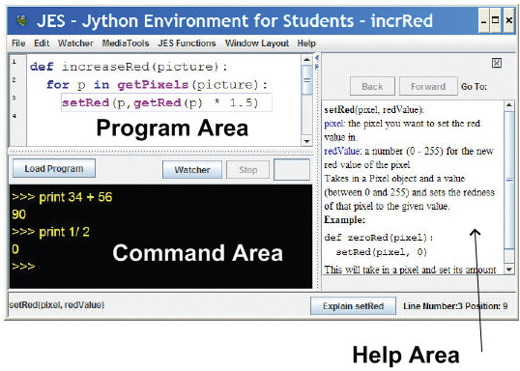
Use Window Layout to get the view you want

Slide 12
Tour of JES
Save and Save As
Cut/Copy/Paste with shortcut keys
Help
If JES runs slow, close other applications.
Web browsers (like Firefox or Internet Explorer) and iTunes and chat tools and… all take up memory. Closing some of them saves memory for JES.

Slide 13
Python understands commands
We can name data with =
We can print values, expressions, anything with print

Slide 14
Names can be (nearly) whatever we want
Must start with a letter
Be careful not to use command names as your own names
  print = 1 won’t work
Case matters
  “Print” is not the same as “print”
  “myPicture” is not the same as “mypicture”

Slide 15

>>> print 34 + 56
90
>>> print 34.1/46.5
0.7333333333333334
>>> print 22 * 33
726
>>> print 14 - 15
-1
>>> print "Hello"
Hello
>>> print "Hello" + "Mark"
HelloMark
Adding integers
Dividing floats
Multiplying integers
Subtracting integers
Printing a string
Adding (concatenating)
two strings

Slide 16
Values and names with same value are interchangeable
>>> print 12 * 3
36
>>> value = 12
>>> print value
12
>>> print value * 3
36
>>> name = "Mark"
>>> print name
Mark
>>> print name * 3
MarkMarkMark
>>> print "Mark" * 3
MarkMarkMark

Slide 17


If you only use integers (numbers without decimal points),
Jython thinks you only want integers.

Slide 18
Command Area Editing
Up/down arrows walk through command history
You can edit the line at the bottom
  Just put the cursor at the end of the line before hitting Return/Enter.

Slide 19
JES Functions
A bunch of functions are pre-defined in JES for sound and picture manipulations
  pickAFile()
  makePicture()
  makeSound()
  show()
  play()
Some of these functions accept input values

Slide 20
What to do to show a picture
1. Find a file with a picture.
2. Pick it.
3. Get the bytes from that file into memory and label it as a type: “picture”
4. Show the picture

Slide 21
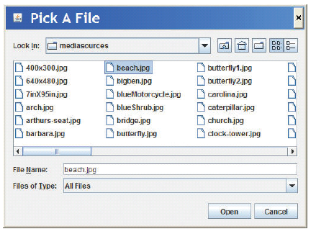
pickAFile() leads to
The File Picker!

Slide 22
Picture Functions
makePicture(filename) creates and returns a picture object, from the JPEG file at the filename
show(picture) displays a picture in a window
We’ll learn functions for manipulating pictures later, like getColor, setColor, and repaint

Slide 23
Sound Functions
makeSound(filename) creates and returns a sound object, from the WAV file at the filename
play(sound) makes the sound play (but doesn’t wait until it’s done)
blockingPlay(sound) waits for the sound to finish
We’ll learn more later like getSample and setSample

Slide 24
Demonstrating simple JES
>>> myfilename = pickAFile()
>>> print myfilename
/Users/guzdial/mediasources/barbara.jpg
>>> mypicture = makePicture(myfilename)
>>> print mypicture
Picture, filename /Users/guzdial/mediasources/barbara.jpg height 294 width 222
>>> show(mypicture)

Slide 25
Demonstrating simple JES
>>> print pickAFile()
/Users/guzdial/mediasources/barbara.jpg
>>> print makePicture(pickAFile())
Picture, filename /Users/guzdial/mediasources/barbara.jpg height 294 width 222
>>> show(makePicture(pickAFile()))
>>> print show(makePicture(pickAFile()))
None
>>> print pickAFile()
/Users/guzdial/mediasources/hello.wav
>>> print makeSound(pickAFile())
Sound of length 54757
>>> print play(makeSound(pickAFile()))
None
pickAFile() returns a filename, which can be used as input to makePicture() to make a picture or makeSound() to make a sound.
Printing a picture just proves there’s a picture there.
show() and play() don’t return anything, so they print None.

Slide 26
COMPLETELY THE SAME:
Values, names for those values, functions that return those values
>>> file=pickAFile()
>>> print file
C:\Documents and Settings\Mark Guzdial\My Documents\mediasources\barbara.jpg
>>> show(makePicture(file))
>>> show(makePicture(r"C:\Documents and Settings\Mark Guzdial\My Documents\mediasources\barbara.jpg"))
>>> show(makePicture(pickAFile()))

Slide 27
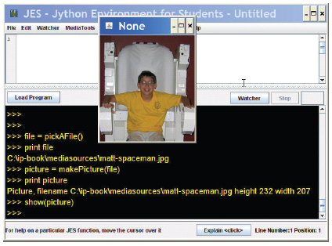
Picking, making, showing a picture

Slide 28
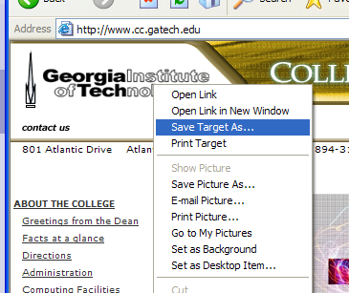
Grabbing media from the Web
Right-click (Windows) or Control-Click (Mac)
Save Target As…
Can only do JPEG images (.jpe, .jpg, .jpeg)
Most images on the Internet are copyright. You can download and use them for your use only without permission.

Slide 29
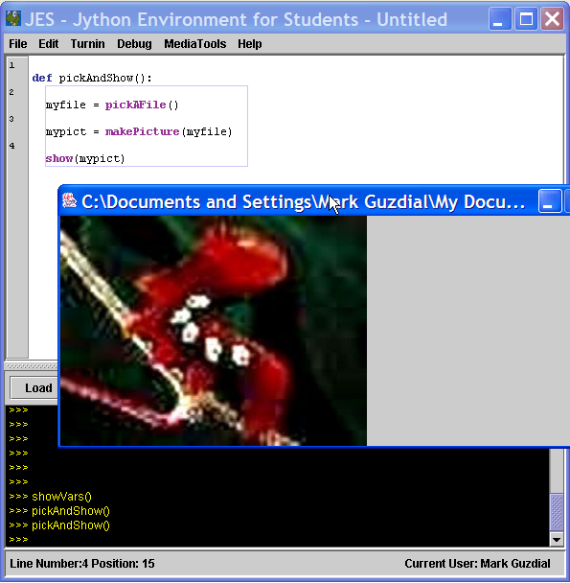
Writing a recipe:
Making our own functions
To make a function, use the command def
Then, the name of the function, and the names of the input values between parentheses (“(input1)”)
End the line with a colon (“:”)
The body of the recipe is indented (Hint: Use two spaces)
  That’s called a block

Slide 30
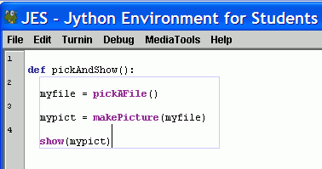
Blocking is indicated for you in JES
Statements that are indented the same, are in the same block.
Statements that are in the same block as where the line where the cursor is are enclosed in a blue box.

Slide 31
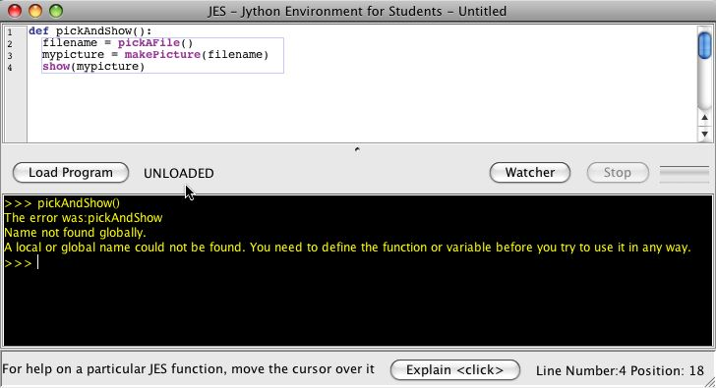
The Most Common JES Bug:
Forgetting to Load
Your function does NOT exist for JES until you load it
  Before you load it, the program is just a bunch of characters.
  Loading encodes it as an executable function
Save and Save As
  You must Save before Loading
  You must Load before you can use your function
An “Unloaded” function doesn’t exist yet.

Slide 32
Making functions the easy way
Get something working by typing commands
Enter the def command.
Copy-paste the right commands up into the recipe

Slide 33

def pickAndPlay():
myfile = pickAFile()
mysound = makeSound(myfile)
play(mysound)
Note: myfile and mysound, inside pickAndPlay(), are completely different from the same names in the command area.

Slide 34

def pickAndShow():
myfile = pickAFile()
mypict = makePicture(myfile)
show(mypict)

Slide 35
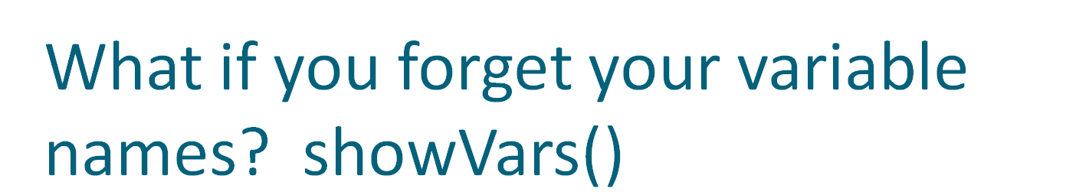
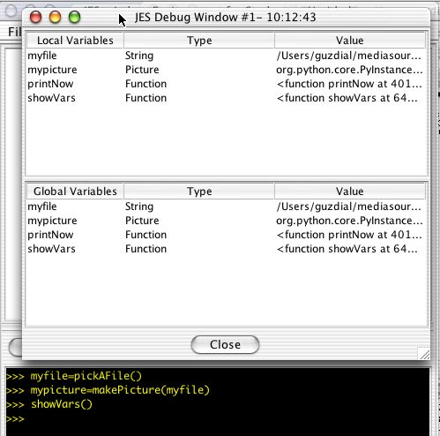

Slide 36
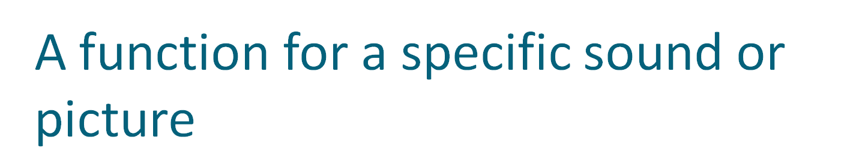
def playSound():
myfile = "FILENAME"
mysound = makeSound(myfile)
play(mysound)
You can always replace data (a string of characters, a number, whatever) with a name (variable) that holds that data—or vice versa.
def showPicture():
myfile = "FILENAME"
mypict = makePicture(myfile)
show(mypict)
Put r in front of Windows filenames: r“C:\mediasources\pic.jpg”

Slide 37
What to do about Windows filenames?
Python doesn’t like you to use “\” in filenames,
like “C:\mediasources\barbara.jpg”
What to do?
  Option #1: Put r in front of Windows filenames: r“C:\mediasources\pic.jpg”
  Option #2: Use forward slashes. Python will translate it for you:
  “C:/mediasources/pic.jpg”

Slide 38

def playNamed(myfile):
mysound = makeSound(myfile)
play(mysound)
What functions do you need? What should be their input?
In general, have enough to do what you want, easily, understandably, and in the fewest commands.
We’ll talk more about what that means later.
def showNamed(myfile):
mypict = makePicture(myfile)
show(mypict)

Slide 39
What can go wrong?
Did you use the exact same names (case, spelling)?
All the lines in the block must be indented,
and indented the same amount.
Variables in the command area don’t exist in your functions, and variables in your functions don’t exist in the command area.
The computer can’t read your mind.
  It will only do exactly what you tell it to do.

Slide 40
MOST IMPORTANT THING TO DO TO PASS THIS CLASS!
DO THE EXAMPLES!
Try them out for yourself. Try to replicate them. Understand them
  EVERY WEEK, TYPE IN AT LEAST TWO OF THE EXAMPLES FROM CLASS
To understand a program means that you know why each line is there.
You will encounter all the simple-but-confusing errors early—BEFORE you are rushing to get homework done!!

