Slide 1
Why scan flops
Every flop becomes a scan SDFF in this full-scan toy
learn_dft_insert — 01 scan flops
Notes:
Every flop becomes a scan SDFF in this full-scan toy.

Slide 2
The idea
GOLDEN: scan_cell_count=4
learn_dft_insert — 01 scan flops
Notes:
GOLDEN: scan_cell_count=4.

Slide 3
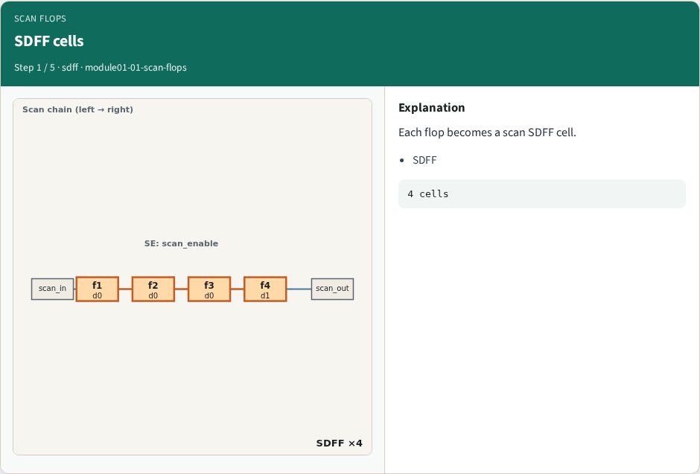
SDFF cells
SDFF cells
learn_dft_insert — 01 scan flops
Notes:
Each flop becomes a scan SDFF cell.

Slide 4
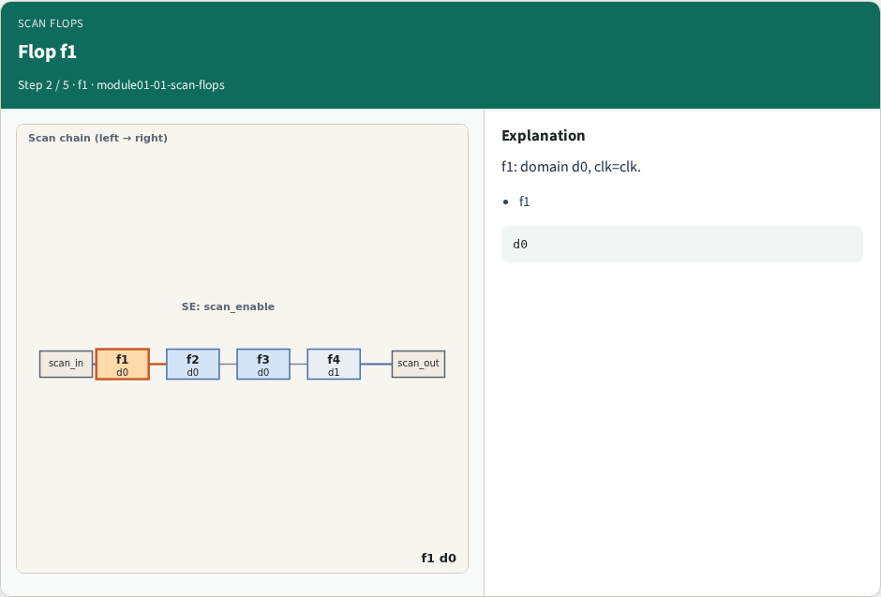
Flop f1
Flop f1
learn_dft_insert — 01 scan flops
Notes:
f1: domain d0, clk=clk.

Slide 5
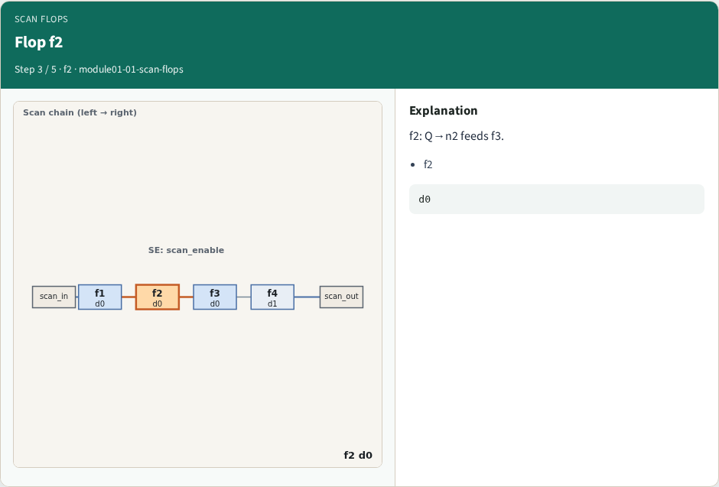
Flop f2
Flop f2
learn_dft_insert — 01 scan flops
Notes:
f2: Q→n2 feeds f3.

Slide 6
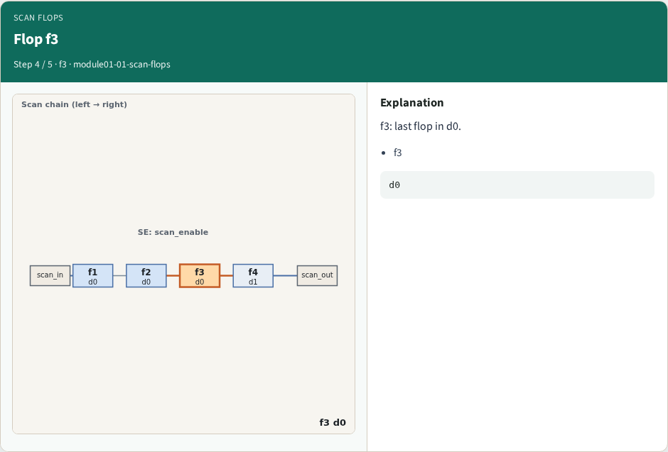
Flop f3
Flop f3
learn_dft_insert — 01 scan flops
Notes:
f3: last flop in d0.

Slide 7
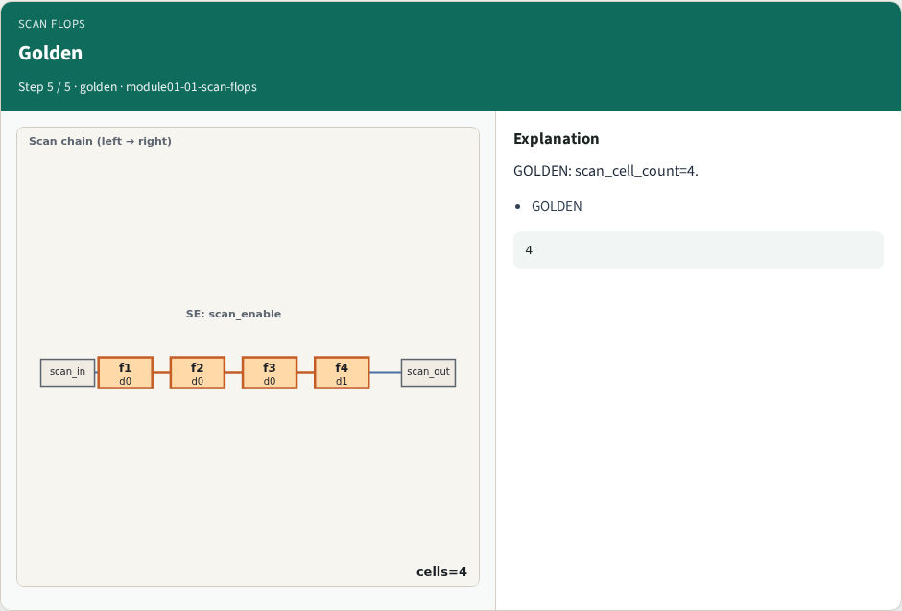
Golden
Golden
learn_dft_insert — 01 scan flops
Notes:
GOLDEN: scan_cell_count=4.

Slide 8

Browser lab track
Browser lab starter
learn_dft_insert — 01 scan flops
Notes:
Open **scan-flops**. Inspect tiny_dft; confirm 4 SDFF cells.

Slide 9
Implement track
Call identify_scan_flops(); assert count==4
learn_dft_insert — 01 scan flops
Notes:
Call identify_scan_flops(); assert count==4.

Slide 10
Pitfalls
Counting only functional flops
Missing SE hook
learn_dft_insert — 01 scan flops
Notes:
Counting only functional flops. Missing SE hook.

Slide 11
Your turn
Next: scan enable ports
learn_dft_insert — 01 scan flops
Notes:
Next: scan enable ports.

