Slide 1
Why scan enable
Scan enable muxes functional vs scan data; SI/SO bookend the chain
learn_dft_insert — 03 scan enable
Notes:
Scan enable muxes functional vs scan data; SI/SO bookend the chain.

Slide 2
The idea
GOLDEN: se=scan_enable, si=scan_in, so=scan_out
learn_dft_insert — 03 scan enable
Notes:
GOLDEN: se=scan_enable, si=scan_in, so=scan_out.

Slide 3
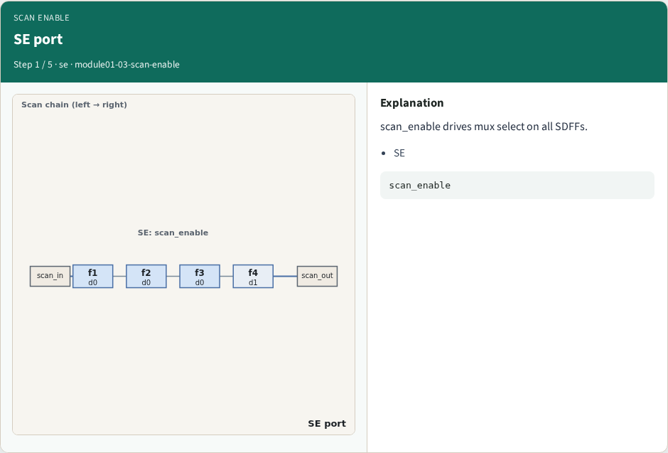
SE port
SE port
learn_dft_insert — 03 scan enable
Notes:
scan_enable drives mux select on all SDFFs.

Slide 4
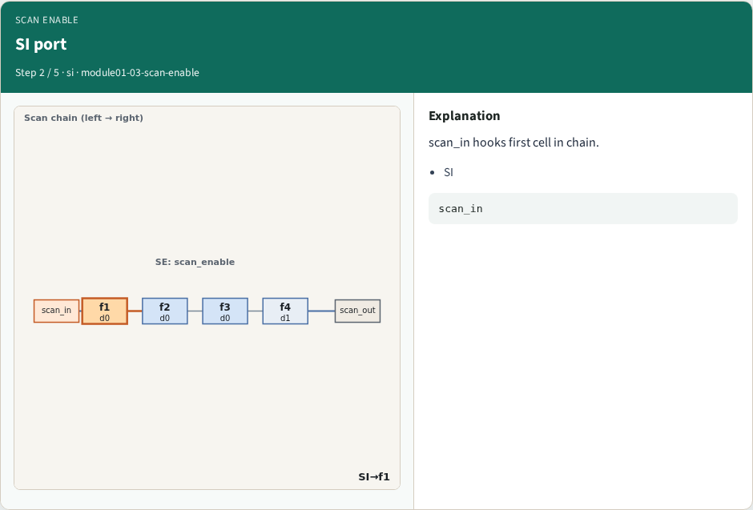
SI port
SI port
learn_dft_insert — 03 scan enable
Notes:
scan_in hooks first cell in chain.

Slide 5
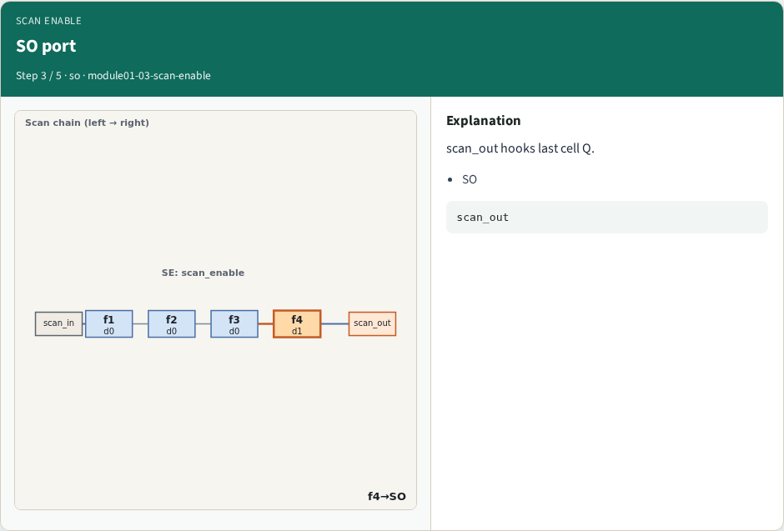
SO port
SO port
learn_dft_insert — 03 scan enable
Notes:
scan_out hooks last cell Q.

Slide 6
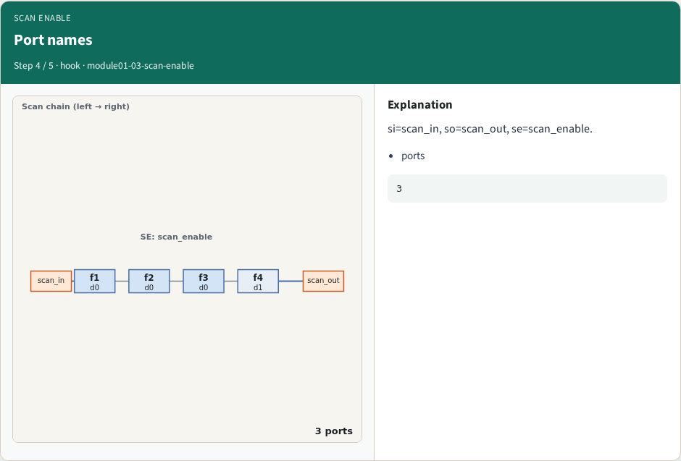
Port names
Port names
learn_dft_insert — 03 scan enable
Notes:
si=scan_in, so=scan_out, se=scan_enable.

Slide 7
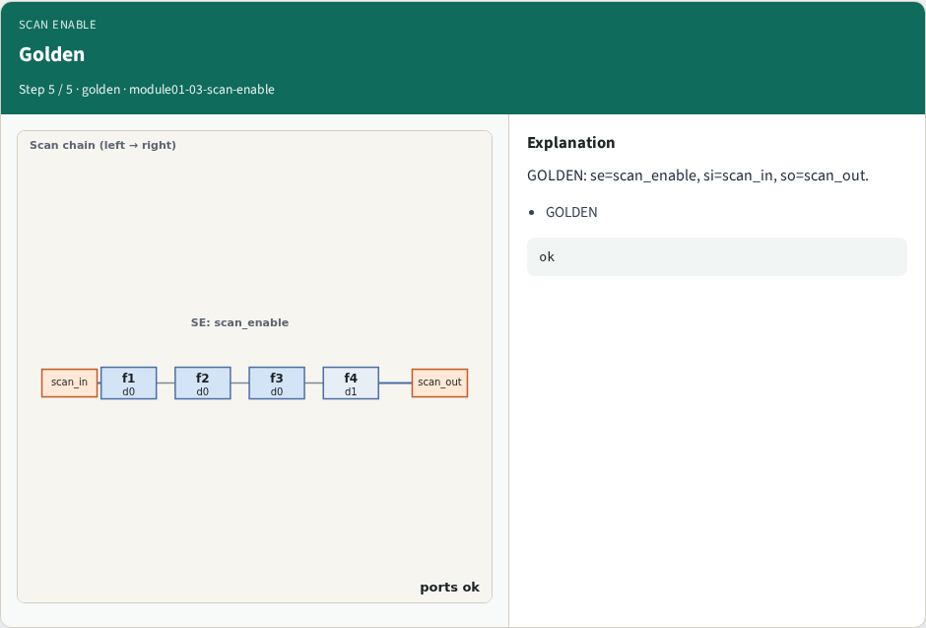
Golden
Golden
learn_dft_insert — 03 scan enable
Notes:
GOLDEN: se=scan_enable, si=scan_in, so=scan_out.

Slide 8
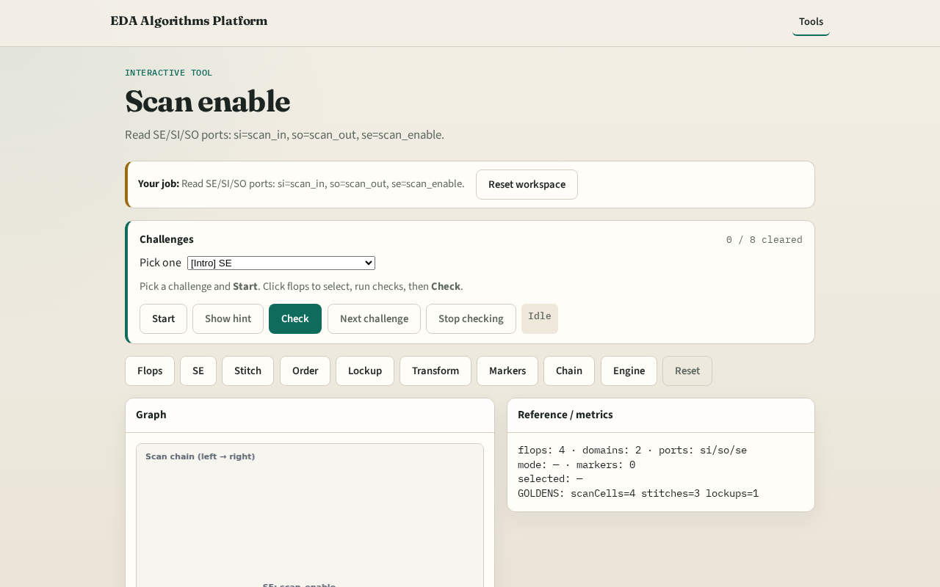
Browser lab track
Browser lab starter
learn_dft_insert — 03 scan enable
Notes:
Open **scan-enable**. Confirm the three port names.

Slide 9
Implement track
Call scan_enable_port(); assert se/si/so match goldens
learn_dft_insert — 03 scan enable
Notes:
Call scan_enable_port(); assert se/si/so match goldens.

Slide 10
Pitfalls
Confusing SI with functional D
Wrong port order
learn_dft_insert — 03 scan enable
Notes:
Confusing SI with functional D. Wrong port order.

Slide 11
Your turn
Next: chain stitch
learn_dft_insert — 03 scan enable
Notes:
Next: chain stitch.

