Slide 1
Why stitch
Chain stitch wires Q of previous flop to SI of next in scan_order
learn_dft_insert — 01 chain stitch
Notes:
Chain stitch wires Q of previous flop to SI of next in scan_order.

Slide 2
The idea
GOLDEN: stitch_count=3
learn_dft_insert — 01 chain stitch
Notes:
GOLDEN: stitch_count=3.

Slide 3
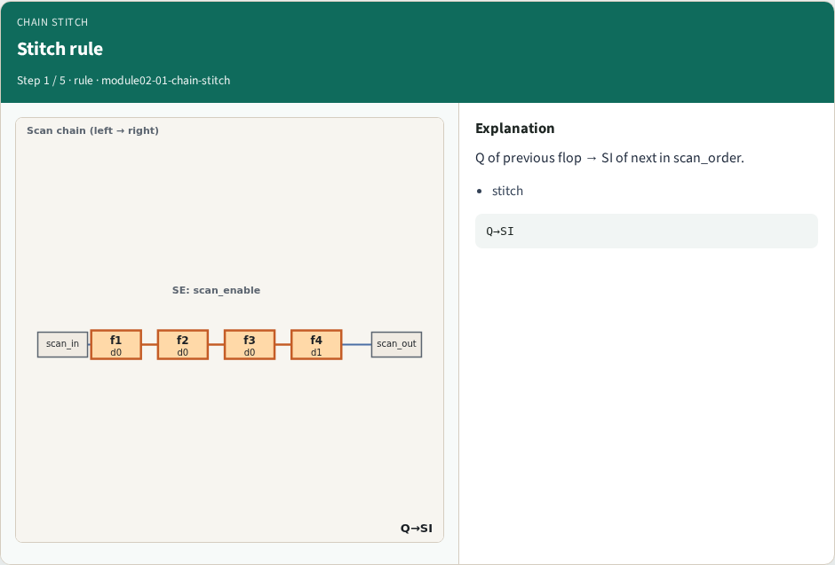
Stitch rule
Stitch rule
learn_dft_insert — 01 chain stitch
Notes:
Q of previous flop → SI of next in scan_order.

Slide 4
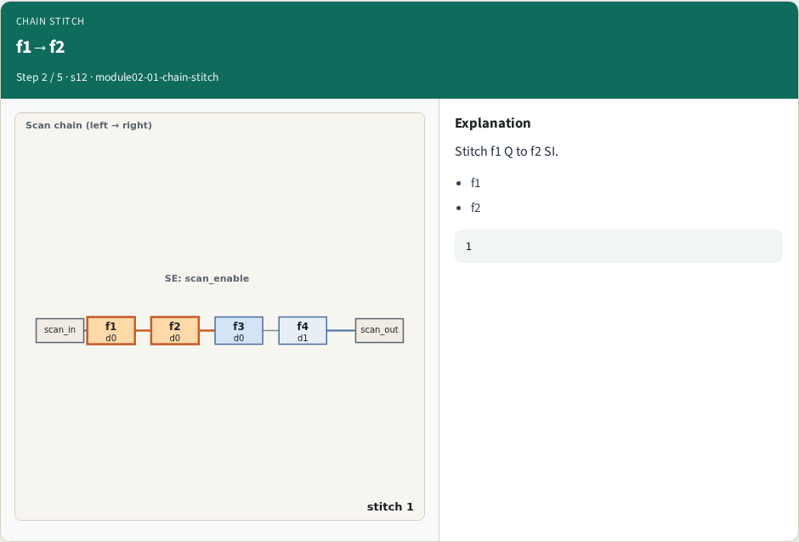
f1→f2
f1→f2
learn_dft_insert — 01 chain stitch
Notes:
Stitch f1 Q to f2 SI.

Slide 5
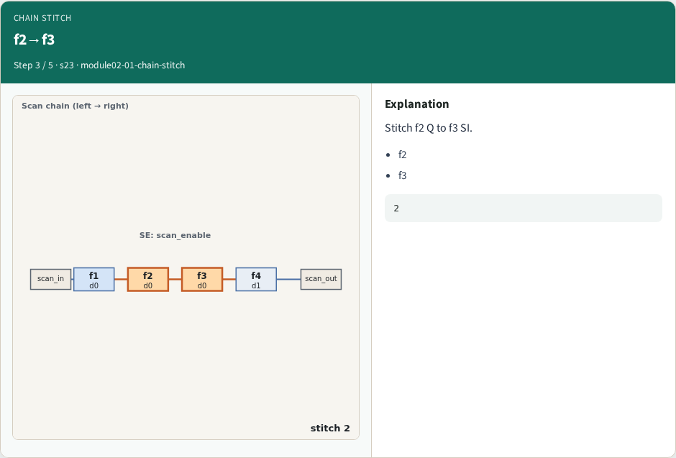
f2→f3
f2→f3
learn_dft_insert — 01 chain stitch
Notes:
Stitch f2 Q to f3 SI.

Slide 6
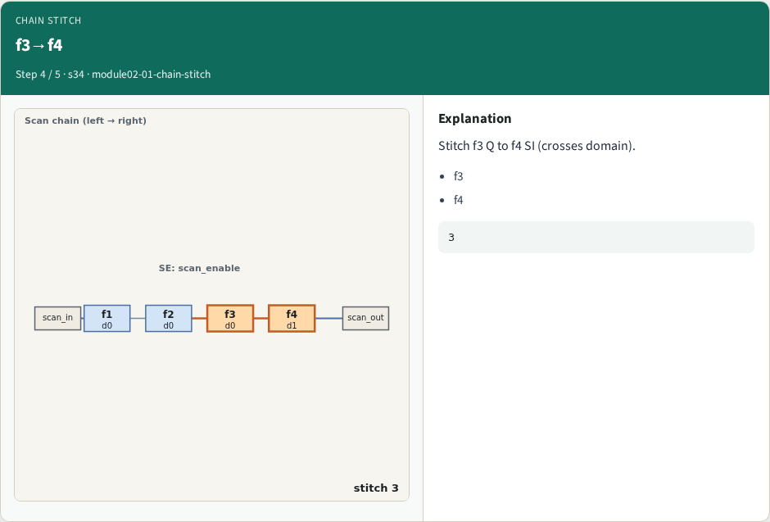
f3→f4
f3→f4
learn_dft_insert — 01 chain stitch
Notes:
Stitch f3 Q to f4 SI (crosses domain).

Slide 7
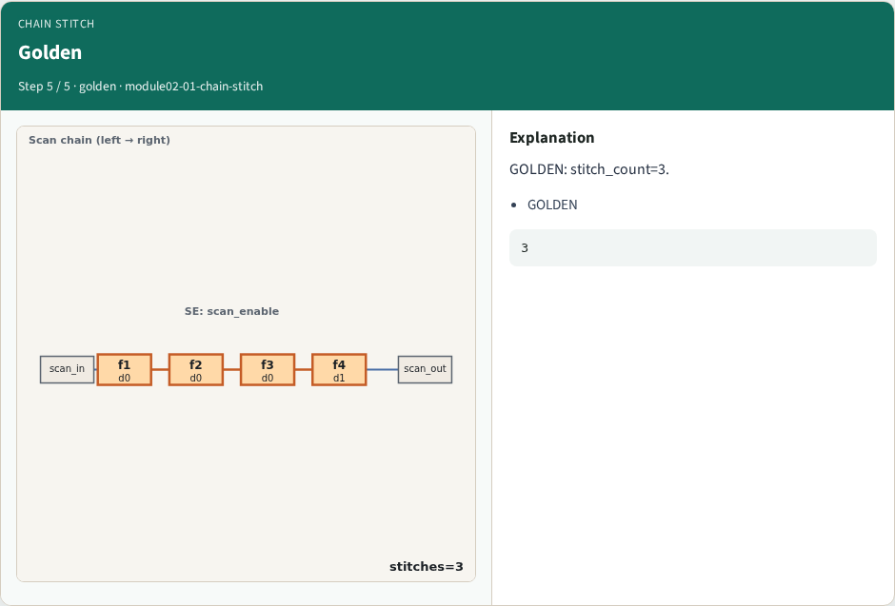
Golden
Golden
learn_dft_insert — 01 chain stitch
Notes:
GOLDEN: stitch_count=3.

Slide 8

Browser lab track
Browser lab starter
learn_dft_insert — 01 chain stitch
Notes:
Open **chain-stitch**. Confirm 3 stitches f1→f2→f3→f4.

Slide 9
Implement track
Call stitch_chain(); assert stitch_count==3
learn_dft_insert — 01 chain stitch
Notes:
Call stitch_chain(); assert stitch_count==3.

Slide 10
Pitfalls
Counting SI/SO hooks as stitches
Wrong order
learn_dft_insert — 01 chain stitch
Notes:
Counting SI/SO hooks as stitches. Wrong order.

Slide 11
Your turn
Next: scan order check
learn_dft_insert — 01 chain stitch
Notes:
Next: scan order check.

