Slide 1
Why order
Scan order must include every flop exactly once
learn_dft_insert — 03 scan order
Notes:
Scan order must include every flop exactly once.

Slide 2
The idea
GOLDEN: order f1→f2→f3→f4; covers_all=true
learn_dft_insert — 03 scan order
Notes:
GOLDEN: order f1→f2→f3→f4; covers_all=true.

Slide 3
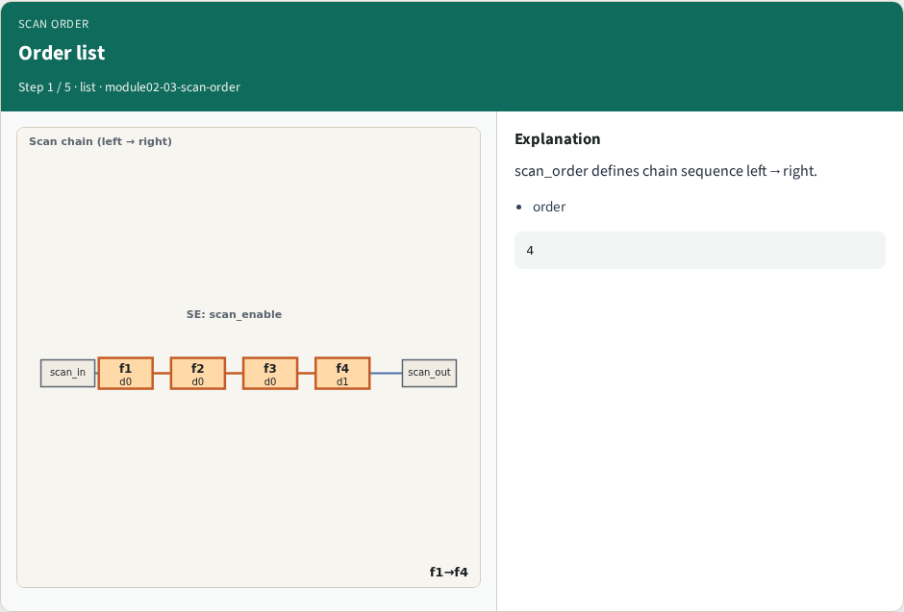
Order list
Order list
learn_dft_insert — 03 scan order
Notes:
scan_order defines chain sequence left→right.

Slide 4
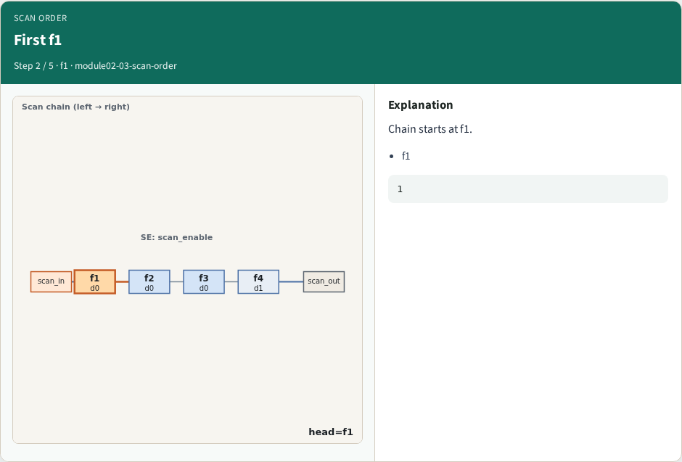
First f1
First f1
learn_dft_insert — 03 scan order
Notes:
Chain starts at f1.

Slide 5
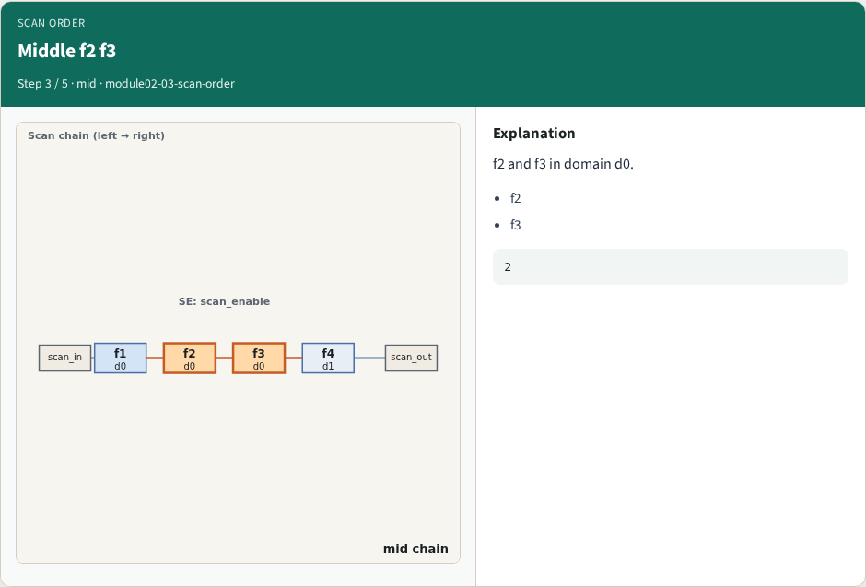
Middle f2 f3
Middle f2 f3
learn_dft_insert — 03 scan order
Notes:
f2 and f3 in domain d0.

Slide 6
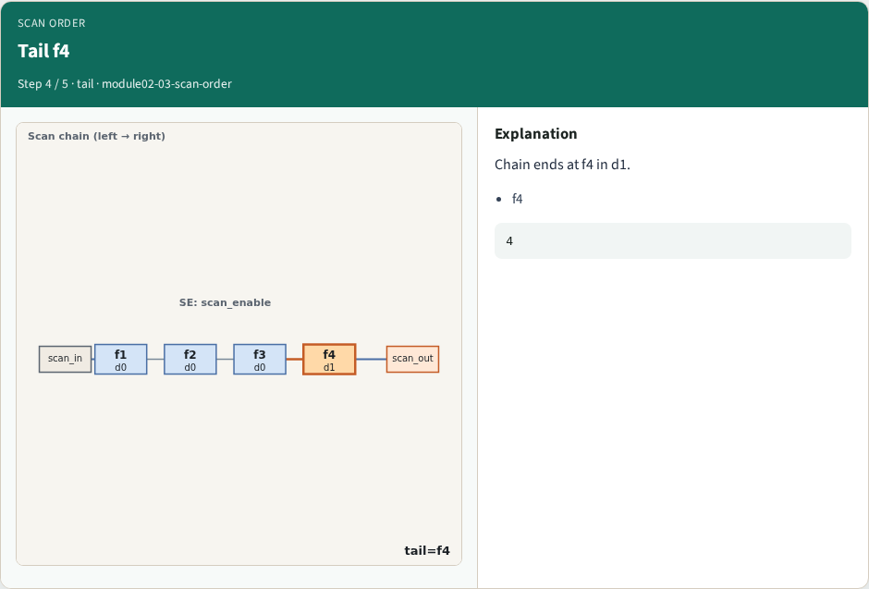
Tail f4
Tail f4
learn_dft_insert — 03 scan order
Notes:
Chain ends at f4 in d1.

Slide 7
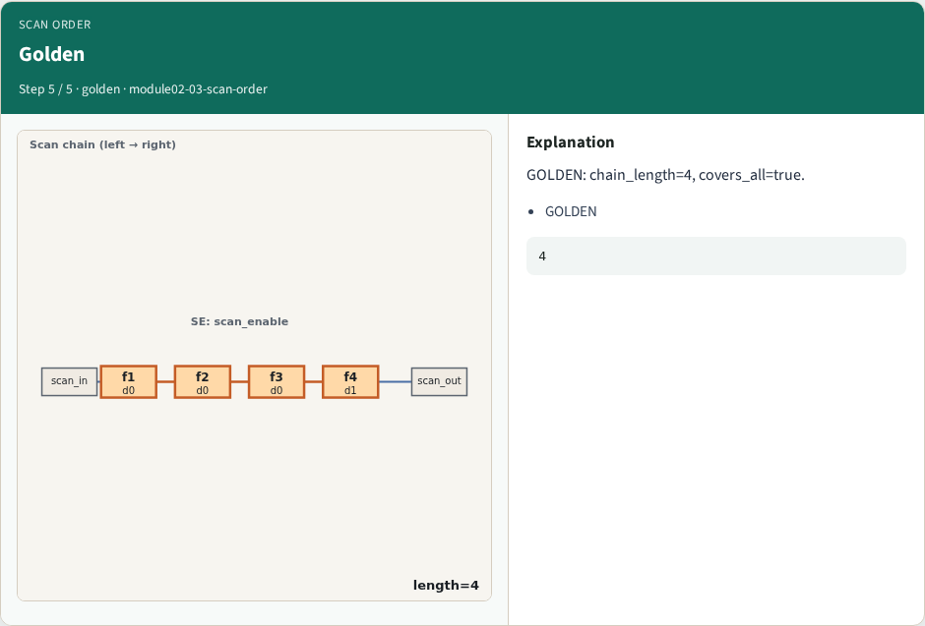
Golden
Golden
learn_dft_insert — 03 scan order
Notes:
GOLDEN: chain_length=4, covers_all=true.

Slide 8
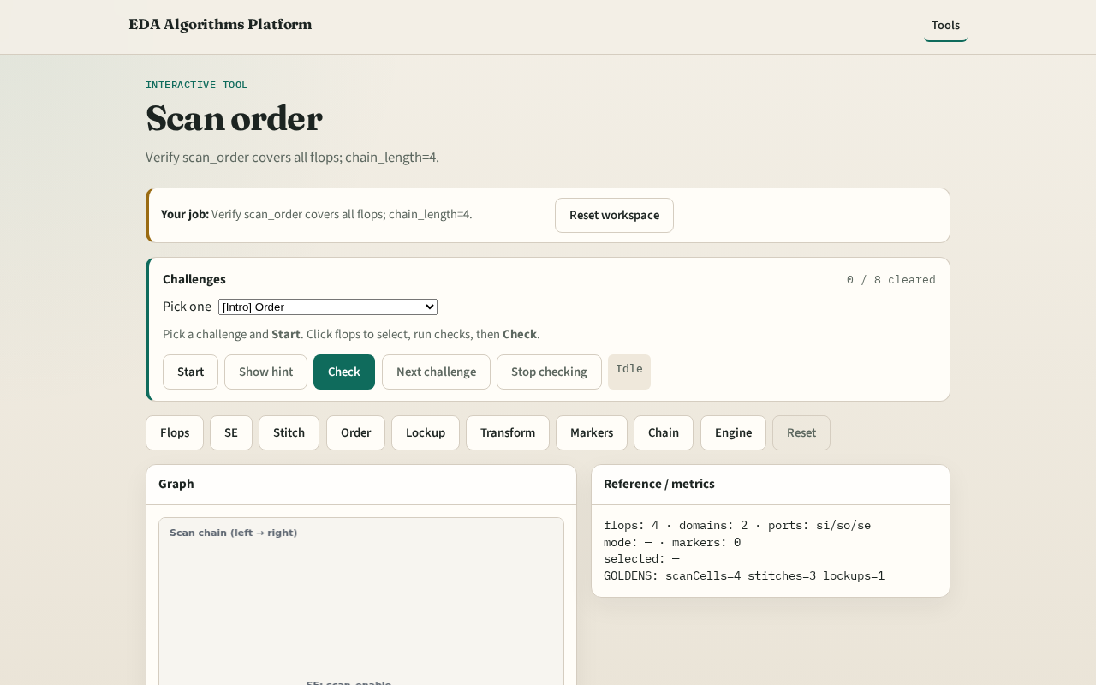
Browser lab track
Browser lab starter
learn_dft_insert — 03 scan order
Notes:
Open **scan-order**. Confirm length=4 and covers all flops.

Slide 9
Implement track
Call scan_order_check(); assert length==4 and covers_all
learn_dft_insert — 03 scan order
Notes:
Call scan_order_check(); assert length==4 and covers_all.

Slide 10
Pitfalls
Duplicate flop in order
Missing f4
learn_dft_insert — 03 scan order
Notes:
Duplicate flop in order. Missing f4.

Slide 11
Your turn
Next: lockup latch
learn_dft_insert — 03 scan order
Notes:
Next: lockup latch.

