Slide 1
Why lockup
Lockup latches bridge clock domains on scan path
learn_dft_insert — 01 lockup latch
Notes:
Lockup latches bridge clock domains on scan path.

Slide 2
The idea
GOLDEN: lockup_count=1 on f3→f4 (d0→d1)
learn_dft_insert — 01 lockup latch
Notes:
GOLDEN: lockup_count=1 on f3→f4 (d0→d1).

Slide 3
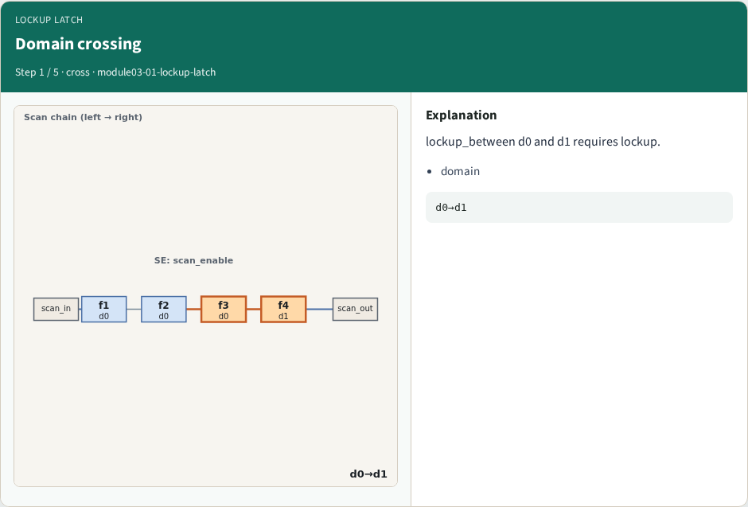
Domain crossing
Domain crossing
learn_dft_insert — 01 lockup latch
Notes:
lockup_between d0 and d1 requires lockup.

Slide 4
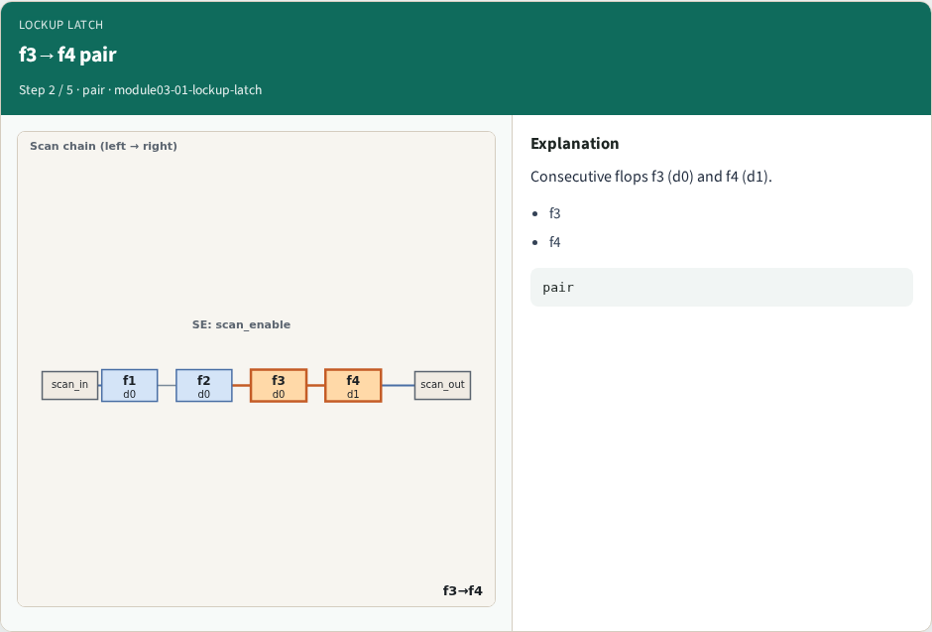
f3→f4 pair
f3→f4 pair
learn_dft_insert — 01 lockup latch
Notes:
Consecutive flops f3 (d0) and f4 (d1).

Slide 5
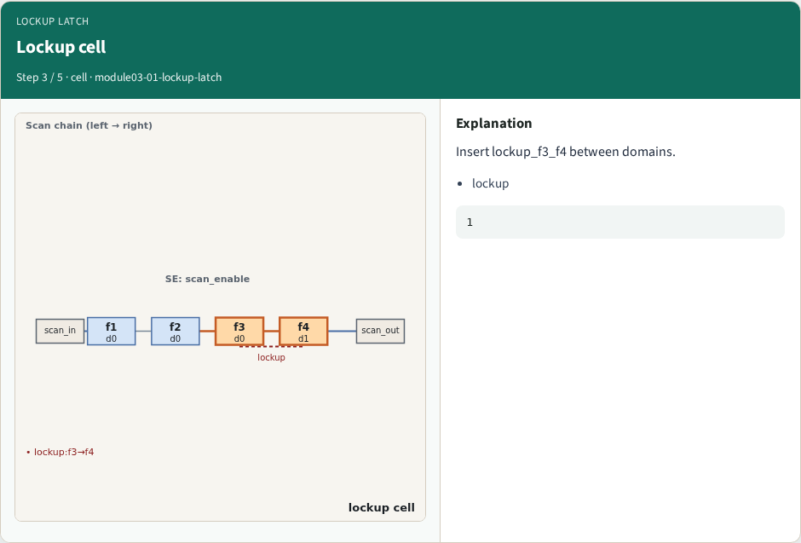
Lockup cell
Lockup cell
learn_dft_insert — 01 lockup latch
Notes:
Insert lockup_f3_f4 between domains.

Slide 6
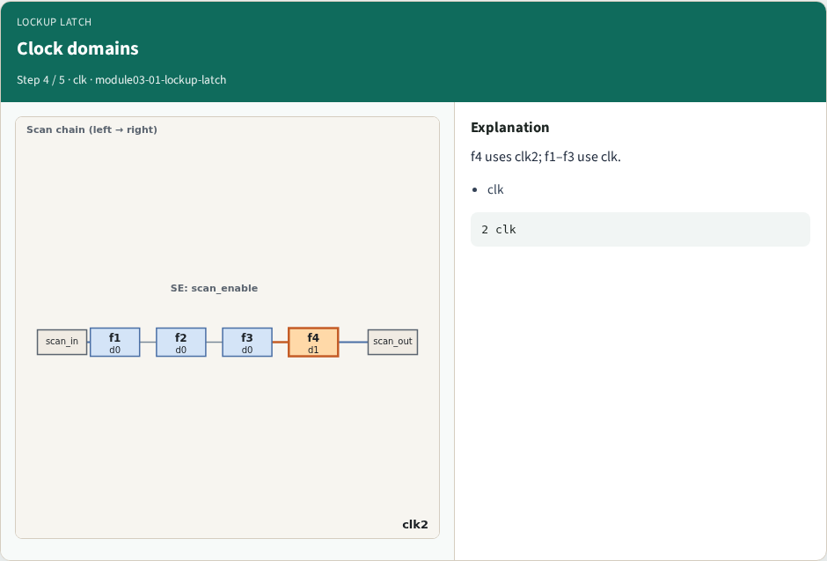
Clock domains
Clock domains
learn_dft_insert — 01 lockup latch
Notes:
f4 uses clk2; f1–f3 use clk.

Slide 7
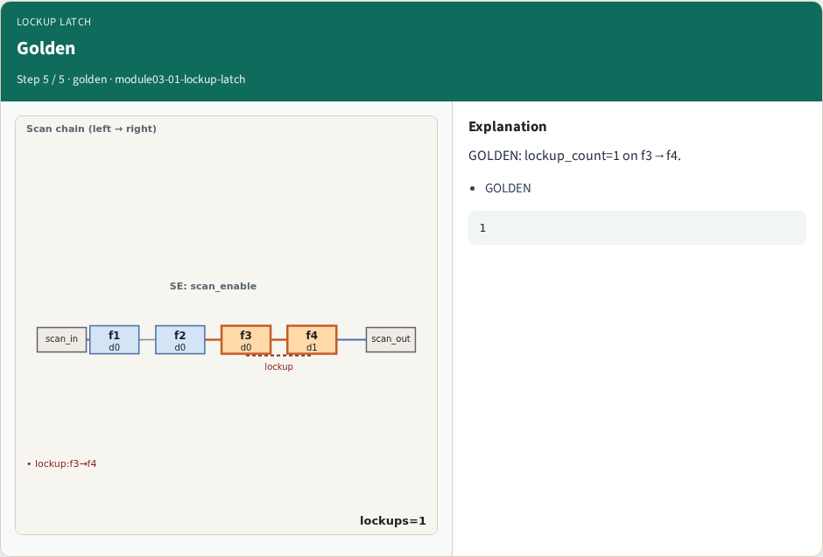
Golden
Golden
learn_dft_insert — 01 lockup latch
Notes:
GOLDEN: lockup_count=1 on f3→f4.

Slide 8
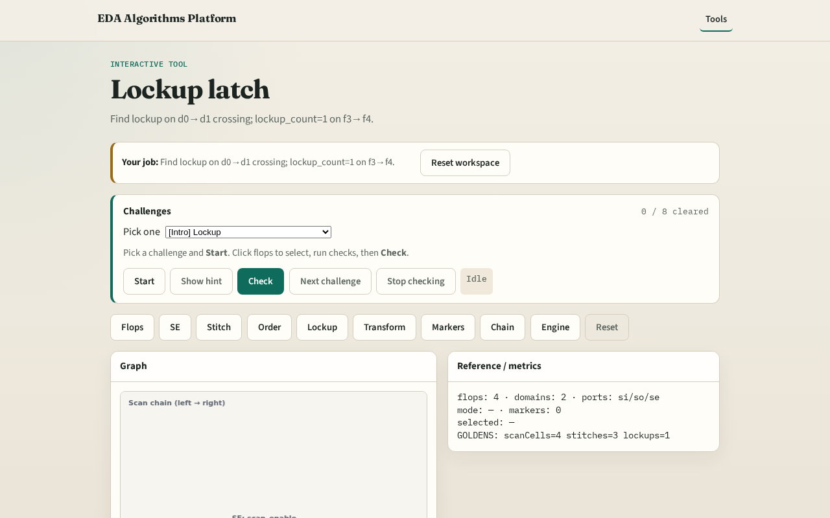
Browser lab track
Browser lab starter
learn_dft_insert — 01 lockup latch
Notes:
Open **lockup-latch**. Confirm one lockup between f3 and f4.

Slide 9
Implement track
Call find_lockups(); assert count==1 and from f3 to f4
learn_dft_insert — 01 lockup latch
Notes:
Call find_lockups(); assert count==1 and from f3 to f4.

Slide 10
Pitfalls
Lockup on same domain
Missing clk2 crossing
learn_dft_insert — 01 lockup latch
Notes:
Lockup on same domain. Missing clk2 crossing.

Slide 11
Your turn
Next: netlist transform
learn_dft_insert — 01 lockup latch
Notes:
Next: netlist transform.

