Slide 1
Why transform
DFT insert adds scan wiring edges to the netlist
learn_dft_insert — 03 netlist transform
Notes:
DFT insert adds scan wiring edges to the netlist.

Slide 2
The idea
GOLDEN: transform_edge_count=6 (SI + 3 stitches + SO + 1 lockup)
learn_dft_insert — 03 netlist transform
Notes:
GOLDEN: transform_edge_count=6 (SI + 3 stitches + SO + 1 lockup).

Slide 3
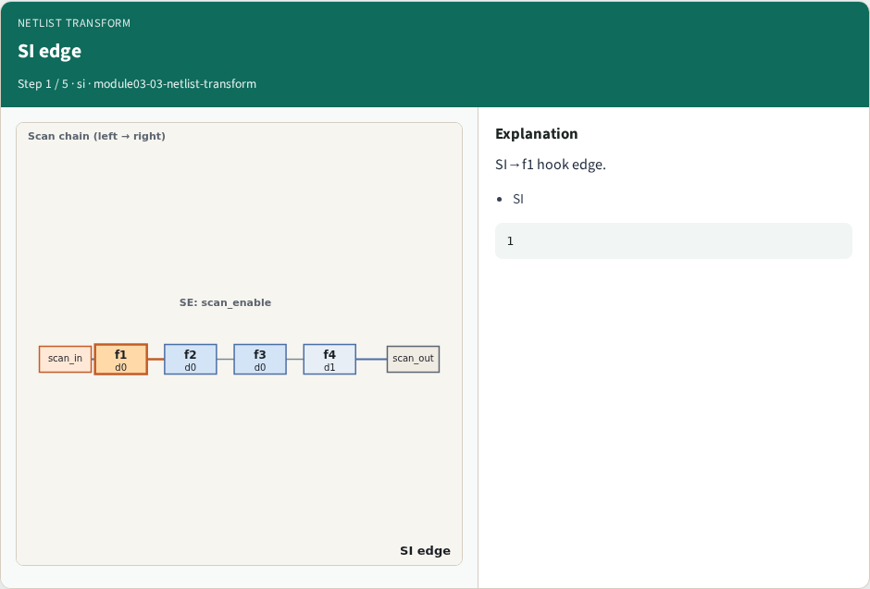
SI edge
SI edge
learn_dft_insert — 03 netlist transform
Notes:
SI→f1 hook edge.

Slide 4
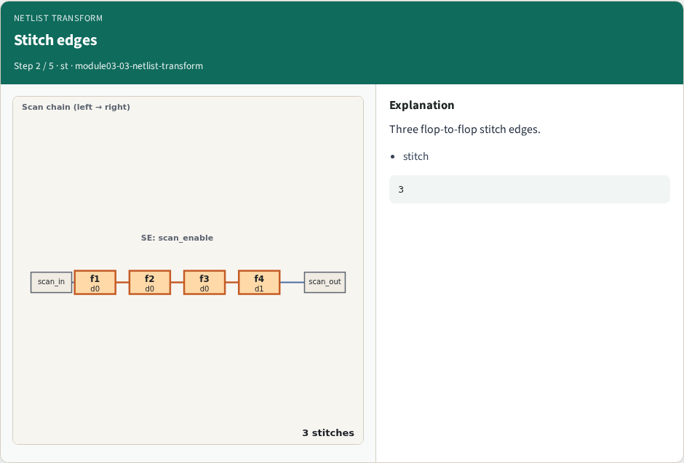
Stitch edges
Stitch edges
learn_dft_insert — 03 netlist transform
Notes:
Three flop-to-flop stitch edges.

Slide 5
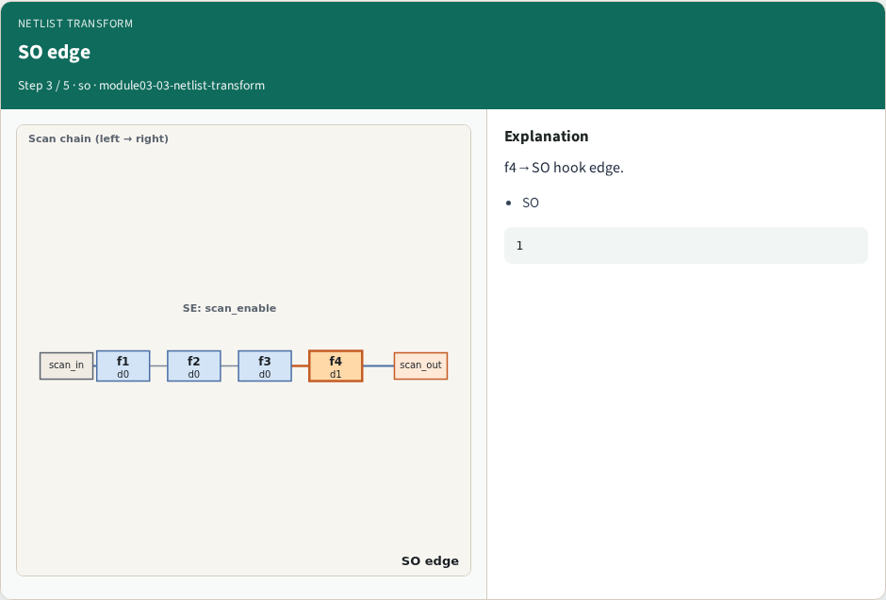
SO edge
SO edge
learn_dft_insert — 03 netlist transform
Notes:
f4→SO hook edge.

Slide 6
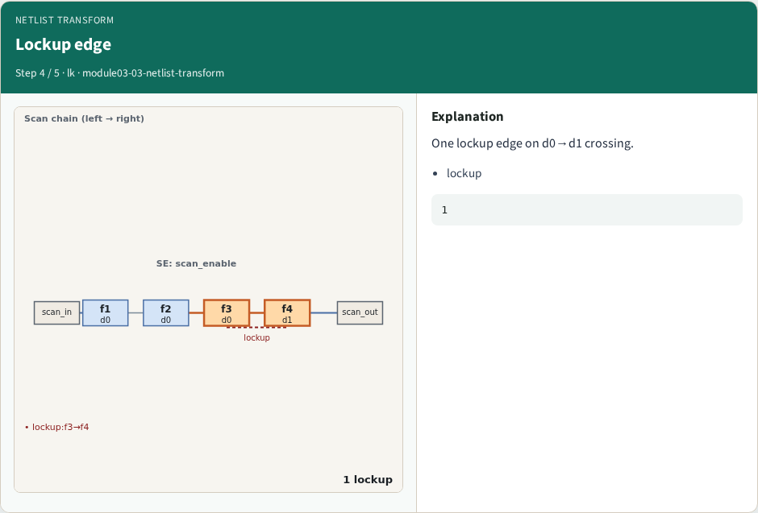
Lockup edge
Lockup edge
learn_dft_insert — 03 netlist transform
Notes:
One lockup edge on d0→d1 crossing.

Slide 7
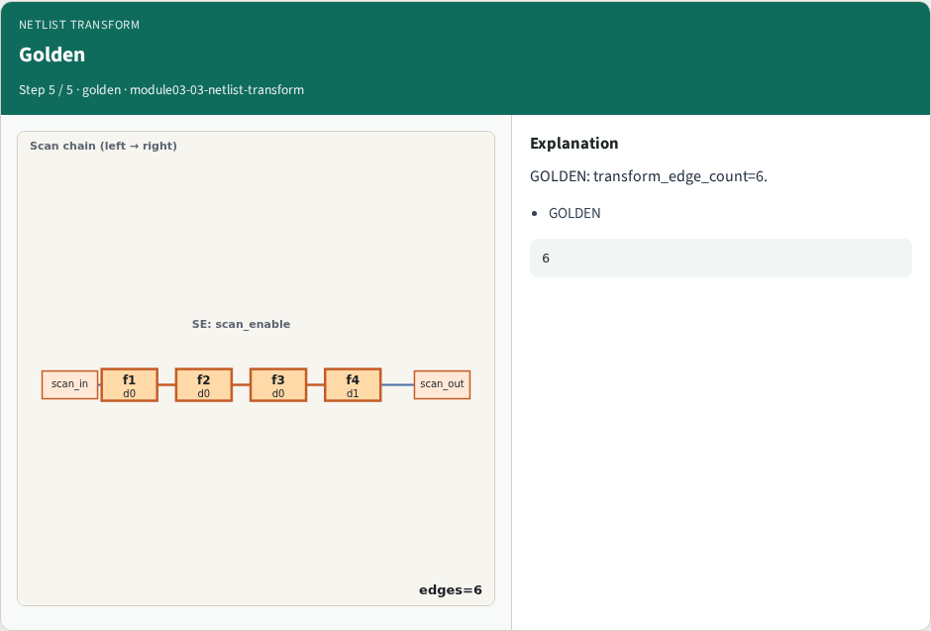
Golden
Golden
learn_dft_insert — 03 netlist transform
Notes:
GOLDEN: transform_edge_count=6.

Slide 8
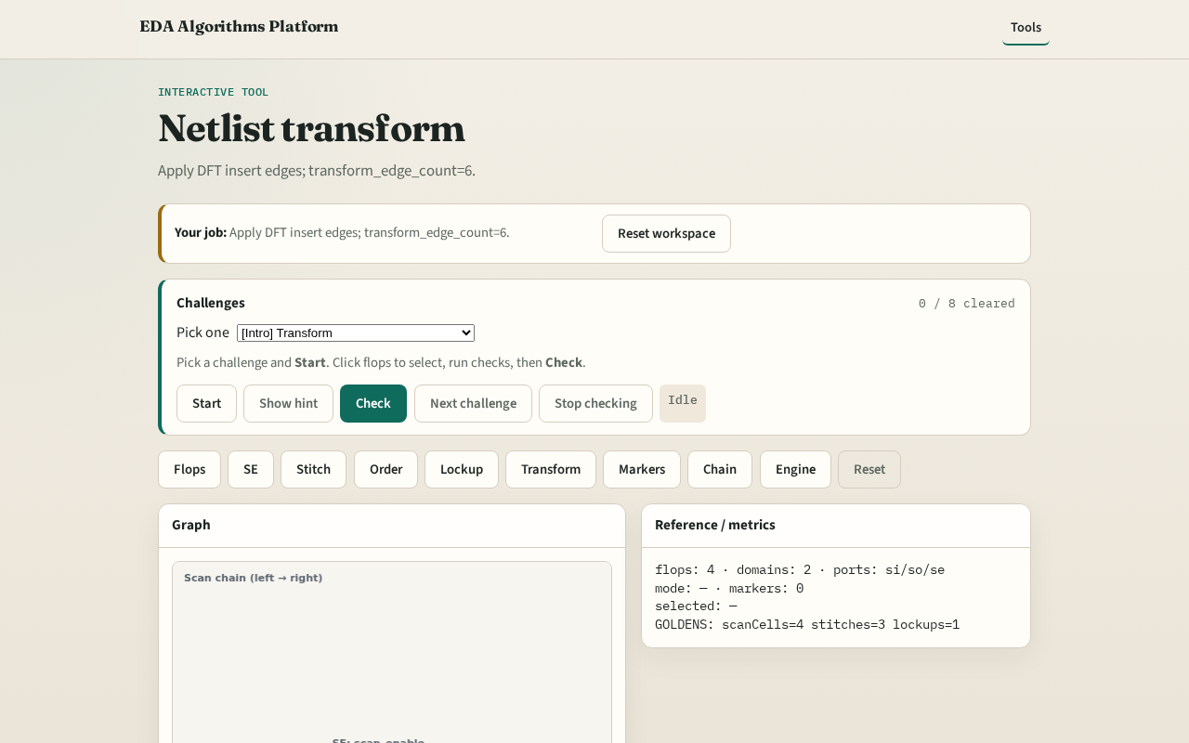
Browser lab track
Browser lab starter
learn_dft_insert — 03 netlist transform
Notes:
Open **netlist-transform**. Confirm 6 transform edges.

Slide 9
Implement track
Call netlist_transform(); assert edge_count==6
learn_dft_insert — 03 netlist transform
Notes:
Call netlist_transform(); assert edge_count==6.

Slide 10
Pitfalls
Double-counting stitches
Forgetting lockup edge
learn_dft_insert — 03 netlist transform
Notes:
Double-counting stitches. Forgetting lockup edge.

Slide 11
Your turn
Next: DFT markers
learn_dft_insert — 03 netlist transform
Notes:
Next: DFT markers.

