Slide 1
Why markers
Signoff DFT emits markers for required lockups on domain crossings
learn_dft_insert — 01 dft markers
Notes:
Signoff DFT emits markers for required lockups on domain crossings.

Slide 2
The idea
GOLDEN: marker_count=1
learn_dft_insert — 01 dft markers
Notes:
GOLDEN: marker_count=1.

Slide 3
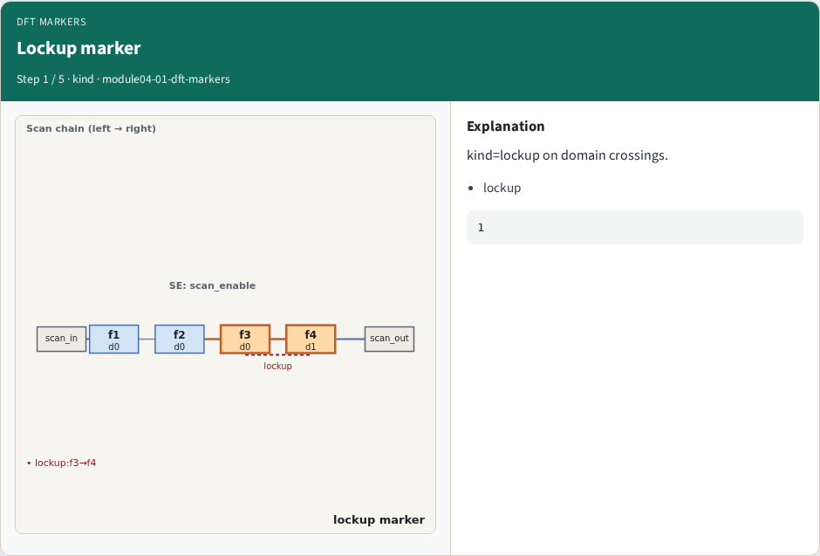
Lockup marker
Lockup marker
learn_dft_insert — 01 dft markers
Notes:
kind=lockup on domain crossings.

Slide 4
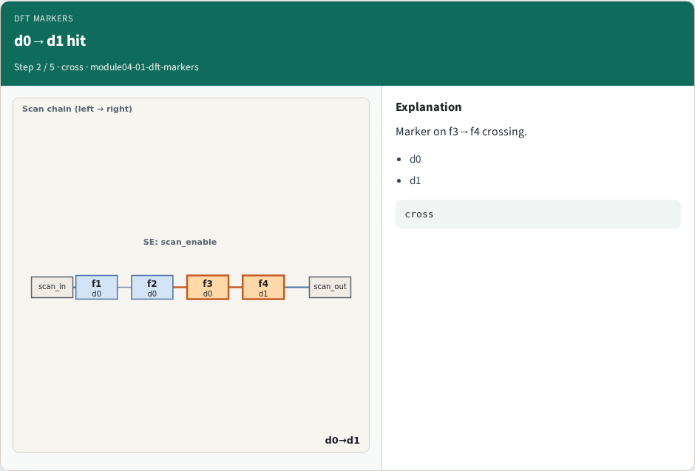
d0→d1 hit
d0→d1 hit
learn_dft_insert — 01 dft markers
Notes:
Marker on f3→f4 crossing.

Slide 5
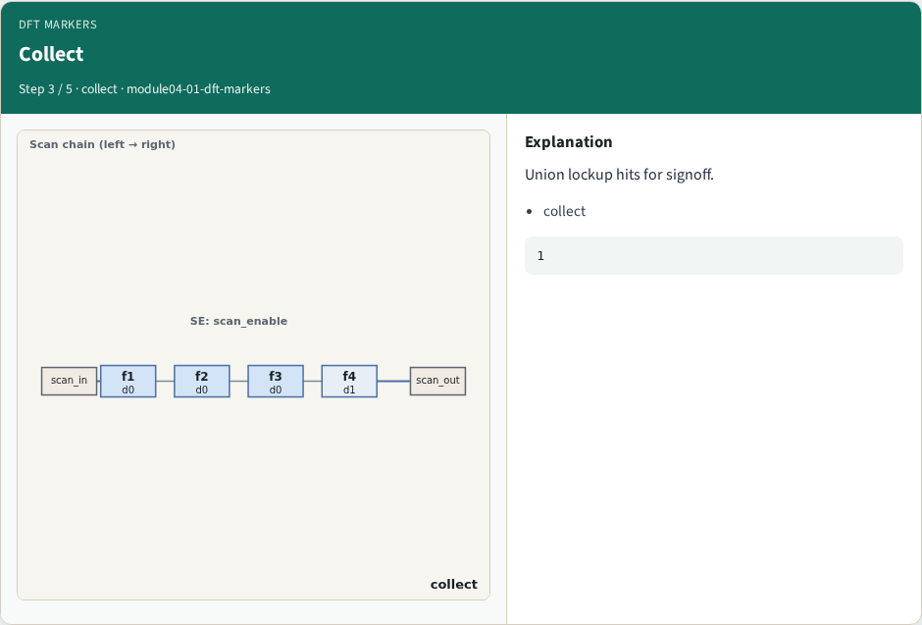
Collect
Collect
learn_dft_insert — 01 dft markers
Notes:
Union lockup hits for signoff.

Slide 6
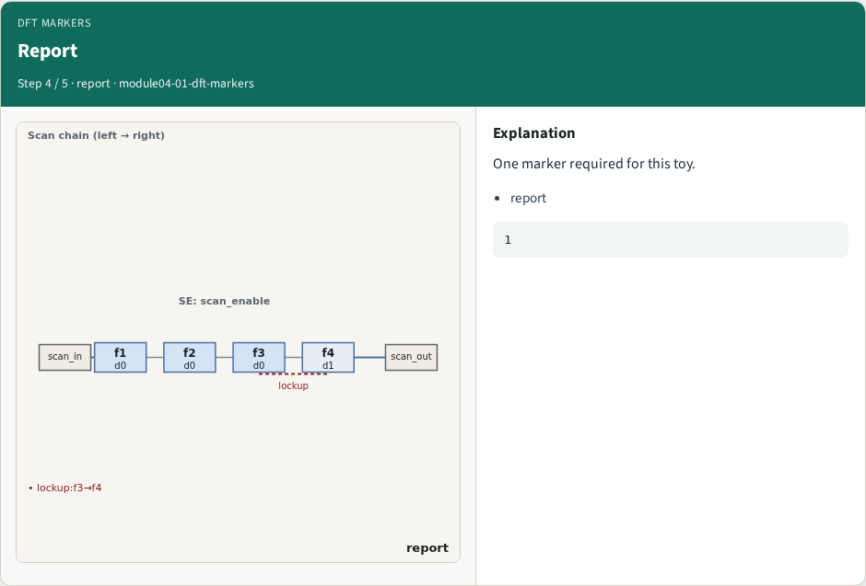
Report
Report
learn_dft_insert — 01 dft markers
Notes:
One marker required for this toy.

Slide 7
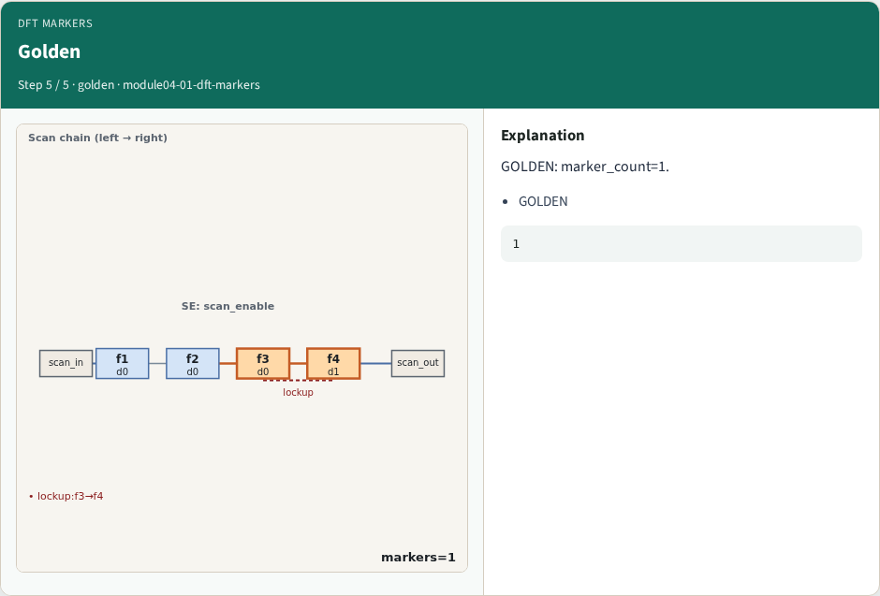
Golden
Golden
learn_dft_insert — 01 dft markers
Notes:
GOLDEN: marker_count=1.

Slide 8

Browser lab track
Browser lab starter
learn_dft_insert — 01 dft markers
Notes:
Open **dft-markers**. Run collect; confirm 1 marker.

Slide 9
Implement track
Call collect_markers(); assert count==1
learn_dft_insert — 01 dft markers
Notes:
Call collect_markers(); assert count==1.

Slide 10
Pitfalls
Counting stitches as markers
Missing domain cross
learn_dft_insert — 01 dft markers
Notes:
Counting stitches as markers. Missing domain cross.

Slide 11
Your turn
Next: scan chain view
learn_dft_insert — 01 dft markers
Notes:
Next: scan chain view.

