Slide 1
Chain view
Browser view stitches chain, ports, and lockup for sanity check
learn_dft_insert — 03 scan chain view
Notes:
Browser view stitches chain, ports, and lockup for sanity check.

Slide 2
The idea
GOLDEN: f1→f2→f3→f4; lockup between f3→f4
learn_dft_insert — 03 scan chain view
Notes:
GOLDEN: f1→f2→f3→f4; lockup between f3→f4.

Slide 3
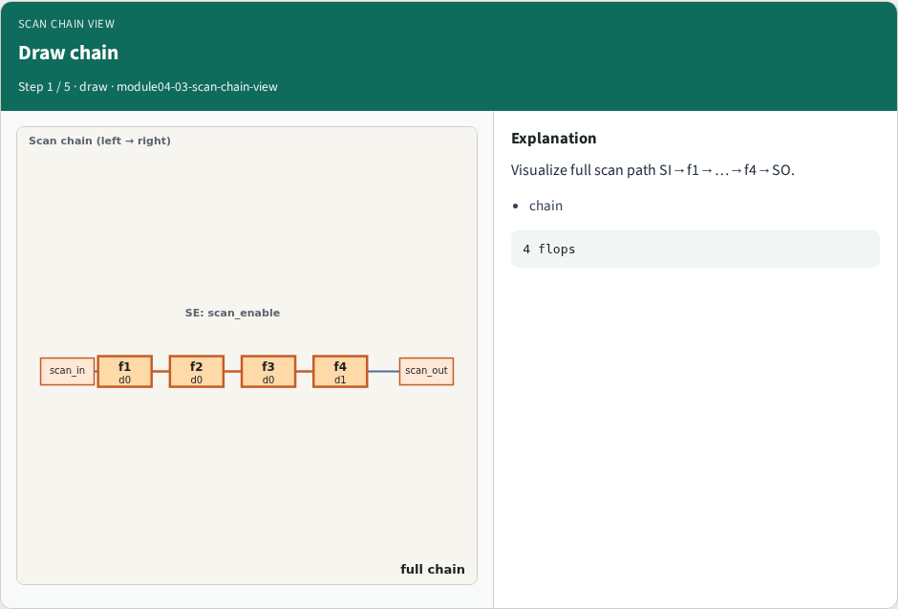
Draw chain
Draw chain
learn_dft_insert — 03 scan chain view
Notes:
Visualize full scan path SI→f1→…→f4→SO.

Slide 4
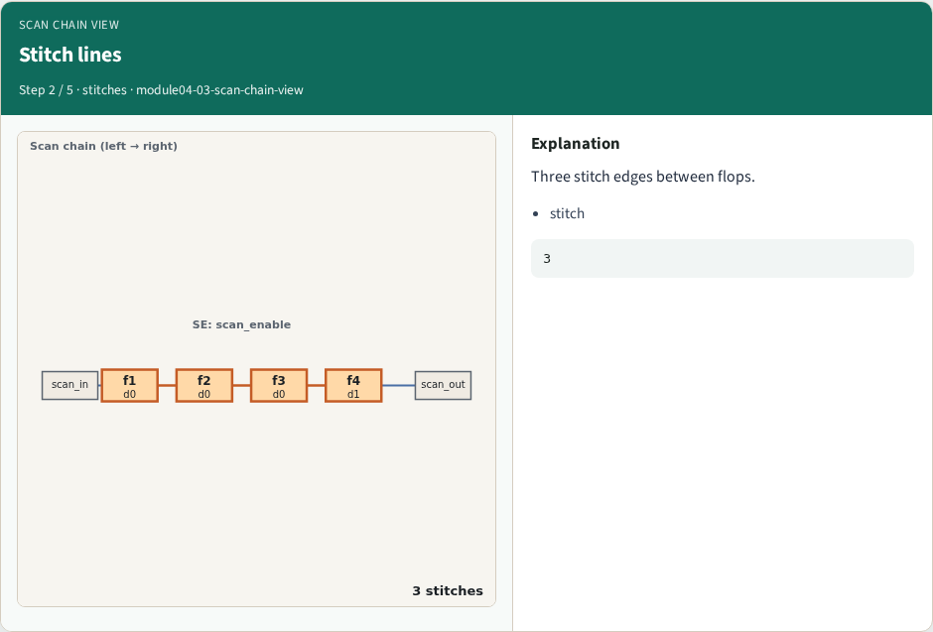
Stitch lines
Stitch lines
learn_dft_insert — 03 scan chain view
Notes:
Three stitch edges between flops.

Slide 5
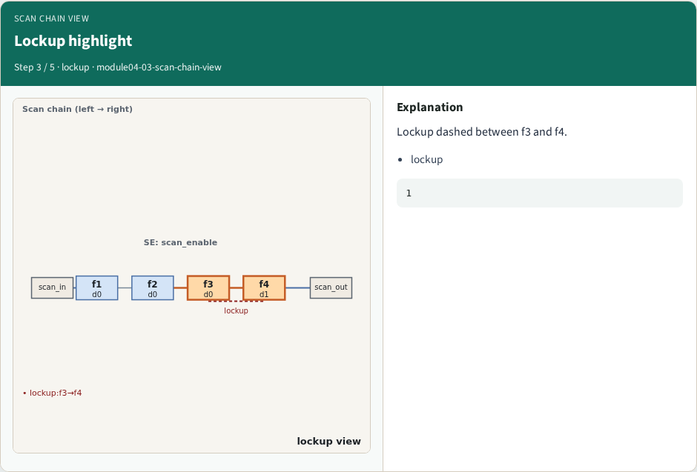
Lockup highlight
Lockup highlight
learn_dft_insert — 03 scan chain view
Notes:
Lockup dashed between f3 and f4.

Slide 6
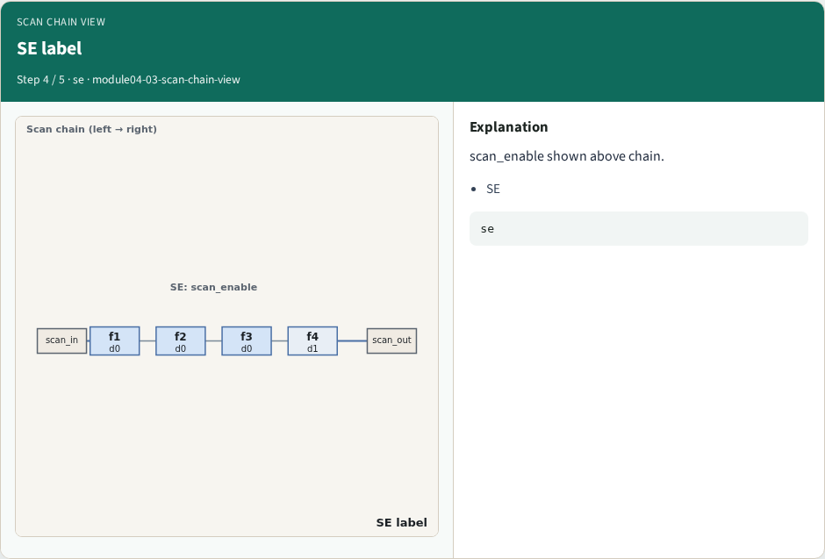
SE label
SE label
learn_dft_insert — 03 scan chain view
Notes:
scan_enable shown above chain.

Slide 7
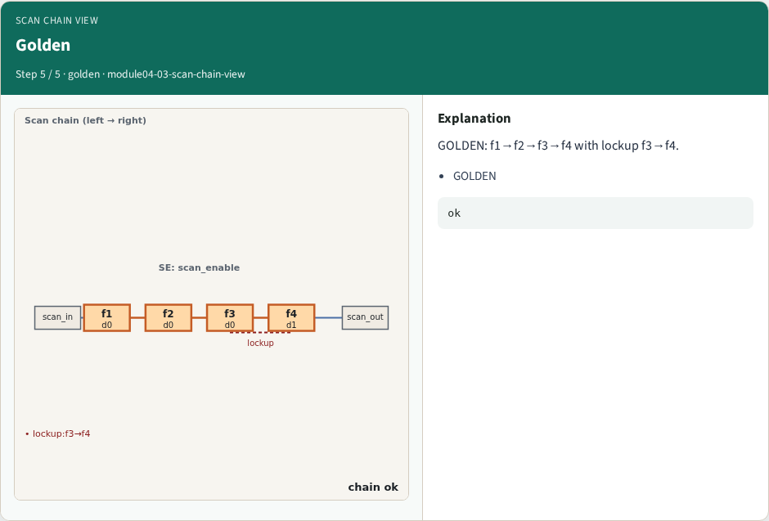
Golden
Golden
learn_dft_insert — 03 scan chain view
Notes:
GOLDEN: f1→f2→f3→f4 with lockup f3→f4.

Slide 8
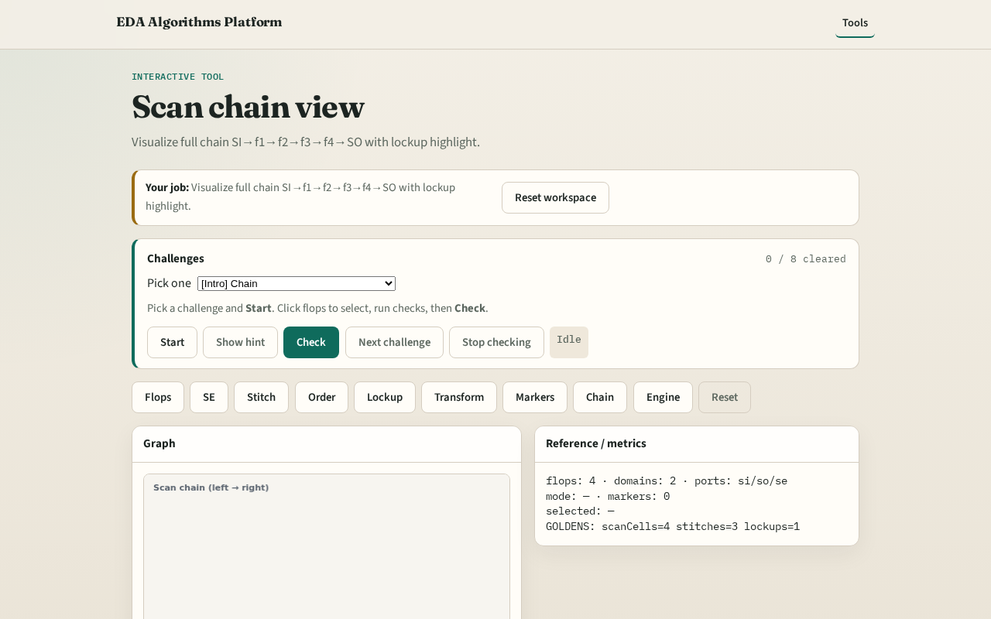
Browser lab track
Browser lab starter
learn_dft_insert — 03 scan chain view
Notes:
Open **scan-chain-view**. Confirm full chain + lockup drawing.

Slide 9
Implement track
Reuse stitch + lockup + transform; drawDft shows chain
learn_dft_insert — 03 scan chain view
Notes:
Reuse stitch + lockup + transform; drawDft shows chain.

Slide 10
Pitfalls
Drawing functional D paths instead of scan
Hiding lockup
learn_dft_insert — 03 scan chain view
Notes:
Drawing functional D paths instead of scan. Hiding lockup.

Slide 11
Your turn
Next: DFT engine
learn_dft_insert — 03 scan chain view
Notes:
Next: DFT engine.

