Slide 1
Engine
A tiny engine chains scan cells, stitch, lockup, transform, and markers
learn_dft_insert — 01 dft engine
Notes:
A tiny engine chains scan cells, stitch, lockup, transform, and markers.

Slide 2
The idea
GOLDEN: scan cells=4, stitches=3, lockups=1, edges=6, markers=1, ok=True
learn_dft_insert — 01 dft engine
Notes:
GOLDEN: scan cells=4, stitches=3, lockups=1, edges=6, markers=1, ok=True.

Slide 3
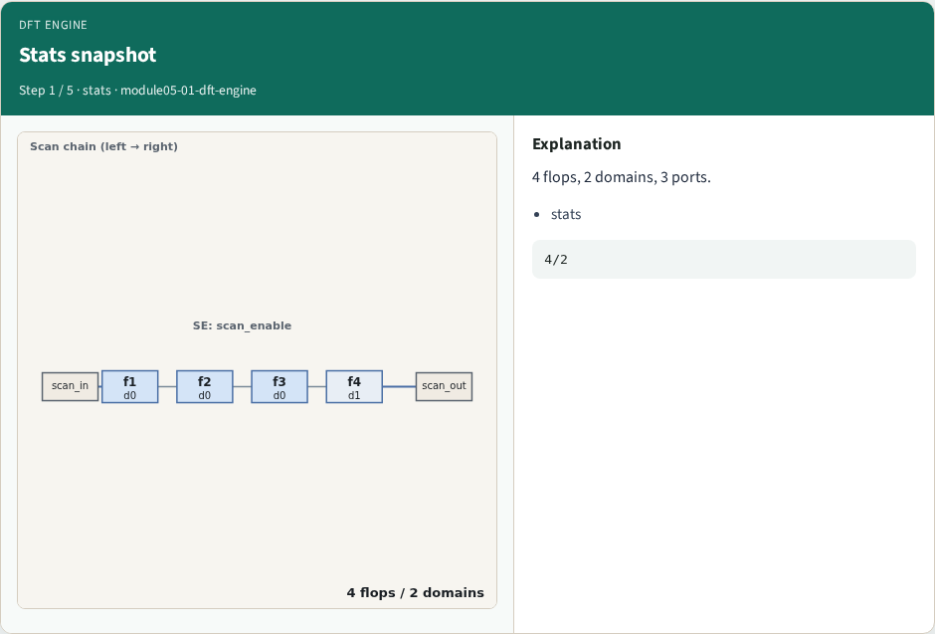
Stats snapshot
Stats snapshot
learn_dft_insert — 01 dft engine
Notes:
4 flops, 2 domains, 3 ports.

Slide 4
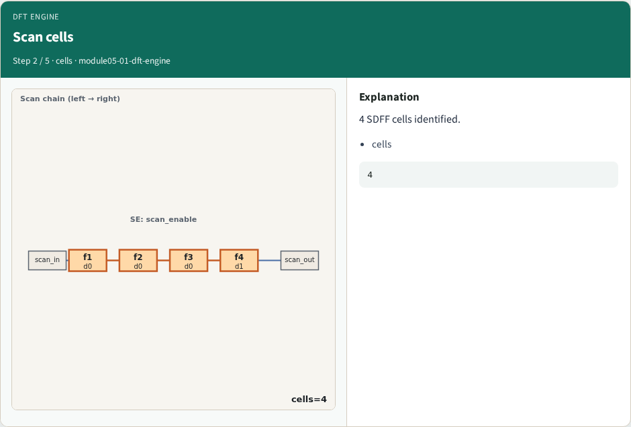
Scan cells
Scan cells
learn_dft_insert — 01 dft engine
Notes:
4 SDFF cells identified.

Slide 5
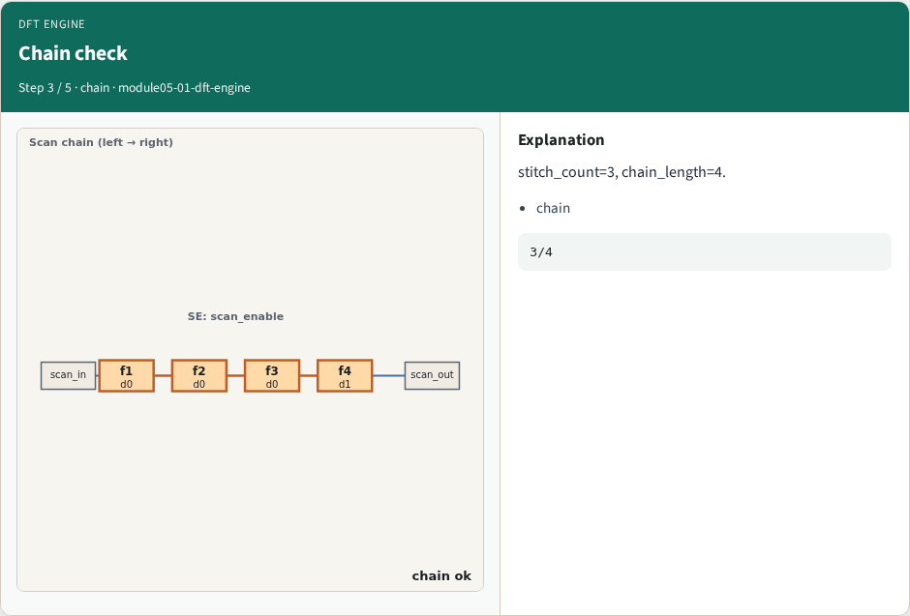
Chain check
Chain check
learn_dft_insert — 01 dft engine
Notes:
stitch_count=3, chain_length=4.

Slide 6
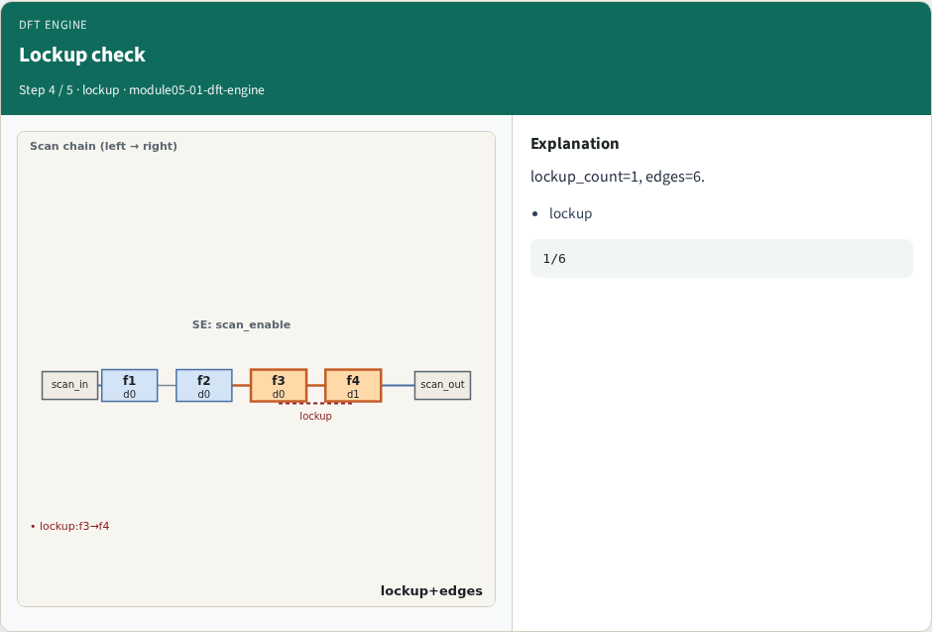
Lockup check
Lockup check
learn_dft_insert — 01 dft engine
Notes:
lockup_count=1, edges=6.

Slide 7
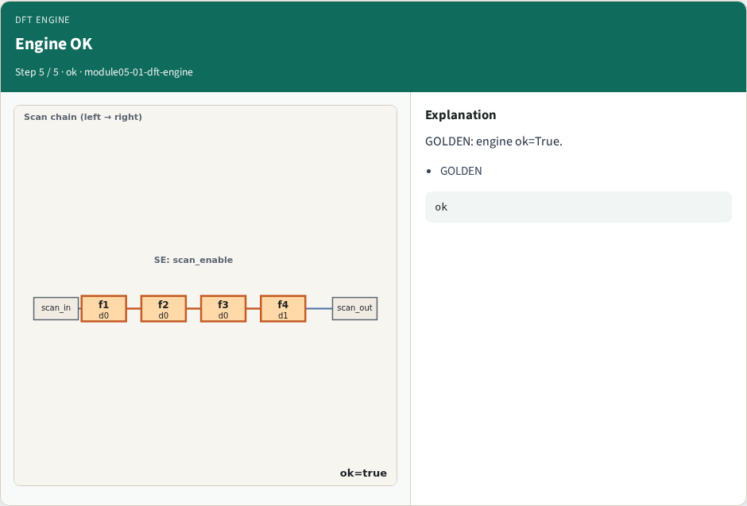
Engine OK
Engine OK
learn_dft_insert — 01 dft engine
Notes:
GOLDEN: engine ok=True.

Slide 8

Browser lab track
Browser lab starter
learn_dft_insert — 01 dft engine
Notes:
Open **dft-engine**. Run engine; confirm ok.

Slide 9
Implement track
Call dft_engine(); assert ok and markers.count==1
learn_dft_insert — 01 dft engine
Notes:
Call dft_engine(); assert ok and markers.count==1.

Slide 10
Pitfalls
Reporting partial checks
Changing toy without updating goldens
learn_dft_insert — 01 dft engine
Notes:
Reporting partial checks. Changing toy without updating goldens.

Slide 11
Your turn
Next: offline compare, then wrap
learn_dft_insert — 01 dft engine
Notes:
Next: offline compare, then wrap.

