Slide 1
Why switching
Dynamic power scales with activity, cap, voltage squared, and frequency
learn_power — 01 switching power
Notes:
Dynamic power scales with activity, cap, voltage squared, and frequency.

Slide 2
The idea
GOLDEN: psw_n1=1.0
learn_power — 01 switching power
Notes:
GOLDEN: psw_n1=1.0.

Slide 3
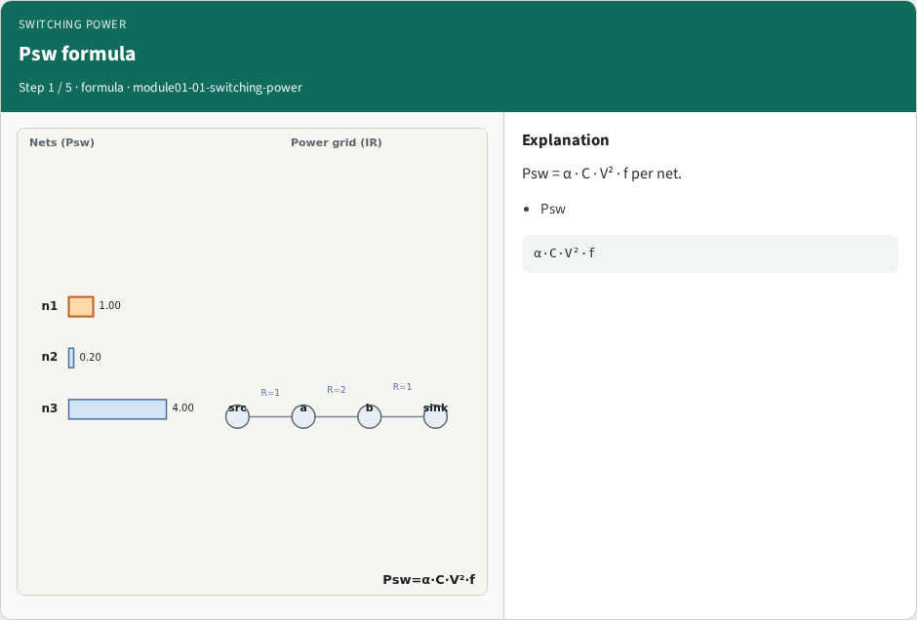
Psw formula
Psw formula
learn_power — 01 switching power
Notes:
Psw = α · C · V² · f per net.

Slide 4
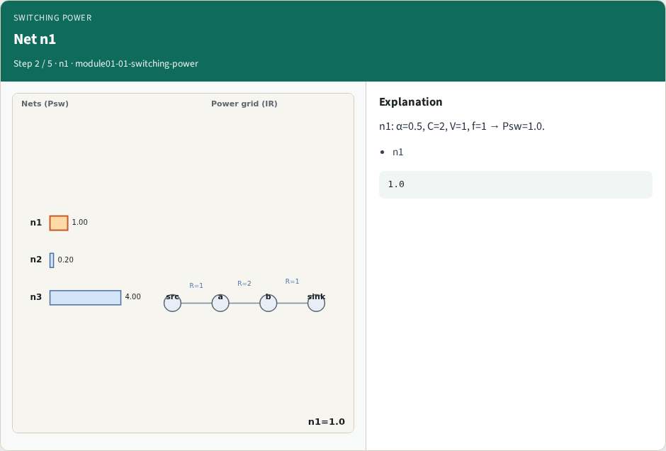
Net n1
Net n1
learn_power — 01 switching power
Notes:
n1: α=0.5, C=2, V=1, f=1 → Psw=1.0.

Slide 5
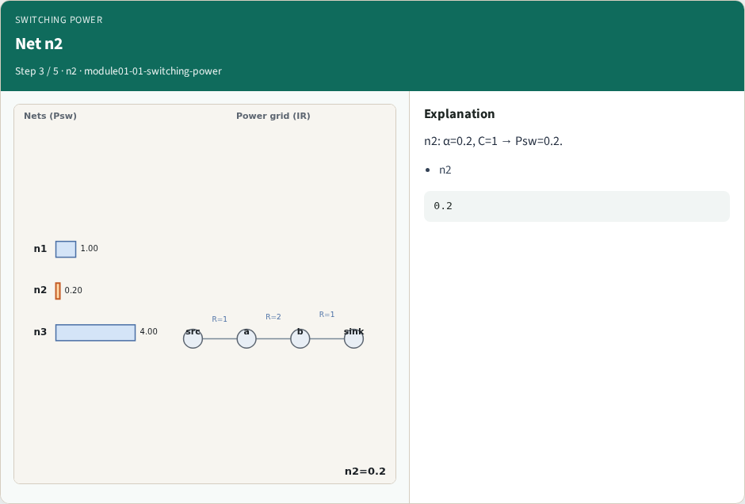
Net n2
Net n2
learn_power — 01 switching power
Notes:
n2: α=0.2, C=1 → Psw=0.2.

Slide 6
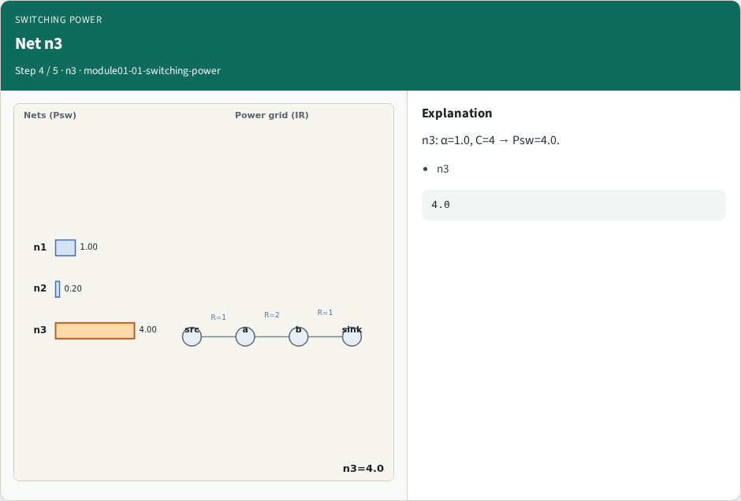
Net n3
Net n3
learn_power — 01 switching power
Notes:
n3: α=1.0, C=4 → Psw=4.0.

Slide 7
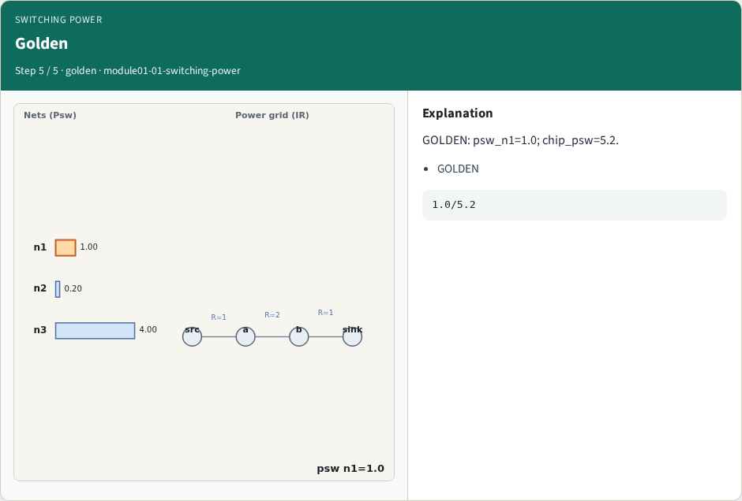
Golden
Golden
learn_power — 01 switching power
Notes:
GOLDEN: psw_n1=1.0; chip_psw=5.2.

Slide 8
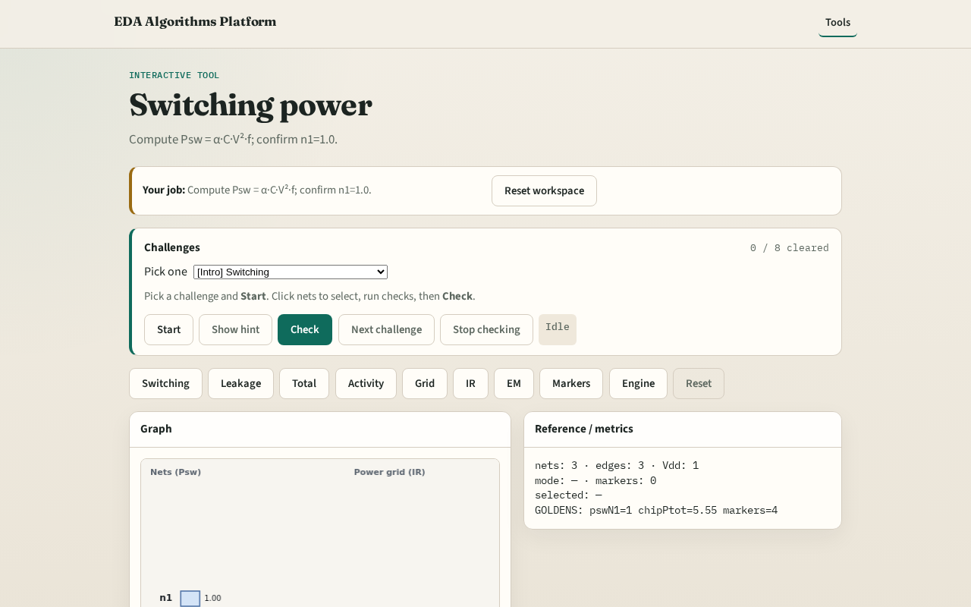
Browser lab track
Browser lab starter
learn_power — 01 switching power
Notes:
Open **switching-power**. Inspect tiny_power; confirm n1 Psw=1.0.

Slide 9
Implement track
Call switching_power(); assert by_net['n1']==1.0
learn_power — 01 switching power
Notes:
Call switching_power(); assert by_net['n1']==1.0.

Slide 10
Pitfalls
Forgetting V²
Using leakage instead of switching
learn_power — 01 switching power
Notes:
Forgetting V². Using leakage instead of switching.

Slide 11
Your turn
Next: leakage power
learn_power — 01 switching power
Notes:
Next: leakage power.

