Slide 1
Why leakage
Static leakage current times supply voltage gives Pleak
learn_power — 03 leakage power
Notes:
Static leakage current times supply voltage gives Pleak.

Slide 2
The idea
GOLDEN: plk_n1=0.1
learn_power — 03 leakage power
Notes:
GOLDEN: plk_n1=0.1.

Slide 3
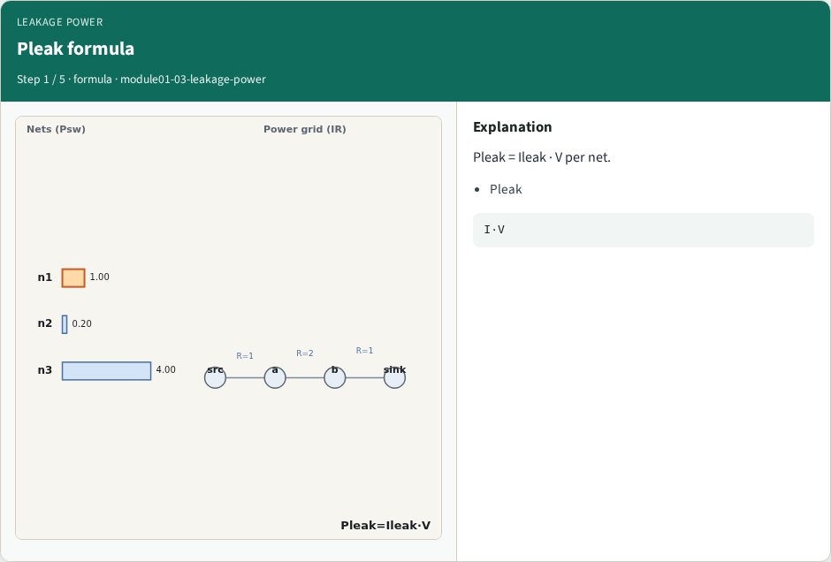
Pleak formula
Pleak formula
learn_power — 03 leakage power
Notes:
Pleak = Ileak · V per net.

Slide 4
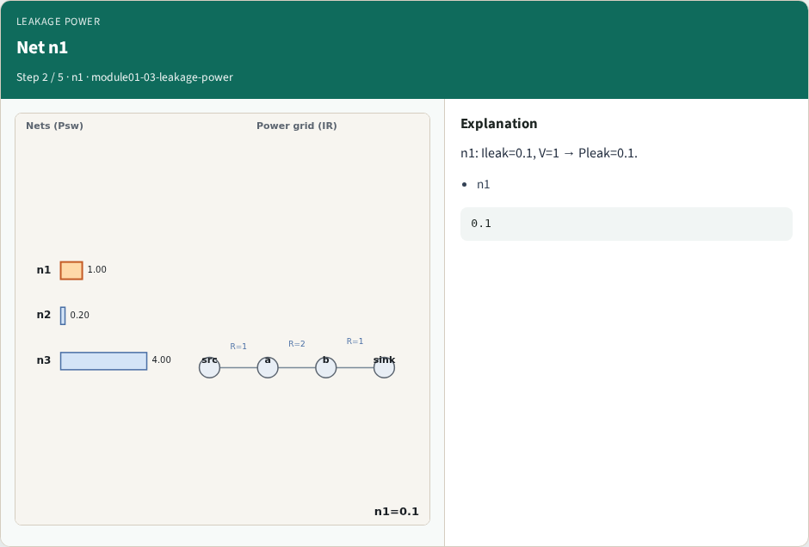
Net n1
Net n1
learn_power — 03 leakage power
Notes:
n1: Ileak=0.1, V=1 → Pleak=0.1.

Slide 5
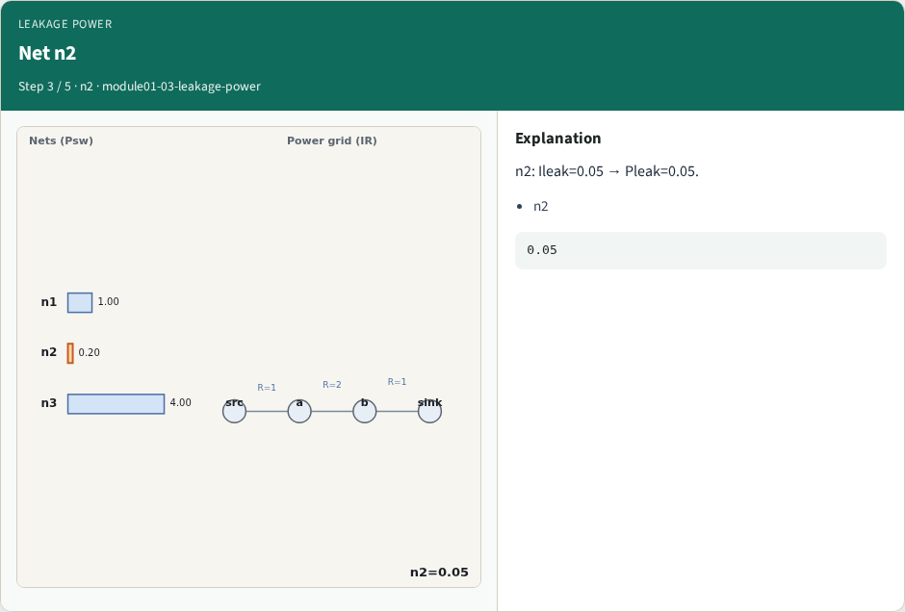
Net n2
Net n2
learn_power — 03 leakage power
Notes:
n2: Ileak=0.05 → Pleak=0.05.

Slide 6
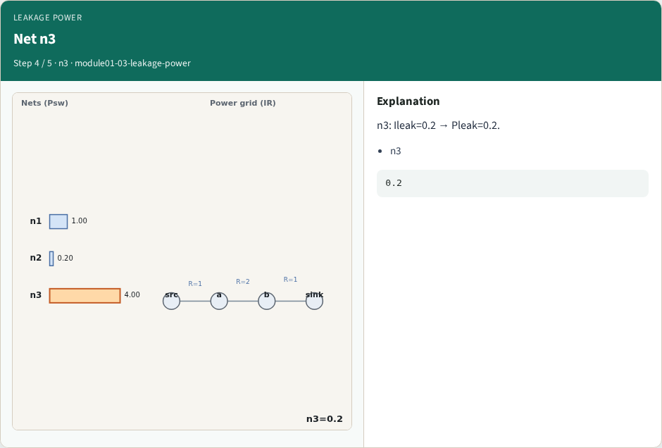
Net n3
Net n3
learn_power — 03 leakage power
Notes:
n3: Ileak=0.2 → Pleak=0.2.

Slide 7
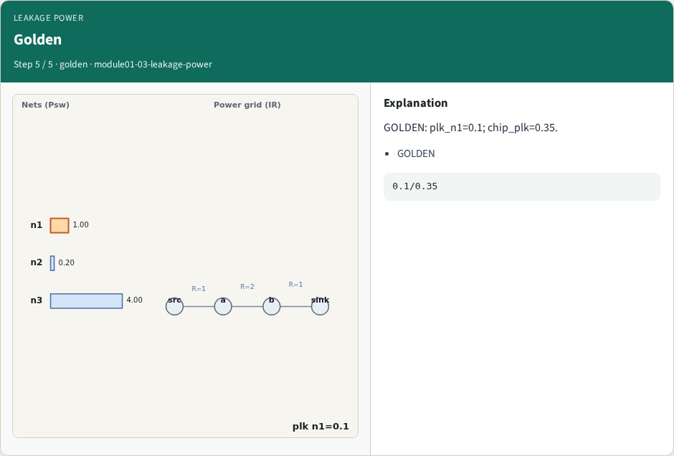
Golden
Golden
learn_power — 03 leakage power
Notes:
GOLDEN: plk_n1=0.1; chip_plk=0.35.

Slide 8

Browser lab track
Browser lab starter
learn_power — 03 leakage power
Notes:
Open **leakage-power**. Confirm n1 Pleak=0.1.

Slide 9
Implement track
Call leakage_power(); assert by_net['n1']==0.1
learn_power — 03 leakage power
Notes:
Call leakage_power(); assert by_net['n1']==0.1.

Slide 10
Pitfalls
Mixing Ileak with switching alpha
Wrong voltage
learn_power — 03 leakage power
Notes:
Mixing Ileak with switching alpha. Wrong voltage.

Slide 11
Your turn
Next: total power
learn_power — 03 leakage power
Notes:
Next: total power.

