Slide 1
Why total
Signoff reports chip Ptot = sum of switching and leakage
learn_power — 01 total power
Notes:
Signoff reports chip Ptot = sum of switching and leakage.

Slide 2
The idea
GOLDEN: chip_ptot=5.55
learn_power — 01 total power
Notes:
GOLDEN: chip_ptot=5.55.

Slide 3
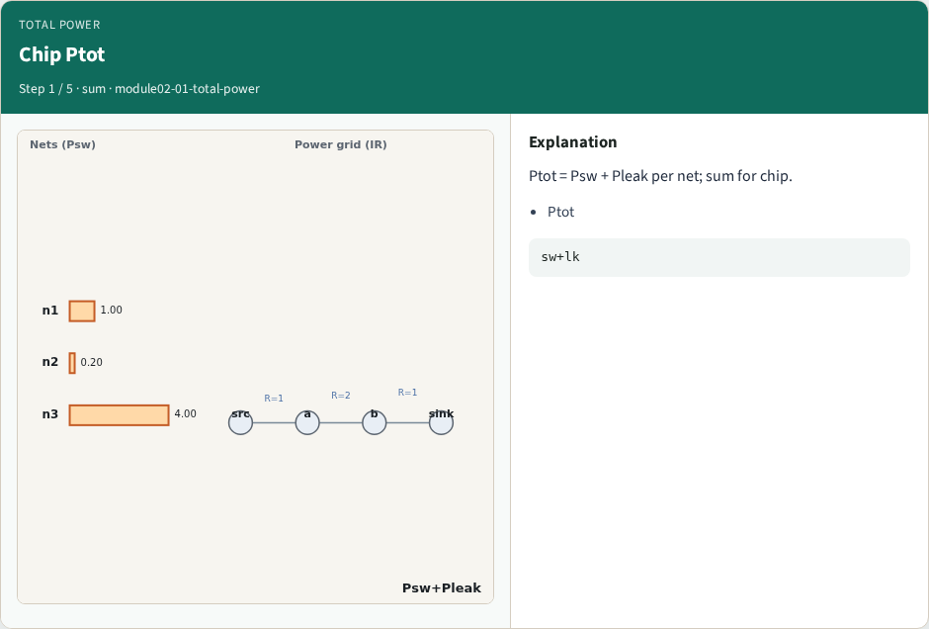
Chip Ptot
Chip Ptot
learn_power — 01 total power
Notes:
Ptot = Psw + Pleak per net; sum for chip.

Slide 4
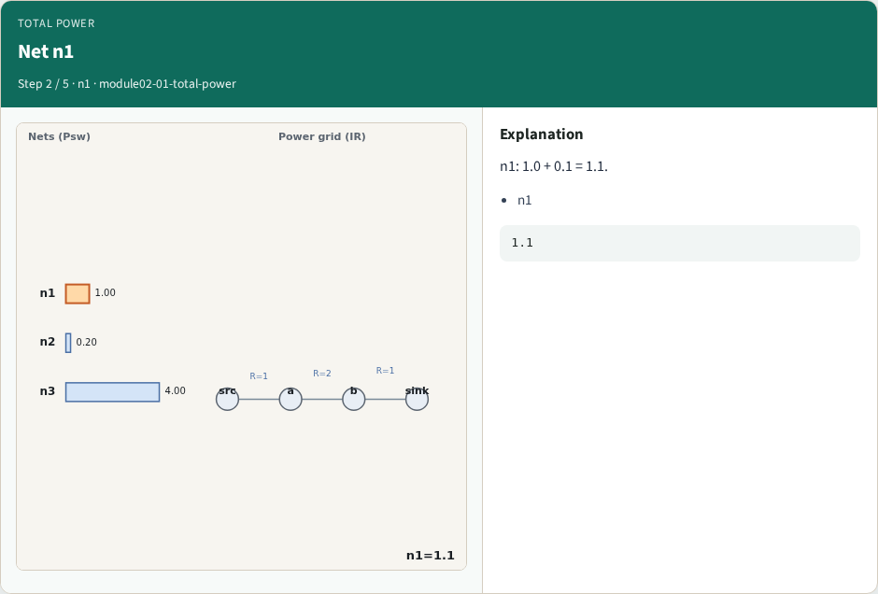
Net n1
Net n1
learn_power — 01 total power
Notes:
n1: 1.0 + 0.1 = 1.1.

Slide 5
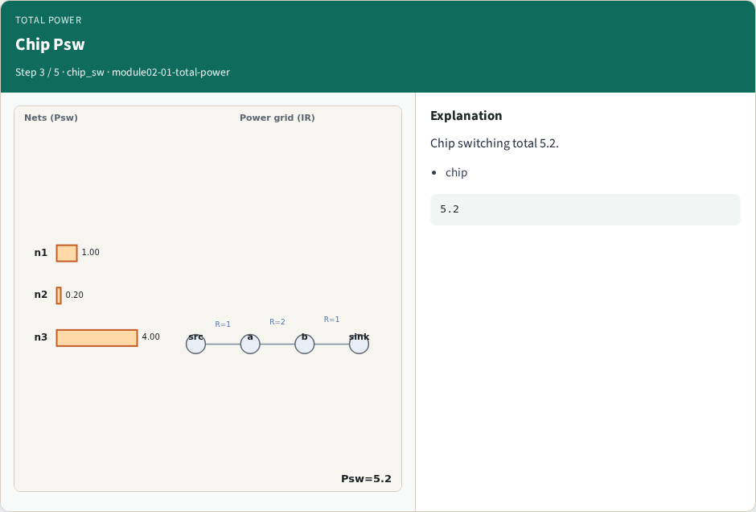
Chip Psw
Chip Psw
learn_power — 01 total power
Notes:
Chip switching total 5.2.

Slide 6
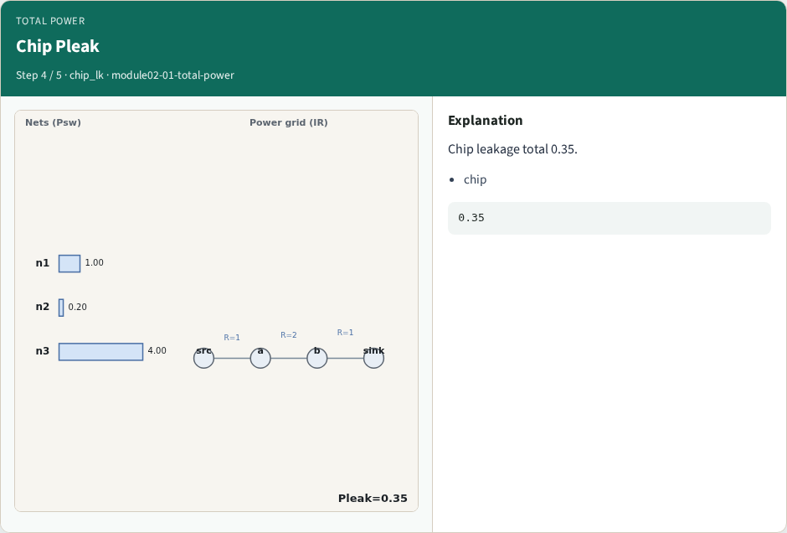
Chip Pleak
Chip Pleak
learn_power — 01 total power
Notes:
Chip leakage total 0.35.

Slide 7
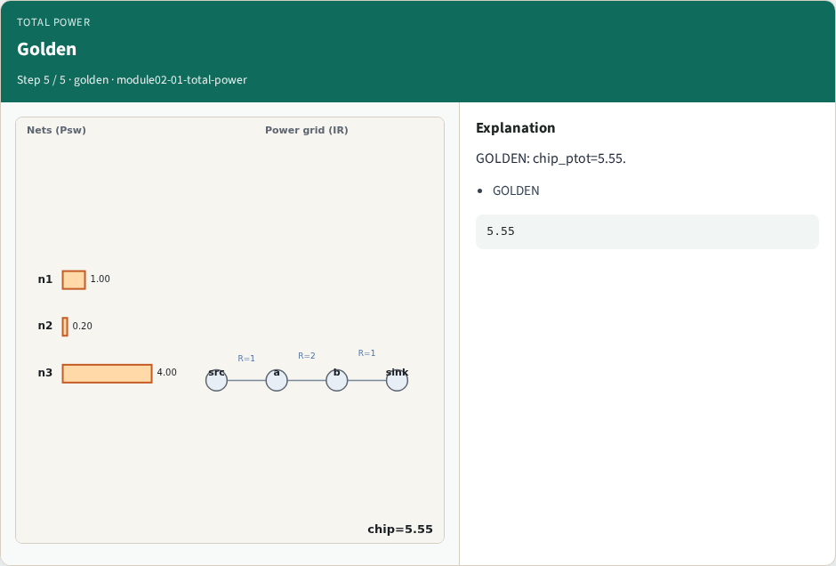
Golden
Golden
learn_power — 01 total power
Notes:
GOLDEN: chip_ptot=5.55.

Slide 8

Browser lab track
Browser lab starter
learn_power — 01 total power
Notes:
Open **total-power**. Confirm chip Ptot=5.55.

Slide 9
Implement track
Call total_power(); assert total==5.55
learn_power — 01 total power
Notes:
Call total_power(); assert total==5.55.

Slide 10
Pitfalls
Summing only one component
Double-counting nets
learn_power — 01 total power
Notes:
Summing only one component. Double-counting nets.

Slide 11
Your turn
Next: activity factors
learn_power — 01 total power
Notes:
Next: activity factors.

