Slide 1
Why activity
Lower α on quiet nets reduces reported switching power
learn_power — 03 activity factors
Notes:
Lower α on quiet nets reduces reported switching power.

Slide 2
The idea
GOLDEN: alphas n1=0.5, n2=0.2, n3=1.0
learn_power — 03 activity factors
Notes:
GOLDEN: alphas n1=0.5, n2=0.2, n3=1.0.

Slide 3
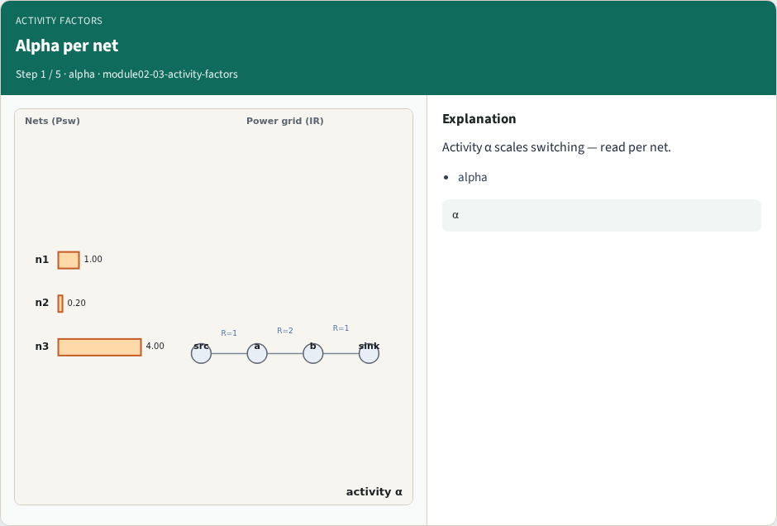
Alpha per net
Alpha per net
learn_power — 03 activity factors
Notes:
Activity α scales switching — read per net.

Slide 4
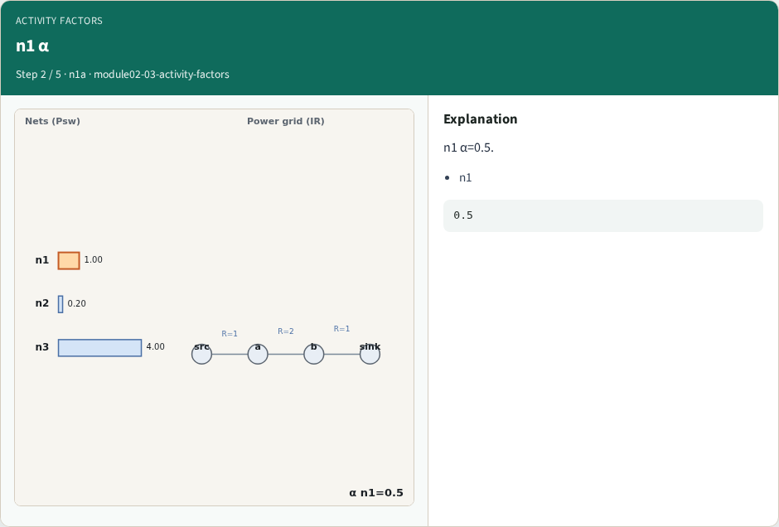
n1 α
n1 α
learn_power — 03 activity factors
Notes:
n1 α=0.5.

Slide 5
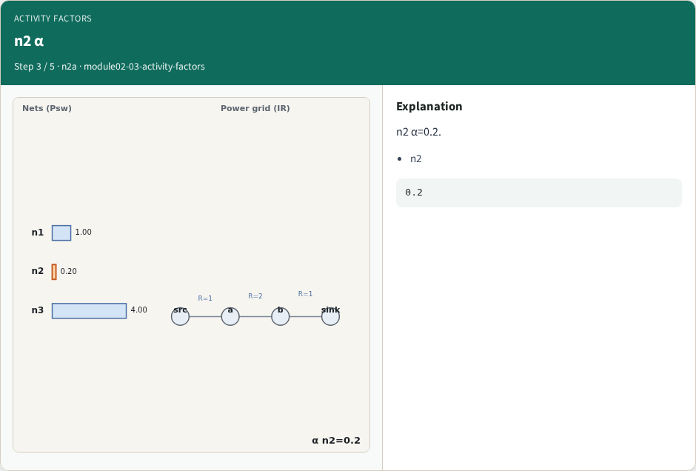
n2 α
n2 α
learn_power — 03 activity factors
Notes:
n2 α=0.2.

Slide 6
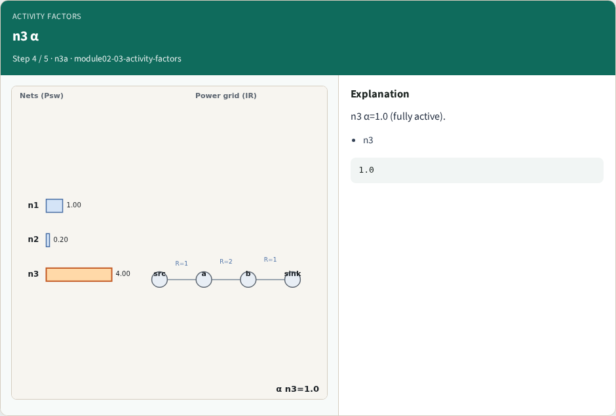
n3 α
n3 α
learn_power — 03 activity factors
Notes:
n3 α=1.0 (fully active).

Slide 7
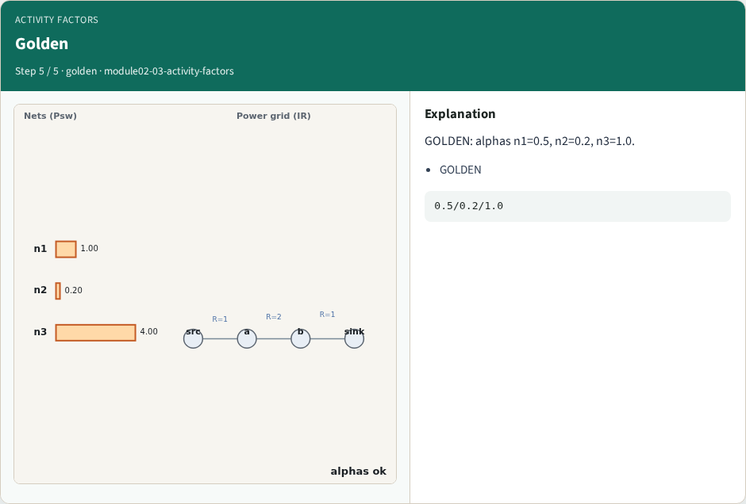
Golden
Golden
learn_power — 03 activity factors
Notes:
GOLDEN: alphas n1=0.5, n2=0.2, n3=1.0.

Slide 8

Browser lab track
Browser lab starter
learn_power — 03 activity factors
Notes:
Open **activity-factors**. Confirm the three alphas.

Slide 9
Implement track
Call activity_factors(); assert alphas match goldens
learn_power — 03 activity factors
Notes:
Call activity_factors(); assert alphas match goldens.

Slide 10
Pitfalls
Confusing α with Ileak
Using mean instead of per-net
learn_power — 03 activity factors
Notes:
Confusing α with Ileak. Using mean instead of per-net.

Slide 11
Your turn
Next: power grid
learn_power — 03 activity factors
Notes:
Next: power grid.

