Slide 1
Why grid
IR analysis starts from a resistive grid and sink current
learn_power — 01 power grid
Notes:
IR analysis starts from a resistive grid and sink current.

Slide 2
The idea
GOLDEN: 4 nodes, 3 series edges
learn_power — 01 power grid
Notes:
GOLDEN: 4 nodes, 3 series edges.

Slide 3
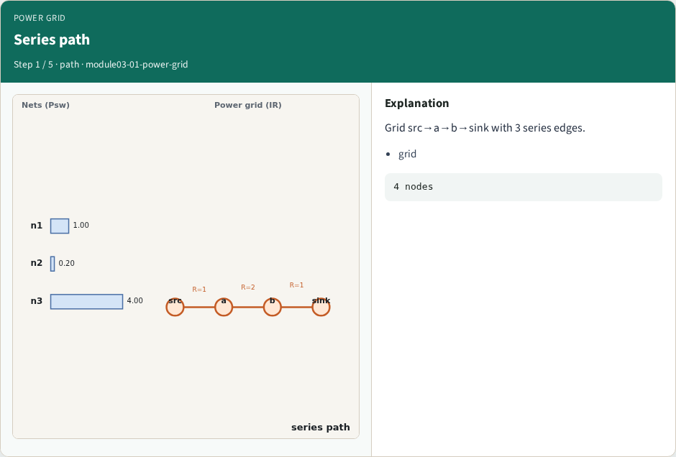
Series path
Series path
learn_power — 01 power grid
Notes:
Grid src→a→b→sink with 3 series edges.

Slide 4
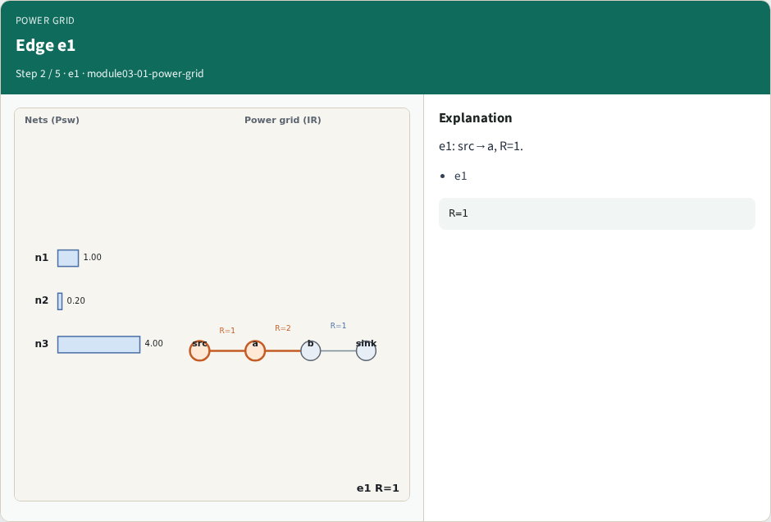
Edge e1
Edge e1
learn_power — 01 power grid
Notes:
e1: src→a, R=1.

Slide 5
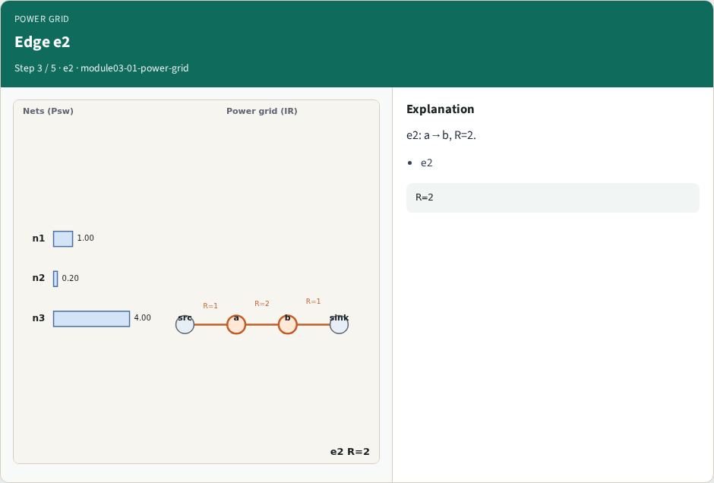
Edge e2
Edge e2
learn_power — 01 power grid
Notes:
e2: a→b, R=2.

Slide 6
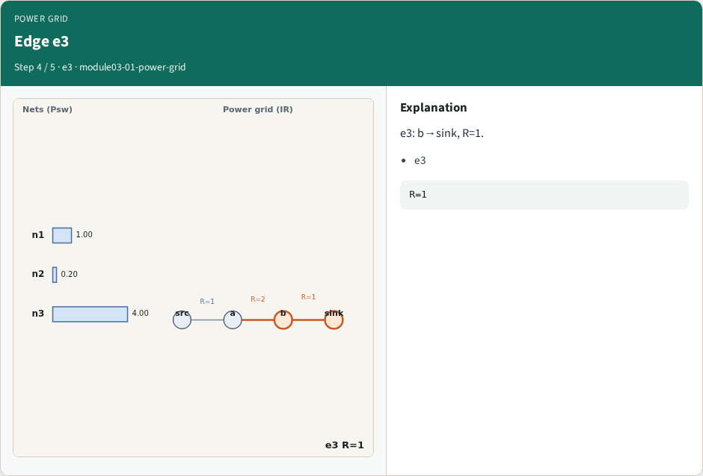
Edge e3
Edge e3
learn_power — 01 power grid
Notes:
e3: b→sink, R=1.

Slide 7
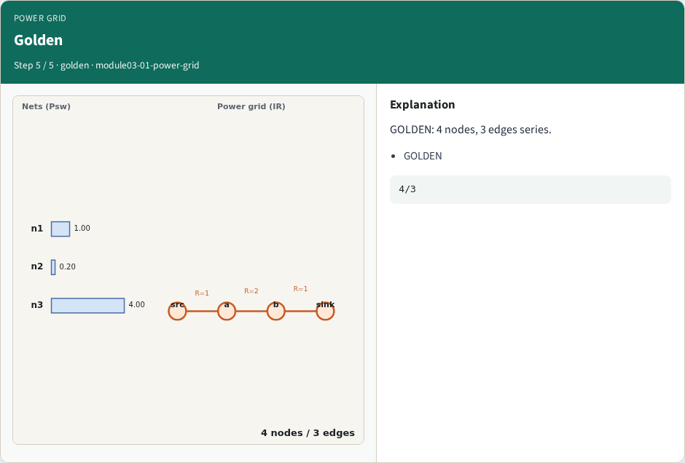
Golden
Golden
learn_power — 01 power grid
Notes:
GOLDEN: 4 nodes, 3 edges series.

Slide 8

Browser lab track
Browser lab starter
learn_power — 01 power grid
Notes:
Open **power-grid**. Confirm 4 nodes and 3 edges.

Slide 9
Implement track
Call build_power_grid(); assert edge_count==3
learn_power — 01 power grid
Notes:
Call build_power_grid(); assert edge_count==3.

Slide 10
Pitfalls
Treating grid as parallel
Wrong node order
learn_power — 01 power grid
Notes:
Treating grid as parallel. Wrong node order.

Slide 11
Your turn
Next: IR drop
learn_power — 01 power grid
Notes:
Next: IR drop.

