Slide 1
Why IR drop
Same sink current on every edge; accumulate I·R drops
learn_power — 03 ir drop
Notes:
Same sink current on every edge; accumulate I·R drops.

Slide 2
The idea
GOLDEN: ir_drop_sink=0.4, v_sink=0.6
learn_power — 03 ir drop
Notes:
GOLDEN: ir_drop_sink=0.4, v_sink=0.6.

Slide 3
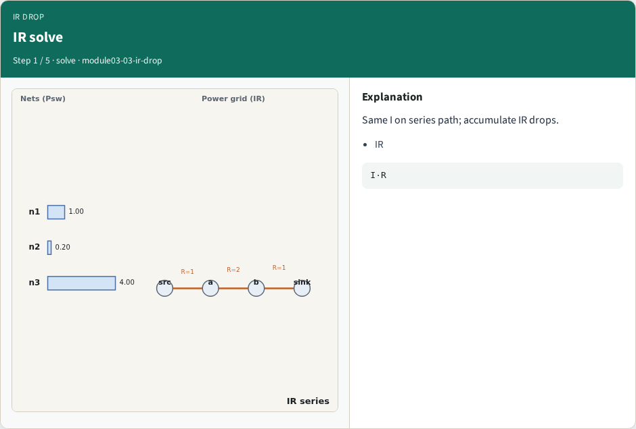
IR solve
IR solve
learn_power — 03 ir drop
Notes:
Same I on series path; accumulate IR drops.

Slide 4
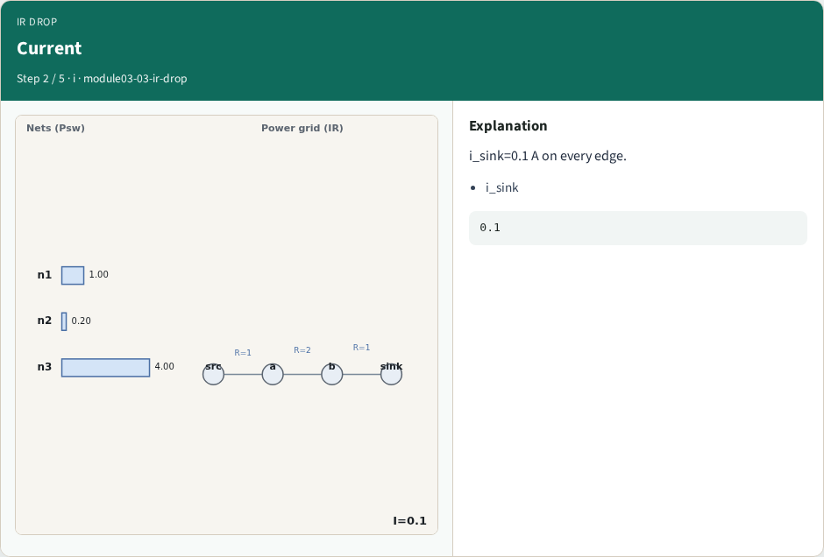
Current
Current
learn_power — 03 ir drop
Notes:
i_sink=0.1 A on every edge.

Slide 5
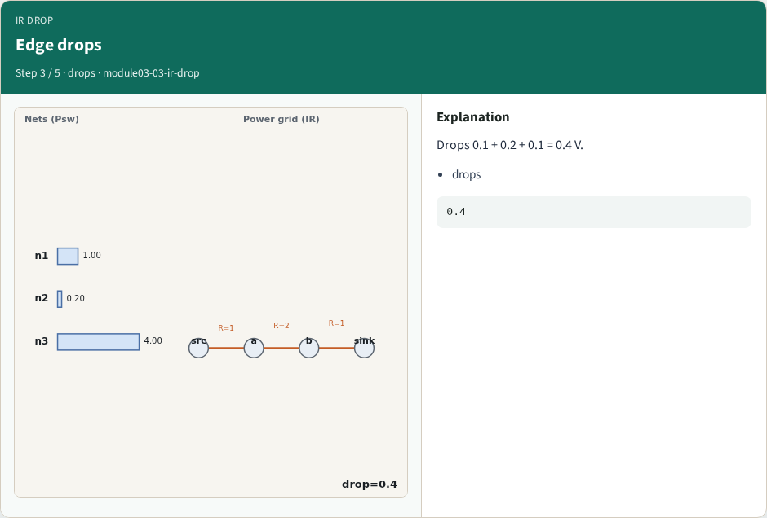
Edge drops
Edge drops
learn_power — 03 ir drop
Notes:
Drops 0.1 + 0.2 + 0.1 = 0.4 V.

Slide 6
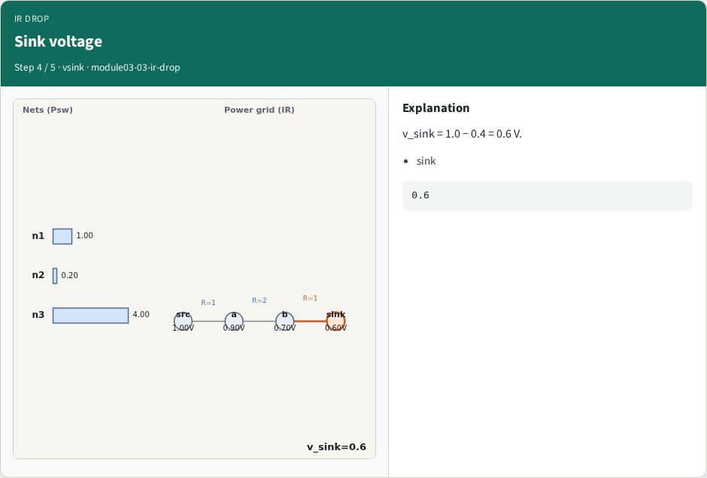
Sink voltage
Sink voltage
learn_power — 03 ir drop
Notes:
v_sink = 1.0 − 0.4 = 0.6 V.

Slide 7
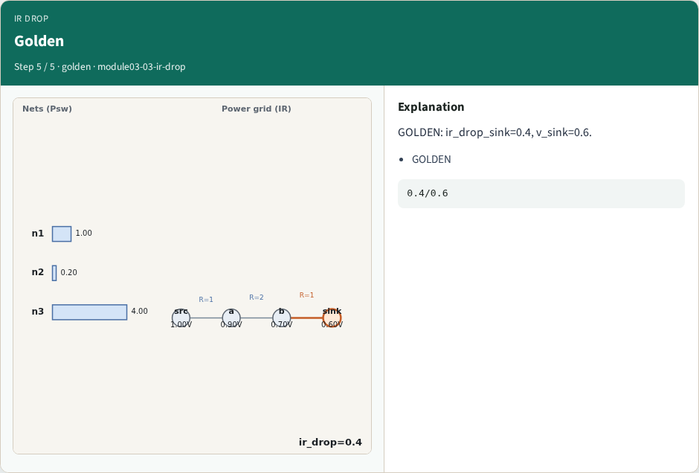
Golden
Golden
learn_power — 03 ir drop
Notes:
GOLDEN: ir_drop_sink=0.4, v_sink=0.6.

Slide 8
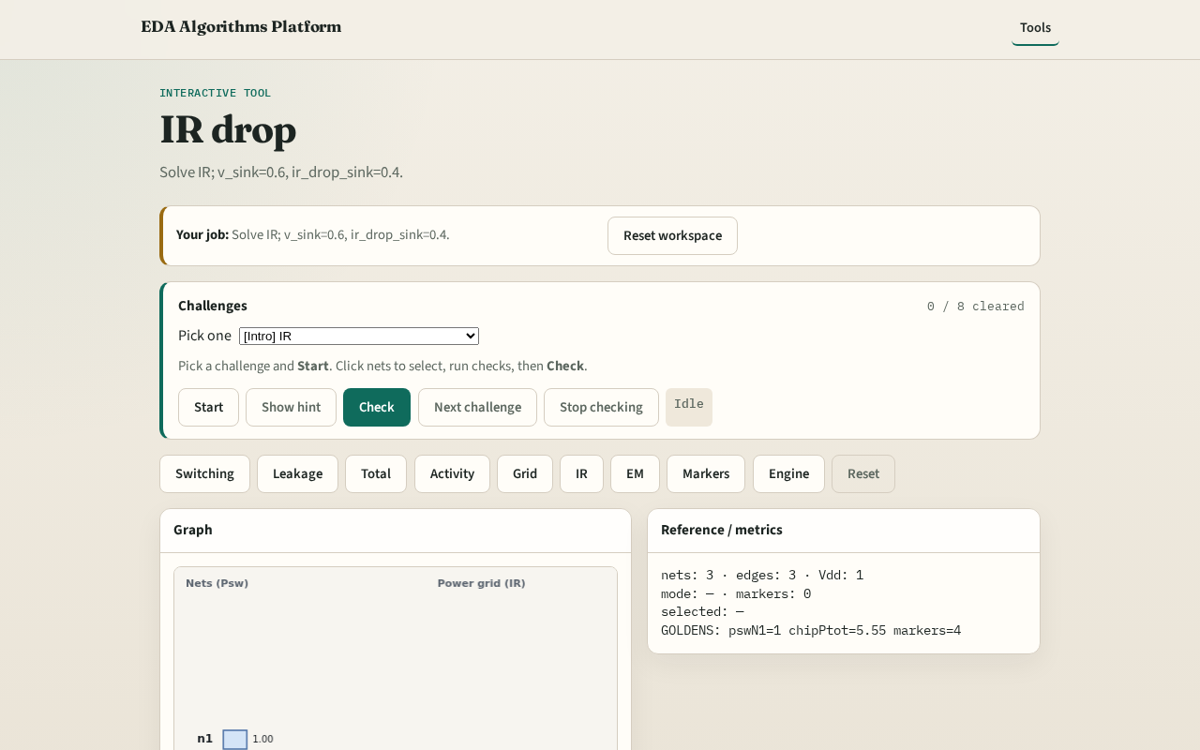
Browser lab track
Browser lab starter
learn_power — 03 ir drop
Notes:
Open **ir-drop**. Confirm v_sink=0.6 and ir_drop=0.4.

Slide 9
Implement track
Call ir_drop_solve(); assert v_sink==0.6 and ir_drop_sink==0.4
learn_power — 03 ir drop
Notes:
Call ir_drop_solve(); assert v_sink==0.6 and ir_drop_sink==0.4.

Slide 10
Pitfalls
Using parallel formula
Wrong edge order
learn_power — 03 ir drop
Notes:
Using parallel formula. Wrong edge order.

Slide 11
Your turn
Next: EM literacy
learn_power — 03 ir drop
Notes:
Next: EM literacy.

