Slide 1
Why EM
Electromigration limits peak current per grid edge
learn_power — 01 em literacy
Notes:
Electromigration limits peak current per grid edge.

Slide 2
The idea
GOLDEN: em_violation_count=3
learn_power — 01 em literacy
Notes:
GOLDEN: em_violation_count=3.

Slide 3
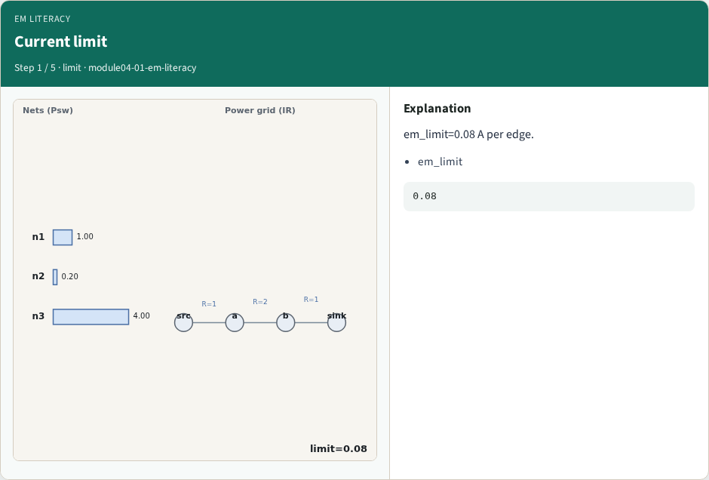
Current limit
Current limit
learn_power — 01 em literacy
Notes:
em_limit=0.08 A per edge.

Slide 4
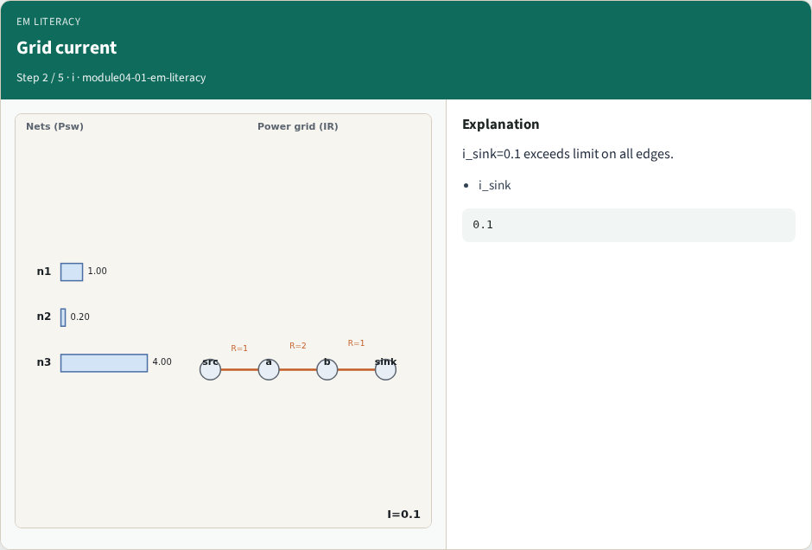
Grid current
Grid current
learn_power — 01 em literacy
Notes:
i_sink=0.1 exceeds limit on all edges.

Slide 5
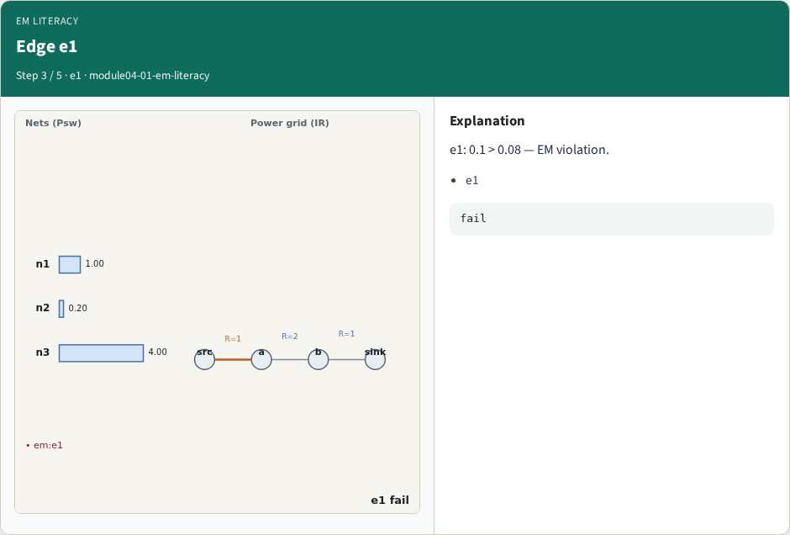
Edge e1
Edge e1
learn_power — 01 em literacy
Notes:
e1: 0.1 > 0.08 — EM violation.

Slide 6
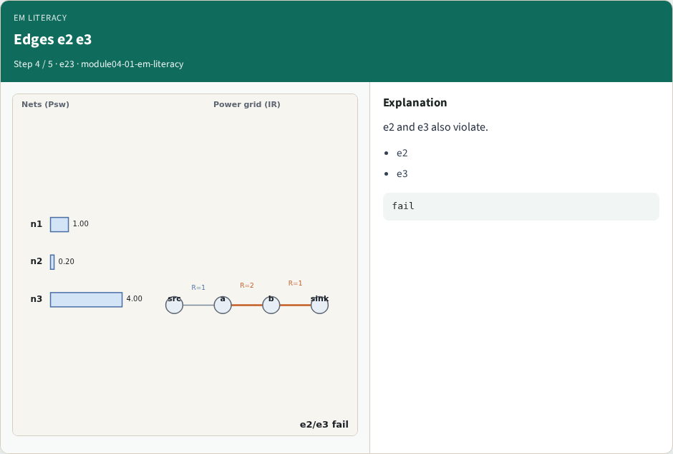
Edges e2 e3
Edges e2 e3
learn_power — 01 em literacy
Notes:
e2 and e3 also violate.

Slide 7
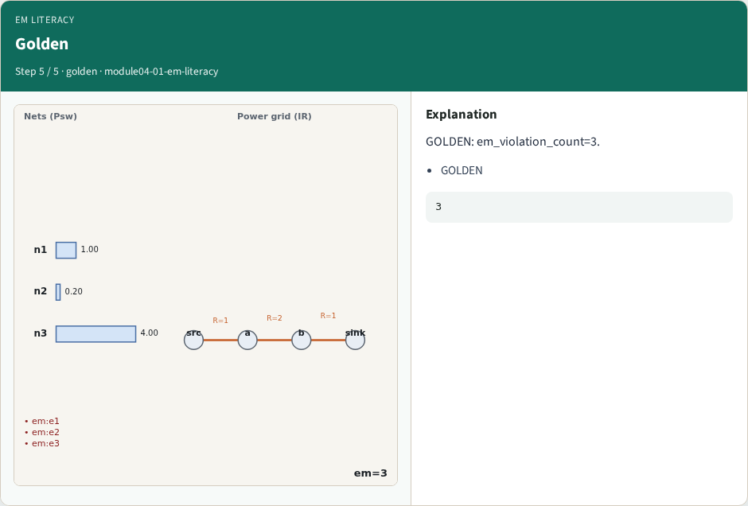
Golden
Golden
learn_power — 01 em literacy
Notes:
GOLDEN: em_violation_count=3.

Slide 8
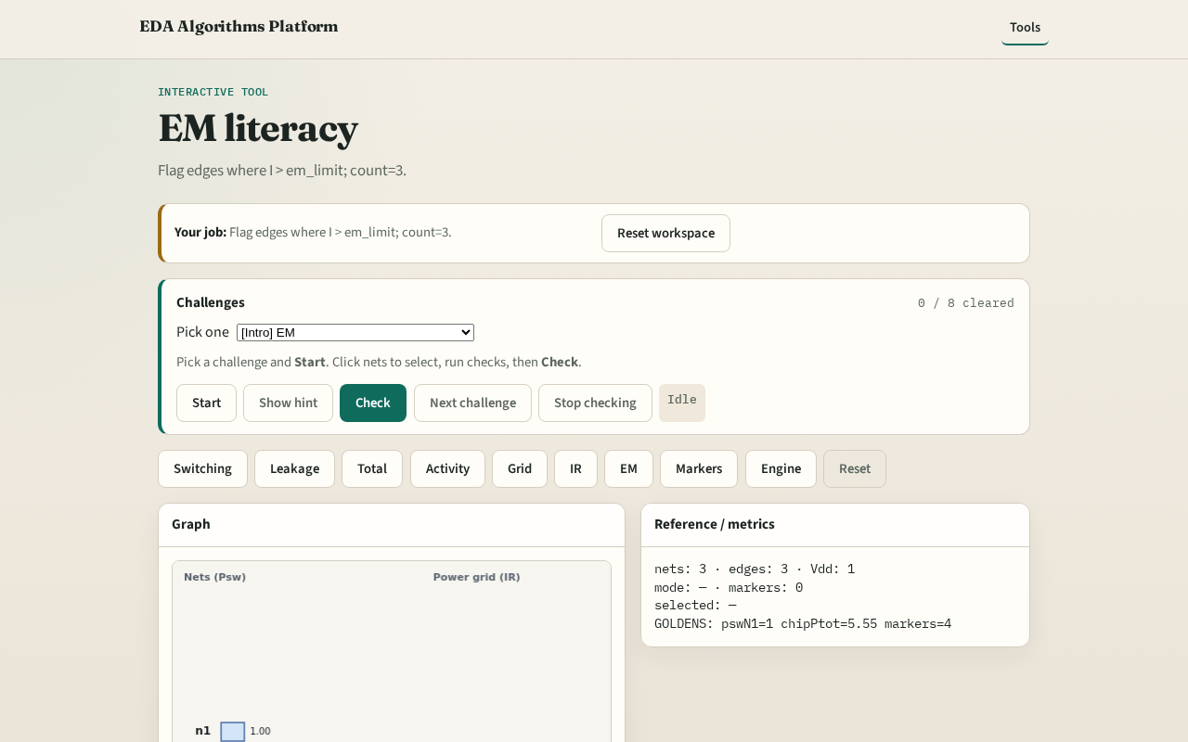
Browser lab track
Browser lab starter
learn_power — 01 em literacy
Notes:
Open **em-literacy**. Confirm 3 EM violations.

Slide 9
Implement track
Call find_em_violations(); assert count==3
learn_power — 01 em literacy
Notes:
Call find_em_violations(); assert count==3.

Slide 10
Pitfalls
Checking IR instead of per-edge I
Wrong limit units
learn_power — 01 em literacy
Notes:
Checking IR instead of per-edge I. Wrong limit units.

Slide 11
Your turn
Next: power markers
learn_power — 01 em literacy
Notes:
Next: power markers.

